Slide 1
BIFROST and Simulation en024048_hion
Maria Loukitcheva
Based on:
1. Gudiksen, B.V., Carlsson, M., Hansteen, V.H., et al. 2011, A&A, 531, A154
2. Carlsson, M., Hansteen, V.H., De Pontieu B. 2013,
IRIS Technical Note 33 Numerical Simulations General Overview

Slide 2
Bifrost - the name of the rainbow bridge from Midgard (the realm of man) to Asgard (the realm of the gods), build from fire, water and air
MHD equations in a stellar atmosphere context
Plus various physical processes and extensions to the basic MHD equations (inclusion of thermal conduction, non-equilibrium effects)
Based on the Oslo Stagger Code (Nordlund &Galsgaard 1995; Galsgaard & Nordlund 1996)
The code solves the standard MHD partial differential equations (PDEs) on a staggered Cartesian grid using a 5th/6th order compact finite difference scheme
A very general modeling code and a variety of modules are available for boundary conditions and the equation-of-state (new physics).

Slide 3
Equation of state (EOS) modules:
Ideal gas EOS
LTE EOS based on tables from the Uppsala Opacity Package (Gustafsson et al. 1975). LTE for atomic level populations and instantaneous molecular dissociation equilibria
NLTE EOS - gas temperature, gas pressure and electron density explicitly based on the non-equilibrium ionization of hydrogen in the solar atmosphere
Radiative transfer:
3 modules handle RT depending on the problem at hand and they are often combined.
In the outer solar atmosphere radiative losses can be simply treated assuming that the atmosphere is optically thin
Chromospheric radiative losses are dominated by a small number of strong lines from hydrogen, calcium and magnesium (Vernazza et al. 1981).
Full radiative transfer computations are required when a simulation includes the convection zone beneath the photosphere, covering optically thick regions, optically thin regions, and the transition between the two regimes.

Slide 4
Simulation en024048_hion
Each simulation is started from an initial condition that often is a result of another simulation with different approximations. The simulation en024048_hion was initialized from a HD simulation of size 6x6x3 Mm3 that had reached a relaxed state. This simulation reached 2.4 Mm below the visible surface but only 0.5 Mm above.
The simulation en024048_hion was expanded horizontally ﬁrst to 12x12 Mm2 and then to
24x24 Mm2. At each step the simulation was run long enough that the horizontal periodicity
from the startup vanished.
The relaxed hydrodynamic state of 24x24x3 Mm3 was then expanded to 24x24x17 Mm3 by adding a chromosphere and corona and a large scale magnetic ﬁeld.
The simulations were mainly intended for chromospheric applications. The opacities are from old tables, basically from Gustafsson et al (1973), in order to be compatible with deep convection simulations from Stein et al.
There are major oscillations in the simulations. The reason is that the lower boundary condition is a pressure node reﬂecting acoustic waves to mimic the refraction of acoustic waves in the solar deeper atmosphere.
The average effective temperature is 5757 K (compared to a solar value of 5880 K) with the often used snapshot 385 having Teff=5773 K and the oscillations causing an amplitude of about 30 K.
Since there are oscillations in the simulation, the average height of τ(500nm)=1 varies in time with an amplitude of 60 km and a mean of 89 km.
The variables that originally are not given at cell-centers (velocities and magnetic ﬁeld strength) have been interpolated to cell-centers with the same high-order interpolation scheme as used in Bifrost. This introduces interpolation noise.

Slide 5
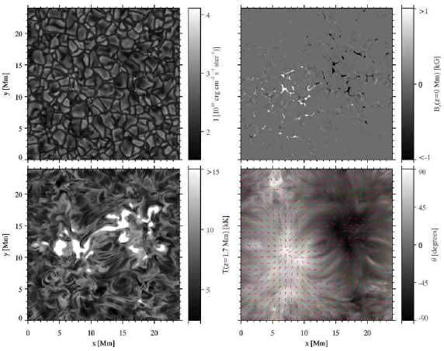
Simulation en024048_hion
The simulation includes optically thick radiative transfer in the photosphere and low chromosphere, parameterized radiative losses in the upper chromosphere, transition region, and corona (Carlsson & Leenaarts 2012), thermal conduction along magnetic field lines (Gudiksen et al. 2011), and an equation of state that includes the effects of non-equilibrium ionization of hydrogen (Leenaarts et al. 2007).
504 × 504 × 496 pxl^3
24 × 24 × 16.8 Mm^3
(32 arcsec FOV)
Z (-2.4Mm, 14.4Mm)
X-,Y-spacing of 48km
(0.064 arcsec/pxl )
Z-spacing of 19km up to 5Mm,
increasing to 98km at the top boundary
figure from Leenarts et al. (2012)
Upper panels: intensity & Bz in photosphere
Lower panels: T at 1.7Mm and B-direction

Slide 6
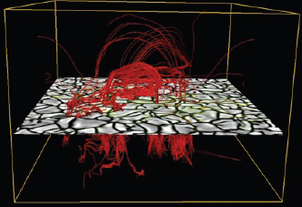
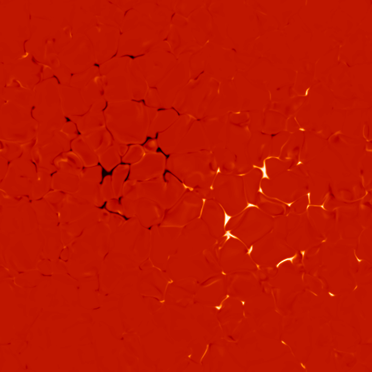
Magnetic field
Bipolar structure
Lower boundary - two patches of opposite polarity separated by 8Mm (10”)
Photosphere -Intergranular kG magnetic field concentrations (max 1.5-2.0 kG)
Photosphere - the average unsigned magnetic field strength is 50G
The magnetic ﬁeld was added by specifying the vertical ﬁeld at the bottom of the computational domain with a potential ﬁeld extrapolation into the rest of the domain. The ﬁeld at the bottom boundary was speciﬁed to have two patches of opposite dominant polarity separated by 8 Mm. This time represents t=0 in the simulation. The simulation was run for 3020 s of solar time assuming instantaneous hydrogen ionization equilibrium before the non-equilibrium hydrogen ionization was switched on.
The ﬁrst published snapshot is snapshot 385 at t=3850 s, which is 830 s after the switch on of the non-equilibrium hydrogen ionization when the initial startup effects have largely disappeared. The last snapshot is at t=5440 s giving a timespan of 1590 s for the published simulation.
24 Mm = 32“
Snapshot t=3850 sec

Slide 7
Distribution of magnetic field with height
Full cube:
Z from - 2.4Mm
to 14.4Mm

Slide 8
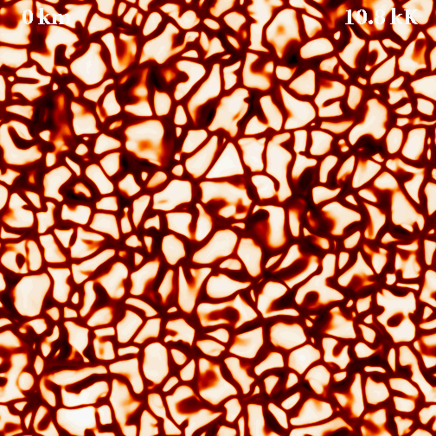
Electron temperature as a function of height
Snapshot
t=3870 s
Z from
0 Mm
to 5Mm

Slide 10
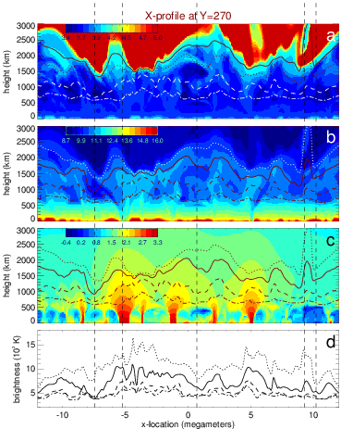
Vertical cut through the atmosphere
From top to bottom:
Lg(Te)
Lg(Ne)
Lg(B)
Tb at mm

Slide 11
Data format
http://sdc.uio.no/search/simulations
Snapshots available: 385-544
All ﬁles are in FITS format with 3D cubes of data (x,y,z) with one variable per ﬁle.
The x- and y-grids are equidistant and can be generated using the standard FITS keywords while the z-grid is non-uniform and is therefore given in a FITS extension.
All variables are cell centered on a right-handed system with z increasing upwards. Index run the same way as the axis which means that z[1] is at the bottom and z[nz] at the top. Note that this is different from the original Bifrost ﬁles.
All units are SI units and given in FITS keywords (Mm, m/s, kg*m/s, T, W/m^3, nm, etc). Speciﬁcally this means that magnetic ﬁeld strength is given in Tesla (1 T=10000 G).
variable name explanation
lgr 10log(mass density)
ux bulk velocity in x
uy bulk velocity in y
uz bulk velocity in z
lge 10log(internal energy)
bx magnetic field strength in x
by magnetic field strength in x
bz magnetic field strength in z
lgne 10log(electron density)
lgp 10log(gas pressure)
lgtg 10log(temperature)

