Slide 1
Bremsstrahlung Radiation Code
Lecture 4

Slide 2
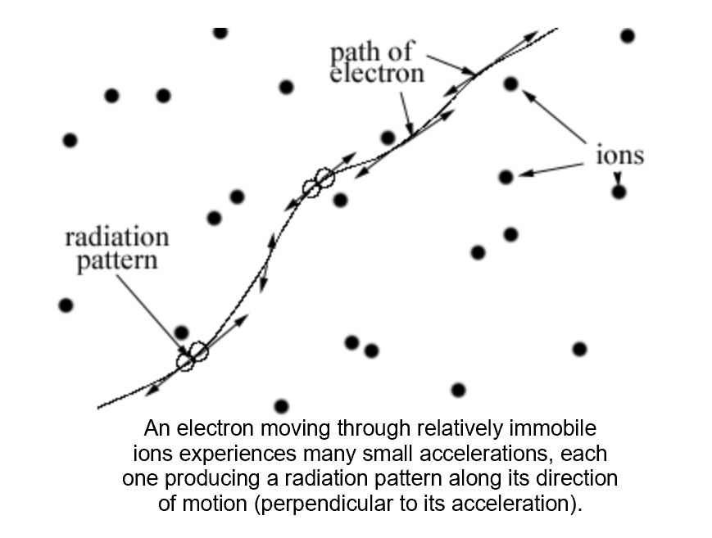
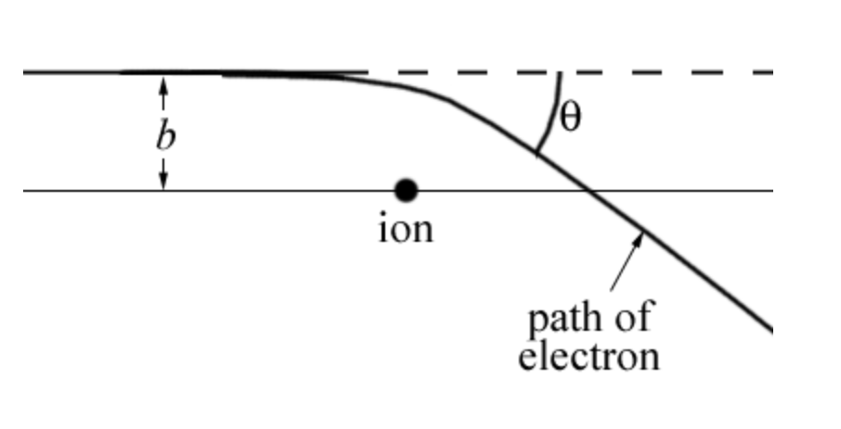
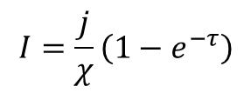
Bremsstrahlung Radiation
This is an important type of radiation in many astrophysical plasmas. The word is German for "braking radiation," as is due to accelerations caused by collisions between electrons and ions (Coulomb collisions).
$$I=\frac{j}{χ}\left(1−e^{−τ}\right)$$

Slide 3



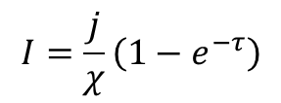

Basic Formulae
(Fleishman and Toptygin; page 447)
Emissivity:
Absorption:
Coulomb logarithm:
Optical depth:
$$τ=χdr$$
$$I=\frac{j}{χ}\left(1−e^{−τ}\right)$$
Intensity of radiation:

Slide 4

Involved Physical Constants
e= 4.80320425 E-10 ;electron charge in cgs units
m= 9.10938215 E-28 ;electron mass in cgs units
kb=1.38064852 E-16 ;Boltzmann constant in cgs units
c= 2.99792458 E+10 ;speed of light in cgs units
Additional instrument-dependent parameters needed for computation and conversion from intensity to flux (expressed in solar flux units: 1 SFU = 10⁴ Jy= 10⁻²² Wm⁻²Hz⁻¹ = 10⁻¹⁹erg s⁻¹cm⁻²Hz⁻¹
dr=1E8; typical radiation path integration step in cgs units (cm)
R=1.496 E13; distance Earth-Sun in cgs units (cm)
ds=1.06289d+019; typical source area in cgs units (cm²)
$F=I\frac{ds}{R2}×{10}^{19}$(sfu)

Slide 5
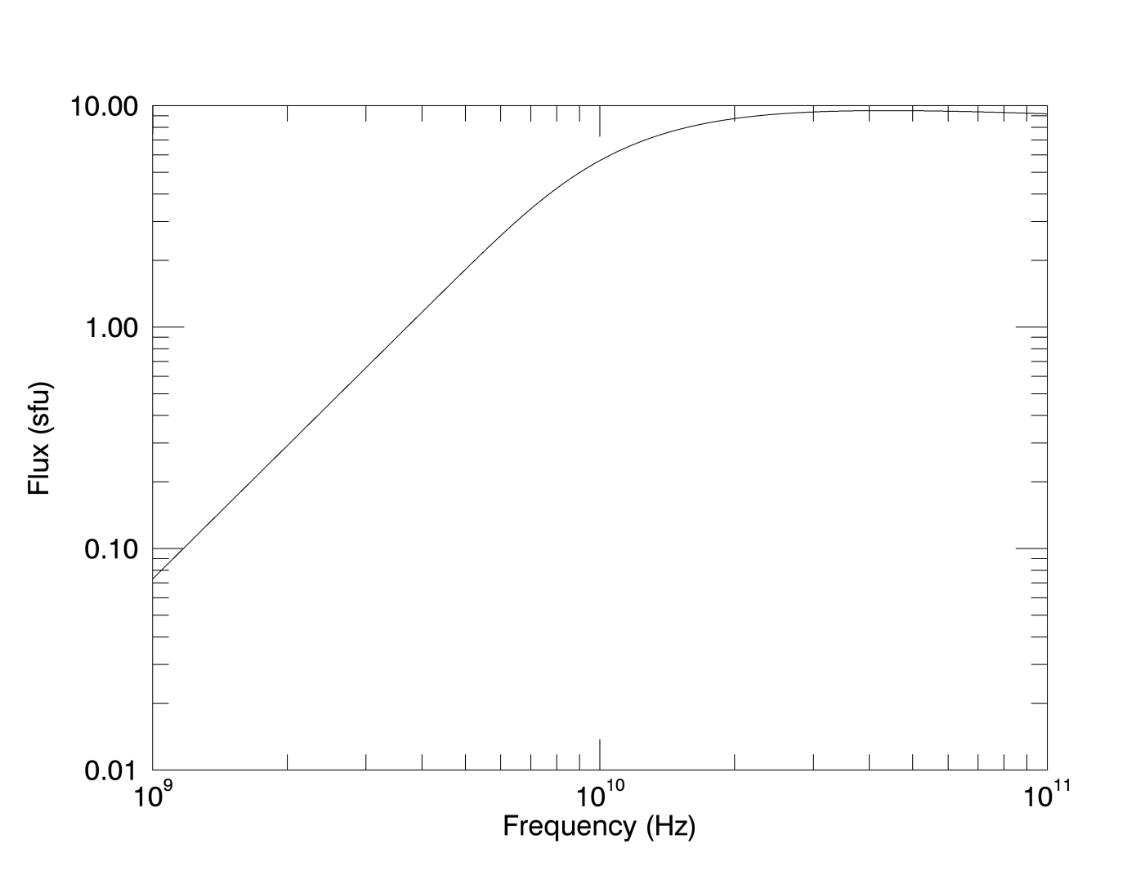
Bremsstrahlung spectrum

