Slide 1
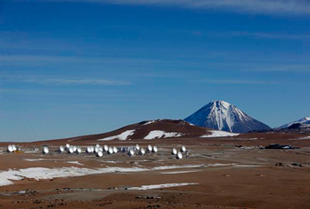
Диагностика магнитного поля в объеме хромосферы по данным миллиметровой спектрополяриметрии
Мария Лукичева
СПбГУ

Slide 2
План
Метод восстановления м.п. по тормозному излучению
Опыт использования метода
Тестирование метода восстановления м.п. с использованием 3D моделей, основанных на коде Bifrost
Обсуждение и планы

Slide 3


Magnetic field from bremsstrahlung
Two modes (e- and o-) are optically thick in different layers due to the magnetic field effect. The temperature difference between these layers is observed as net circular polarization: circular polarization of free-free emission depends sensitively on the temperature gradient
Works by Gelfreikh (1972), Bogod & Gelfreikh (1980), Grebinskij et al. (2000) provide the method: The basic idea is that the radio spectrum itself measures the temperature gradient
If we consider the local slope of the free-free emission Tb spectrum
then the polarization becomes,
and thus,
longitudinal component of magnetic field

Slide 4
Examples: Radio magnetograms of solar ARs: RATAN-600
Bogod & Gelfreikh 1980 - observations made in August 1977 at the RATAN- 600 in 2–4 cm (5λ) with the high 1D resolution (17-34”) demonstrated effectiveness of the method on an example of a flocculus. The magnetic field of 40-50 G was measured with the accuracy of about 10 G. The spectral index of n = 0.7–1.0 was found for the flocculus. region.
P%
B (G)

Slide 5
Examples: Radio magnetograms of solar ARs: NoRH
Nobeyama Radioheliograph
λ = 1.76 cm
I and P maps with 2D resolution of 10-15 arcsec
gyroresonance (or cyclotron) emission and bremsstrahlung should be taken into account
spectral observations are needed for index n
a reasonable approximation for spectral index is n≈1 (the same as for the quiet Sun and weak plage regions
V maps can be used directly as approximate magnetograms of ARs
Sensitivity issue – need for long averaging of images

Slide 6
Gelfreikh & Shibasaki 1999
Upper panel: I and V-maps with contours
Left bottom: Photospheric magnetogram with overlaid I-map contours
Right bottom: Photospheric magnetogram smeared to NoRH resolution with overlaid P contours
Max P=2.8%
Tb_I=27*10³ K
Tb_V=440 K

Slide 7
Examples: Radio magnetograms of solar ARs: NoRH
Iwai & Shibasaki (2013)
Observations in April 2012, small AR near the disk center (N06W19)
The observed P - between 0.5 % and 1.7 %. The images were averaged to reduce their noise level.
The observed spectral index is between 0.4 and 0.6 around the AR (17 and 34GHz)
Coronal magnetic field at the edge of AR – 70 G
In the AR center chromo and coronal components can not be separated. The derived magnetic field is about 20 % to 50 % of the corresponding photospheric magnetic field
HMI magnetogram on April
13, 2012. P at 17 GHz is superimposed as contours: positive in red, 0.5 %, 1.0 %; negative in blue, 0.5, 1.0, 1.5 %.
(b) HMI magnetogram . B at 17 GHz are superimposed as contours: positive in red, 50, 150G; negative in blue, 50, 150, 250G.

Slide 8
Method drawbacks
Optically thick emission - spectral observations are needed to derive spectral index n
Optically thin emission - spectral observations are also necessary to confirm the bremsstrahlung nature of emission and its thickness
At cm – it is needed to distinguish between
(i) bremsstrahlung and gyroresonance,
(ii) chromospheric and coronal contribution to bremsstrahlung –
inversion and use of modelling of contribution (Grebinskij et al.
2000)
Derived magnetic field refers to an average over the line of sight, weighted by

Slide 9
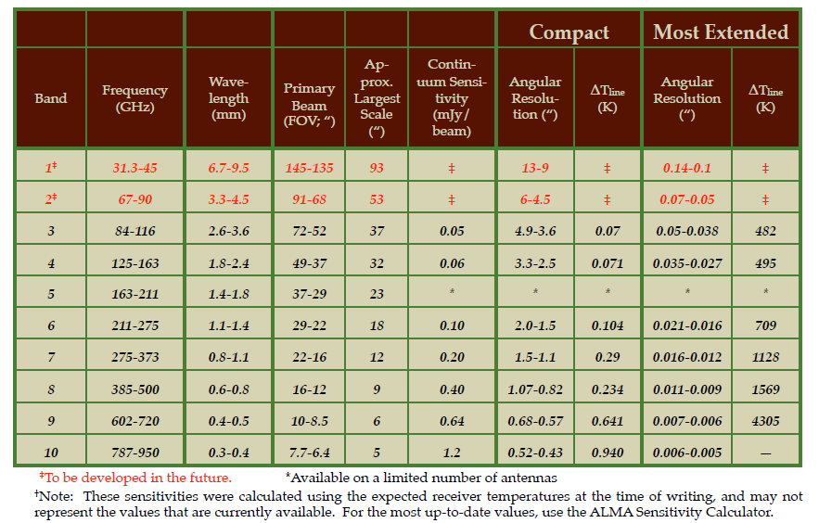
Chromospheric magnetometry with mm interferometer ALMA
Testing ALMA capabilites

Slide 10
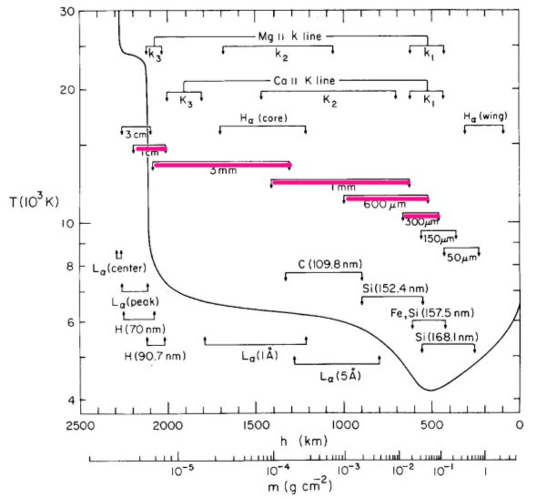
Formation of mm/submm radiation in the solar atmosphere
from Vernazza et al. 1981

Slide 11
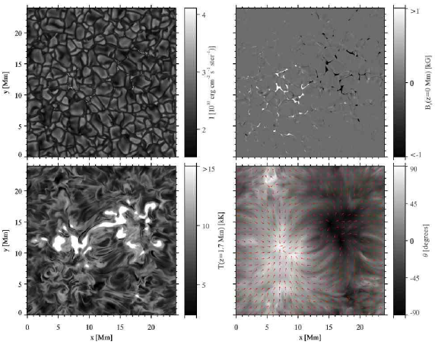
3D QS radiation-MHD simulations using Bifrost code by Oslo group
Bifrost - Gudiksen, B. V., Carlsson, M., Hansteen, V. H., et al., 2011
figure from Leenarts, J., Carlsson, M., Roupe van der Voort, L., 2012
504 × 504 × 496 pxl
24 × 24 × 16.8Mm
(32 arcsec FOV)
Z (-2.4Mm, 14.4Mm)
X-,Y-spacing of 48km
(0.064 arcsec/pxl )
Z-spacing of 19km
Upper panels: intensity &
Bz in photosphere
Lower panels: T at 1.7Mm
and B-direction

Slide 12
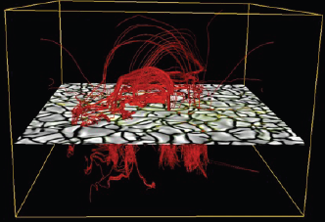
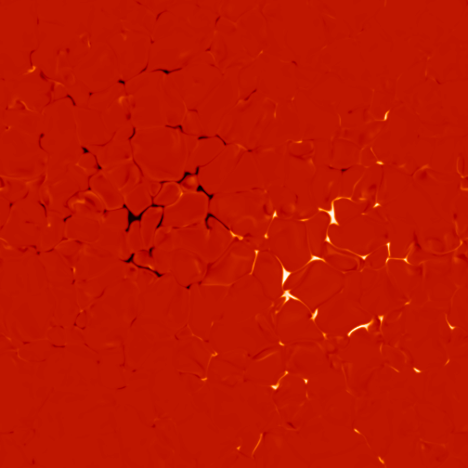
QS Magnetic field
Bipolar structure
Lower boundary - two patches of opposite polarity separated by 8Mm (10”)
Photosphere -Intergranular kG magnetic field concentrations (max 1.5-2.0 kG)
Photosphere - the average unsigned magnetic field strength is 50G
24 Mm = 32“
Snapshot t=3850 sec

Slide 13
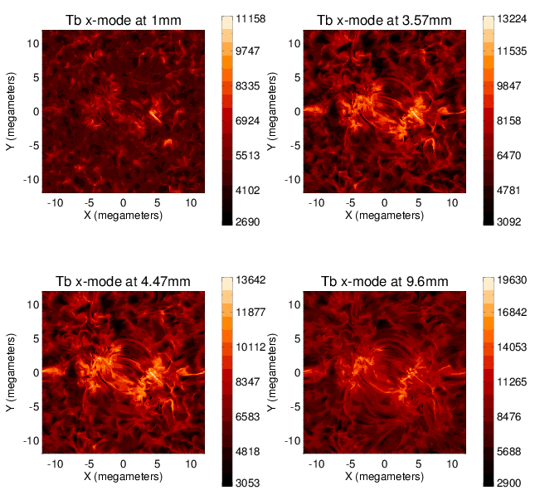
Simulated mm brightness
(Band 7)
(Band 3)
1 snapshot atmosphere
(Te, Ne, Np, NHI, B)
32 lambda in [0.3-10]mm
Magnetic Bremsstrahlung
with - H- opacities
- H0 opacities
X-mode
O-mode
Tb
Pol
(Band 2)
(Band 1)

Slide 14
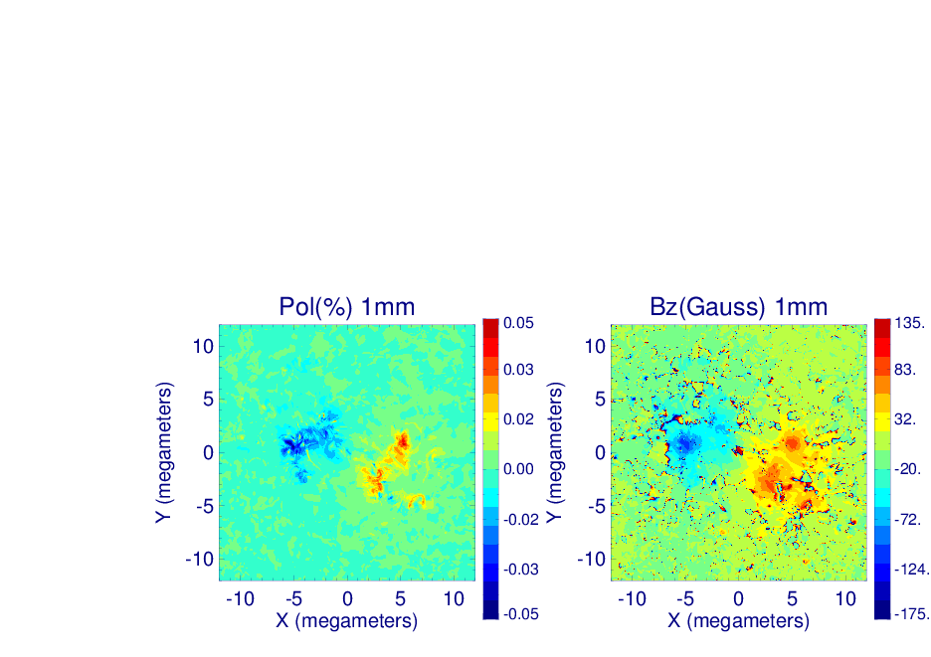
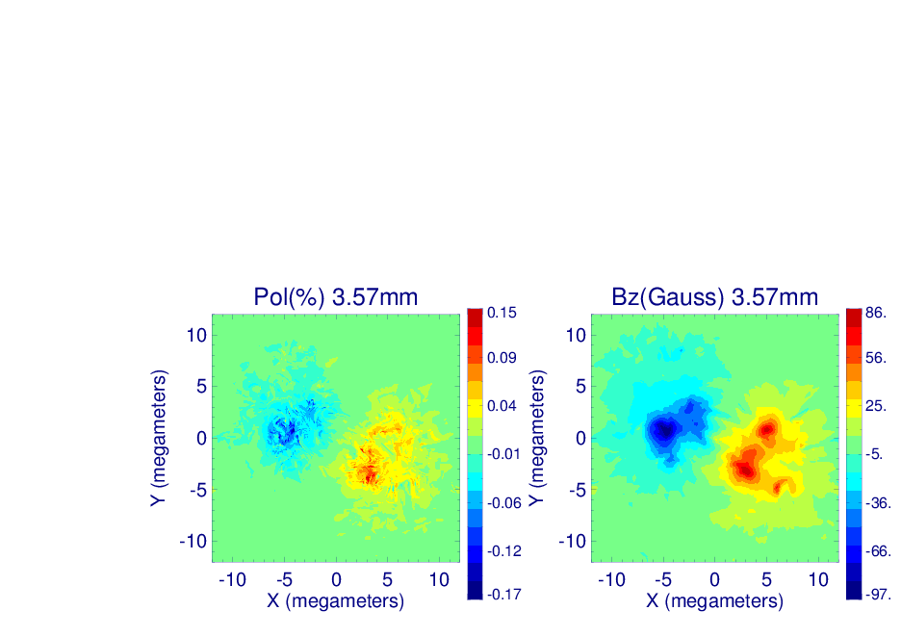
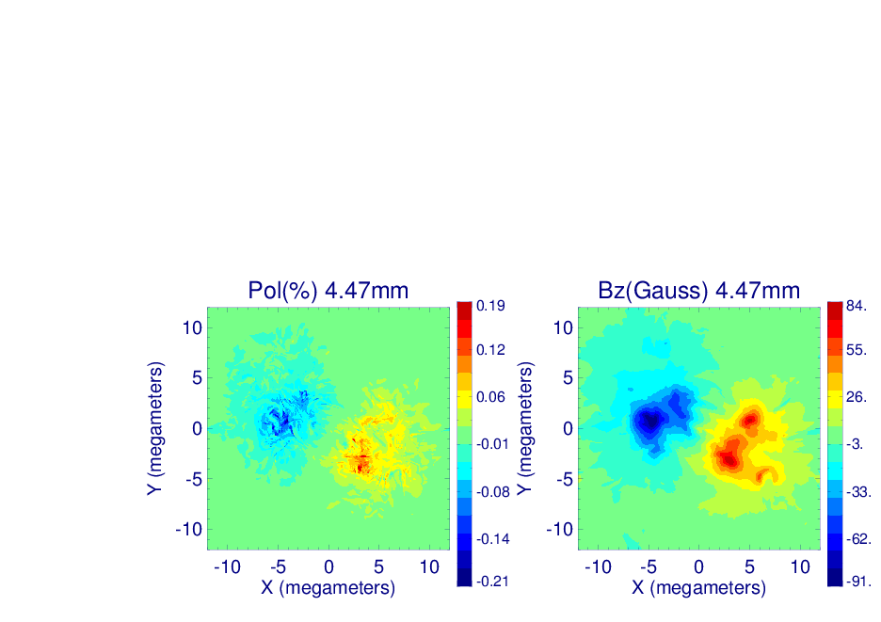
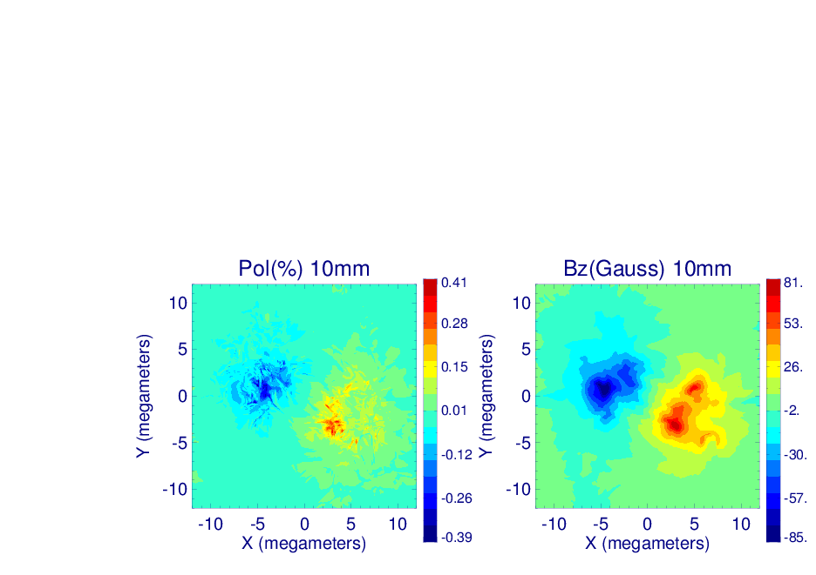
Simulated Circular Polarization

Slide 15


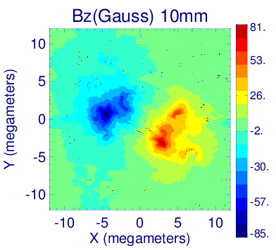
Restored Longitudinal Magnetic Field

Slide 16
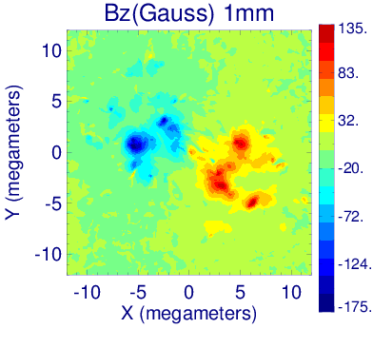
Model Longitudinal Magnetic Field

Slide 17
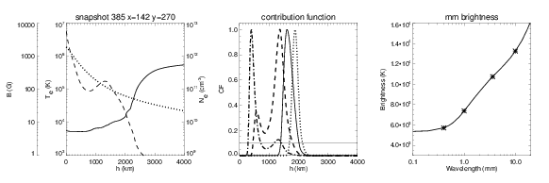
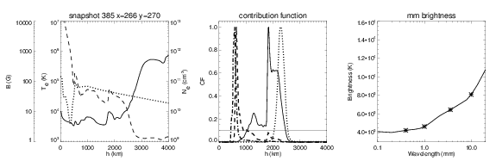
What height B refers to:
Analysis of individual profiles
Magnetic concentration
B=1900G
Central part of the loop

Slide 18
Effective formation heights
What heights are sampled
by what wavelength?
heights corresponding to the centroid of the CFs
0.4mm 650km
1mm 900km
3mm 1500km
4.5mm 1700km
10mm 2000km
Fig. Gray-scale figures of the contribution function along the cut at Y = 0.9Mm. Heights with CF amplitudes equal to 10% of the highest contribution to the emerging intensity are marked with blue contours. Red solid lines represent effective formation heights. The various panels show results for a) 0.4 mm, b) 1mm, c) 3.6 mm, and d) 10 mm

Slide 19
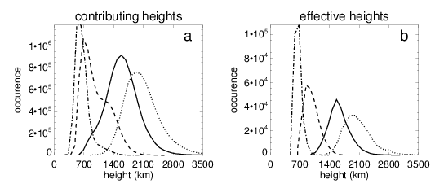
Contributing vs. effective heights
Histograms of the heights contributing more than 1% of total contribution to the emergent intensity at 0.4mm (dot-dashed), 1mm (dashed), 3.6mm (solid) and 10mm (dotted).
The same for the effective heights of formation.

Slide 20
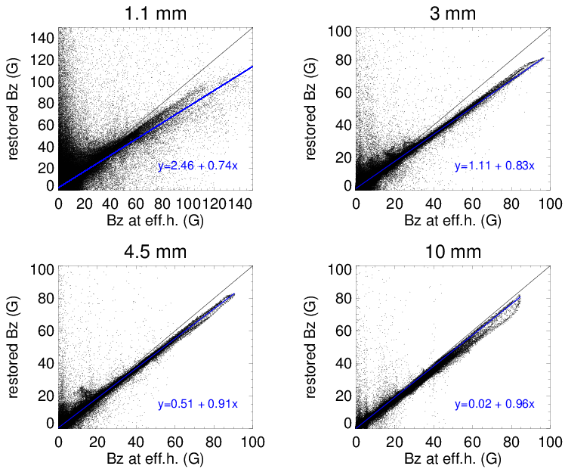
Model vs Restored Field

Slide 21
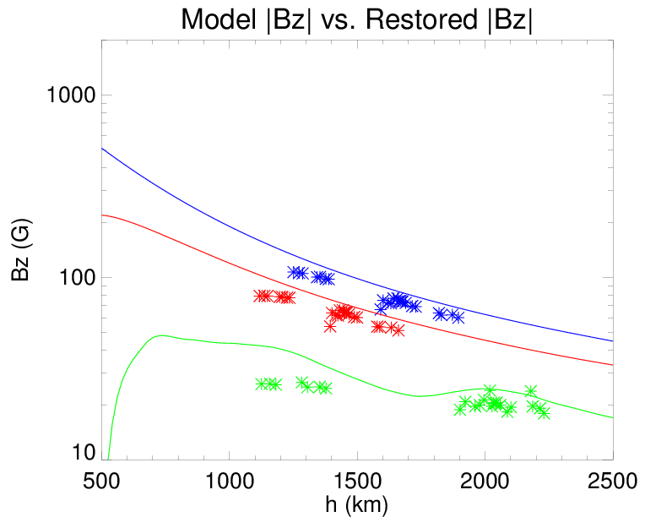
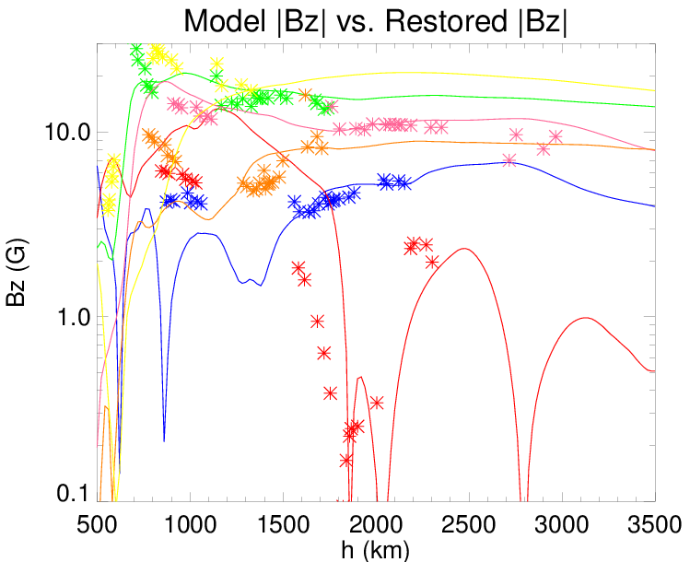
Model vs Restored Field
Locations with Strong MF
Locations with Weak MF

Slide 22
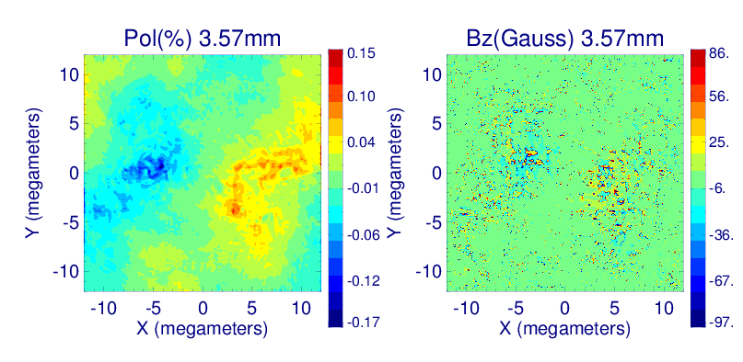
Polarization and Bz at 84GHz –”ideal” vs. “real”
After passing through the instrument response the spectrum is steeper, noisier, and polarization is reduced
This shows importance of precision polarization measurements and accurate calibration

Slide 23
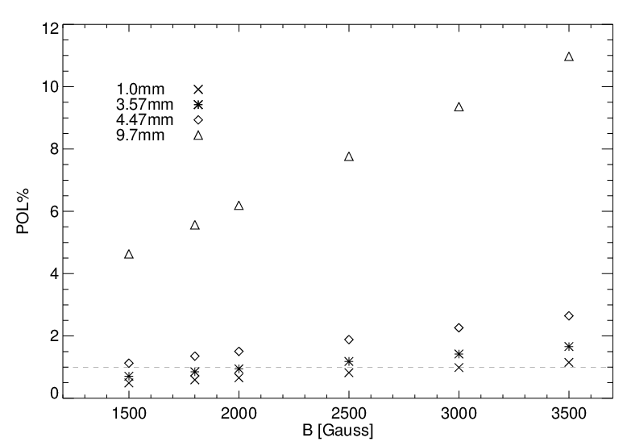
Sunspots : Circular Polarization as a function of Bphoto
Based on the sunspot model of Severino et al. 1994

