Slide 1
Advancing the coronal heating problem with microwave gyro emission
ApJ, in press
Gregory D. Fleishman, Sergey A. Anfinogentov, Alexey G. Stupishin, Alexey A. Kuznetsov, and Gelu M. Nita
New Jersey Institute of Technology
SPW-GR—SolFER Colloquium
2021-Feb-19

Slide 2
Outline
Introduction: EUV vs radio probing of solar corona, magneto-thermal coupling, gyroresonant radio emission.
3D modeling with GX Simulator.
Magnetic models and associated thermal structure.
Workflow to constrain parametric model of the coronal heating.
AR selection.
Modeling results.
Conclusions.

Slide 3
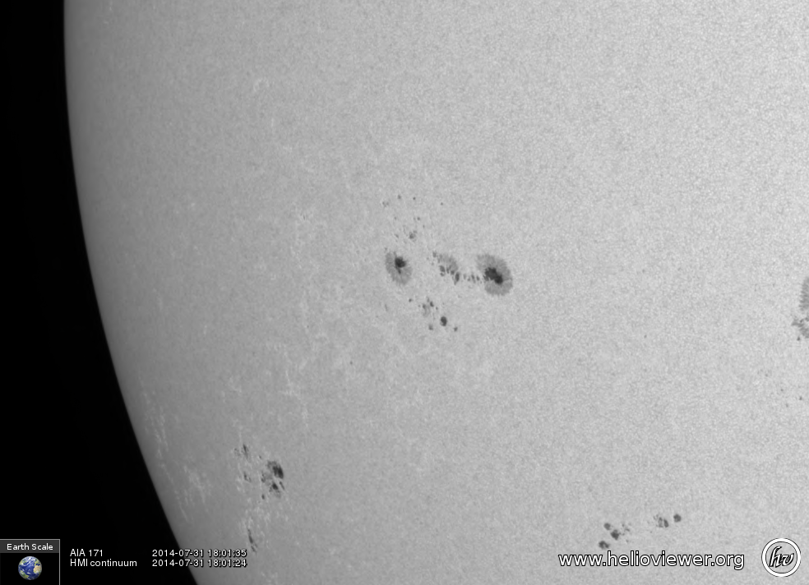
Misleading impressions
When an active region visible in continuum images is seen in the extreme ultraviolet (EUV), the coronal B field appears only in discrete loops.
Introductory slides are adopted from Dale Gary 2014 COSPAR presentation.

Slide 4
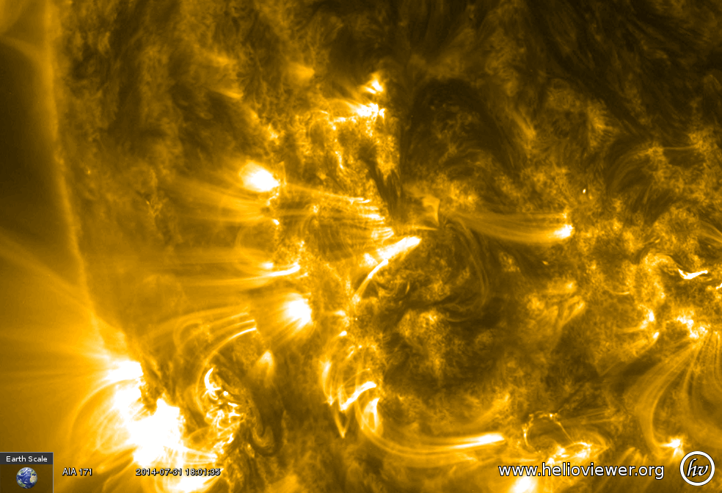
Misleading impressions
One gets the impression that the B field is bundled into these loops and is absent or negligible elsewhere.
This is highly misleading.

Slide 5
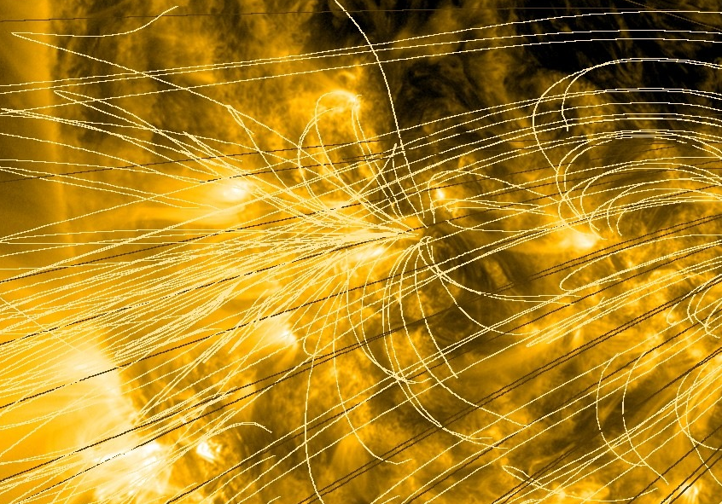
Misleading impressions
One gets the impression that the B field is bundled into these loops and is absent or negligible elsewhere. Drawing field lines also leads to this impression.
This is highly misleading.

Slide 6
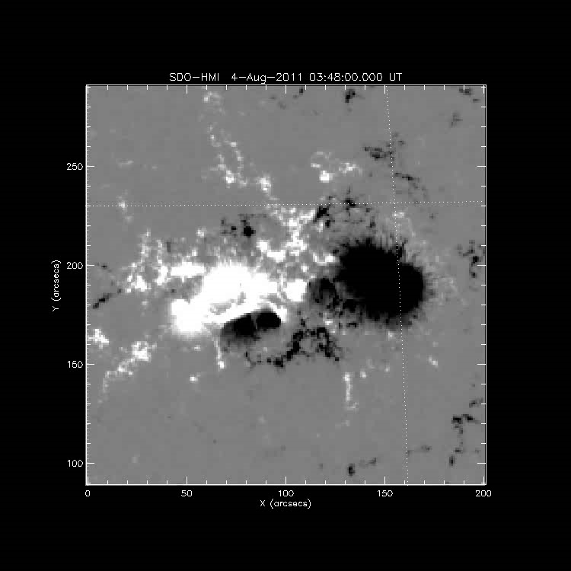
Smoothness of Magnetic extrapolations
Starting from an SDO photospheric magnetogram, it is true that the magnetic field is highly structured.
However, in a NLFFF extrapolation, the total magnetic field strength seen in this movie rapidly smooths out, and fills the space with little structure.

Slide 7
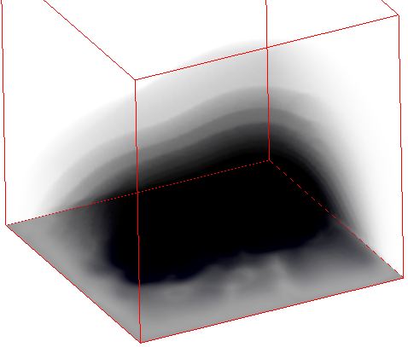
Isogauss surfaces
This volumetric shading representation clearly shows the smooth nature of isogauss surfaces in the model.
We will focus on such isogauss surfaces to explain the nature of gyroresonance radio emission.
At a given magnetic field strength B, electrons spiraling in that field produce radio emission at low harmonics of the gyrofrequency f = sf_{B}, where s = 1, 2, 3… is a small integer and f_{B} is the gyrofrequency f_{B} = 2.8x10⁶ B Hz.
For a given field strength, emission at these few frequencies is highly efficient, but is (almost) completely absent at other frequencies.

Slide 8
Coronal Heating: Coupling with Magnetic Field (Jim’s Talk)
Diagnostics of coronal thermal plasma:
EUV
SXR
Is not explicitly sensitive to the magnetic field
Depends on elemental abundances.

Slide 9
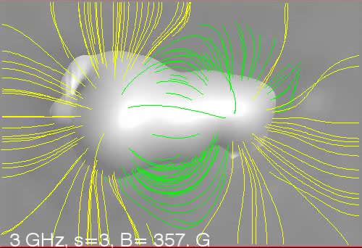
The s = 3 layer vs. frequency
Radio diagnostics of coronal thermal plasma:
Explicitly sensitive to magnetic field
Does not depend on abundances
In the case of thermal plasma, thin isogauss layers are the origin of thermal radio emission traveling outward from the hot corona.
By virtue of the resonance condition, we can select different isogauss layers simply by changing our observing frequency.

Slide 10
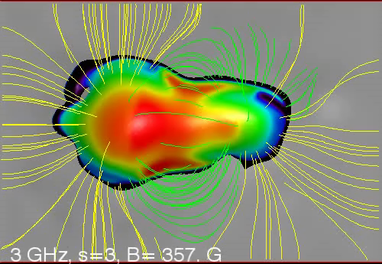
Brightness of the s = 3 layer
Here we paint the isogauss surfaces with the plasma temperature while scanning in frequency.
This is almost what we see when observing gyroresonance emission in active regions, but there is one additional effect that must be taken into account—the varying opacity on the surface, which varies mainly with direction of the magnetic field.

Slide 11
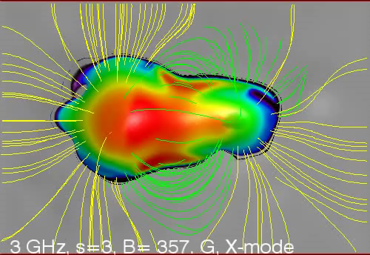
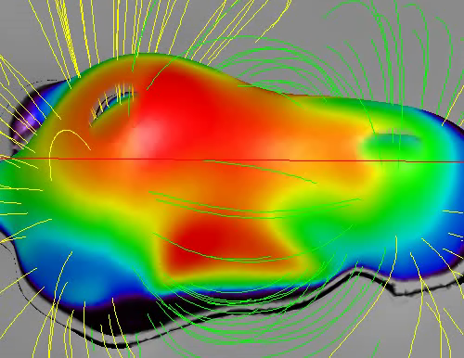
OPACITY and harmonic layers
This movie shows lower harmonic layers peeking through the opacity holes, although it is hard to see.
It may be a bit more apparent from a side perspective, as in this movie.

Slide 12
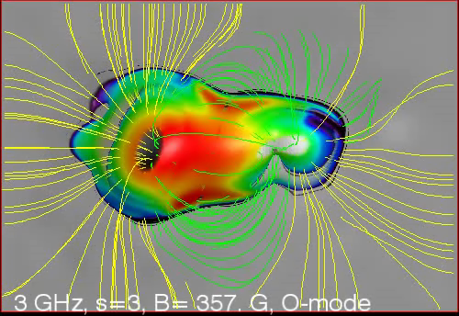
Polarization and magnetoionic mode
Gyroresonance emission, caused by electrons spiraling in the magnetic field, naturally occurs most strongly in the sense of circular polarization whose electric vector rotates in the same direction as the electrons. This is the extra-ordinary mode, or x-mode. However, the electrons also emit, with lower opacity, in the opposite sense ordinary mode, or o-mode.
Here is what the o-mode looks like. The opacity holes are now larger, and the lower harmonic layers are more easily seen.

Slide 13
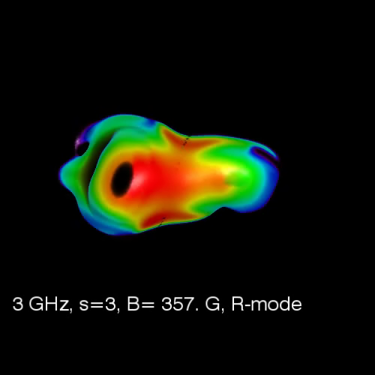
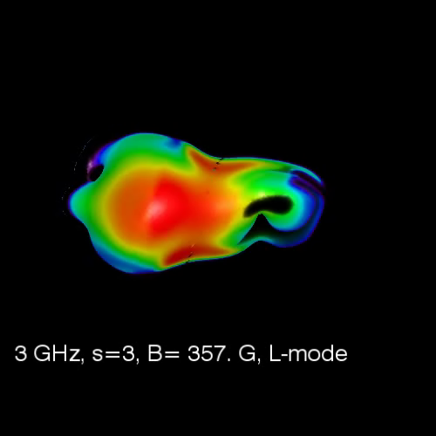
Putting it all together
To see what would be seen in a given circular polarization, one merely chooses either o- or x-mode depending on sign of local B_{z} on the gyro surface. (Assuming no polarization reversal due to quasi transverse magnetic layers along LOS).
Here we have turned off the background image and field lines for clarity.
RCP LCP

Slide 14
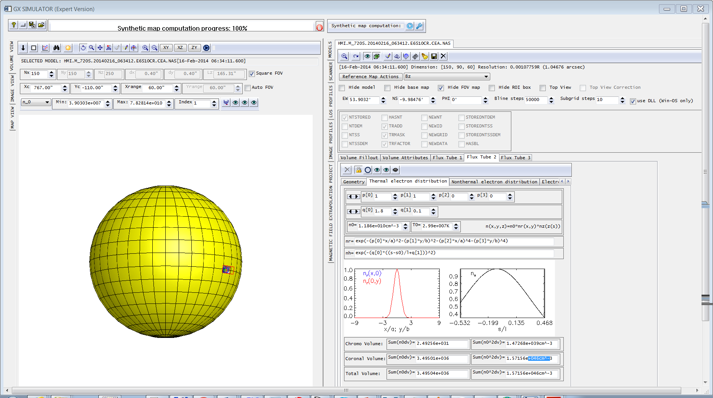
GX SIMULATOR
Nita et al. 2015
Nita et al. 2018
Nita et al. 2021 (in prep)
Models are linked to HMI base maps. Box index helps placing the model at a right place and apply B angle.

Slide 15
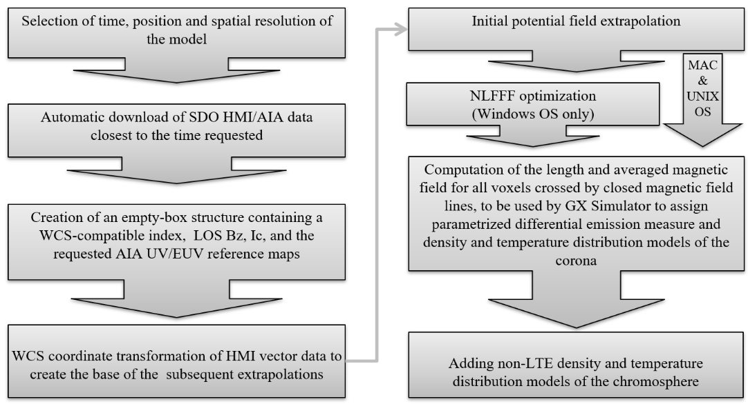
Automated Model Production Pipeline (AMPP)

Slide 16
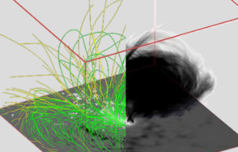
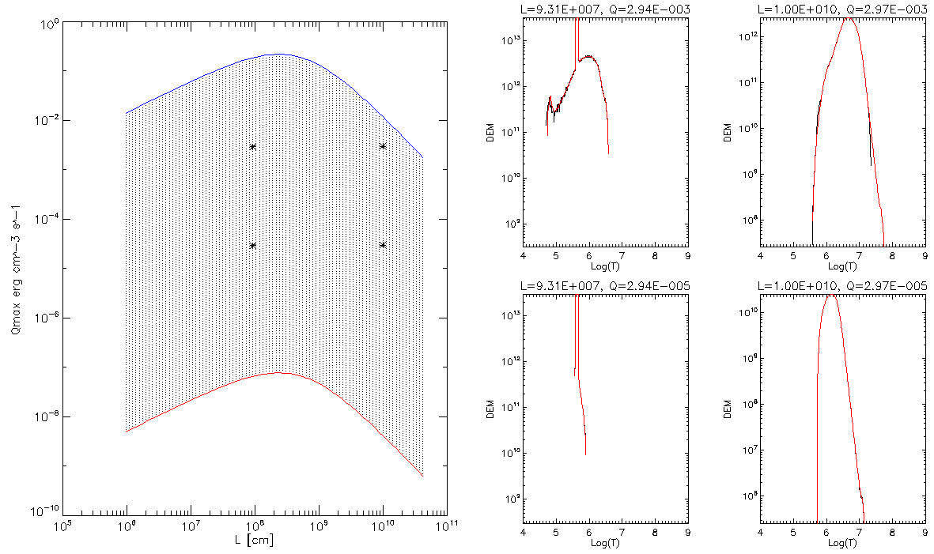
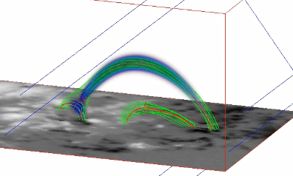
Adding Thermal Structure
1
2
Q
For each voxel we compute
L & B_{avg} of the crossing field line and use them to compute the volumetric heating rate Q
1
2
DEM
3
4
Precomputed EBTEL lookup tables contain DEM distributions for a representative set of (Q, L) pairs
3
4
L; B_{avg}
L

Slide 17
Steady State
Impulsive

Slide 18
Workflow.

Slide 19
AR 11520; 12-Jul-2012. Data and models.

Slide 20
Properties of These Flux Tubes

Slide 21
In This Study We Employ:
Four magnetic models – one potential (POT) and three NLFFF
Two EBTEL lookup tables – impulsive and steady state.
For the impulsive EBTEL model we consider three different thermal models: a=1, b=0.5, 0.75, and 1.
For the steady state EBTEL model we consider 169 different thermal models: a=0—1.2, b=1.1—2.3. (High school student summer research project)

Slide 22
Synthetic vs observed MW maps: best impulsive thermal model.
Polarization, Stokes V
17 GHz
17 GHz
Stokes I, 5.7 GHz
POT
NLFFF

Slide 23
Metrics of Success

Slide 24
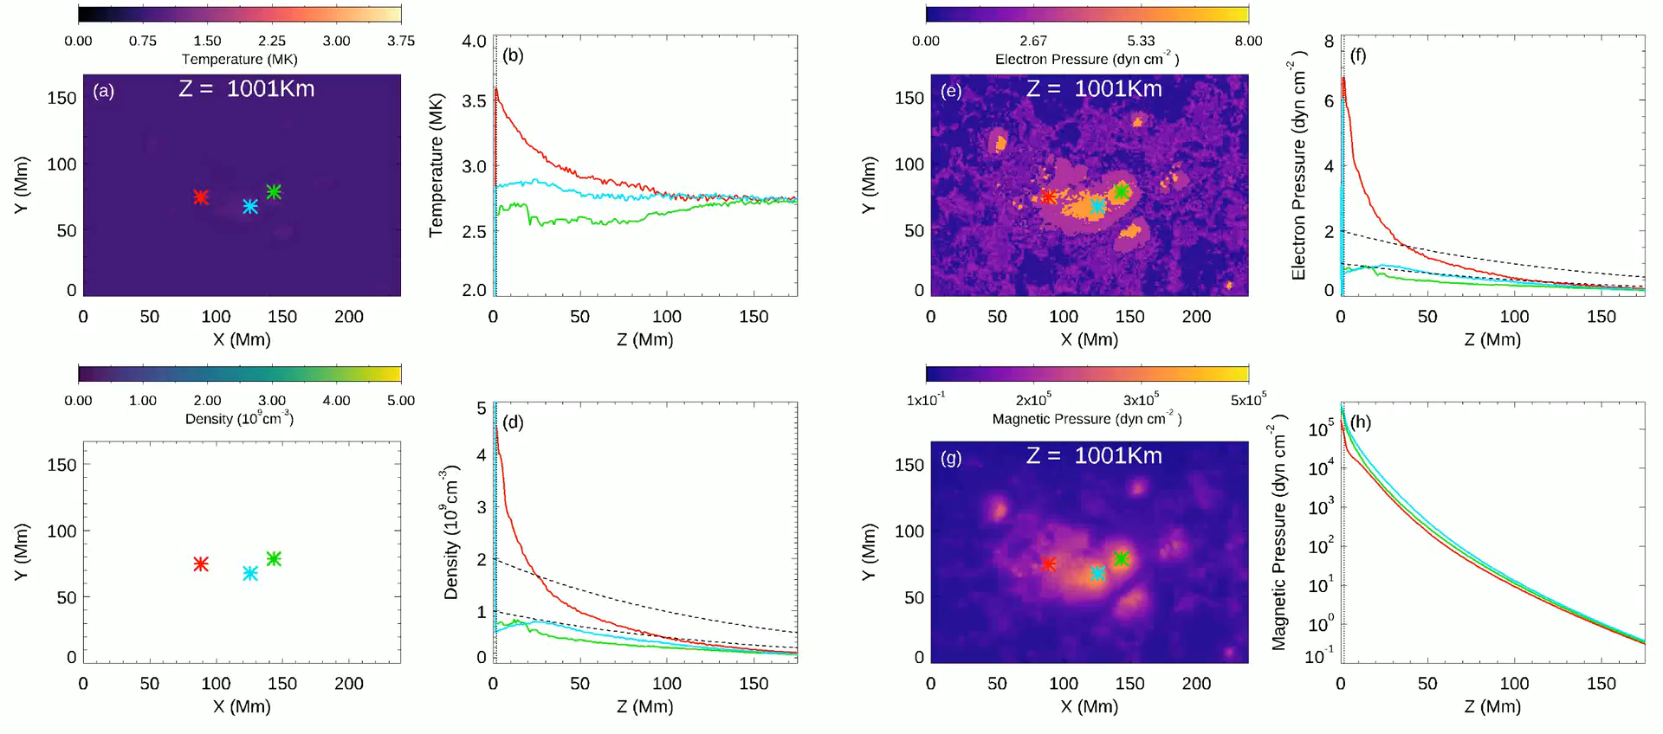
Thermal structure in 3D

Slide 25
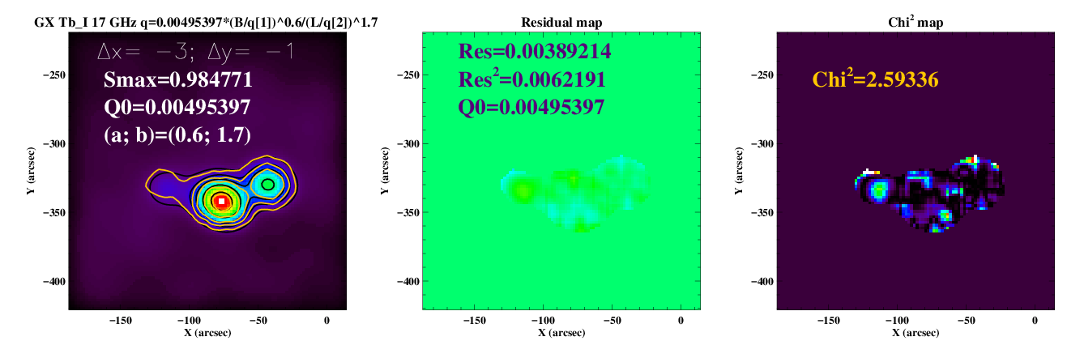
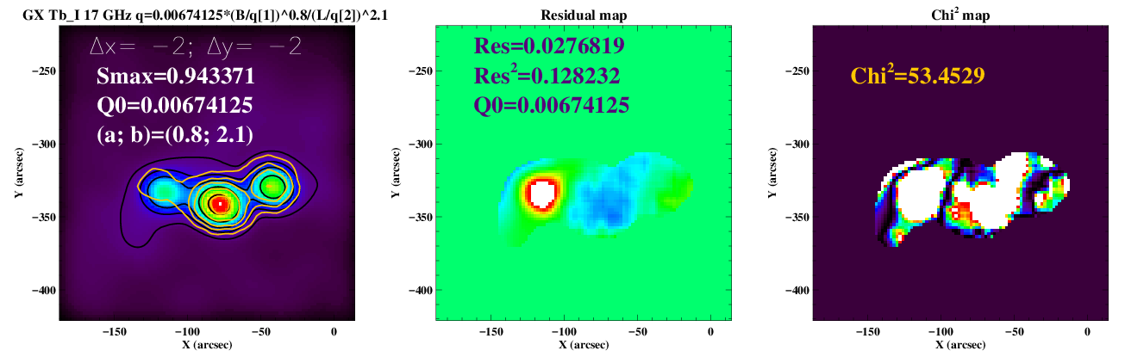
Steady State case
Best EBTEL Steady State thermal model with metrics of success comparable with those in the EBTEL impulsive model.
One of non-optimal EBTEL Steady State thermal models.
This shows an extreme sensitivity of GR radio emission to the thermal model.

Slide 26
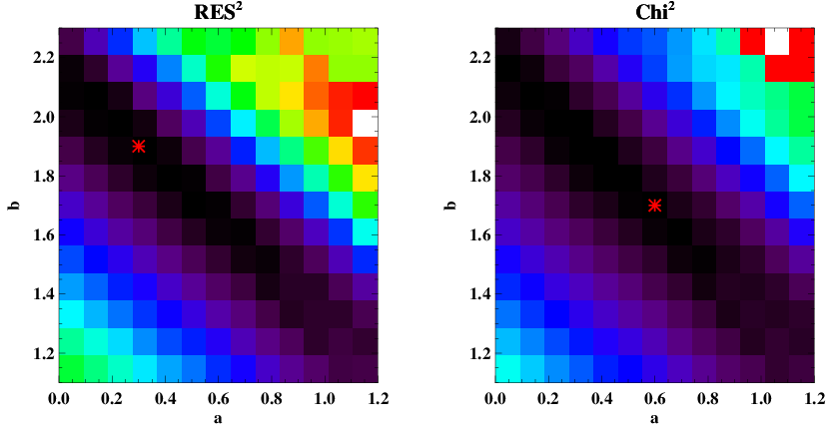
Matrices of 169 steady state thermal models
b=2.2 – 0.9a

Slide 27
Take Away
Microwave gyroresonant emission is extraordinarily sensitive to details of the coronal heating.
In case of impulsive heating, the best parametric heating model is a=1; b=0.75.
In case of steady state heating, the best parametric heating model is a=0.6; b=1.7 with a degeneracy described by b=2.2 – 0.9a.
A relatively simple scaling, containing only THREE free parameters (a, b, Q₀) is capable of very close reproducing the coronal thermal structure of an AR.
New progress in the coronal heating diagnostics with the microwave emission is expected from analysis of other AR instances and from multifrequency data (EOVSA, VLA, SRH).

