Slide 1
Диагностика магнитного поля в основании короны с использованием гирорезонансного излучения: практические аспекты. Обсуждение: как включить эти данные в схему бессиловой экстраполяции магнитного поля?
Г.Д.Флейшман
8 Апреля 2015

Slide 2
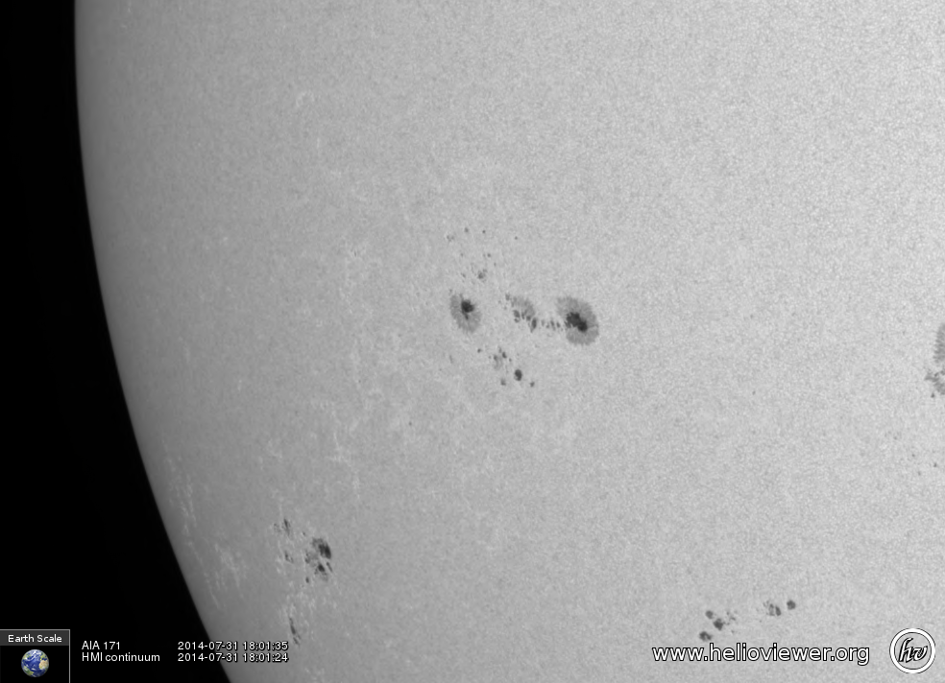
Misleading impressions
When an active region visible in continuum images is
seen in the
extreme
ultraviolet
(EUV), the
coronal B
field appears
only in
discrete
loops.

Slide 3
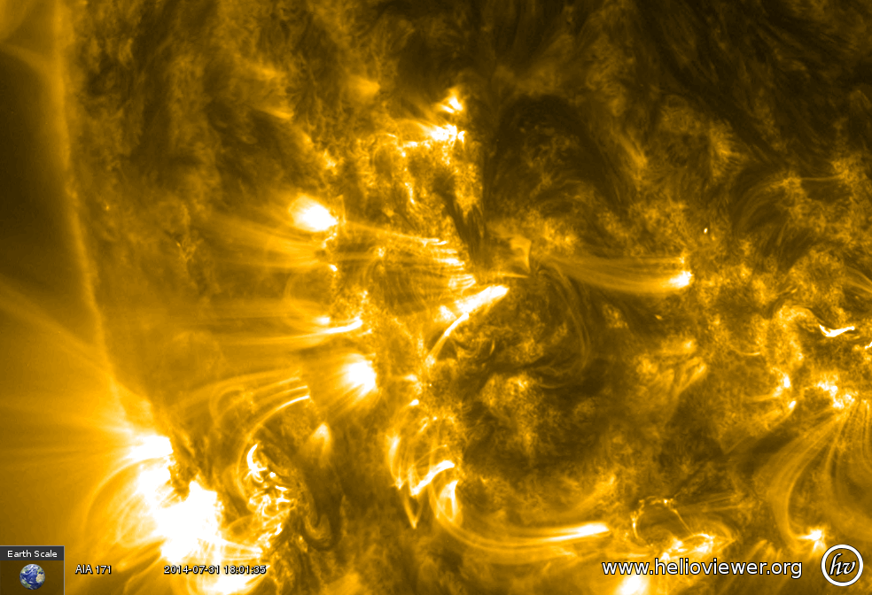
Misleading impressions
One gets the impression that the B field is bundled
into these
loops and is
absent or
negligible
elsewhere.
This is highly
misleading.

Slide 4
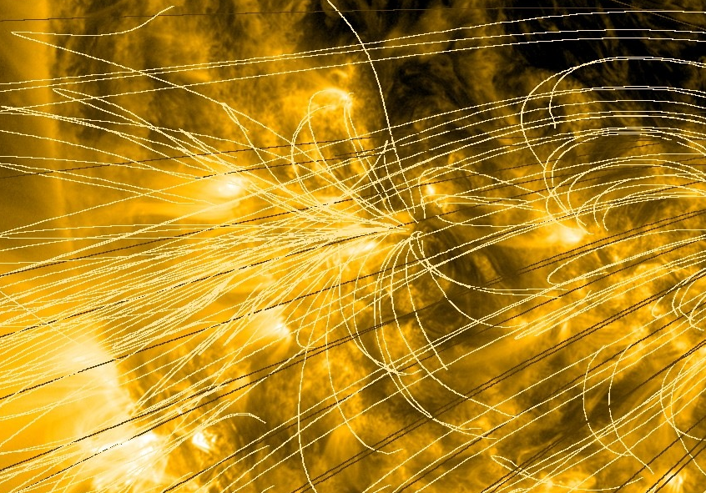
Misleading impressions
One gets the impression that the B field is bundled
into these
loops and is
absent or
negligible
elsewhere.
Drawing field
lines also leads
to this
impression.
This is highly
misleading.

Slide 5
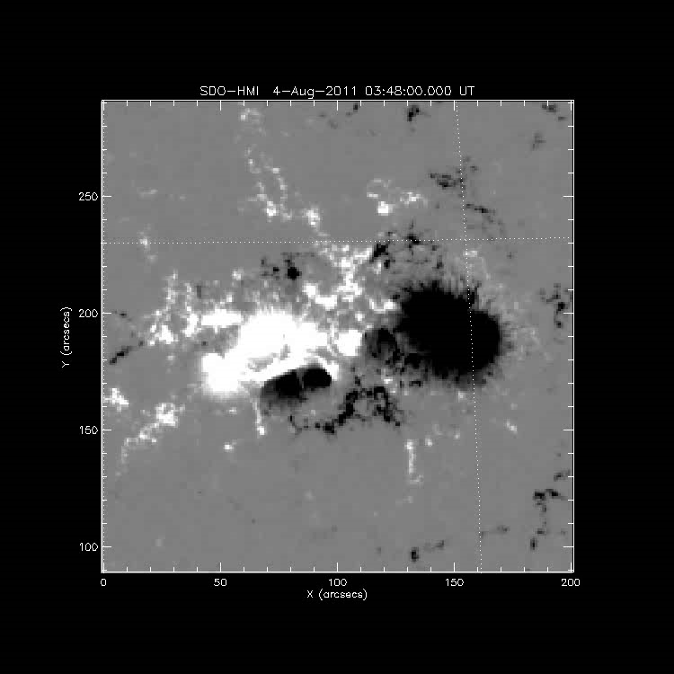
Smoothness of Magnetic extrapolations
Starting from an SDO photospheric magnetogram, it is true that the magnetic field is highly structured.
However, in a NLFFF extrapolation, the total magnetic field strength seen in this movie rapidly smooths out, and fills the space with little structure.

Slide 6
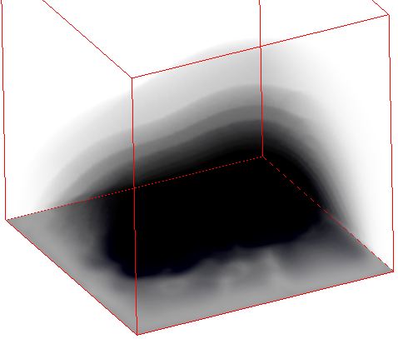
Isogauss surfaces
This volumetric shading representation clearly shows the smooth nature of isogauss surfaces in the model.
We will focus on such isogauss surfaces to explain the nature of gyroresonance radio emission.
At a given magnetic field strength B, electrons spiraling in that field produce radio emission at low harmonics of the gyrofrequency f = sf_{B}, where s = 1, 2, 3… is a small integer and f_{B} is the gyrofrequency f_{B} = 2.8x10⁶ B Hz.
For a given field strength, emission at these few frequencies is highly efficient, but is completely absent at other frequencies.

Slide 7
Optical depth and isogauss layers
For typical coronal temperatures and densities, only the 1st, 2nd and 3rd harmonics are optically thick, and again due to the resonance, the optically thick layer is extremely thin—only of order 100 km (<0.2”) in thickness.
Consider launching a ray at radio frequency 5.7 [17] GHz towards the Sun. The solar corona is essentially transparent to the ray until it is within ~100 km of the isogauss layer where
B = f / (2.8x10⁶ s) = 5700[17000]/(2.8 ∙ 3) = 678 [2023] G.
It will then typically be absorbed in that narrow layer, but if it somehow survives passing through that 100 km distance, the corona will again become transparent until it reaches within 100 km of the 2nd-harmonic layer, where B = 5700[17000]/(2.8 ∙ 2) = 1018 [3035] G. Here, it will suffer even stronger absorption.
If again it survives, it will pass through a transparent medium until it reaches 2036 G, the s = 1 layer, or strong free-free absorption layer.

Slide 8
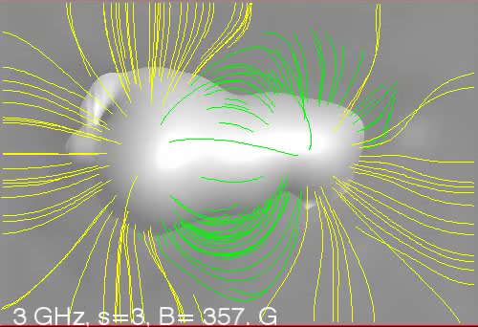
The s = 3 layer vs. frequency
In the case of thermal emission, the foregoing discussion about absorption also holds for emission. These thin isogauss layers where the various harmonics strongly absorb are also the origin of thermal radio emission traveling outward from the hot corona.
By virtue of the resonance condition, we can select different isogauss layers simply by changing our observing frequency.

Slide 9
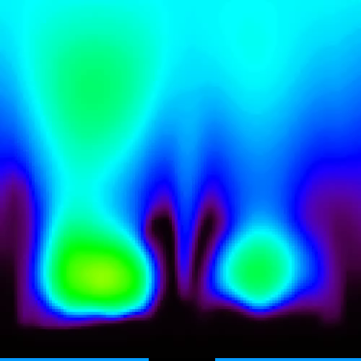
Brightness of the s = 3 layer
The brightness of the surface where it is optically thick is just proportional to the electron temperature on the surface.
This movie shows the temperature variation east-west across the model (x) vs. height (z), while scanning from south-to-north (y).
You can see that the temperature structure on these vertical surfaces is rather complex, but generally peaks in the loops spanning between the two sunspot regions.

Slide 10
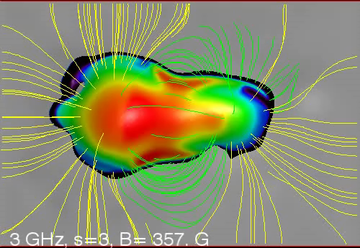
Brightness of the s = 3 layer
In the previous movie, we painted the vertical surfaces with the temperature while scanning in y. In just the same way, we can paint the isogauss surfaces while scanning in frequency.
This is almost what we see when observing gyroresonance emission in active regions, but there is one additional effect that must be taken into account—the varying opacity on the surface, which varies mainly with direction of the magnetic field.

Slide 11
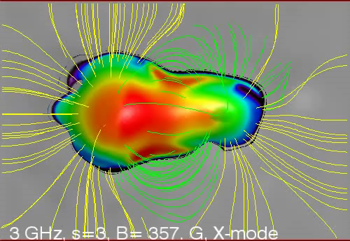
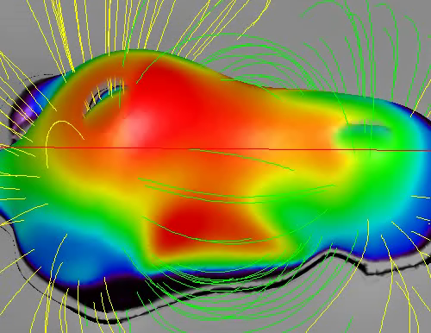
OPACITY and harmonic layers
This movie shows lower harmonic layers peeking through the opacity holes, although it is hard to see.
It may be a bit more apparent from a side perspective, as in this movie.

Slide 12
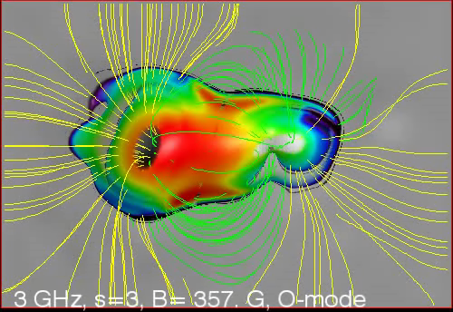
Polarization and magnetoionic mode
Gyroresonance emission, caused by electrons spiraling in the magnetic field, naturally occurs most strongly in the sense of circular polarization whose electric vector rotates in the same direction as the electrons. This is the extra-ordinary mode, or x-mode. However, the electrons also emit, with lower opacity, in the opposite sense ordinary mode, or o-mode.
Here is what the o-mode looks like. The opacity holes are now larger, and the lower harmonic layers are more easily seen.

Slide 13
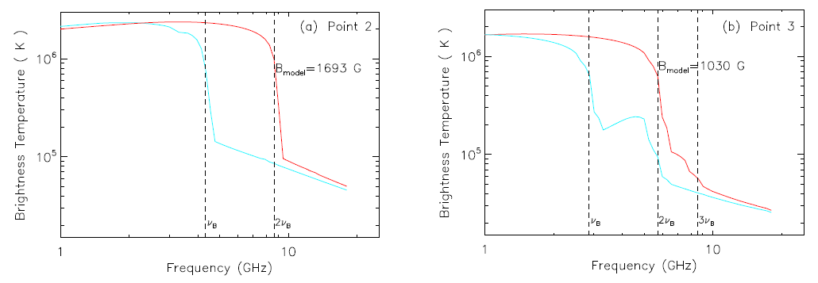
Spectra from a given pixel
Another view is to consider vertical cuts in the datacube, i.e. spectra at different positions in the images.
The spectra below show the harmonic structure in the two polarizations, which allow direct determination of the relevant harmonic from the frequency ratio for different features seen in the two polarizations.

Slide 14
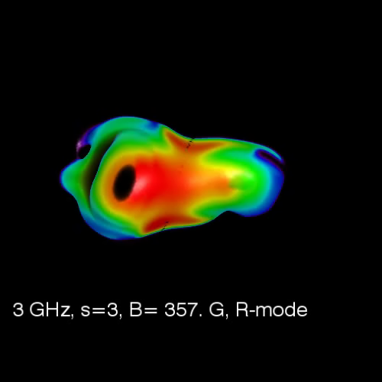
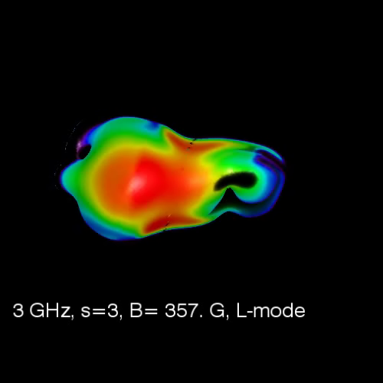
Putting it all together
To see what would be seen in a given circular polarization, one merely chooses either o- or x-mode depending on sign of local B_{z} on the surface.)
Here we have turned off the background image and field lines for clarity.
RCP LCP

Slide 15
Measuring coronal magnetic fields
The foregoing has hopefully provided an appreciation for how gyroresonance radio emission works.
We see that multifrequency radio images give mainly the electron temperature on the s = 3 isogauss surface.
One can ask how this fact can be used to determine the coronal magnetic field. There are several answers that we will explore using simulated observations from a real radio instrument, the 13-antenna Expanded Owens Valley Solar Array.
We do a detailed calculation of radio emission from the same coronal model used to make the foregoing movies. This model, due to Mok et al. (2005), provides the vector magnetic field in the volume (B_{x}, B_{y}, B_{z}), the electron temperature T_{e}, and the electron density n_{e}.

Slide 16
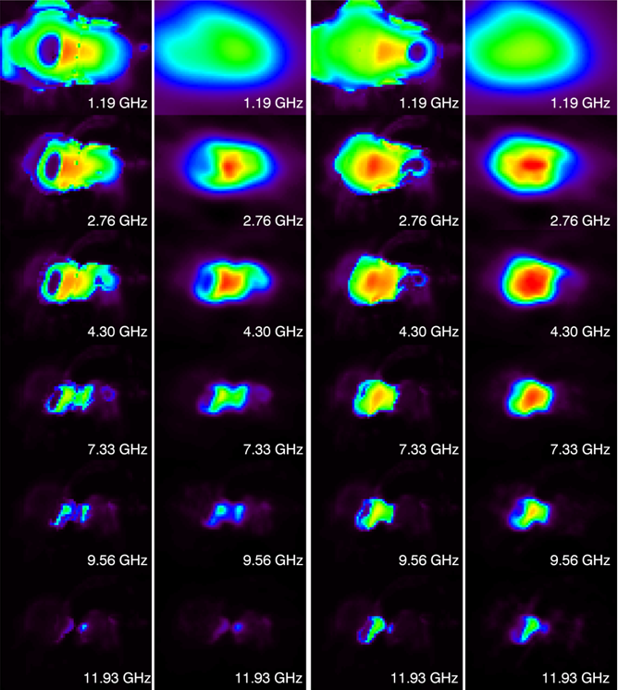
Model and simulated eovsa images
RCP LCP
At right are the direct images for 6 representative frequencies, calculated from the model using gyroresonance and free-free emission, although for the frequencies shown the result is dominated by gyroresonance.
In adjacent columns are the simulated EOVSA images obtained after folding the images through the EOVSA instrument.
We can make three-dimensional datacubes from these multifrequency images, one for the model, and one for the “folded images”
model simulated model simulated

Slide 17
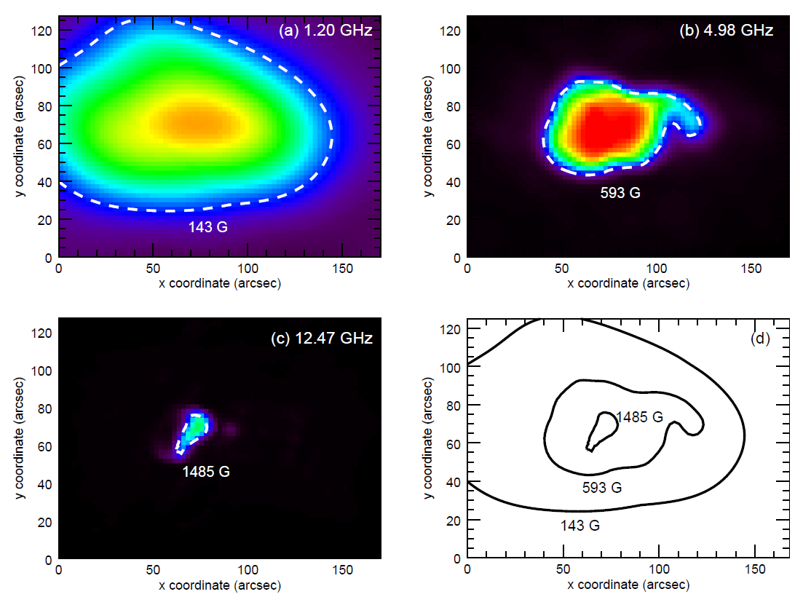
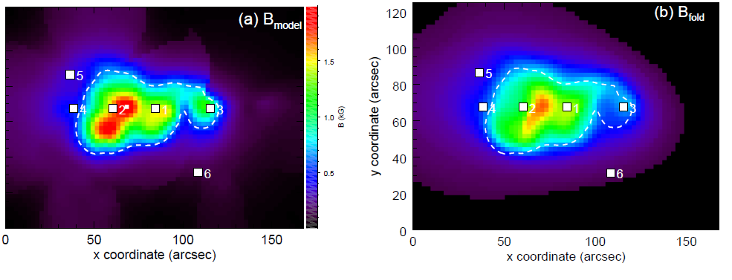
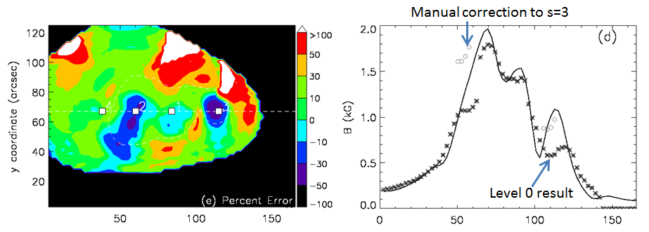
Coronal magnetogram ‘level-0’ method
The panels at right indicate the basis for the simplest method, which is to draw an outermost contour at a fixed brightness for the radio map at each frequency, and interpret as 3rd harmonic.
The upper panels show this at three frequencies. The panels below show the result for 64 frequencies.
Differences are within 20%, except over sunspots (due to 3rd harmonic assumption), and outer regions (due to limited resolution).
Actual B from model
B from contours

Slide 18
Coronal magnetogram: 3D
The ultimate method, direct “forward-fit” modeling, is the most sophisticated, and is likely to be most useful, although the detailed procedure and analysis tools are not yet available.
The approach is to start with the magnetic field extrapolation, which takes into account the level-0 magnetogram at the TR level and chromospheric magnetic measurements, then apply various physics-based temperature and density models, and derive simulated images that are then compared with the actual images obtained with a given radio array.
Differences between the observed and simulated images will then be used to modify the model (including the magnetic field extrapolation), iterating toward an acceptable solution that fits all of the data, including radio, EUV, optical, and any other available data.

Slide 19
Conclusions
We have demonstrated the use of gyroresonance radio emission for measuring coronal magnetic fields, with the help of isogauss surfaces in a 3D active region model.
Each observed frequency mainly reflects the electron temperature on the isogauss surface representing the 3rd harmonic of the gyrofrequency, although with some transparency windows that allow lower surfaces to be seen. A continuous increase in observing frequency corresponds to a CAT-scan-like continuous sweep of the relevant isogauss surface to lower heights, and vice versa.
Together with the coronal magnetograms, one simultaneously obtains the 3D temperature structure in the region. In particular, regions of hotter temperature can be expected to correlate with non-potential magnetic field regions and enhanced currents.
New instruments (EOVSA, JVLA, CSRH, USSRT, and ultimately FASR) are now coming online to make these methods of measuring coronal magnetic fields possible for the first time.

