Slide 1
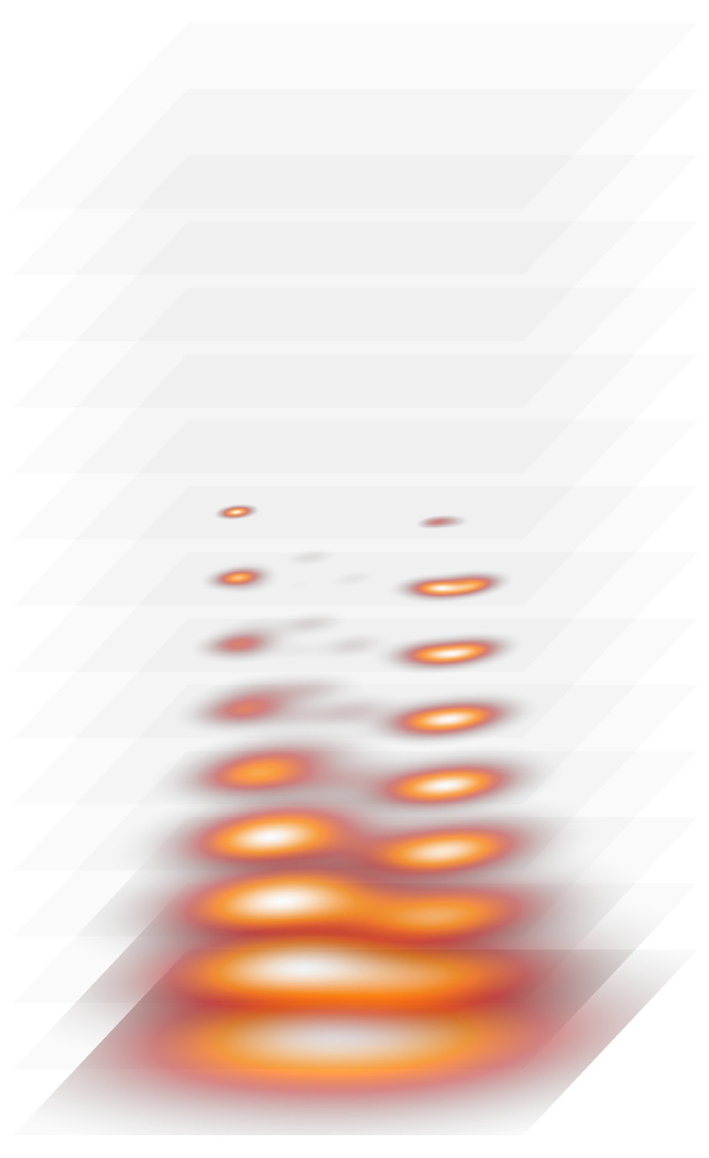
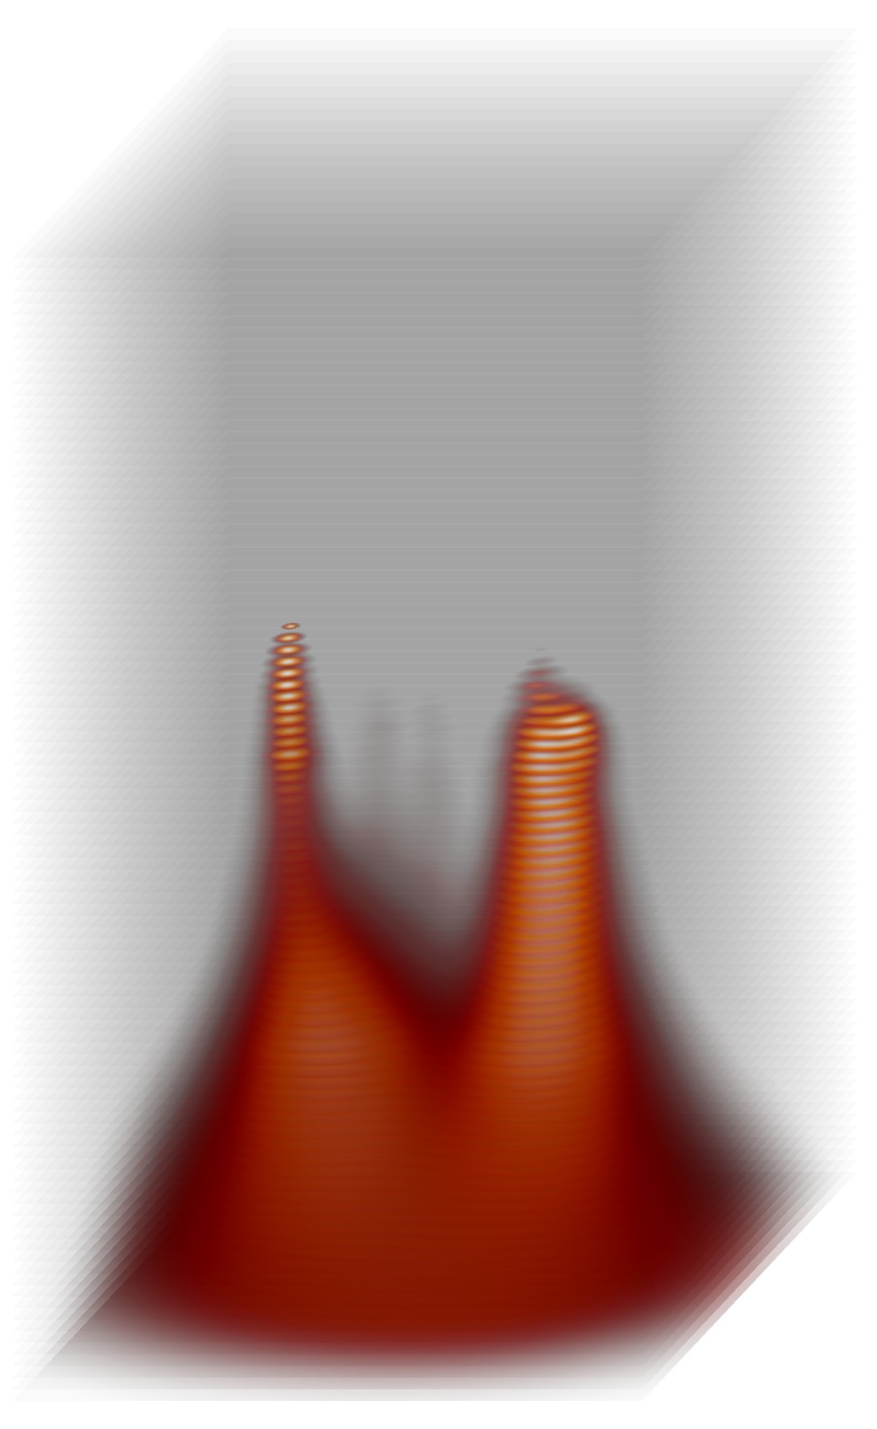
Routine mode
15 channels
Magnetographic mode
100 channels
Frequency

Slide 2
From free-free emission
Line of sight component averaged over height
Polarization degree of free-free emission
Magnetic field
From gyrosynchrotron emission
Forward fitting with
GX-simulator
From cyclotron emission
Absolute value at the base of the corona
cutoff frequency of the cyclotron emission
Magnetic field in a flaring loop

Slide 3
Magnetic field from cyclotron emission

Slide 4
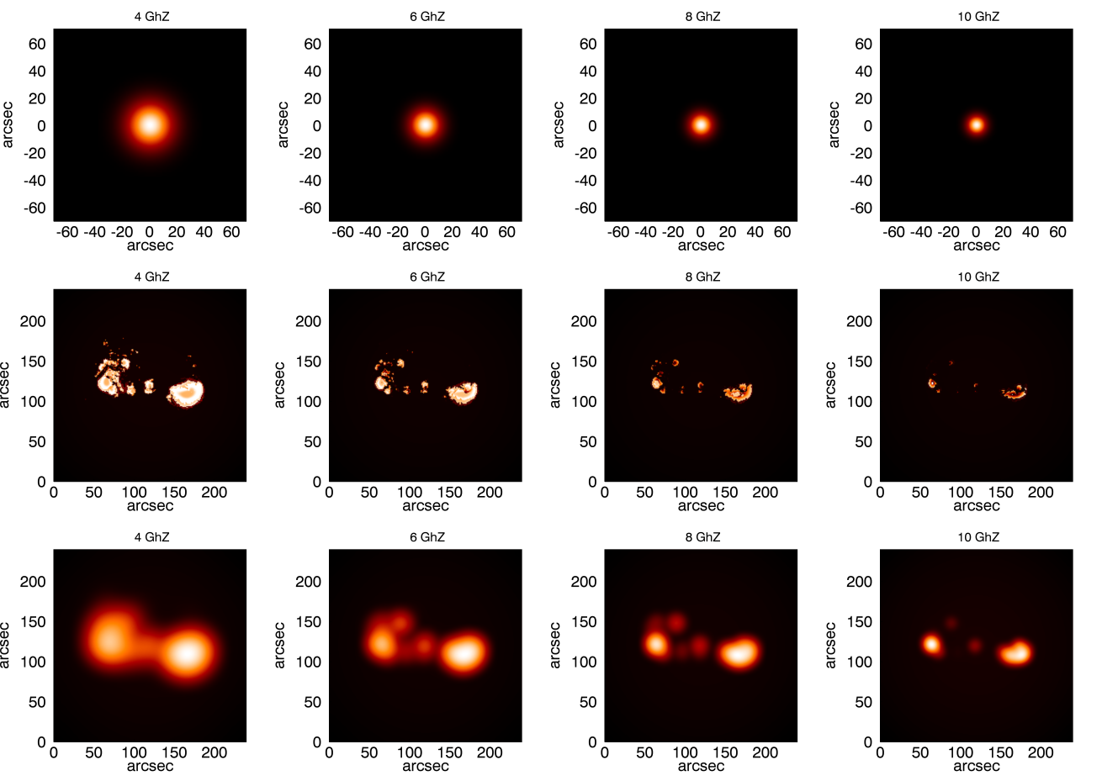
Simulated images at 4, 6, 8 and 10 GHz
Beam
(PSF)
Fine
details
Convolved
with BEAM

Slide 5
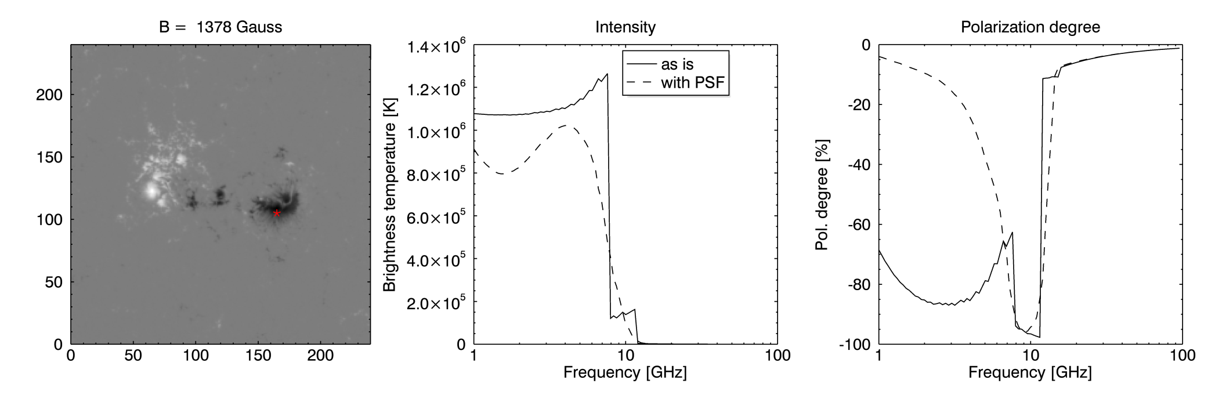
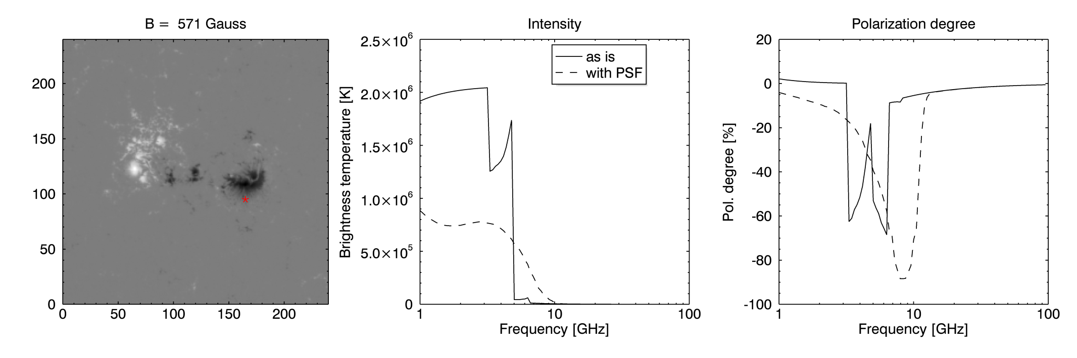
Spatial resolution effects (Spectrum)

Slide 6
Spatial resolution effects
Magnetogram is significantly smoothed
Magnetic field is overestimated for weak and medium fields

Slide 7
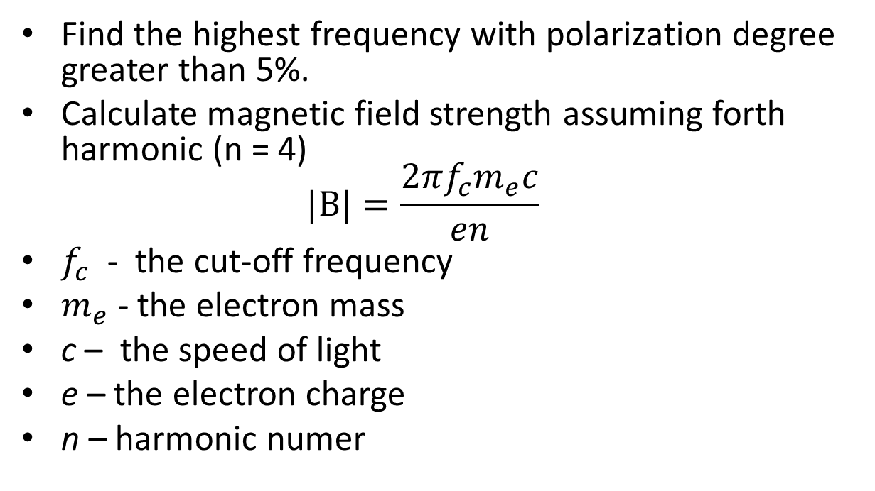
The method of the magnetic field inversion from the modelled cyclotron radiation
Find the highest frequency with polarization degree greater than 5%.
Calculate magnetic field strength assuming forth harmonic (n = 4)
$|B|=\frac{2πf_{c}m_{e}c}{en}$
$f_{c}$ - the cut-off frequency
$m_{e}$ - the electron mass
c – the speed of light
e – the electron charge
n – harmonic numer

Slide 8
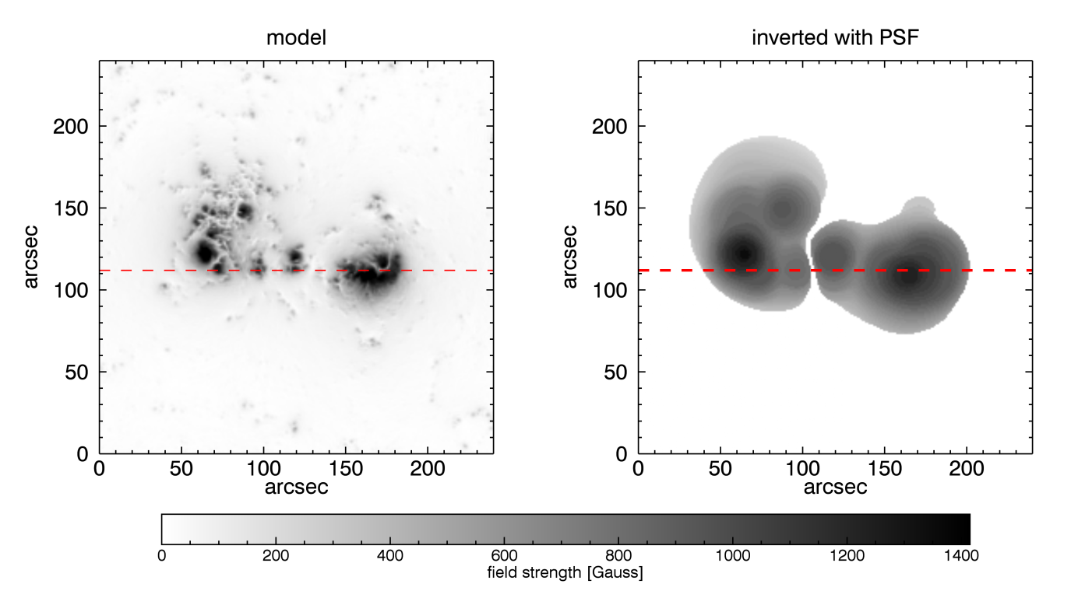
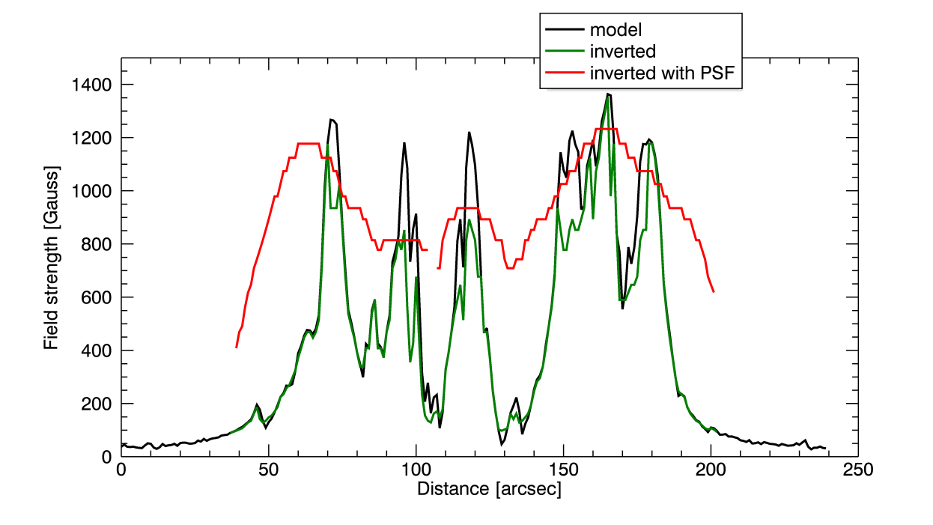
Magnetic field strength from cyclotron radiation

Slide 9
Magnetic field from free-free emission

Slide 10
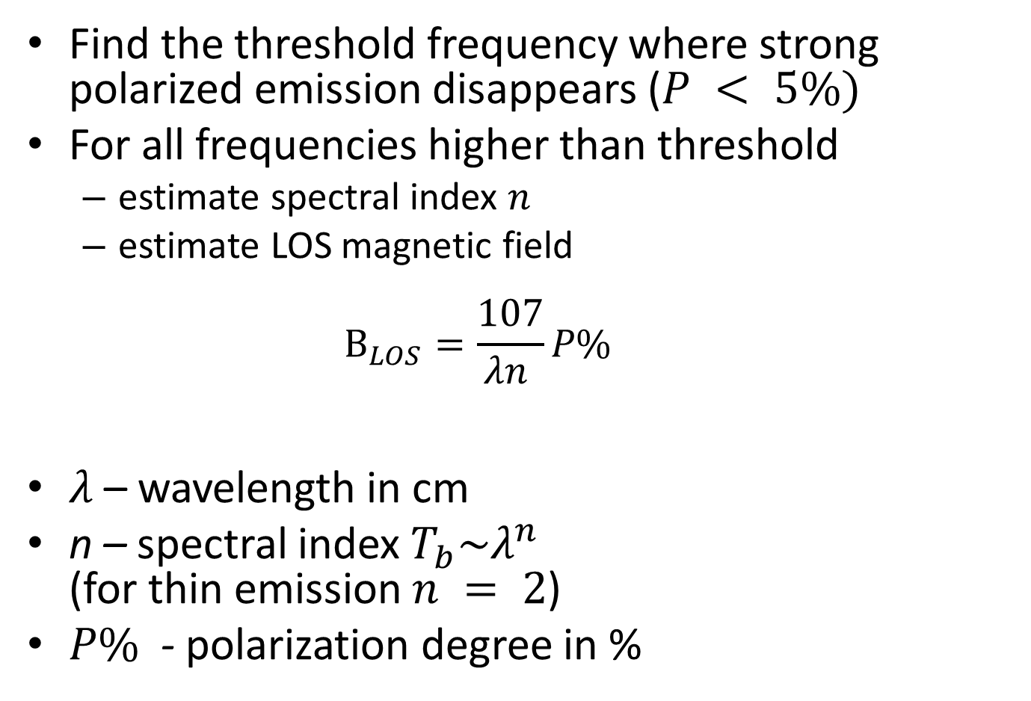
The method
Find the threshold frequency where strong polarized emission disappears ($P < 5\%)$
For all frequencies higher than threshold
  estimate spectral index $n$
  estimate LOS magnetic field
  $B_{LOS}=\frac{107}{λn }P\%$
$λ$ – wavelength in cm
n – spectral index $T_{b}\sim λ^{n}$
(for thin emission $n = 2$)
$P\%$ - polarization degree in %

Slide 11
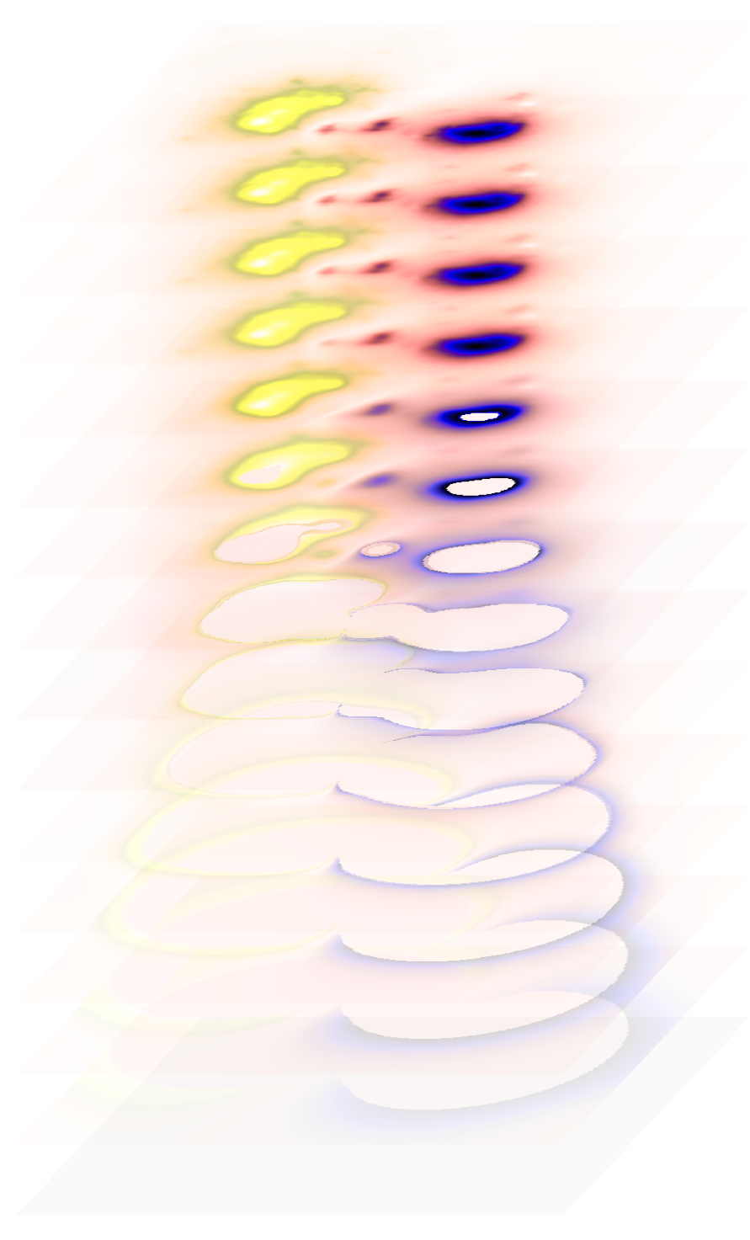
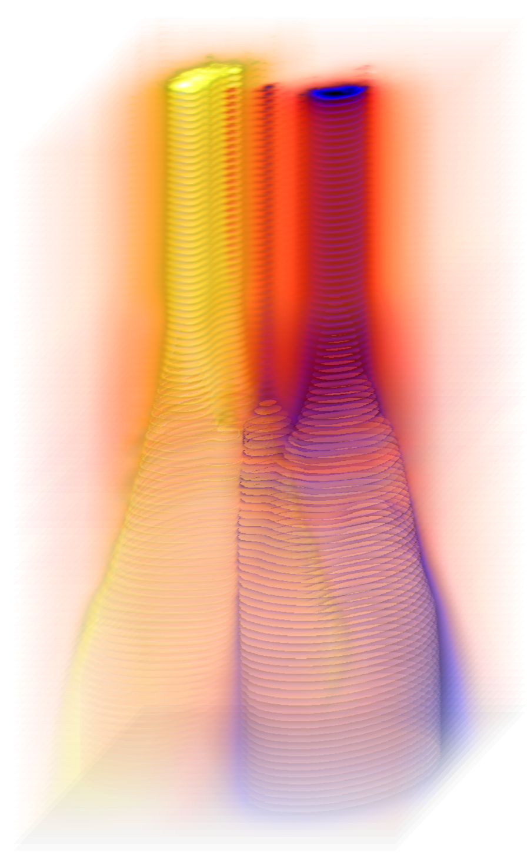
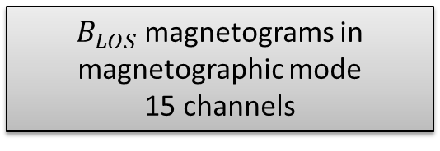
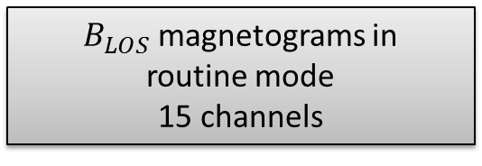
Frequency
$B_{LOS}$ magnetograms in
routine mode
15 channels
$B_{LOS}$ magnetograms in
magnetographic mode
15 channels

Slide 12
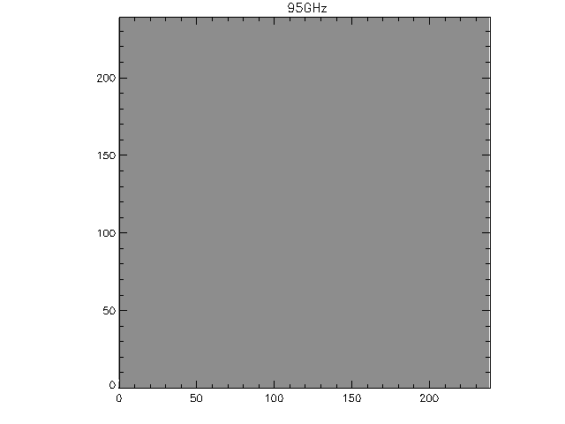

Slide 13
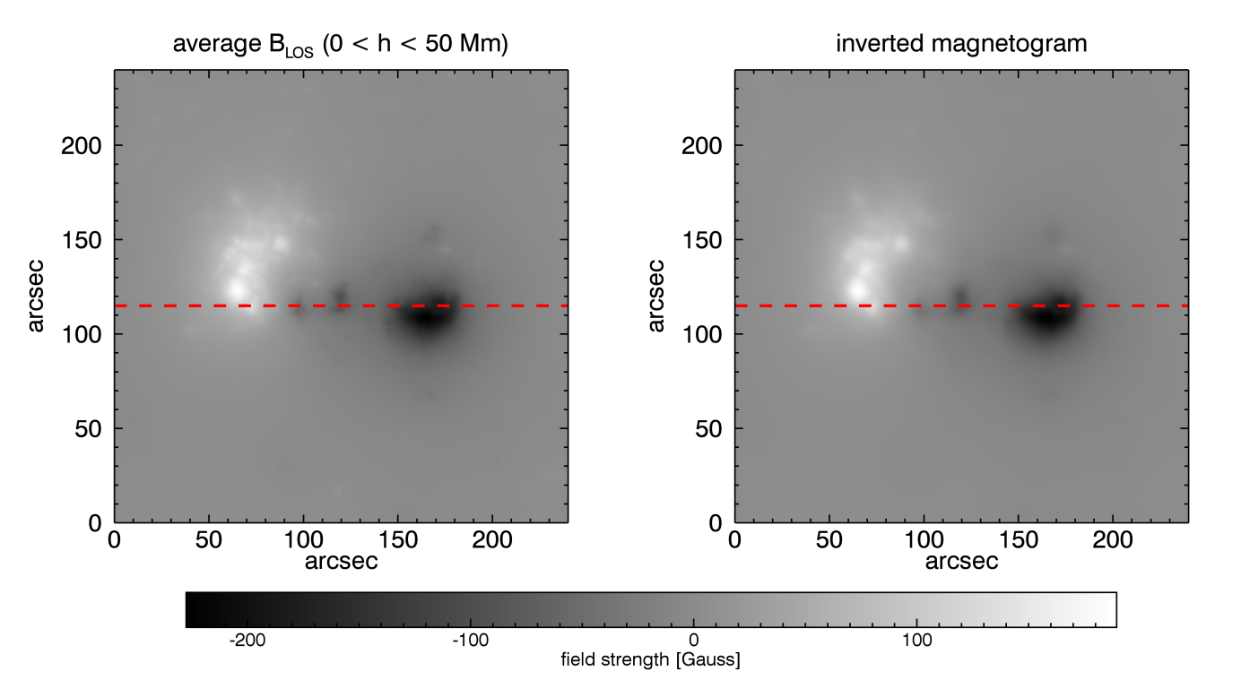
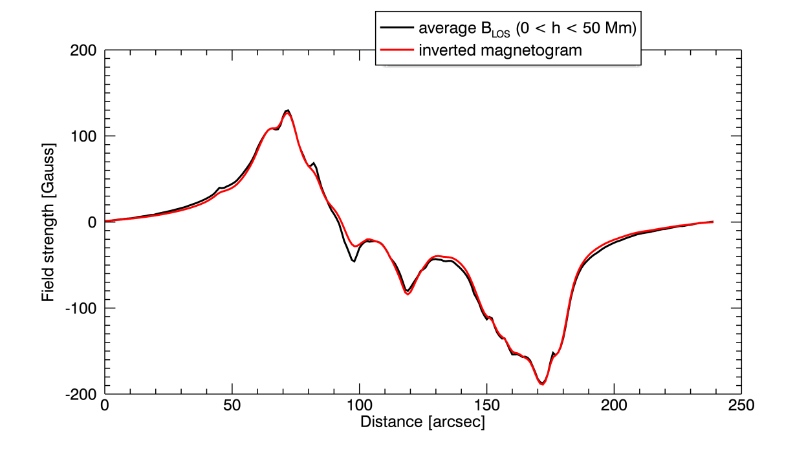
Line of sight component inverted from free-free radiation

Slide 14
Summary
The uSSRT will provide
Regular observations in special magnetographic mode
  High spectral resolution (~100 channels)
The measurements of
  Absolute value of the magnetic field at the base of the corona (regular magnetograms)
  Line of sight component of the magnetic field averaged over height (regular magnetograms)
  Magnetic field value in flaring loops

