Slide 1
New enhancements of the GX Simulator:
3D data-driven modeling of active regions and simulation of associated microwave and EUV emission maps
Gelu M Nita¹
Gregory Fleishman¹, Alexey A Kuznetsov², Maria A Loukitcheva⁴, Nicholeen M. Viall⁵, James A Klimchuk⁴, E. Kontar³, Dale E. Gary¹
¹New Jersey Institute of Technology, ² Institute of Solar-Terrestrial Physics, ³University of Glasgow, ⁴Saint-Petersburg State University, ⁵NASA Goddard Space Flight Center

Slide 2
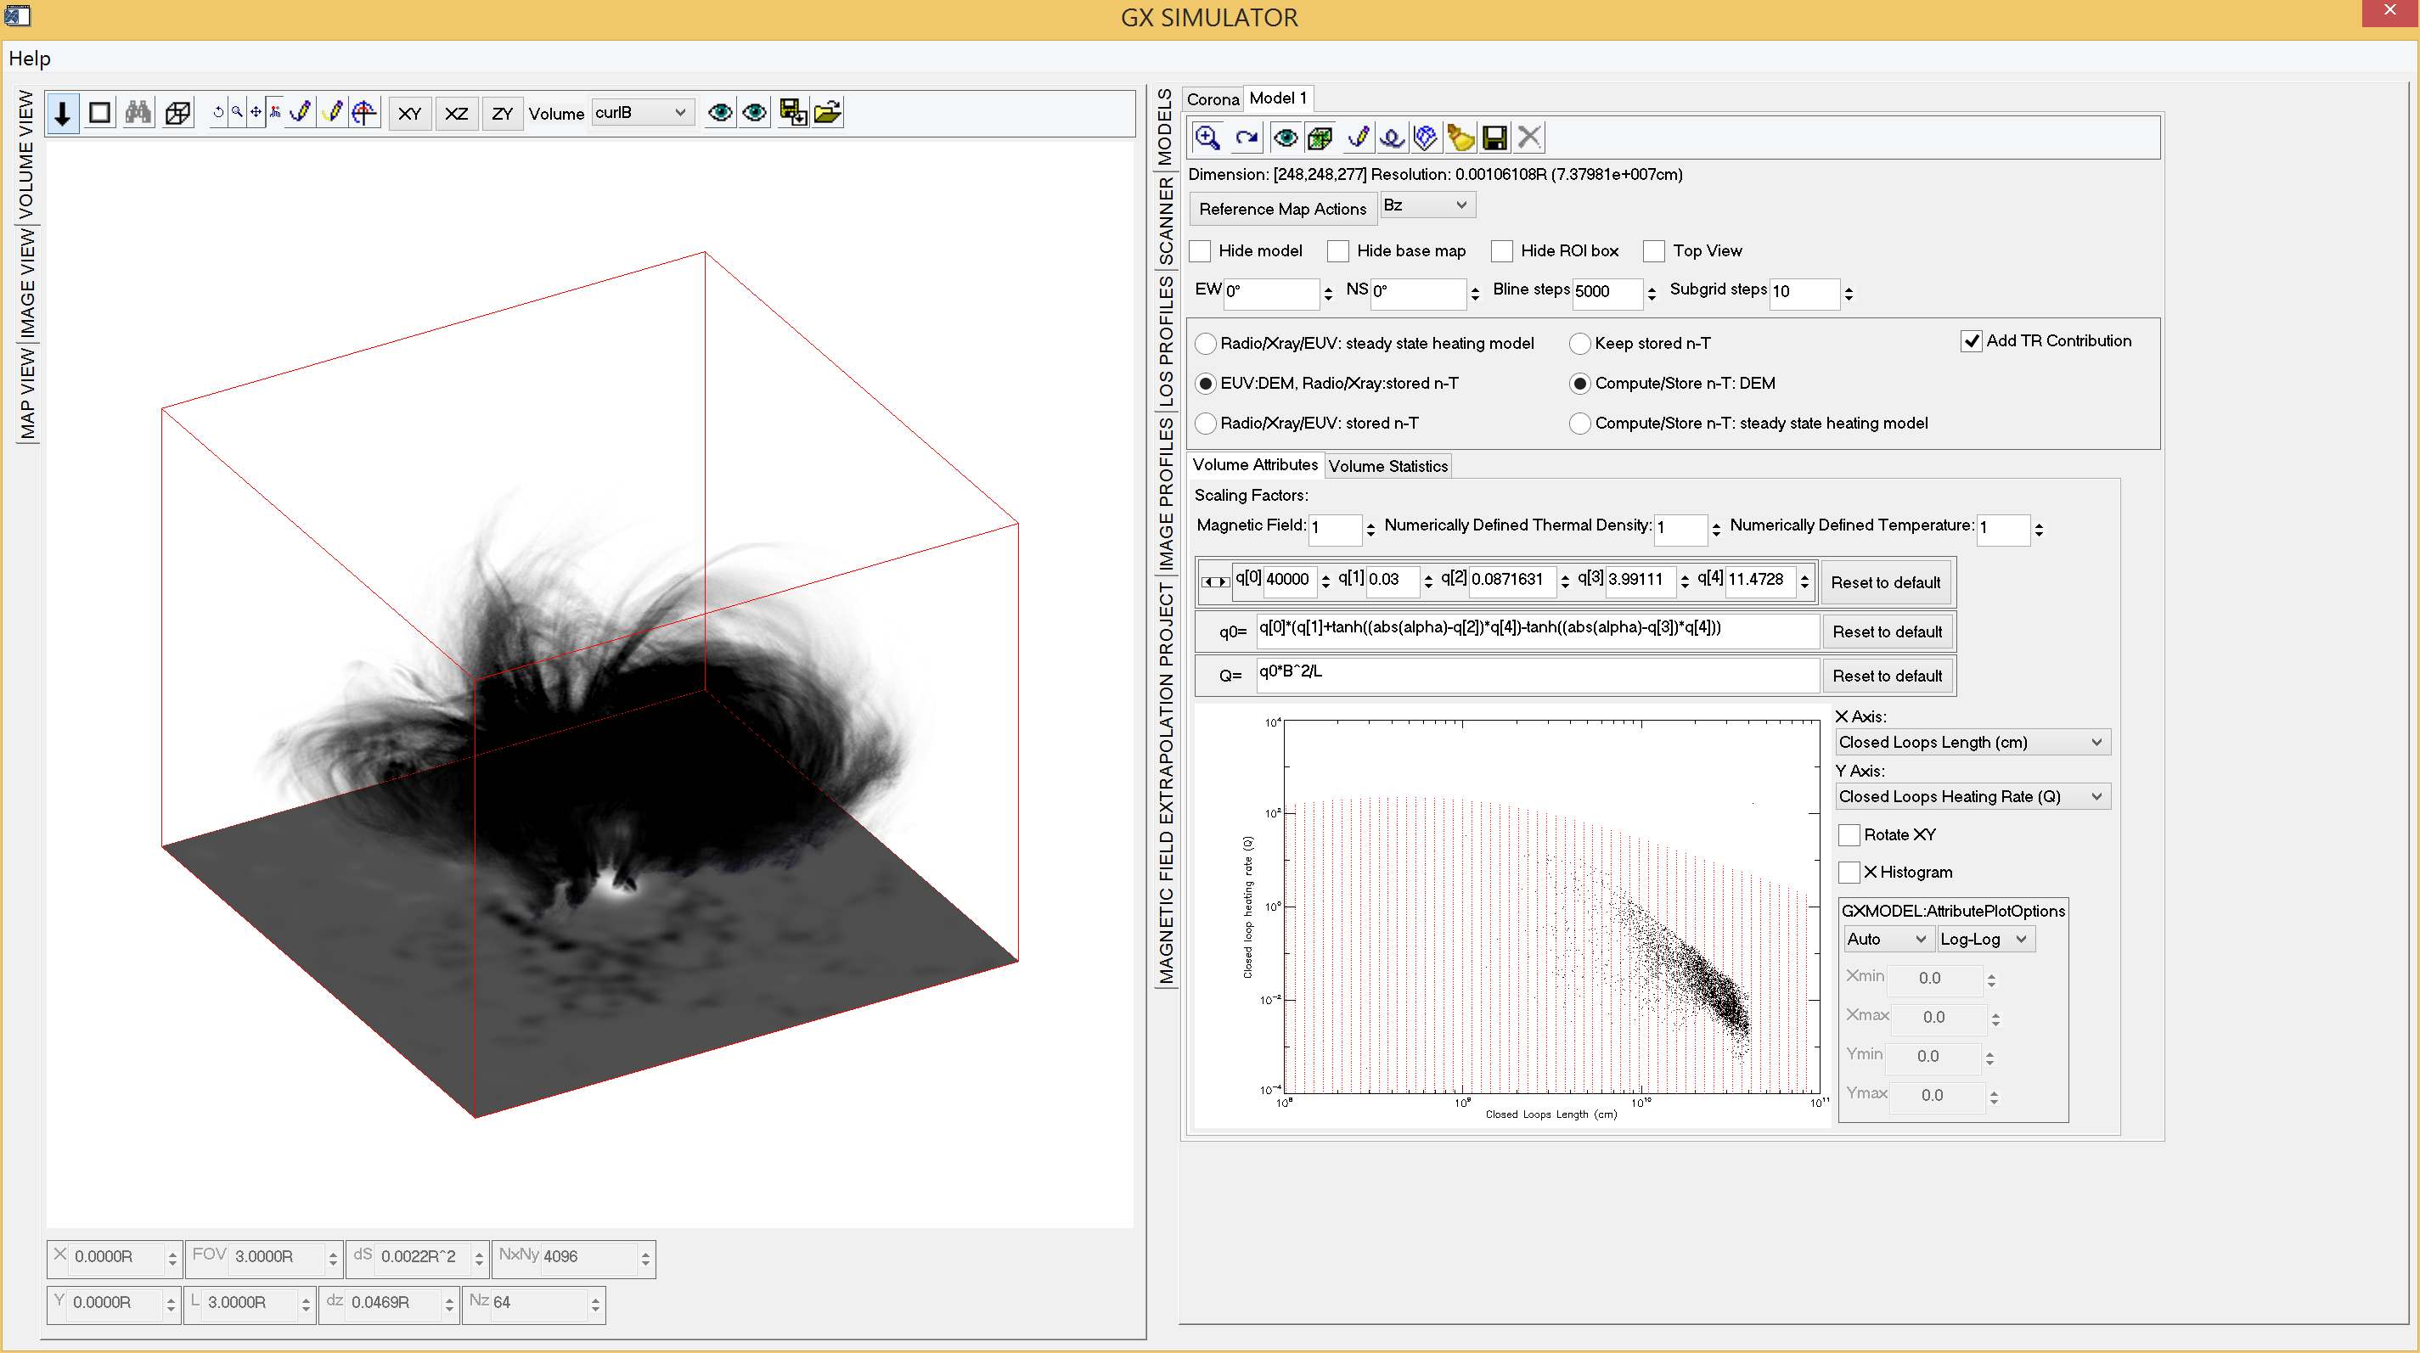
GX Simulator
3D Modeling SSW Package
(Nita et al. 2015, ApJ 799)
What’s new?
Integrated tools for generating data-driven chromospheric models
  Assignment to each photospheric pixel of vertical 1D adaptive height step chromospheric models (Fontenla et al. 2009)
Integrated tools for generating coronal models
  User defined closed loops heating functions
  Assignment of voxel-dependent DEM distributions to compute EUV emission from TR and chromosphere (EBTEL- Klimchuk et al. 2008)
  Assignment of densities and temperatures derived from the moments of the DEM distributions
Generation of Microwave, EUV, and soft X-ray maps based on the combined chromospheric and coronal models
Ability to import numerically defined chromo and coronal models and compute MW, EUV, and X-ray synthetic emission maps
Upgrade of the SSW GX_Simulator package coming this summer

Slide 3
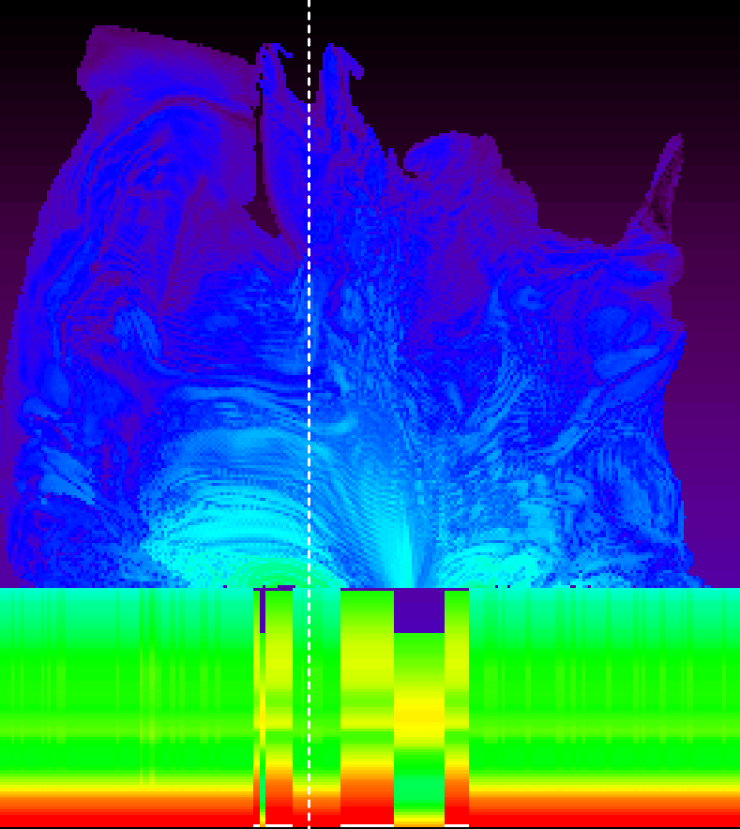
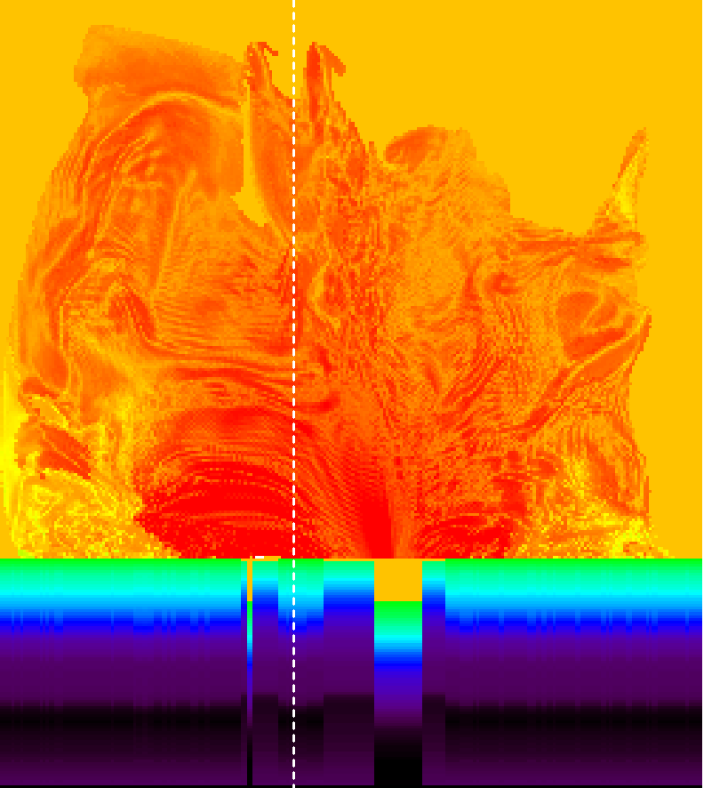
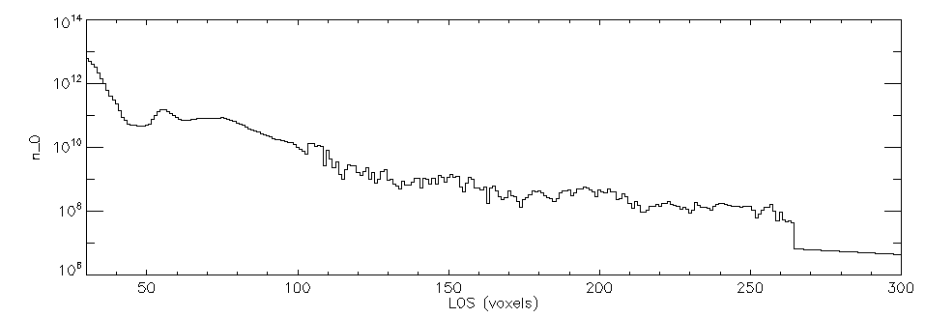
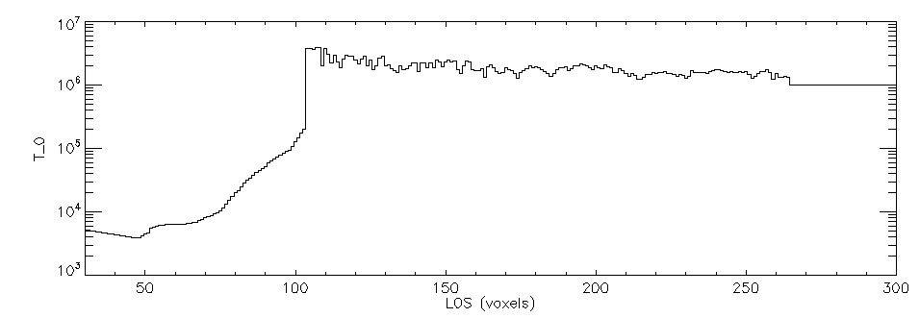
Chromospheric and Coronal
Temperature and Density Models

Slide 4
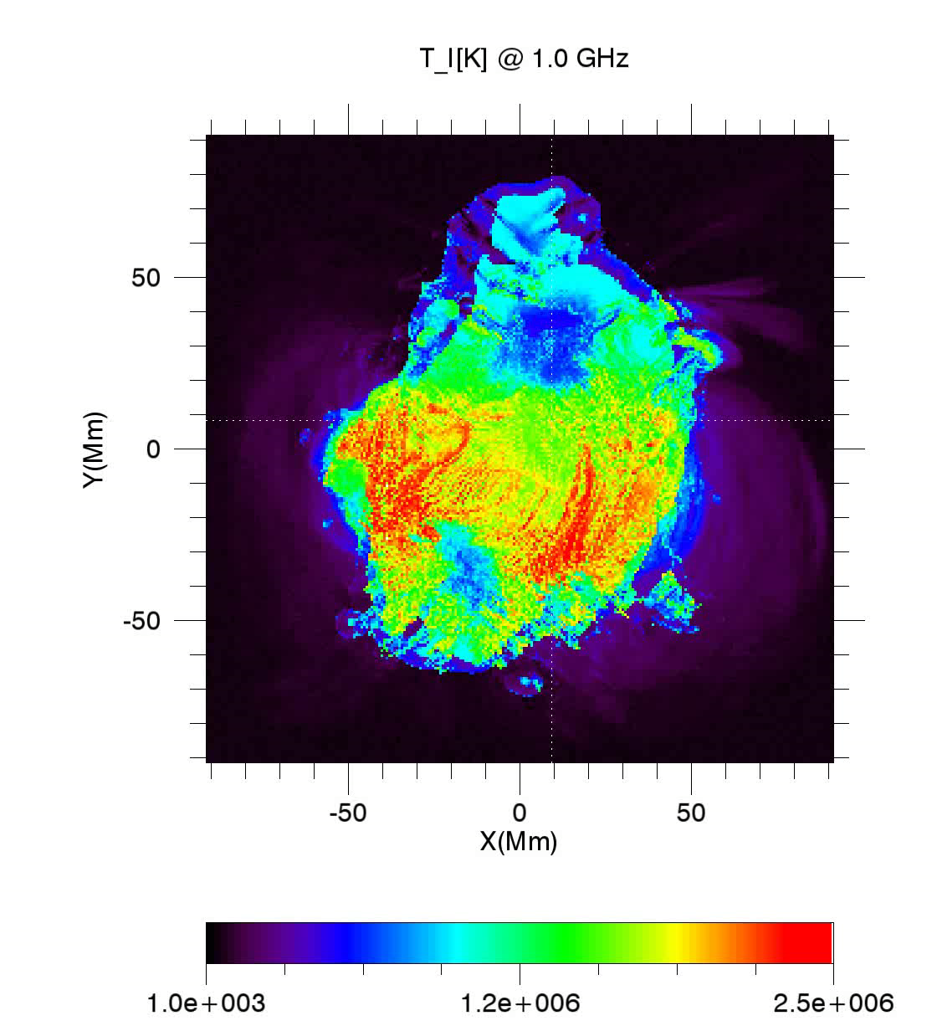
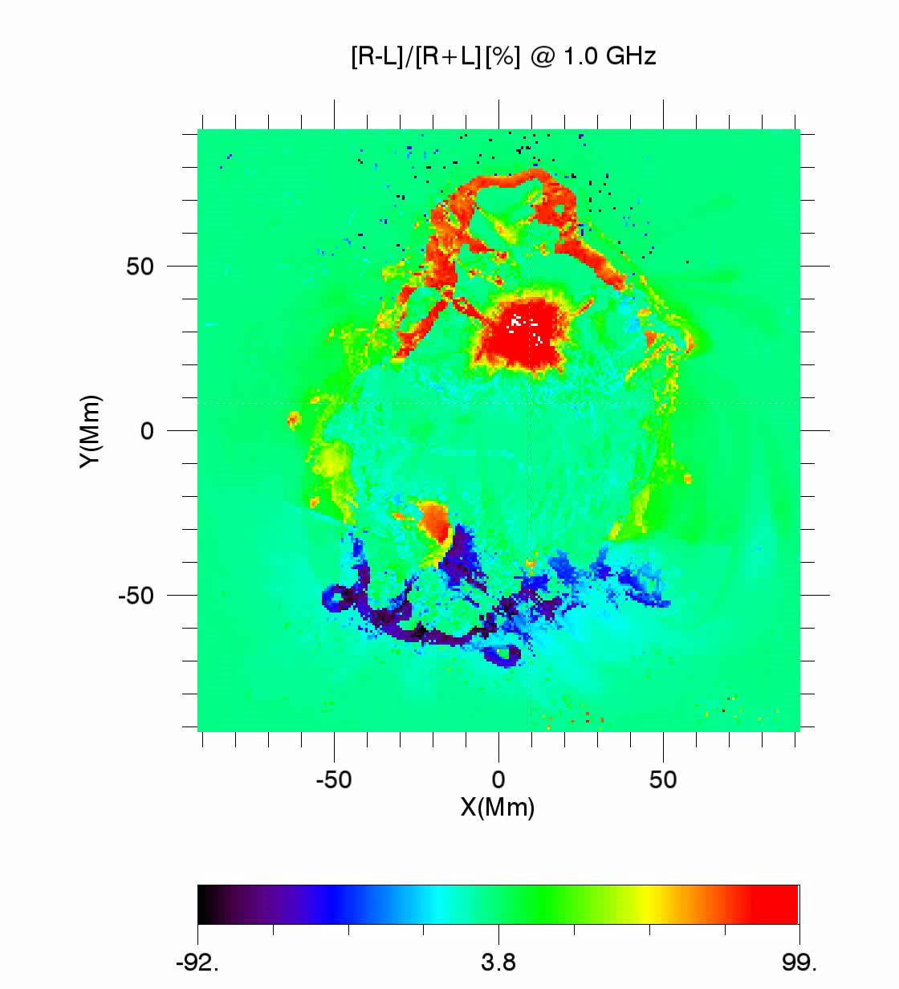
Synthetic Microwave Maps
Fast Gyrosynchrotron/Gyroresonance Codes
(Fleishman & Kuznetsov 2010, ApJ, 721)

Slide 5
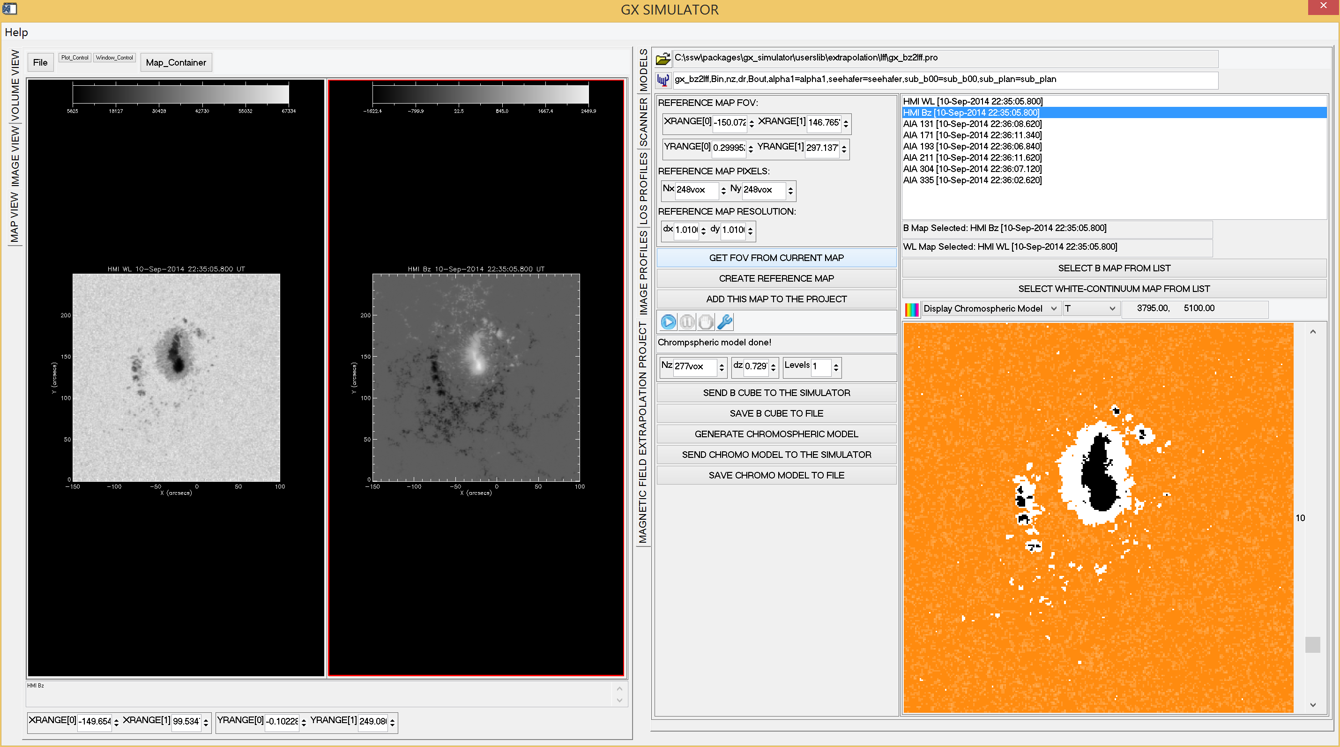
GX Simulator Chromospheric Model Project Page
White Light
Magnetic Field
Bz

Slide 6
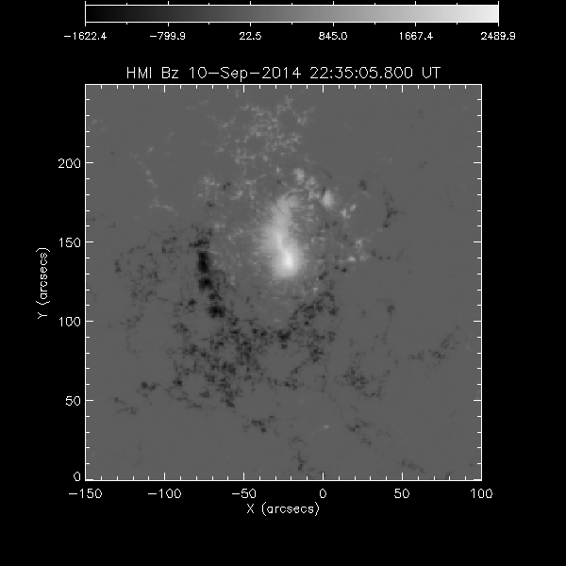
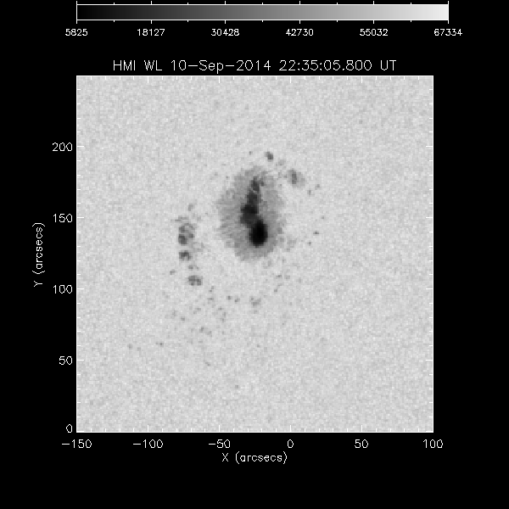
Photospheric Input to Chromospheric Model

Slide 7
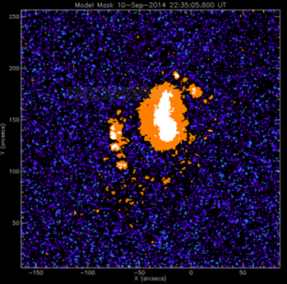
Chromospheric Model Mask
(Fontenla et al. 2009)
Photospheric Decomposition
IN (Inter Network)
NW (Network)
Enhanced NW
Sunspot Penumbra
Sunspot Umbra
Facula
Plage

Slide 8
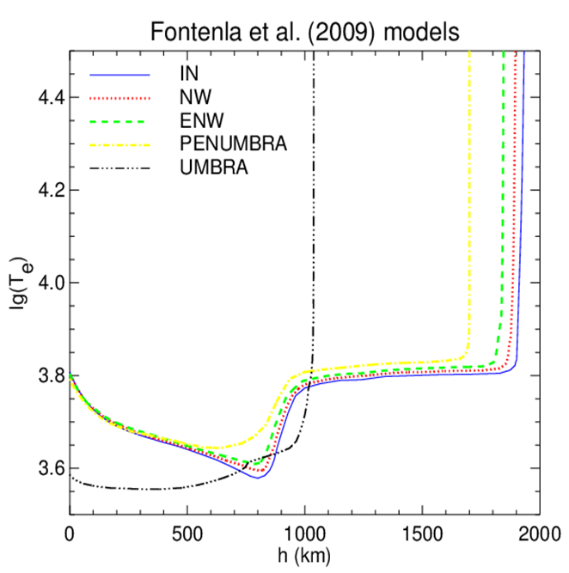
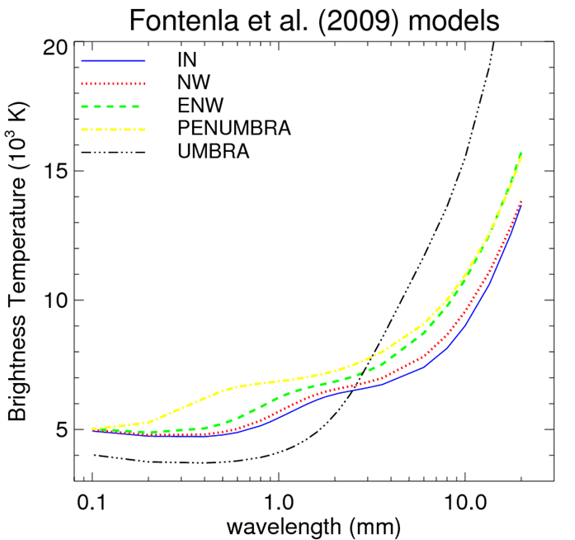
Fontenla et al. (2009) Models
Temperature as a function of height for a number of components from 1D static solar atmospheres
Brightness temperature spectra computed from the 1D models

Slide 9
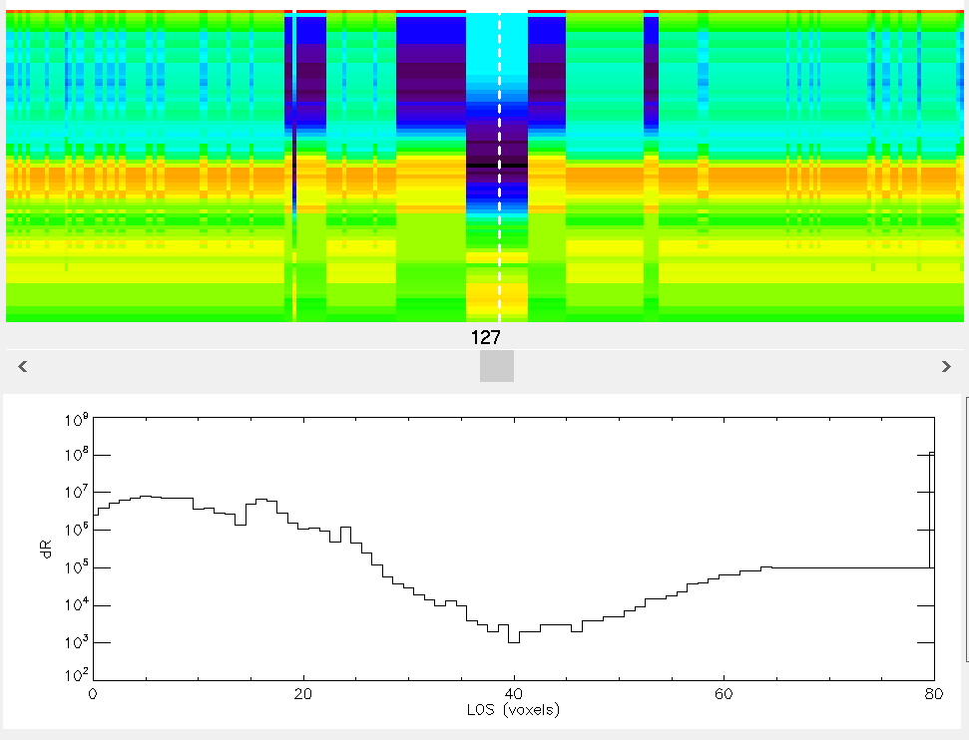
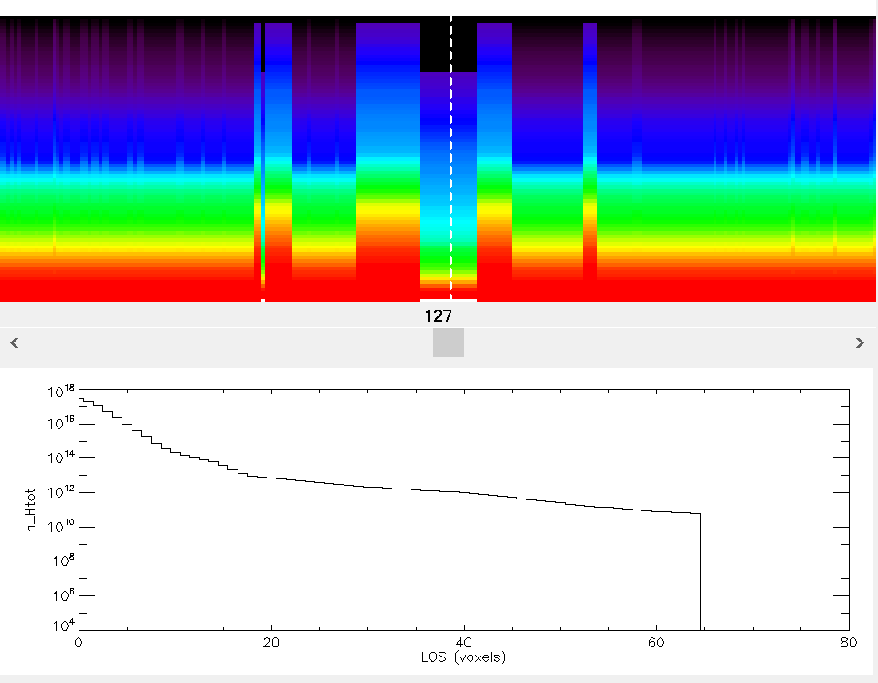
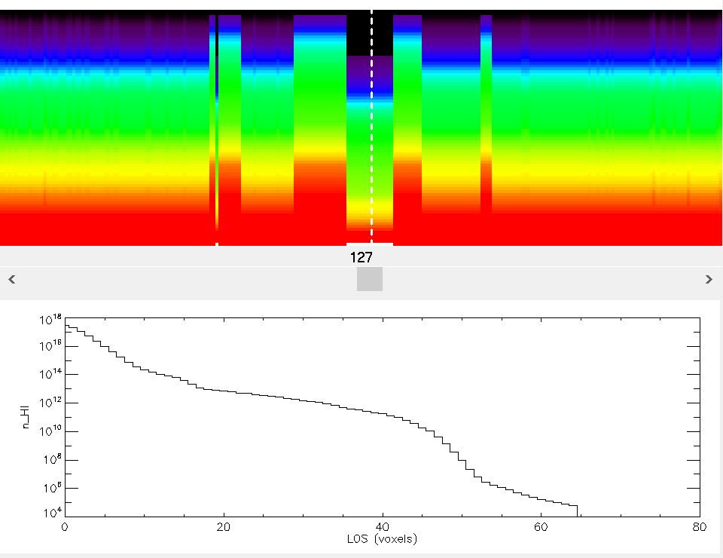
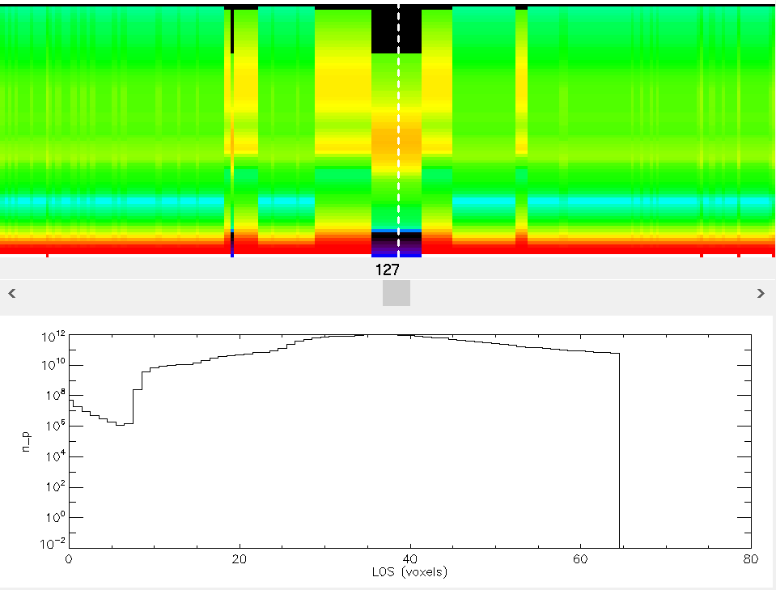
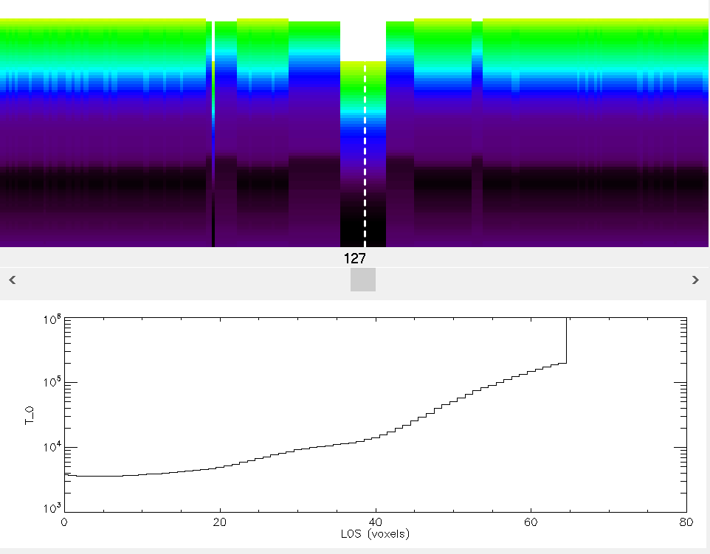
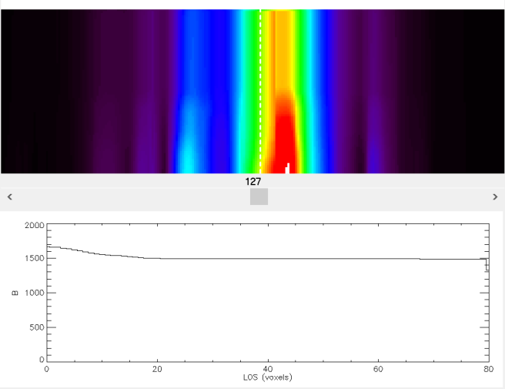
Chromo Model Vertical Slices
Voxel Height
Total Hydrogen Density
Neutral Hydrogen Density
Proton Density
Temperature
Magnetic Field

Slide 10
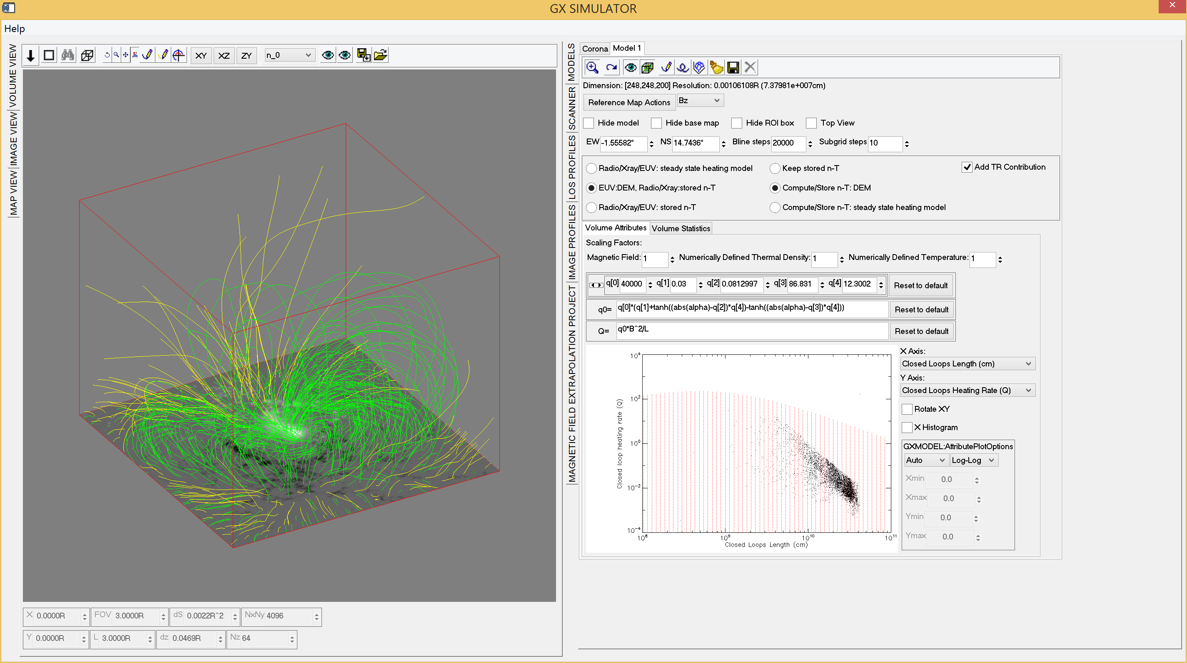
GX Simulator Coronal Model Project Page
Q(x,y,z)=Q(Bmed, L, alpha)→DEM(x,y,z)

Slide 11
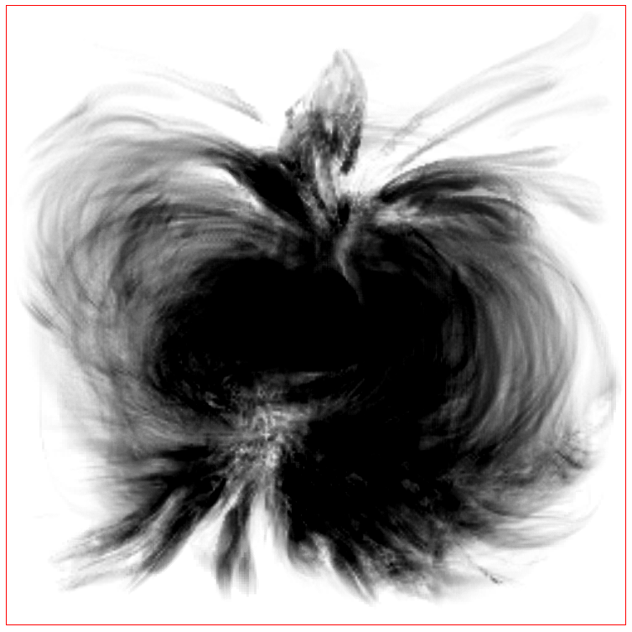
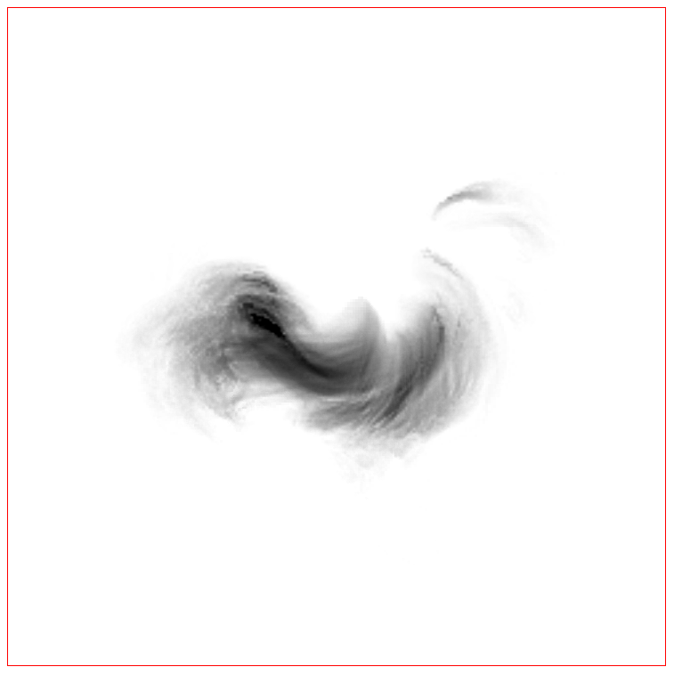

Interactively Defined Heating Rate
$$Q\left(x,y,z\right)=Q_{0}\left(α\right)B^{2}L^{−1}$$
$$Q_{0}\left(α\right)=q_{0} \left\{q_{1}+q_{4}\left[\begin{aligned}+tanh\left(\left|α\right|−q_{2}\right) \\ −tanh\left(\left|α\right|−q_{3}\right)\end{aligned}\right]\right\}$$
Closed Magnetic Field Lines alpha
Closed Loop Heating Rate

Slide 12
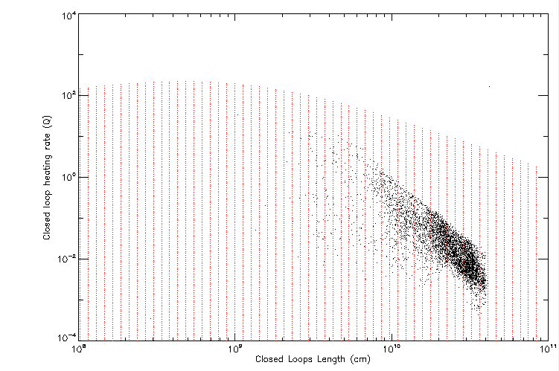
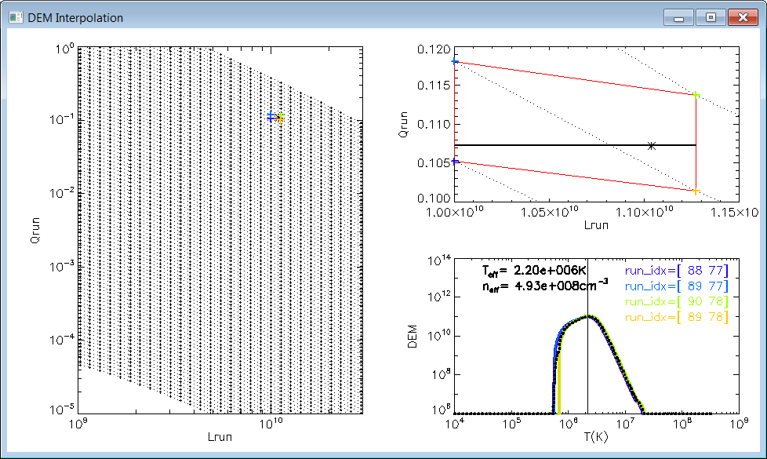
DEM Interpolation
(EBTEL runs- Klimchuk et al. 2008)

Slide 13
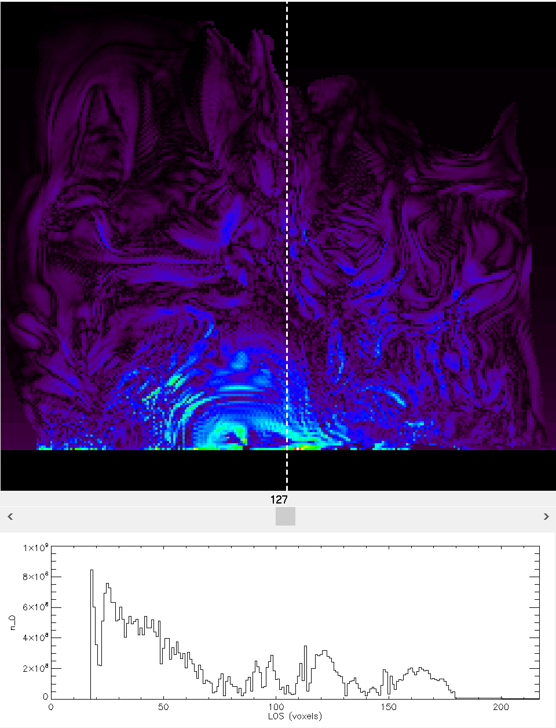
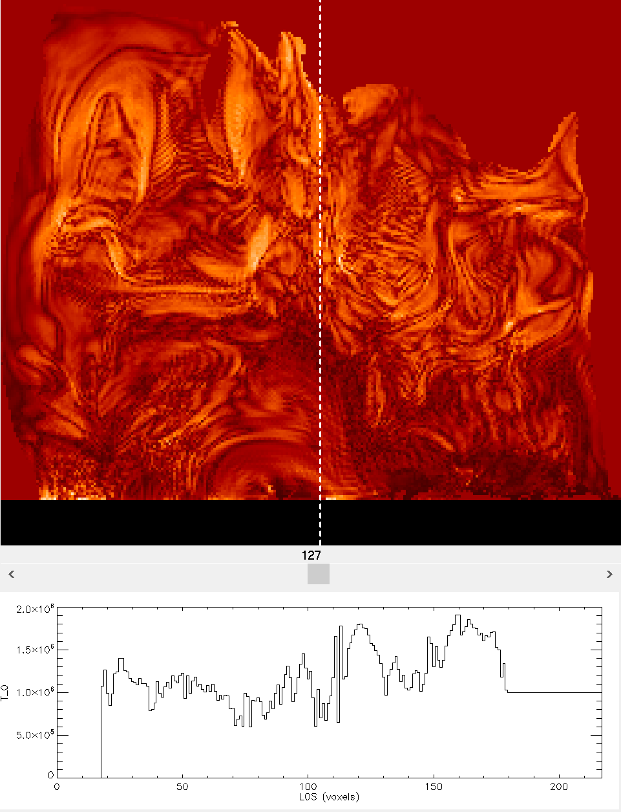
Density and Temperature Derived from DEM Moments
Density Slice
Temperature Slice

Slide 14
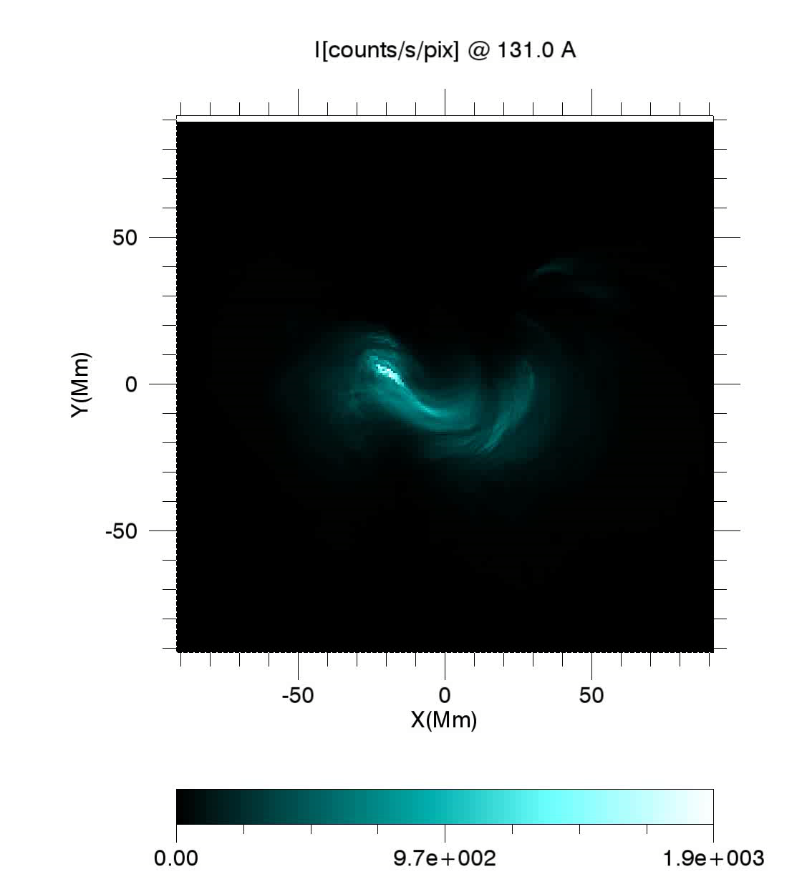
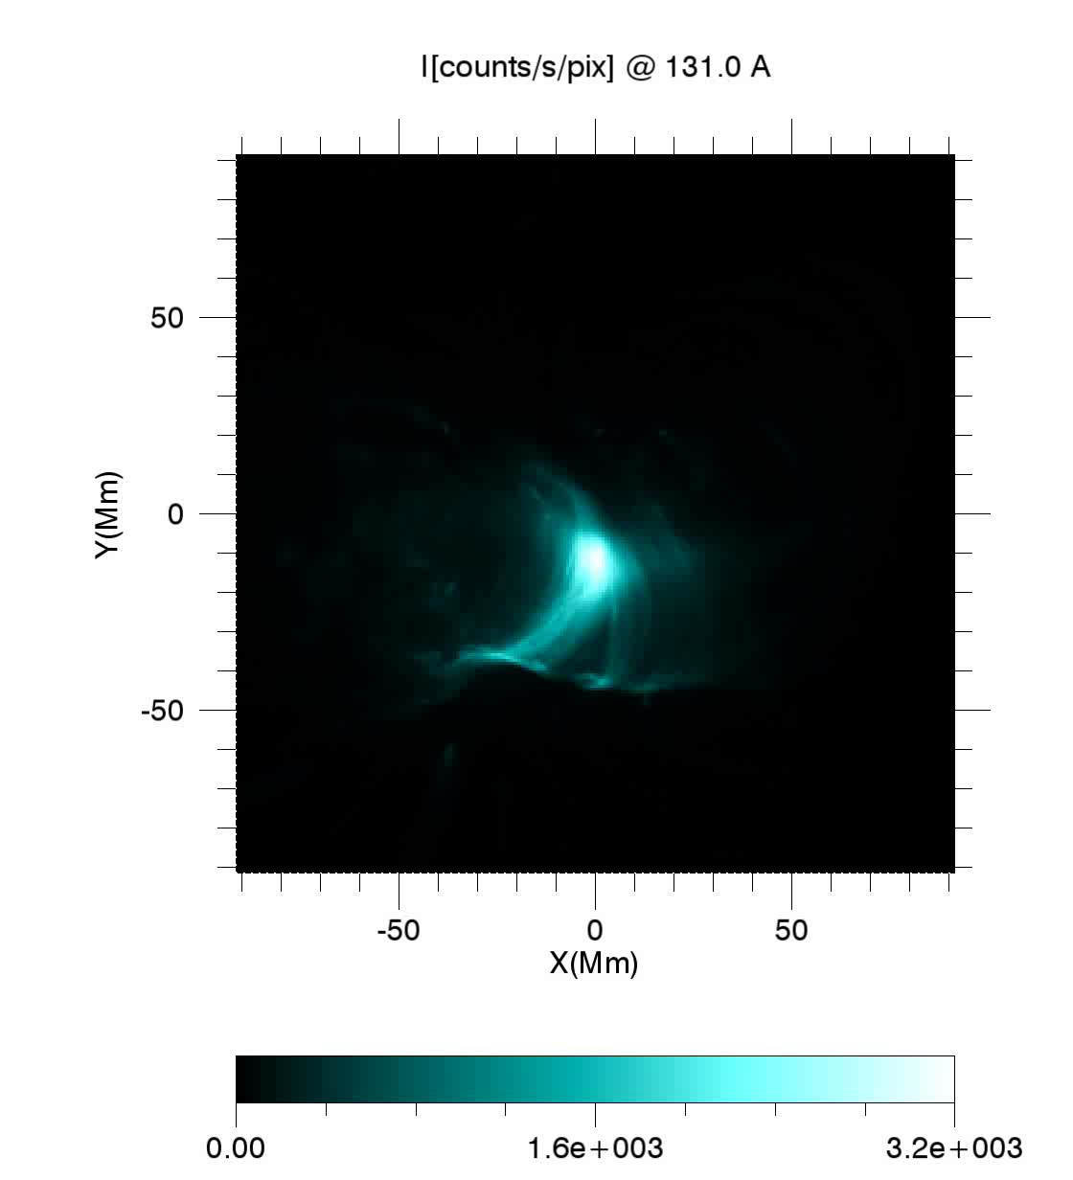
Synthetic EUV/AIA Maps

Slide 15
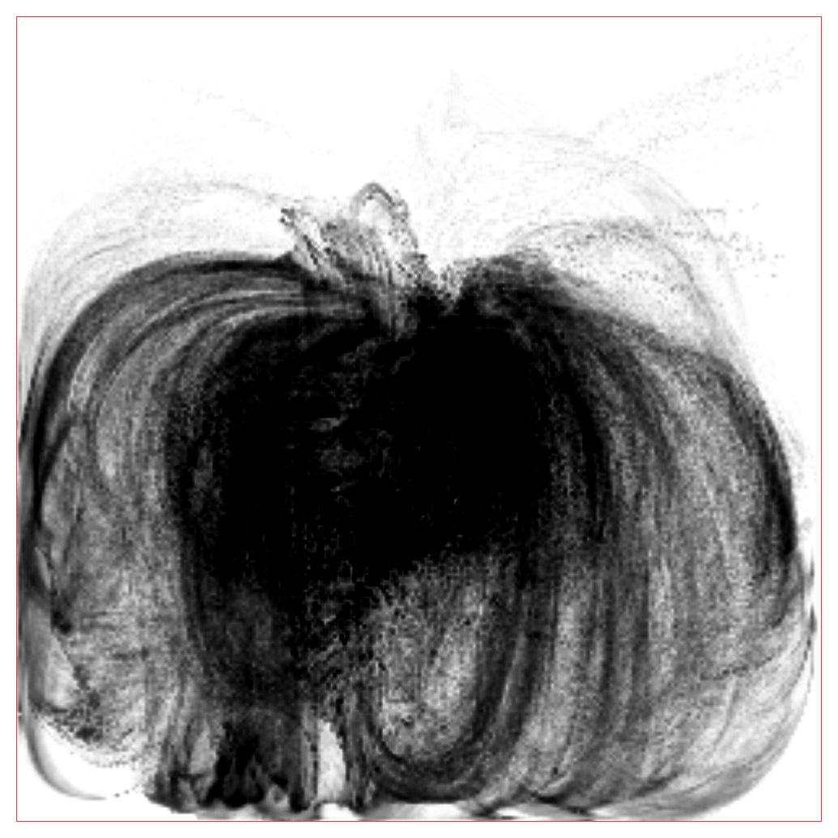
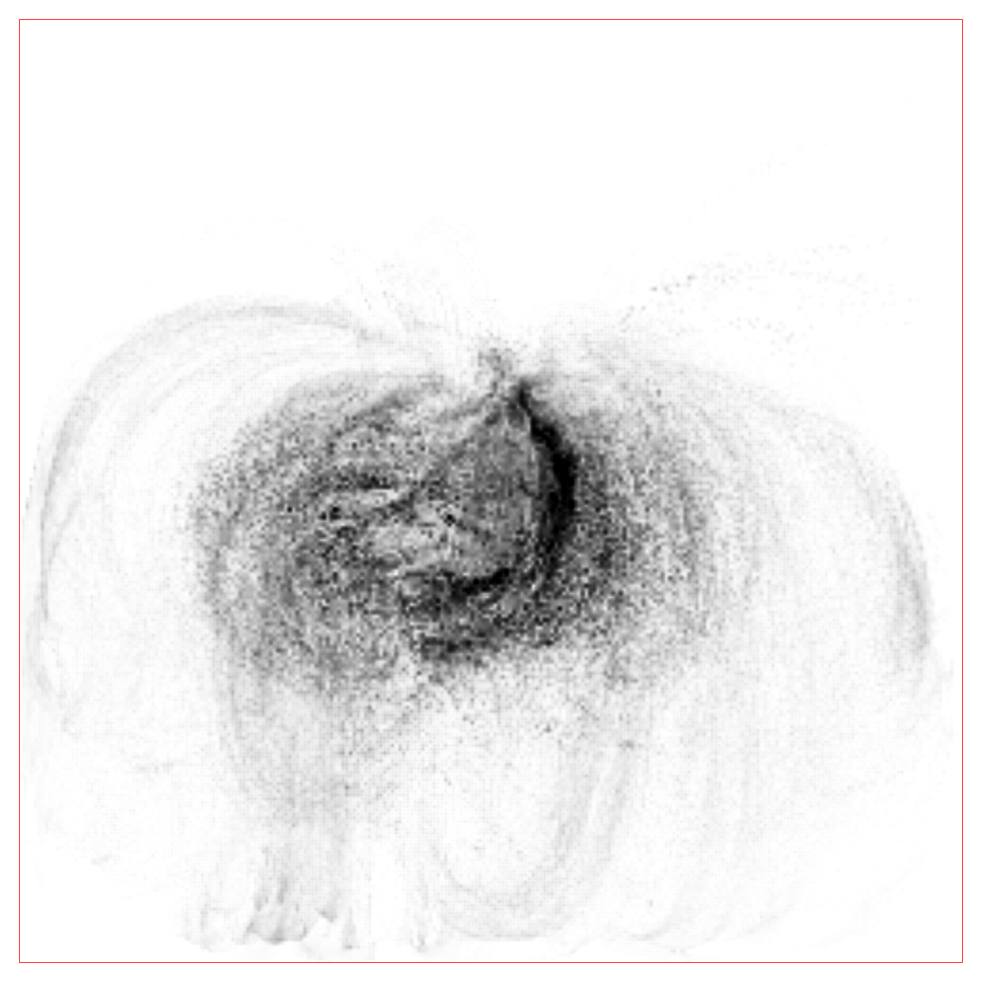
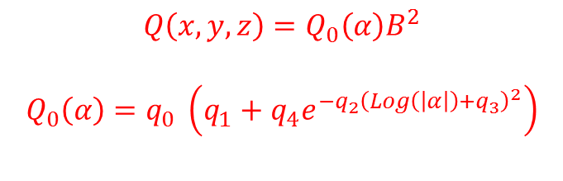
Alternative Heating Function
$$Q\left(x,y,z\right)=Q_{0}\left(α\right)B^{2}$$
$$Q_{0}\left(α\right)=q_{0} \left(q_{1}+q_{4}e^{−{q_{2}\left(Log\left(\left|α\right|\right)+q_{3}\right)}^{2}}\right)$$
Closed Magnetic Field Lines alpha
Closed Loop Heating Rate

Slide 16
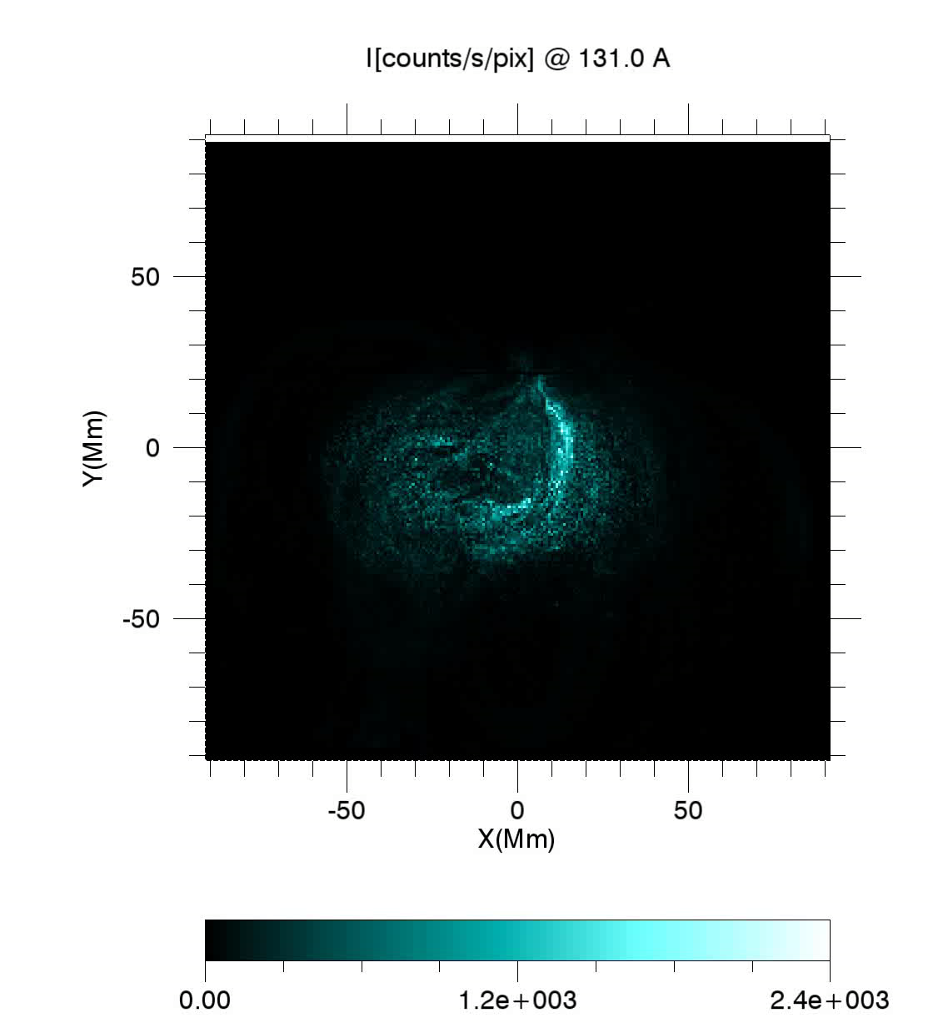
Synthetic EUV/AIA Maps
(Alternative Heating Function)

Slide 17
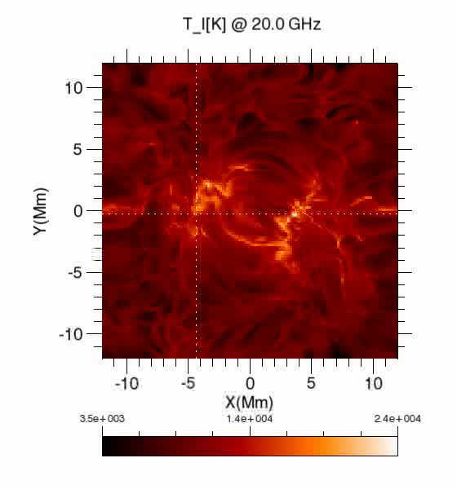
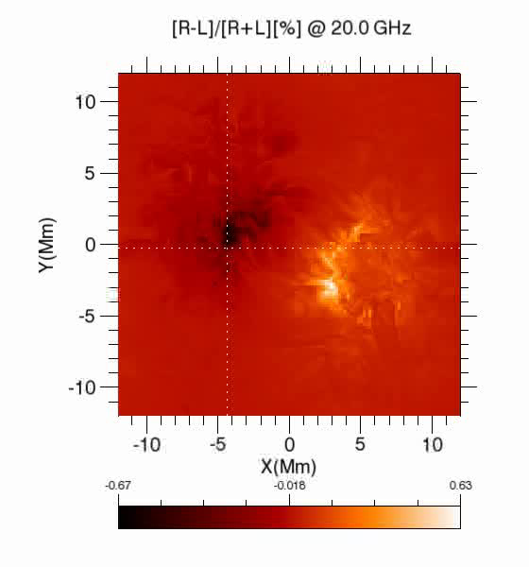
User Defined Density and Temperature Models
BIFROST MODEL

Slide 18
Thank you

