Slide 1
New enhancements of the GX Simulator:
3D data-driven modeling of flaring loops and simulation of associated microwave and X-ray emission maps
G. Nita¹
G. Fleishman¹, A. Kuznetsov², E. Kontar³, D. Gary¹
¹New Jersey Institute of Technology, Physics, Newark- NJ, USA.
²Institute of Solar-Terrestrial Physics, Irkutsk, Russia.
³University of Glasgow, Astronomy, Glasgow, United Kingdom.

Slide 2
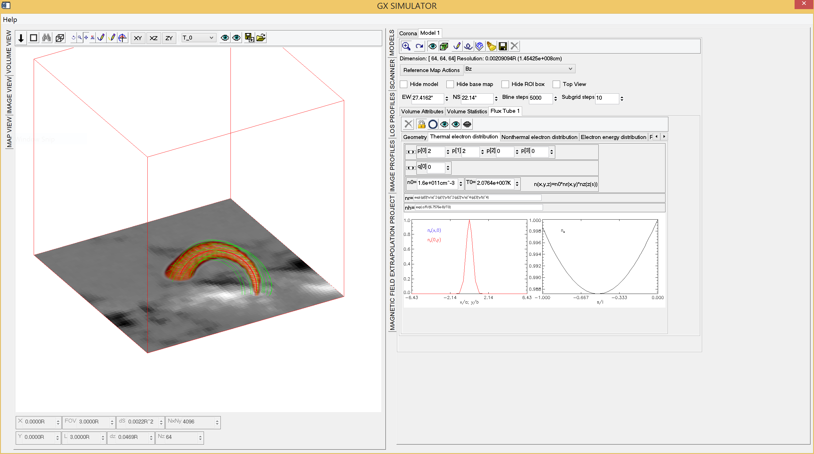
GX Simulator
3D Modeling SSW Package
(Nita et al. 2015, ApJ 799)
What’s new?
Version running on Windows, Unix and Mac platforms already available on SSW
Ability to import numerically defined chromospheric and coronal models
Integrated tools for generating data-driven chromospheric and coronal models (See my IUGG 4123 presentation on Friday for more details)
Generation of Microwave, EUV, and soft X-ray maps based on 3D models that may embed (still) analytical flaring loops models into numerical or analytical chromospheric and coronal models
A new upgrade of the SSW GX_Simulator package will be released on SSW before my GX Simulator lecture at the CESRA Summer School in Glasgow, August 24-28, 2015

Slide 3
Overview of Temporal and Spectral Observational Data
April 12 2002 17:41 UT
Notes:
The vertical dashed lines in panel (c) demarcate the time range selected for the RHESSI spectral fit.

Slide 4
Overview of imaging Data
RHESSI 12-26 keV OVSA 2.8-5.6 GHz

Slide 5
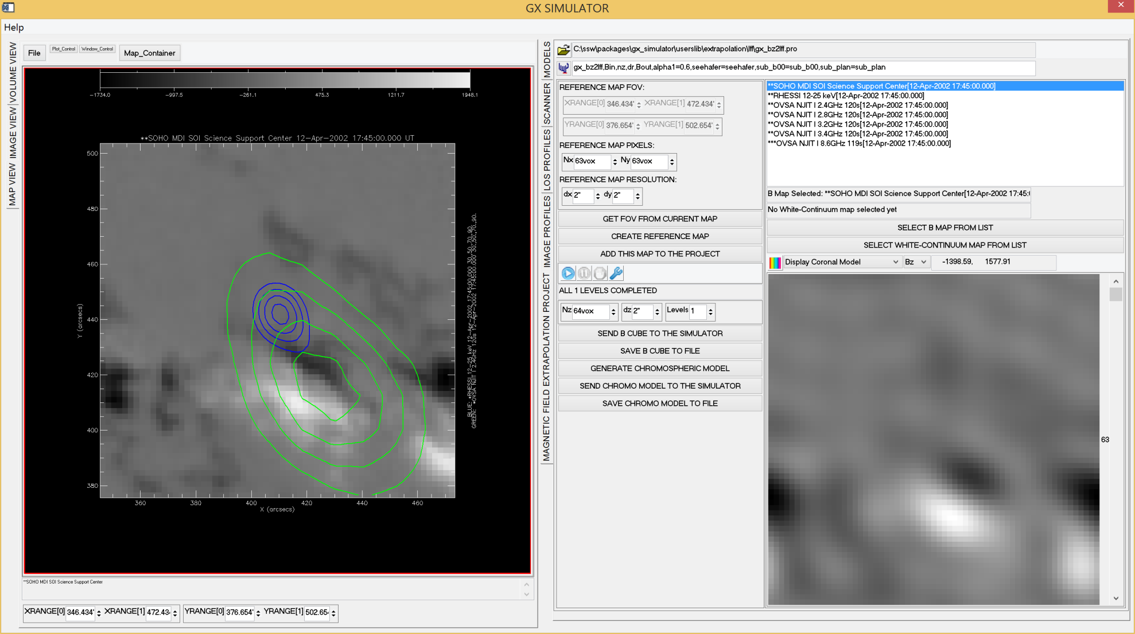

GX Magnetic Field PFE/LFFF Extrapolation Engine
LFFF
=$6.6×{10}^{−10}cm$

Slide 6
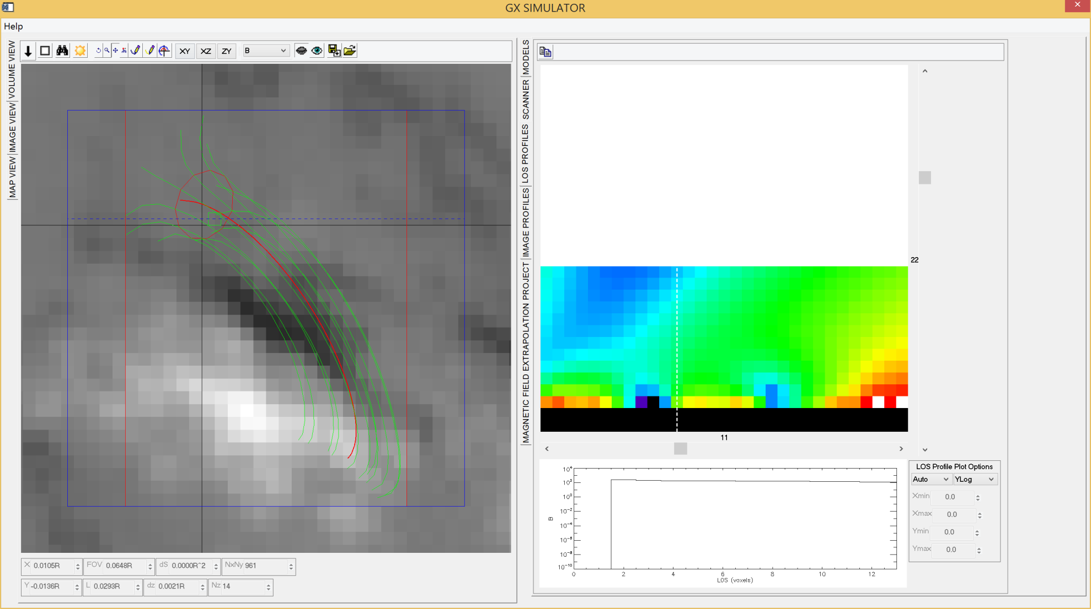
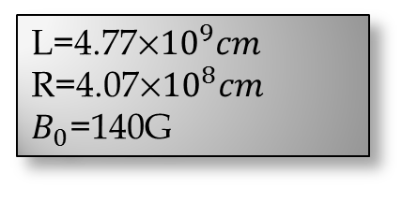
Magnetic Field Structure
SOHO-MDI
L=4.77${10}^{9}cm$
R=4.07${10}^{8}cm$
$B_{0}$=140G

Slide 7
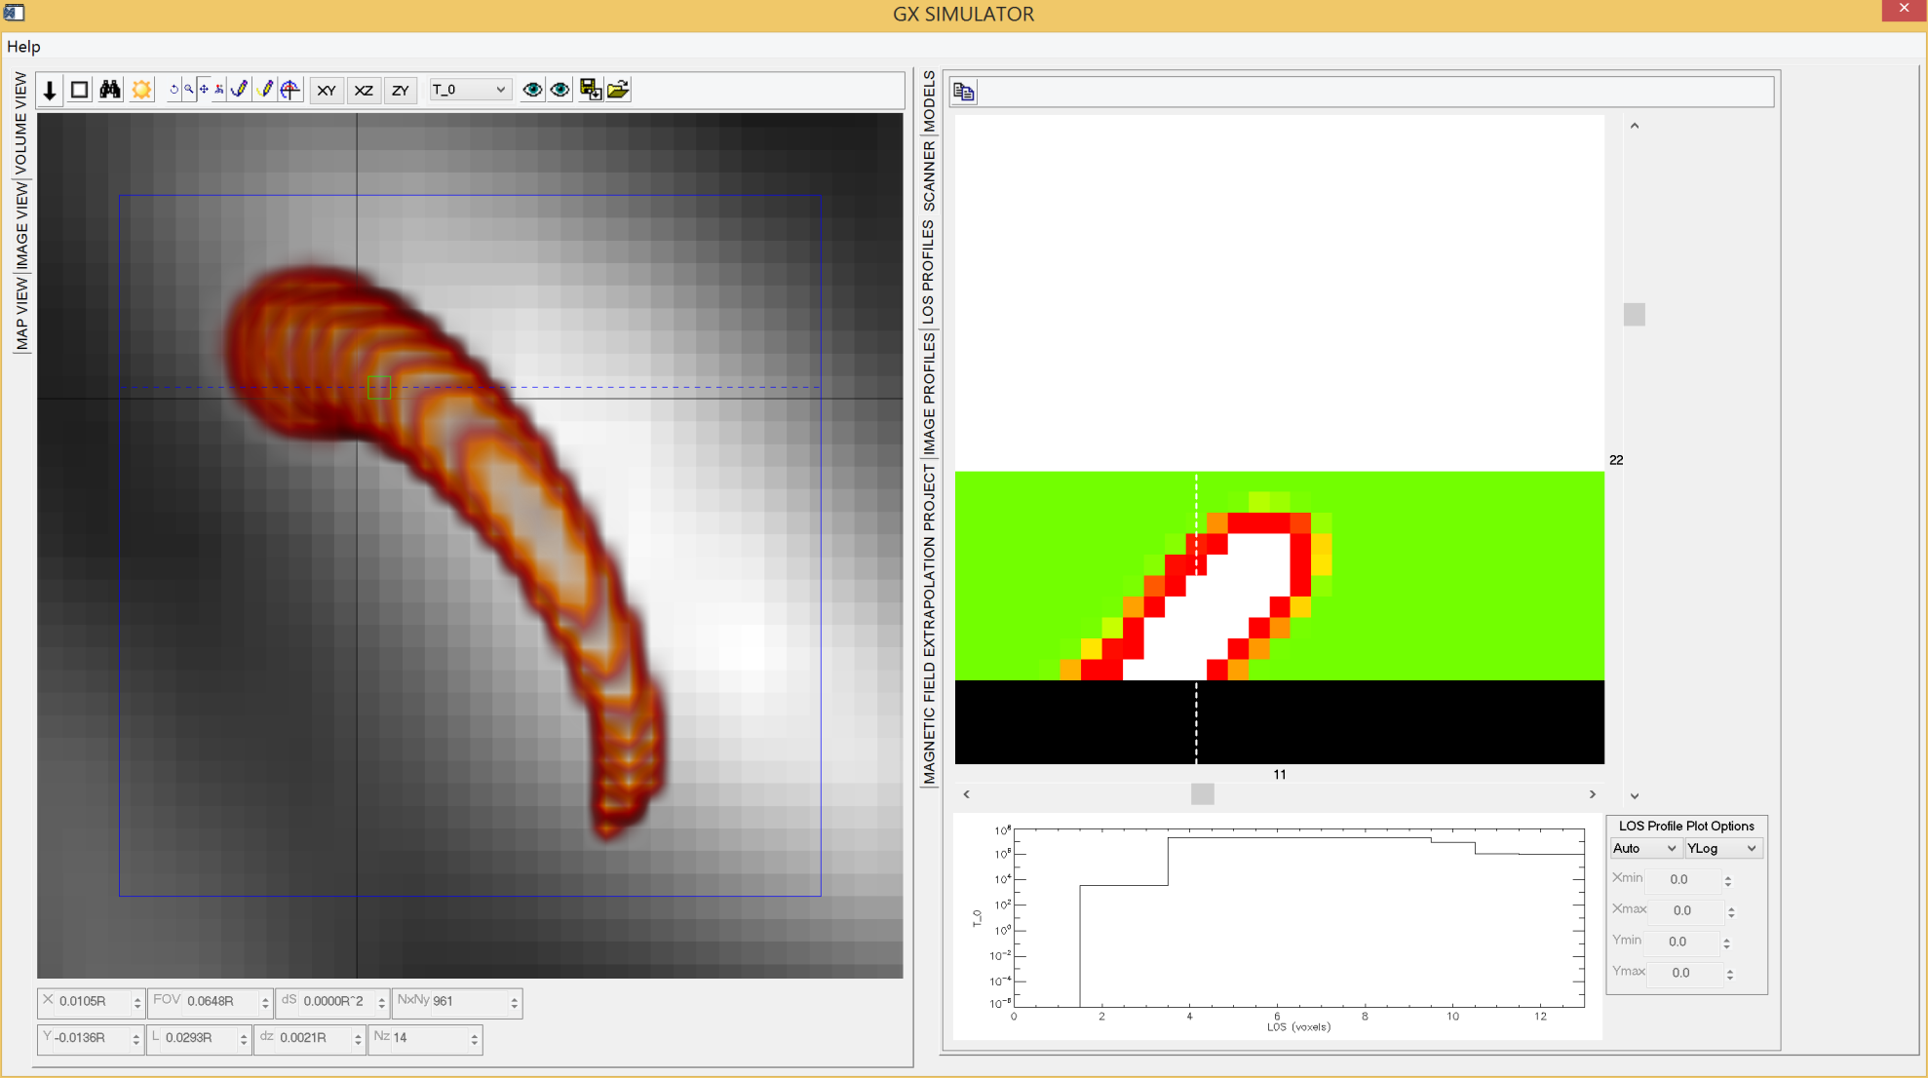
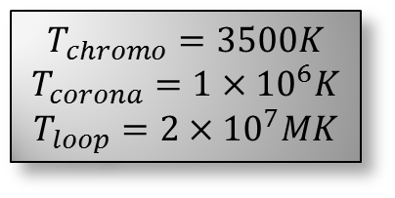
Temperature
$$T_{chromo}=3500K$$
$$T_{corona}=1×{10}^{6}K$$
$$T_{loop}=2×{10}^{7}MK$$
OVSA 2.8GHz

Slide 8
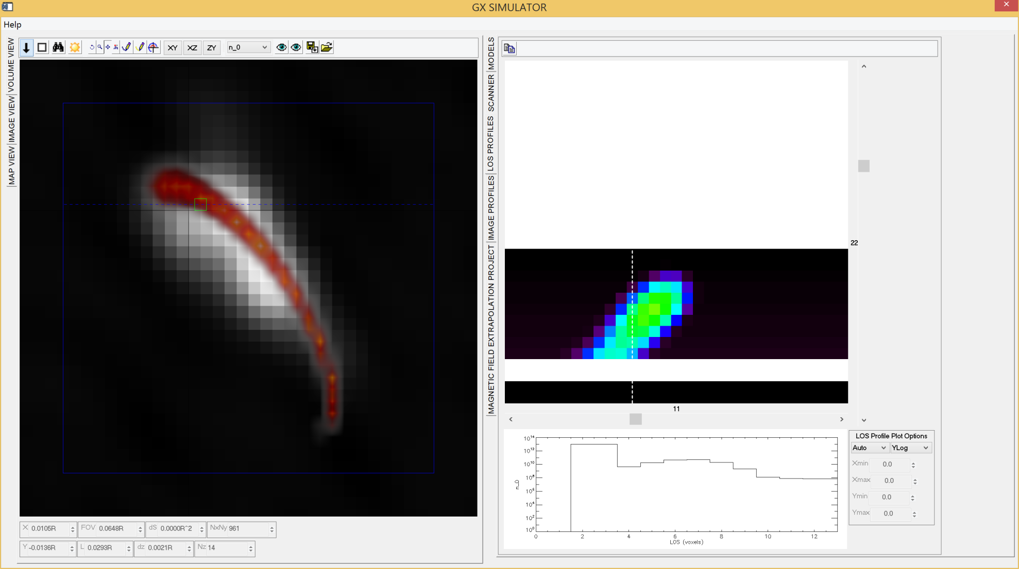
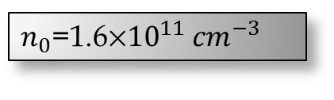
Thermal Electron Density
OVSA 8.6GHz
$n_{0}$=1.6${10}^{11}$ ${cm}^{−3}$

Slide 9
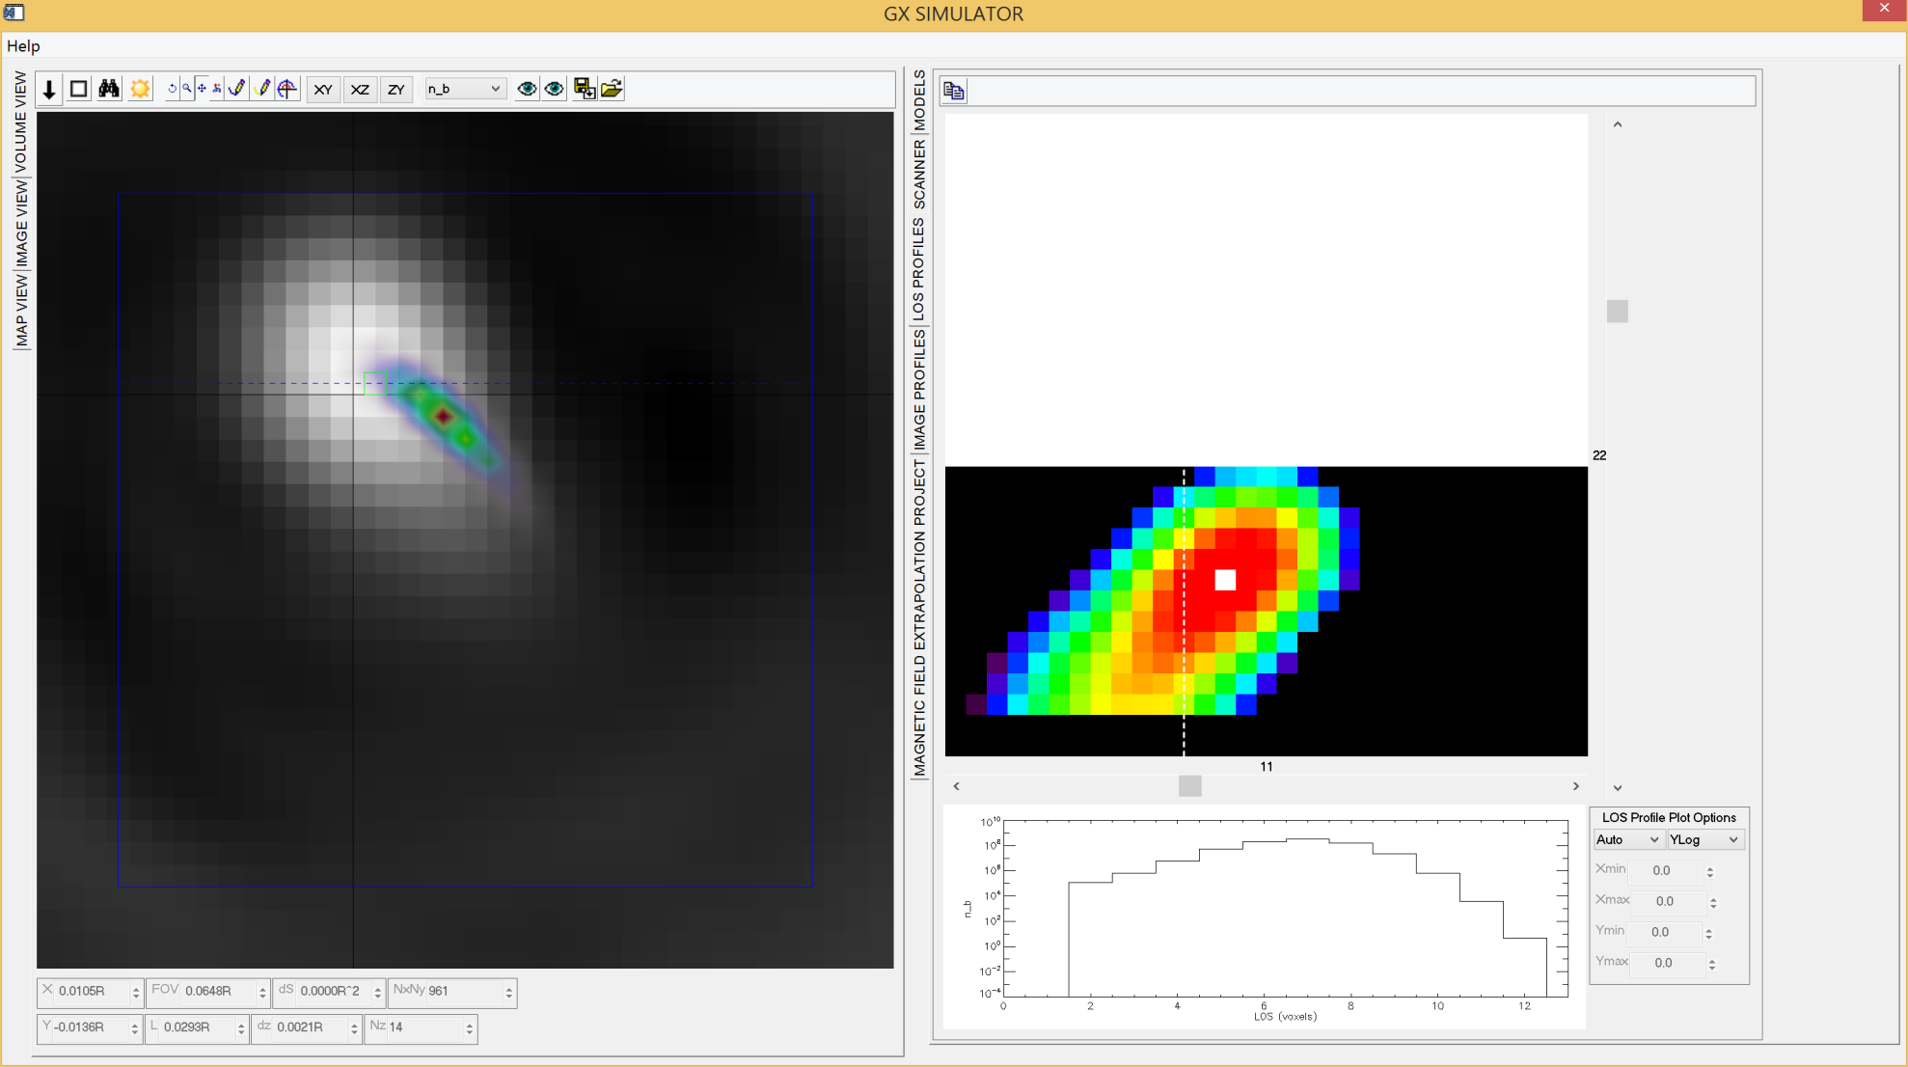
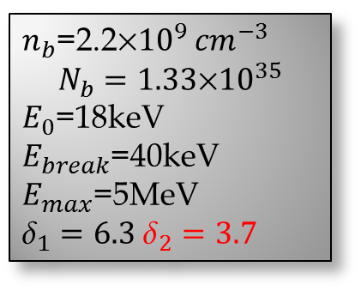
Nonthermal Electron Density and Energy Distributions
$n_{b}$=2.2${10}^{9}$ ${cm}^{−3}$
$$N_{b}=1.33\text{×}{10}^{35}$$
$E_{0}$=18keV
$E_{break}$=40keV
$E_{max}$=5MeV ${\text{}}_{1}=6.3 {\text{δ}}_{2}=3.7$
RHESSI 12-25 MeV

Slide 10
Models to Observed Spectrum Comparison
Notes:
Comparison of the \mw\ spectra obtained by OVSA at the rise phase at 17:41:46~UT and the image-integrated synthetic spectra computed from the adopted 3D model loop with $a\approx 1.82\cdot10^8$~cm, \sout{thick} {\gff black} solid line{\gff, and from the same 3D model but assuming a smaller values of the high-energy cut-off in the electron spectrum, $E_{\max} = 1$~MeV, red solid line}, and two models with thicker loops: $a\approx 2.55\cdot10^8$~cm (dashed line) and $a\approx 3.64\cdot10^8$~cm (dotted line). The remarkable model-to-data agreement is apparent in case of the adopted model loop with $a\approx 1.82\cdot10^8$~cm. Thicker loops (with the same total number of the fast electrons and the same $EM$) produce excessive low-frequency emission. %Some excess of the data at the very low frequencies is due to a secondary source as often seen in the microwave spectra \citep{Nita_etal_2004}.{\gff Right: a similar model-to-data comparison but for the peak phase of the event. The red solid curve is produced for the adopted model (Table~\ref{table:2}); other curves give some idea about uncertainties of the model parameters.

Slide 11
X-ray 15keV model on
RHESSI 12-25 keV
OVSA image at 5.6 GHz on microwave 5.6 GHz model
X-ray 15keV model on
microwave 5.6GHz model
RHESSI 12-25keV on OVSA 5.6 GHz

Slide 12
Conclusions
3D modeling along with additional MW imaging and spectral data help to much better constrain the source model.
3D modeling confirms that the relatively displaced HXR and MW emissions are produced by co-spatial electron distributions.
MW-producing electron energy distribution is substantially harder than the HXR-producing ones.
In addition, by comparing rise and peak time models (not detailed here), we found that the fast electron spatial distribution width increases with time as the flare progresses.

