Slide 1
Microwave Imaging Spectroscopy:
Dynamic Measurement of Electron Acceleration and Coronal Magnetic Fields in Solar Flares
Dale E. Gary, Gregory D. Fleishman, Gelu M. Nita, Bin Chen, Natsuha Kuroda
Center for Solar-Terrestrial Research
New Jersey Institute of Technology

Slide 2
Outline
Solar Flare Energy Release and Particle Acceleration
Expanded Owens Valley Solar Array (EOVSA)
  EOVSA Instrument
  EOVSA View of 2017 Sep 10 Event
  Overview of EOVSA Imaging Spectroscopy Method
Implications of microwave spectroscopy for particle acceleration in the “standard model”
  Erupting flux rope and reconnecting current sheet
  Main phase and magnetic field decay
  Implications of the decay for particle acceleration
  Dynamic evolution of energy release

Slide 3
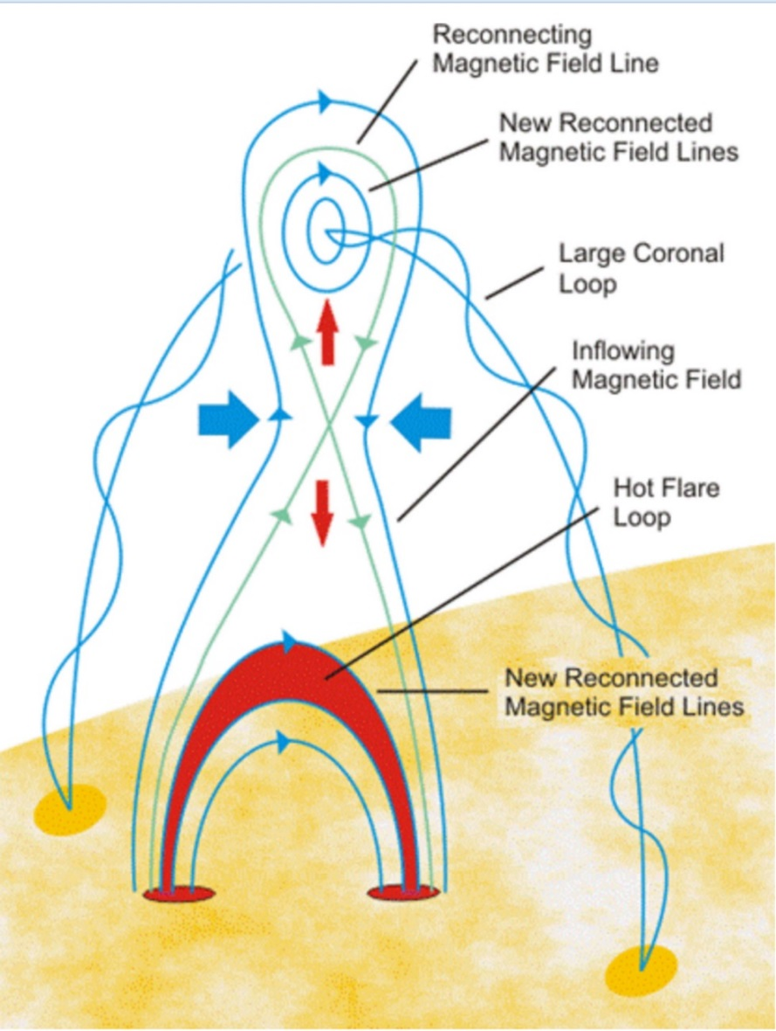
Solar Magnetic Free Energy
The energy to power solar flares comes from stored magnetic energy in the form of non-potential field (due to currents flowing in the highly-conductive coronal volume).
Somehow, this stored energy can be released in a very short time (seconds or minutes), which requires some anomalous resistivity (enhanced magnetic diffusion).
In the standard solar flare model, the location of this enhanced diffusion is placed at an x-type neutral point behind a rising flux rope, where “magnetic reconnection” takes place, but that is too slow and involves too small a volume.
An enhancement to the model is to consider lots of such neutral points in a “current sheet,” where many small islands are formed.
This can increase the volume where conversion of free magnetic energy takes place, and vastly increases the rate of energy release.
Standard Solar Flare Model

Slide 4
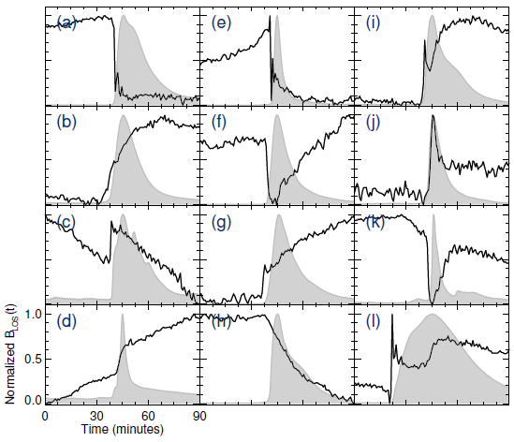
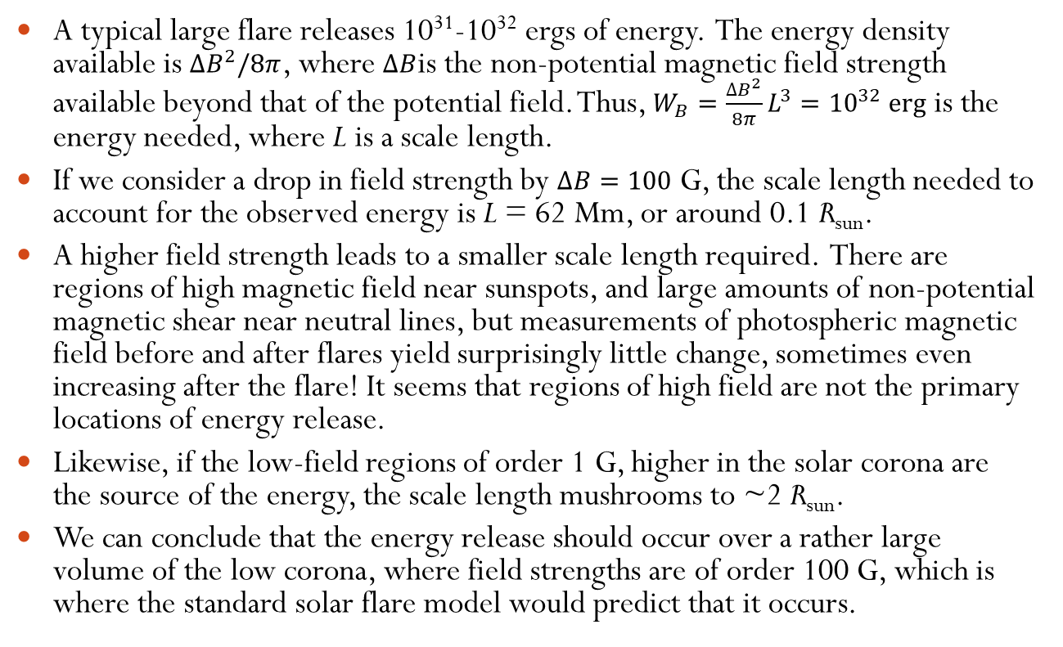
Estimate of Energy Release Scale Length
A typical large flare releases 10³¹-10³² ergs of energy. The energy density available is $∆B^{2}/8π$, where $∆B$is the non-potential magnetic field strength available beyond that of the potential field. Thus, $W_{B}=\frac{∆B^{2}}{8π}L^{3}={10}^{32} \text{erg}$ is the energy needed, where L is a scale length.
If we consider a drop in field strength by $∆B=100$ G, the scale length needed to account for the observed energy is L = 62 Mm, or around 0.1 R_{sun}.
A higher field strength leads to a smaller scale length required. There are regions of high magnetic field near sunspots, and large amounts of non-potential magnetic shear near neutral lines, but measurements of photospheric magnetic field before and after flares yield surprisingly little change, sometimes even increasing after the flare! It seems that regions of high field are not the primary locations of energy release.
Likewise, if the low-field regions of order 1 G, higher in the solar corona are the source of the energy, the scale length mushrooms to ~2 R_{sun}.
We can conclude that the energy release should occur over a rather large volume of the low corona, where field strengths are of order 100 G, which is where the standard solar flare model would predict that it occurs.
Durán, Kleint & Calvo-Mozo (2017)
The source of these strong coronal fields may indeed be the (slower) eruption of field from lower heights, but the energy release mainly occurs higher.

Slide 5
More Scale Length Considerations
Another scale-length-related issue comes from the total number of high-energy electrons required to explain the X-ray and radio emission from solar flares, ~10³⁵ s⁻¹ or more.
If the non-thermal particle density is as high as 10⁶ cm⁻³, this still requires a scale length of about 0.1 R_{sun}, to be drained in 10 s, although return currents may provide a way to replenish lost particles.
We can conclude that magnetic energy release and particle acceleration must take place in a large volume of the lower corona, and lead to a considerable reduction of magnetic field strength (~100 G) on the time scale of 10s of seconds.
In the standard flare model, the current sheet alone seems insufficient to provide the needed energy and the needed volume.
With EOVSA microwave imaging spectroscopy, I will show that we finally have the ability to measure the coronal magnetic field strength dynamically during solar flares. What do we see?
I will describe the instrument and analysis procedures, show the results for a classic erupting flux rope limb flare (2017 Sep 10), and discuss the implications.

Slide 6
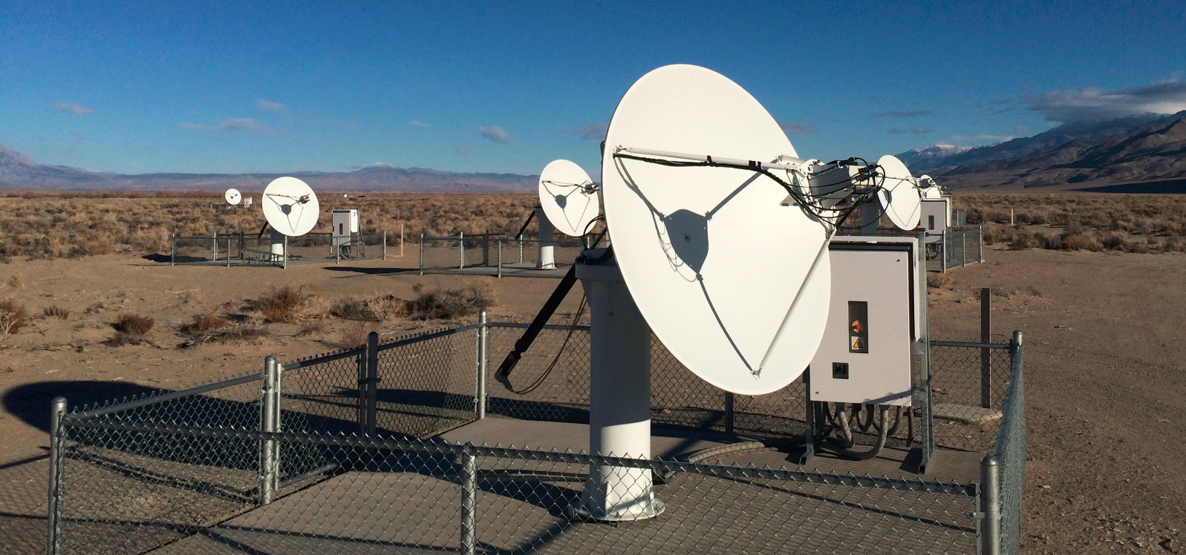
EOVSA—NJIT’s solar radio array
13-antenna interferometer array operating over frequency range 1-18 GHz
Provides dynamic (1 s) “imaging spectroscopy” (>100 frequencies)

Slide 7
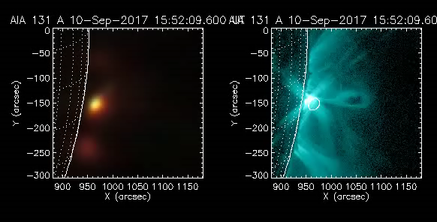
EOVSA “True-color” Movie of the Flare
2017-Sep-04 20:30 – 20:50 2017-Sep-10 16:54 – 16:08
“True color” movies, with contributions to R, G, B color planes, apportioned by frequency
  Red => low frequency
  Blue => high frequency

Slide 8
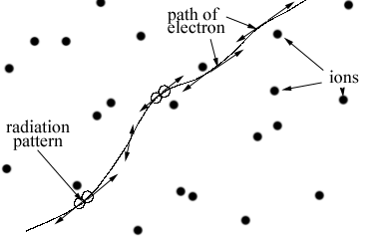
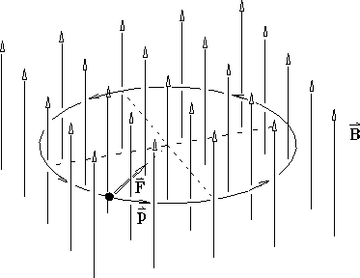
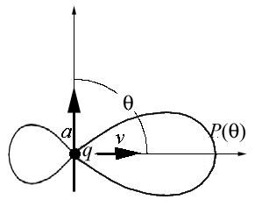
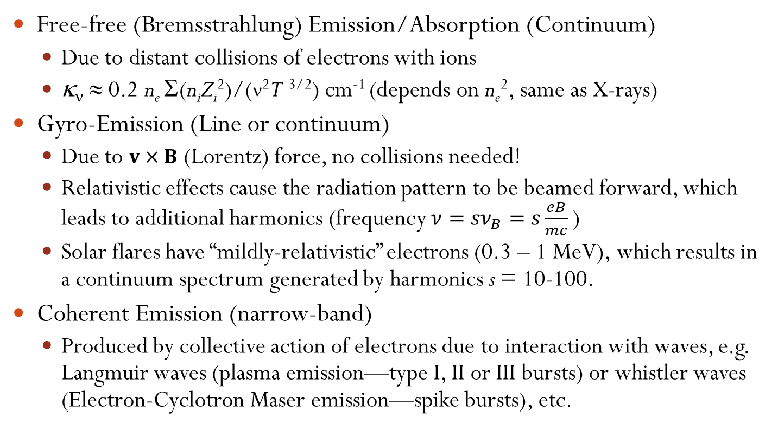
Radio Emission Mechanisms
Free-free (Bremsstrahlung) Emission/Absorption (Continuum)
  Due to distant collisions of electrons with ions
  κ_{ν} ≈ 0.2 n_{e} Σ(n_{i}Z_{i}²)/(ν²T ^{3/2}) cm⁻¹ (depends on n_{e}², same as X-rays)
Gyro-Emission (Line or continuum)
  Due to $v×B$ (Lorentz) force, no collisions needed!
  Relativistic effects cause the radiation pattern to be beamed forward, which leads to additional harmonics (frequency $ν={sν}_{B}=s\frac{eB}{mc}$)
  Solar flares have “mildly-relativistic” electrons (0.3 – 1 MeV), which results in a continuum spectrum generated by harmonics s = 10-100.
Coherent Emission (narrow-band)
  Produced by collective action of electrons due to interaction with waves, e.g. Langmuir waves (plasma emission—type I, II or III bursts) or whistler waves (Electron-Cyclotron Maser emission—spike bursts), etc.

Slide 9
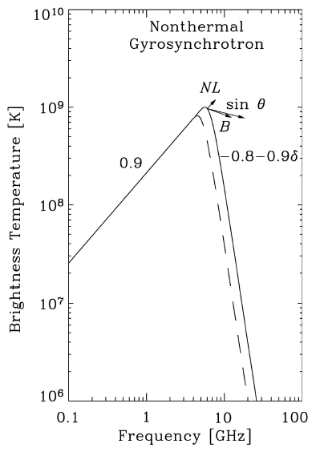
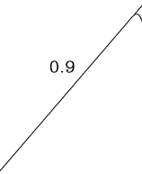

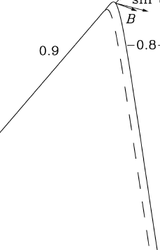
Diagnostics from the Gyrosynchrotron Spectrum
The peak frequency depends mainly on the magnetic field strength.
But slightly on the number density of the high-energy electrons.
The high-frequency (optically thin) slope of the MW spectrum constrains the power-law index of nonthermal electrons.
The low-frequency (optically thick) spectral range constrains the effective energy of radiating electrons.
The shape of low-frequency spectral region depends on the thermal plasma density (via Razin-effect and/or free-free contribution).
The shape of high-frequency spectral region depends on the high-energy cutoff (which is, however, rather poorly constrained in most cases).
Schematic shape of GS spectrum

Slide 10
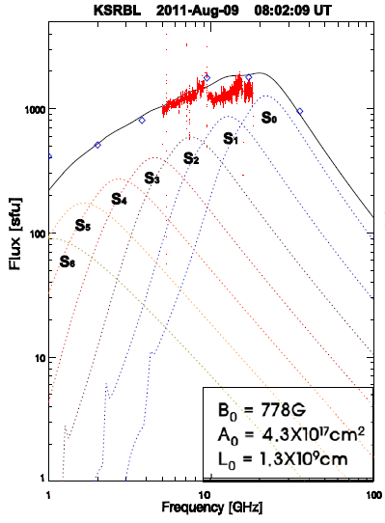
The Effect of Inhomogeneity
When spatial resolution is not available, the microwave spectrum is some unknown admixture of spectra from different parts of a potentially complex source.
This is particularly true of the 2017 Sep 10 event, as I will show in a moment.
In this case, the microwave spectrum largely loses its diagnostic potential, and the spectrum becomes broad and relatively flat, especially on the optically thick side, as shown in this example.
EOVSA for the first time provides spatially-resolved spectra, so that these multiple components can be separated.
Hwangbo et al. (2014)

Slide 11
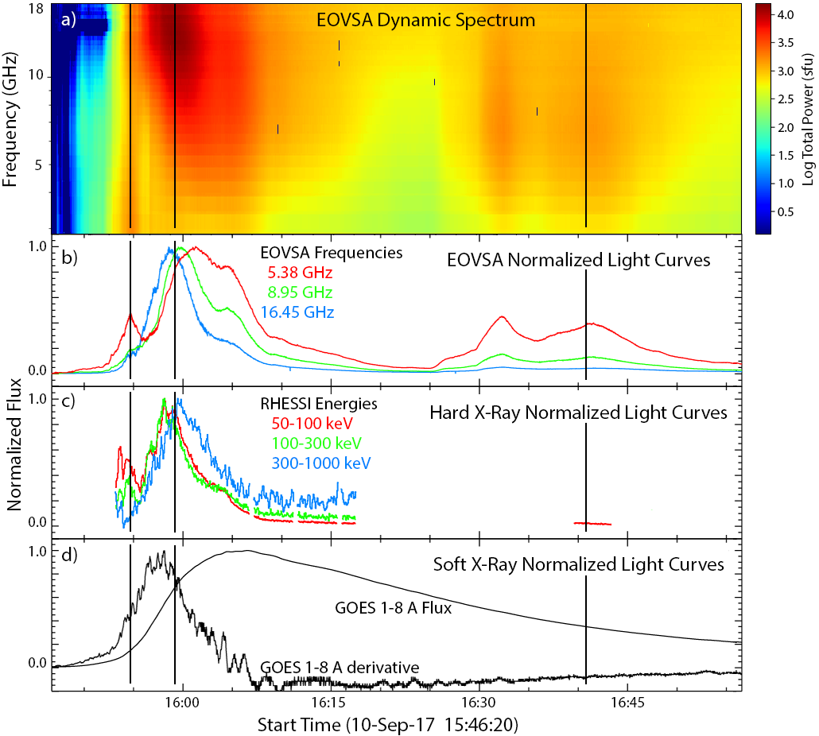
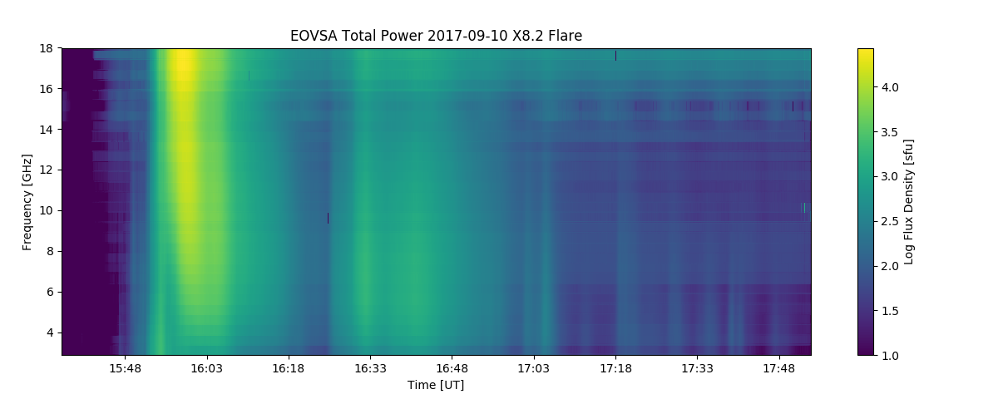
2017 Sep 10 Time Behavior
Can make images for every frequency-time bin in this dynamic spectrum!
Pulsations
The erupting flux rope coincides with a relatively minor peak that has a remarkably flat microwave spectrum.
The main peak occurs about 5-6 minutes later at high frequencies, with a rising spectrum throughout our frequency range. Peak T_{b} > 10⁹ K => bulk energies ~ 300 keV
The microwave peak is progressively delayed at lower frequencies.
Late in the event, a series of pulsations occur.

Slide 12
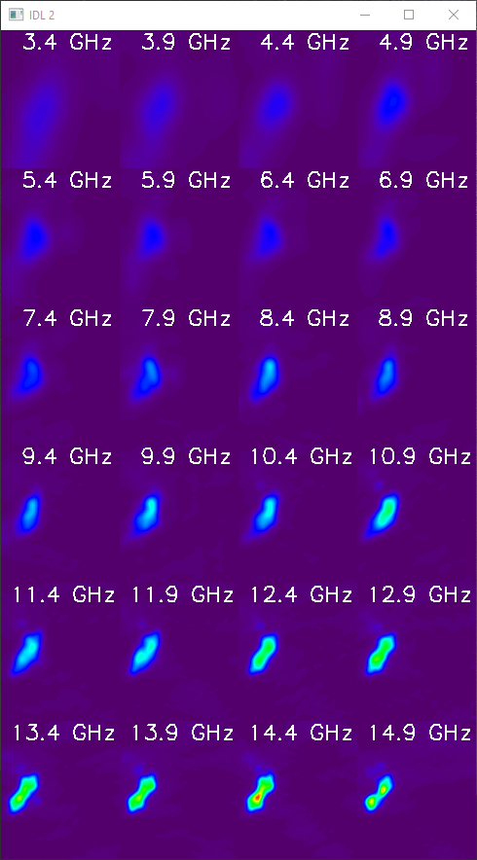
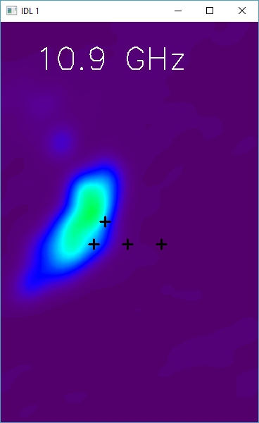
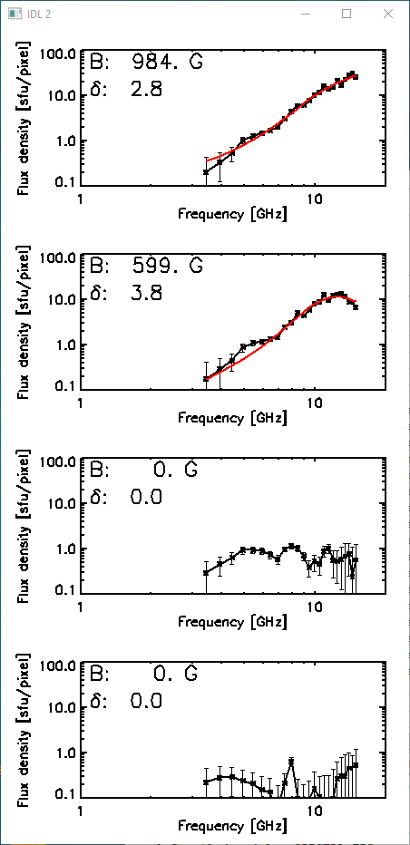
EOVSA Imaging Spectroscopy Method (15:57 UT)
Points with error bars are measured data.
Multi-parameter fits are red curves.
The two points highest in the corona have no fit (flux density too low)

Slide 13
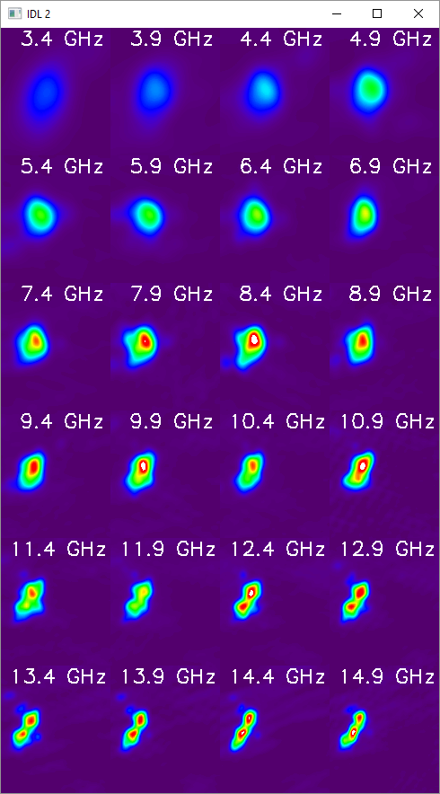
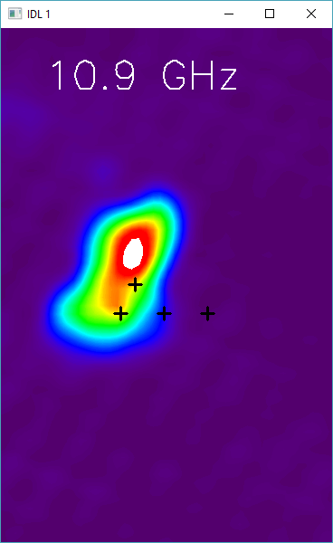
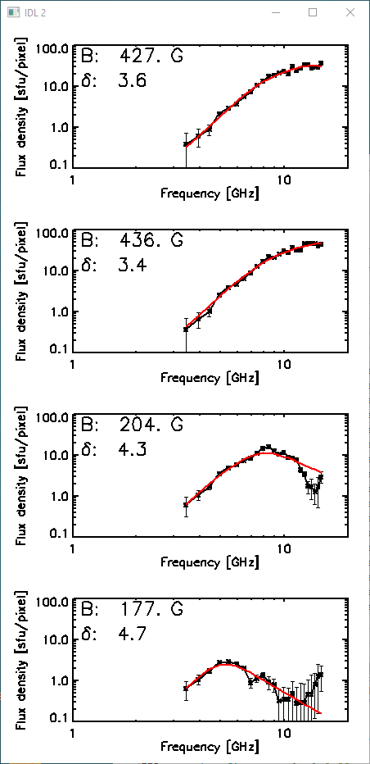
EOVSA Imaging Spectroscopy Method (15:59 UT)
As source grows outward, the highest two points have fitted spectra.
Magnetic field falls with height.
Electron spectral index is fairly uniform.

Slide 14
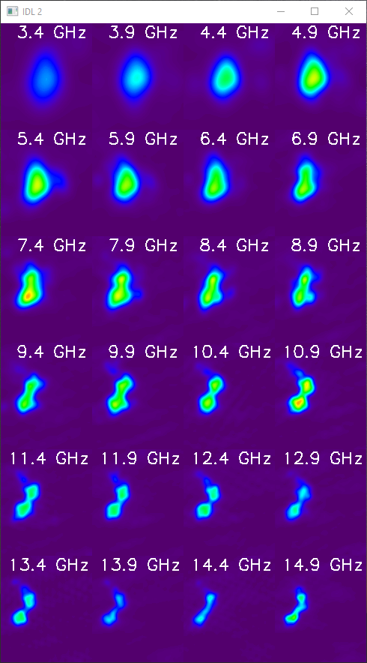
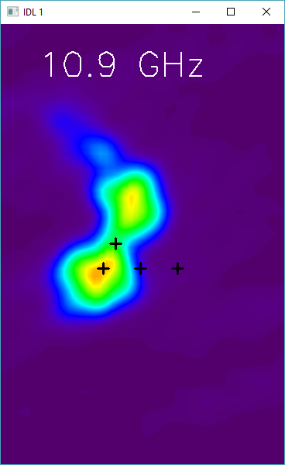
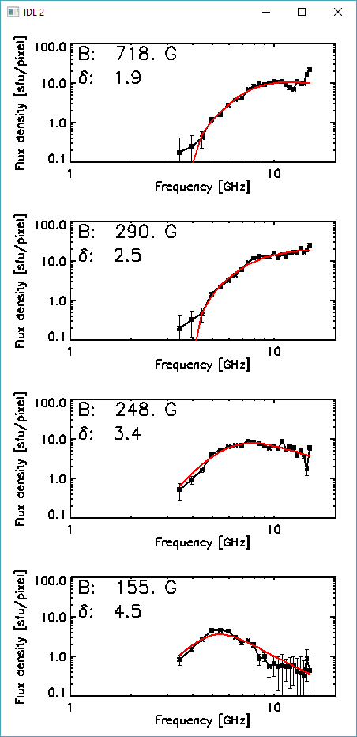
EOVSA Imaging Spectroscopy Method (16:01 UT)
Magnetic field values are fairly consistent with time.
Possible increase of electron spectral index at lower heights.
We can make parameter maps and movies over the entire emitting region.

Slide 15
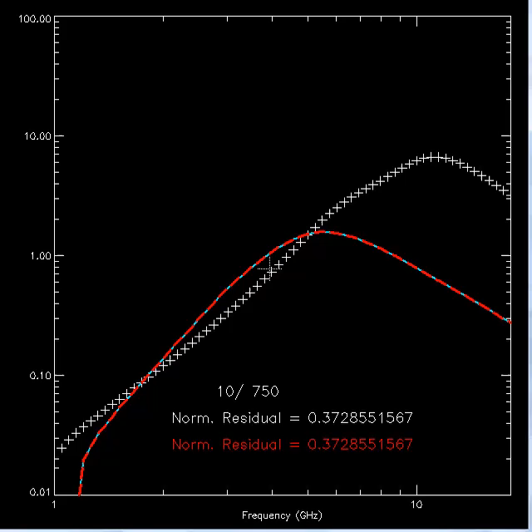
Fitting Algorithm
The fitting is done assuming a homogeneous source (i.e. the line-of-sight variation is ignored).
Many parameters can potentially be fit, or kept fixed. For these fits, we used 6 parameters:
  magnitude of B
  angle θ between the magnetic field vector and the line-of-sight
  thermal plasma density n_{th}
  nonthermal electron density n_{nth} above a preset low-energy cutoff E_{min}=20 keV
  power-law index δ
  high-energy cutoff E_{max}.
The latter three parameters are used to determine overall energy in nonthermal particles
The minimization employs the SIMPLEX method, with shaking, to guard against settling on a local minimum.
Every position and time is fit completely independently, so spatially or temporally smooth fits are an indication of stability of the process.

Slide 16
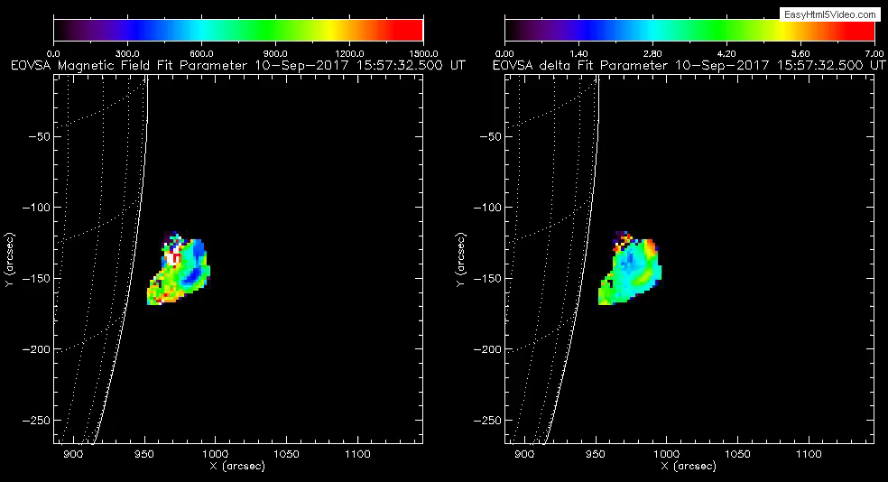
B Field (0-1500 G) and Electron Powerlaw Index (0-7)
Magnetic field falls with height – reasonable – and decays with time at a given height.
Electron powerlaw index gets smaller (harder) at low heights (rises with time), and larger (softer) at high heights.
I will give some quantitative results shortly.

Slide 17
Implications of the 2017 Sep 10 Event for Particle Acceleration in the Standard Model

Slide 18
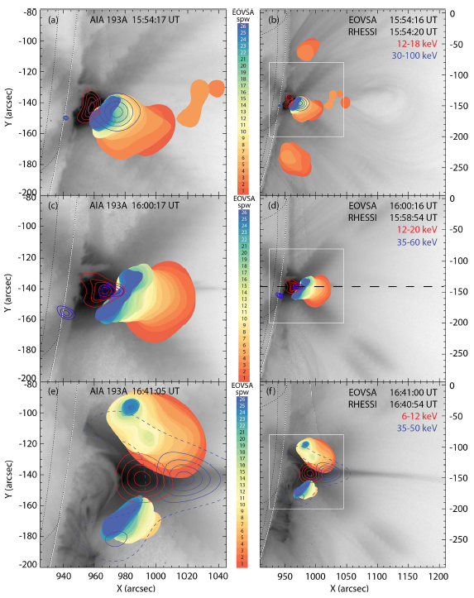
EOVSA/RHESSI Comparison
Early period, 15:54 UT, flux rope expansion:
  EOVSA shows main source above EUV loops, cospatial with nonthermal hard X-ray source.
  RHESSI thermal source is within EUV loops.
  EOVSA shows an extension of low-frequency emission along plasma sheet.
  Two low-frequency outlier sources appear briefly (about 2 min duration) to either side of main source.
Main phase, 16:00 UT:
  RHESSI thermal and nonthermal sources are within higher density cusp region, with nonthermal slightly higher.
  Only the main EOVSA source remains, slowly rising upward along with the EUV loops, at up to 30 km/s.
  High-frequency EOVSA source becomes loop-like, while lower frequencies extend higher along plasma sheet.
Later phase, 16:40 UT:
  EOVSA source is bifurcated to either side of the thickening plasma sheet.
  RHESSI source remains in the cusp region, with nonthermal source at somewhat lower energies than earlier.
(Gary et al. 2018)

Slide 19
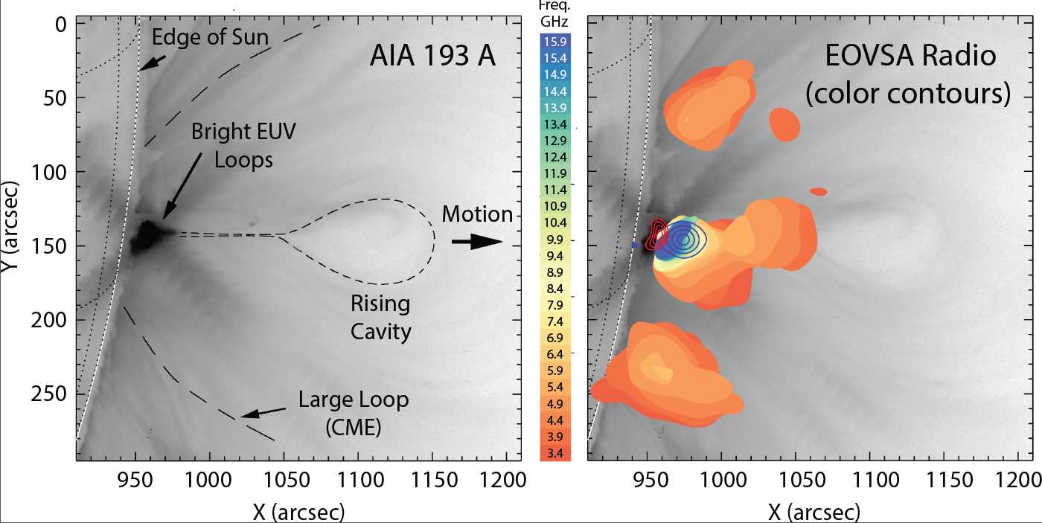
Initial Flux Rope Eruption and Standard Model
171-193-211 A
Fe IX-XII-XIV
6 x 10⁵ - 2 x 10⁶ K
Standard Solar Flare Model

Slide 20
Initial Flux Rope Eruption and Standard Model
171-193-211 A
Fe IX-XII-XIV
6 x 10⁵ - 2 x 10⁶ K
?
Breakout Reconnection?
Standard Solar Flare Model

Slide 21

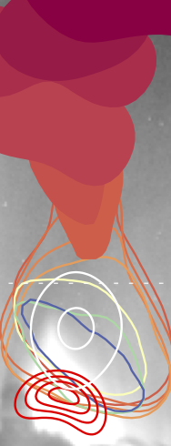
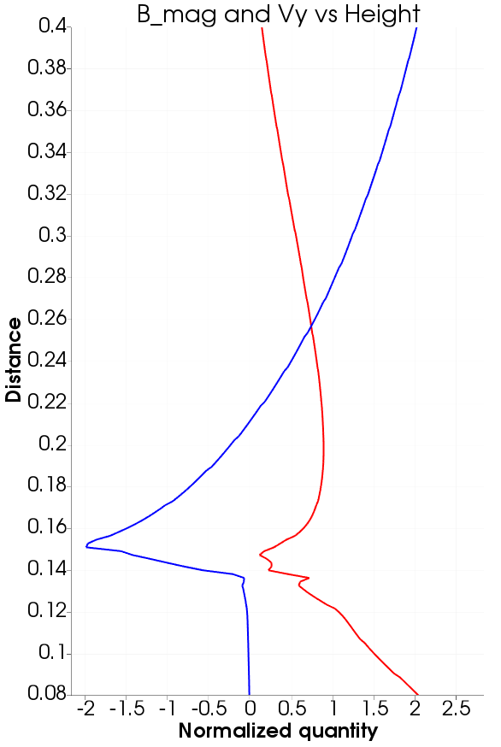
Bin Chen SHINE poster
(paper in preparation)
The derived B field distribution along the current sheet appears to agree with MHD predictions for upflow, downflow, looptop, and an interface region where high-speed downflows meet the dense flare loops
V_{y}
B Mag
V_{y}
Upflow
From Chen et al. 2015
x
x
x
Downflow
Interface region, shock?
Looptop
MHD simulation of standard eruptive flare by C. Shen
B (Gauss)
From MHD
From microwave spectra fitting

Slide 22
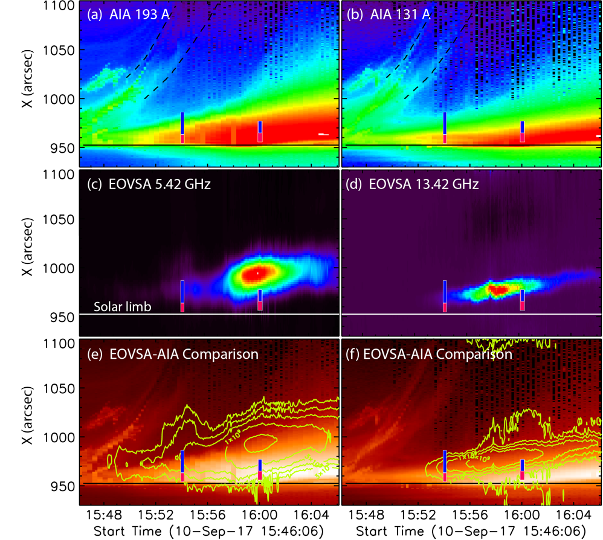
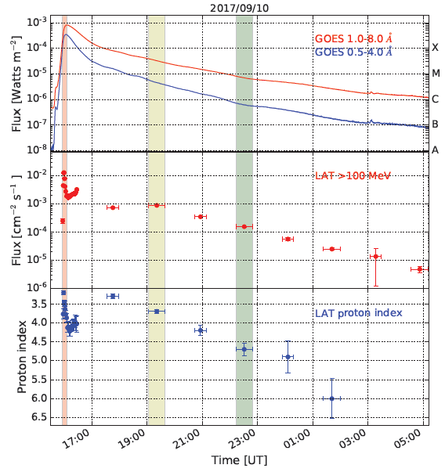
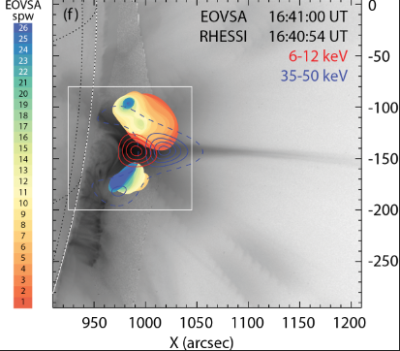
Continuous Acceleration
Height-time plot through peak 16:05 UT Acceleration through 16:41 UT >100 MeV γ-rays over 12 h (!)
(Gary et al. 2018) (Gary et al. 2018) (Omodei et al. 2018)

Slide 23
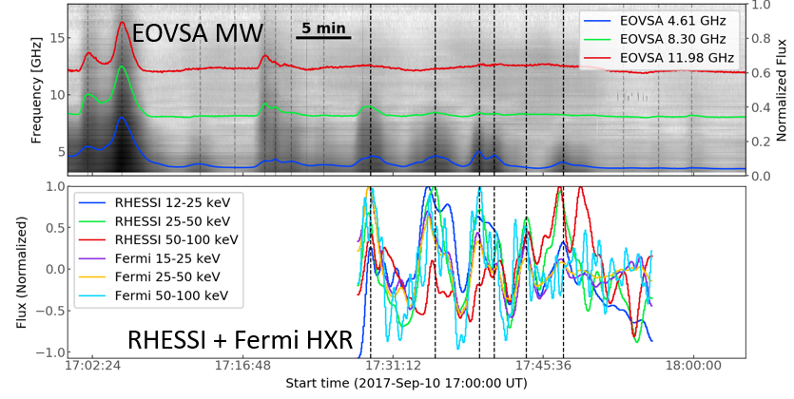
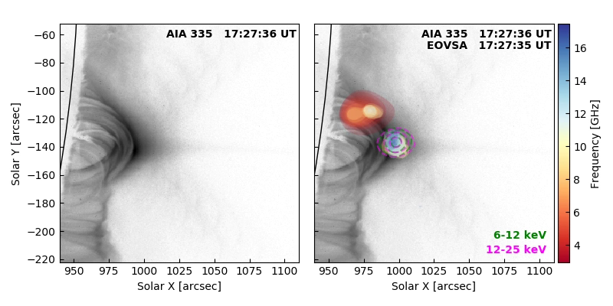
2017-SEP-10 Movie: 17:31 – 18:06 UT
Sijie Yu, paper in preparation

Slide 24
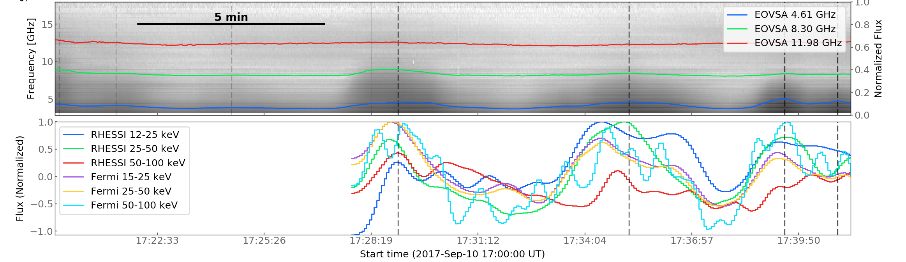
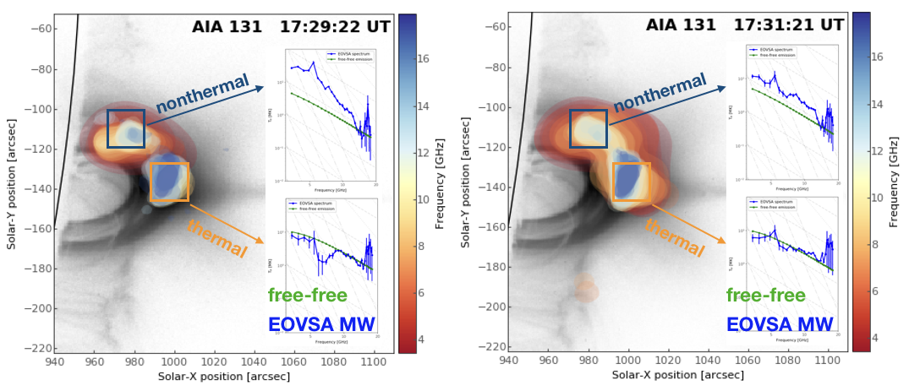
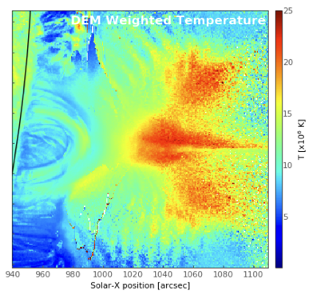
Thermal loop-top and nonthermal loop
DEM Weighted Temperature

Slide 25
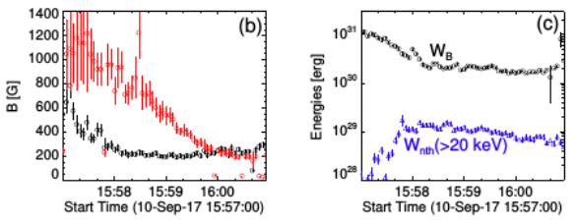
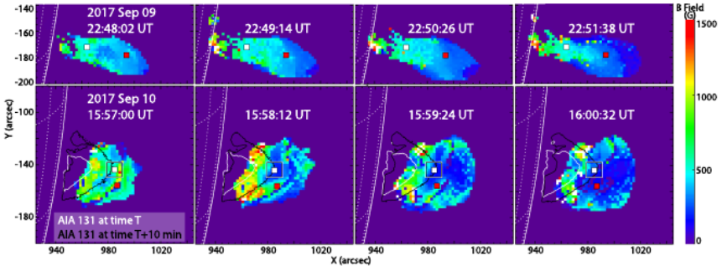
Quantitative Look at B Field and Changes
Decay rate of magnetic field at two representative pixels is about 5 G s⁻¹.
Decay ends at different times, possibly associated with closing of field to form new loops.
White contours show EUV loop emission at time of map.
Black contours show EUV loop emission 10-min later (accounts for cooling time).
5 G s⁻¹
(Fleishman et al., in prep.)
Four frames from the movie, 72 s apart

Slide 26
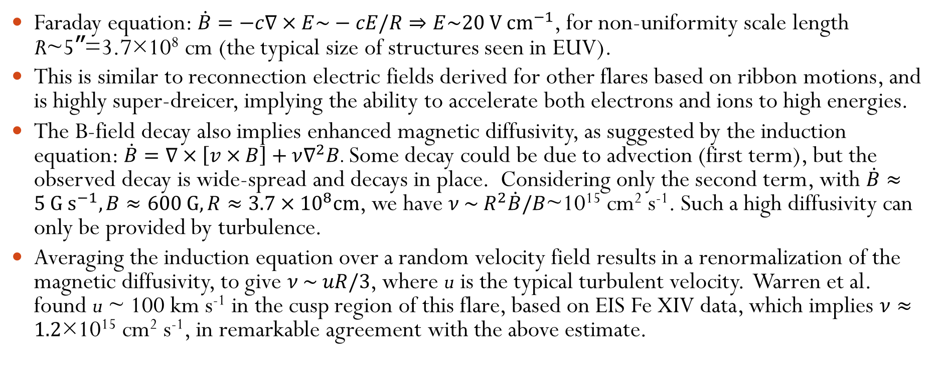
Quantitative Look at B Field Decay
Faraday equation: $\dot{B}=−c∇×E\sim −cE/R⇒E\sim 20 V {\text{cm}}^{−1}$, for non-uniformity scale length R~5ˮ=3.7×10⁸ cm (the typical size of structures seen in EUV).
This is similar to reconnection electric fields derived for other flares based on ribbon motions, and is highly super-dreicer, implying the ability to accelerate both electrons and ions to high energies.
The B-field decay also implies enhanced magnetic diffusivity, as suggested by the induction equation: $\dot{B}=∇×\left[v×B\right]+ν∇^{2}B$. Some decay could be due to advection (first term), but the observed decay is wide-spread and decays in place. Considering only the second term, with $\dot{B}≈5 {\text{G} \text{s}}^{−1}, B≈600 \text{G}, R≈3.7×{10}^{8}\text{cm}$, we have $ν \sim R^{2}\dot{B}/B$~10¹⁵ cm² s⁻¹. Such a high diffusivity can only be provided by turbulence.
Averaging the induction equation over a random velocity field results in a renormalization of the magnetic diffusivity, to give $ν \sim uR/3$, where u is the typical turbulent velocity. Warren et al. found u ~ 100 km s⁻¹ in the cusp region of this flare, based on EIS Fe XIV data, which implies $ν≈1.2$×10¹⁵ cm² s⁻¹, in remarkable agreement with the above estimate.

Slide 27
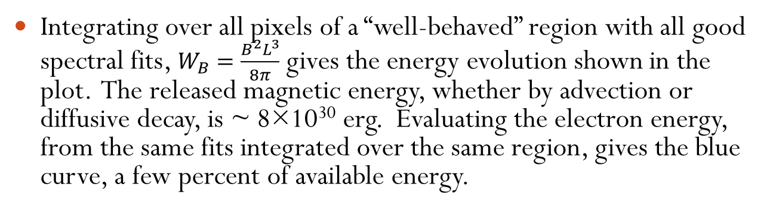
Energy Associated with B-Field Decay
Integrating over all pixels of a “well-behaved” region with all good spectral fits, $W_{B}=\frac{B^{2}L^{3}}{8π}$ gives the energy evolution shown in the plot. The released magnetic energy, whether by advection or diffusive decay, is ~ 8×10³⁰ erg. Evaluating the electron energy, from the same fits integrated over the same region, gives the blue curve, a few percent of available energy.
(Fleishman et al., in prep.)
Four frames from the movie, 72 s apart

Slide 28
Conclusions
With the completion of EOVSA, we now have a breakthrough instrument for the study of the Sun. EOVSA brings imaging spectroscopy for quantitative measurements of particles, magnetic field, and plasma in the flaring regions.
When we examine the results of our first opportunity to measure dynamic magnetic field behavior in the corona, we see exactly what we might have predicted, large-scale decay of the magnetic field, sufficient to provide the energy that goes into accelerating particles, heating, and plasma motions.
The results suggest that although the reconnecting current sheet of the standard model gets things going, the main energy release that powers the flare (at least in this particular large, long-duration event) occurs simultaneously over a much larger volume. We also see a similar change, at lower rates, in the 2017 Sep 9, M1 flare.
The means of dissipation of magnetic energy is not revealed, but is consistent with a high level of turbulence existing throughout this large volume.
Future work will include making similar measurements for a range of flare types, and over a range of flare energies.
We will also use EOVSA to investigate the transport and decay of the high-energy particles (through spatially-resolved decay rates and conversion to thermal energy)

Slide 29
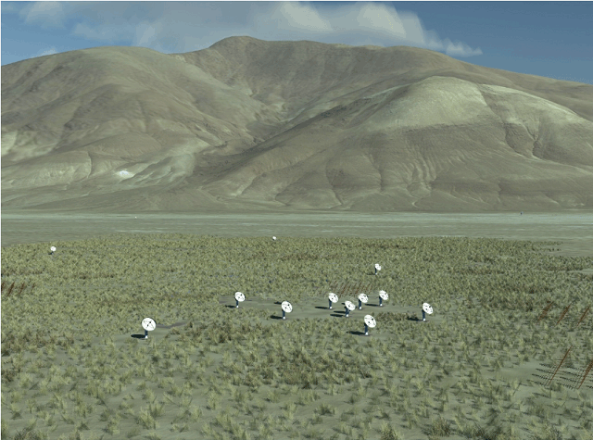
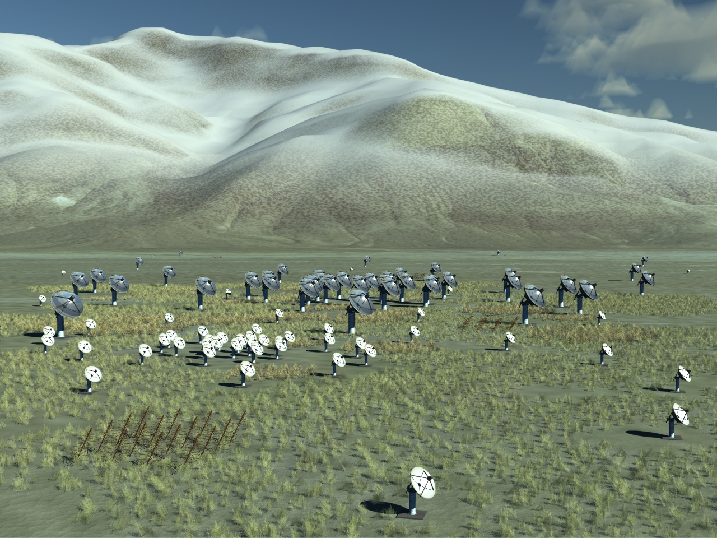
FASR
Table 1: FASR Instrument Specifications
Angular resolution | 20/ν_{GHz} arcsec
Frequency range | 0.05-21 GHz
Frequency resolution | 1%
Time resolution | 1 s
Polarization | Stokes I & V (Q/U selectable)
Number of antennas | 2-21 GHz: ~100 0.2-3 GHz: ~60 < 0.3 GHz: ~40
Size of antennas | 2-21 GHz: 2 m parabolic 0.2-3 GHz: 6 m parabolic < 0.3 GHz: log-periodic dipoles
Maximum antenna spacing | 4.25 km
Proposed Site | Owens Valley (Big Pine, CA)
15 15 0
45 15 15
Isaac Gary

Slide 30
Extra Slides

Slide 31
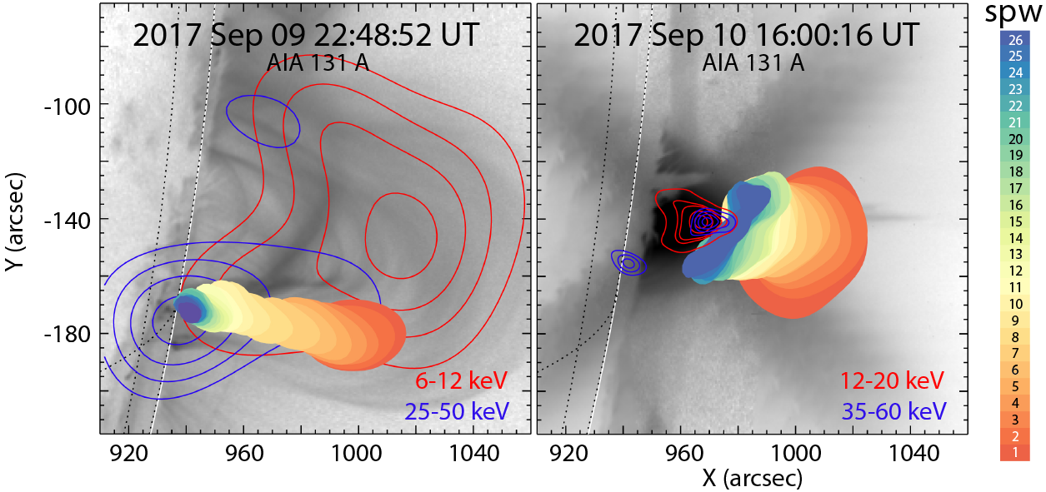
Comparing 2017 Sep 9 and Sep 10 Events

Slide 32
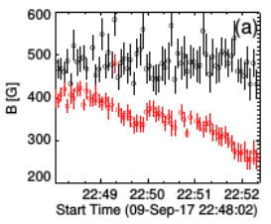
B Field Decay in 2017 Sep 9 Event
Decay rate of magnetic field at one representative pixel is about 0.7 G s⁻¹.
There is no decay for a pixel at a lower height.
0.7 G s⁻¹
(Kuroda et al., in prep.)
Four frames from the movie, 72 s apart

Slide 33
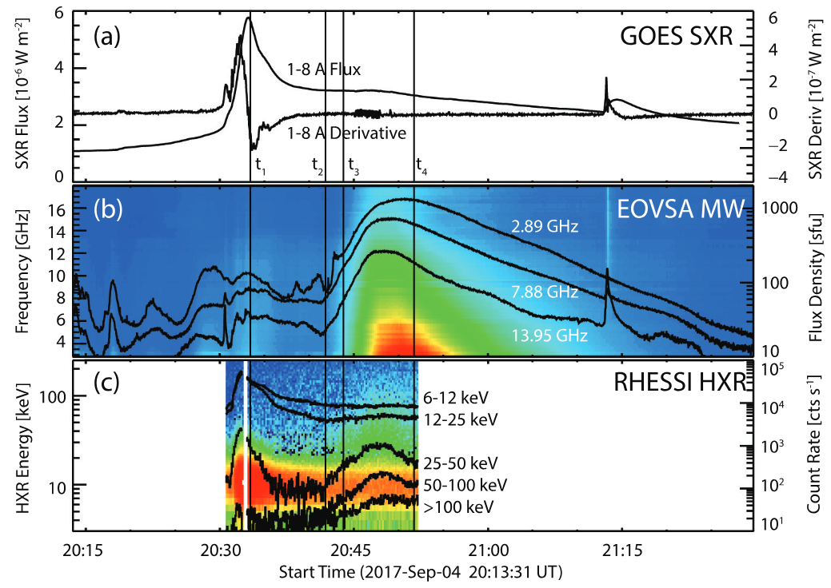
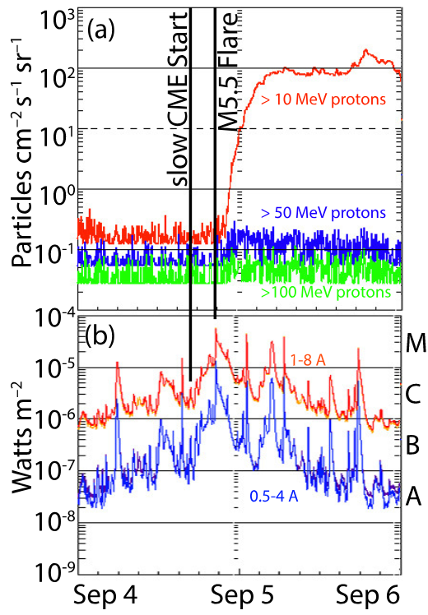
2017 September 04 SEP Event Timing

Slide 34
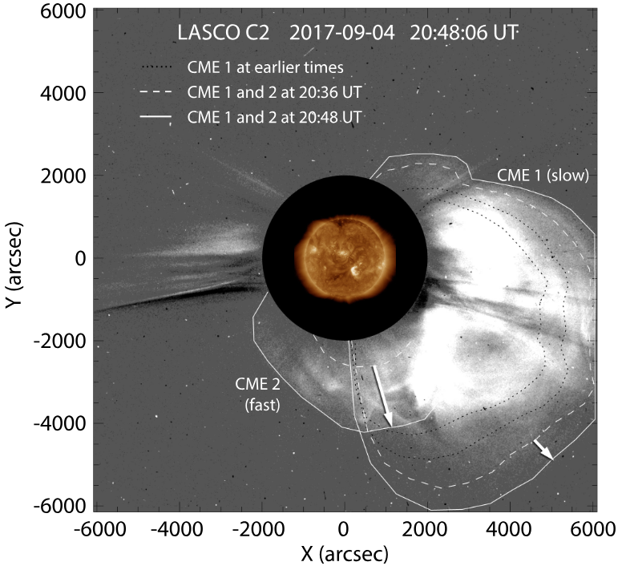
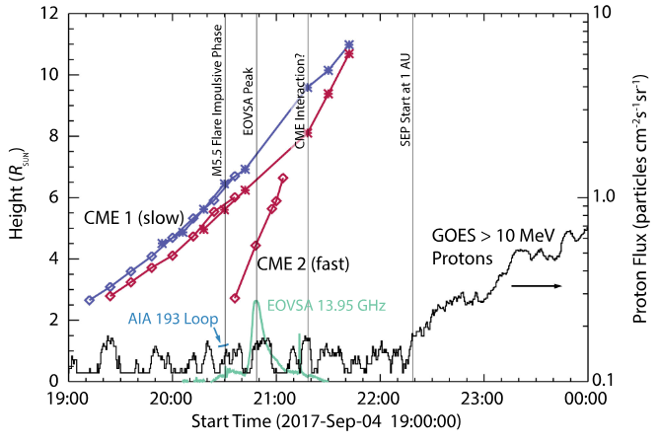
Associated CME and SEP Activity

Slide 35


2017 September 04 SEP Event

Slide 36


Need For 3D Forward-Fit Modeling
Example from 2017 Sep 04:
  Start with magnetic field model (extrapolation or MHD)
  Identify field line that matches source structure, and create loop
  “Dress” the loop with plasma and accelerated particles (use parameters from parameter maps as a guide
  Calculate emission from the model (microwave, hard X-ray, EUV)
  Convolve with instrument resolution, and compare with observations.

