Slide 1
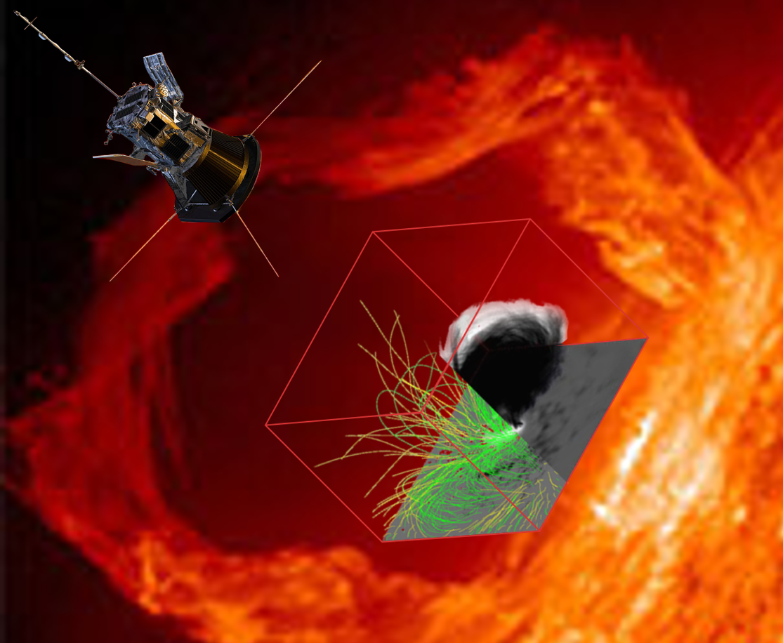
Data-constrained 3D Modeling of Solar Flares and Active Regions with GX Simulator
Gelu M. Nita
Center for Solar Terrestrial Research
New Jersey Institute of Technology

Slide 2
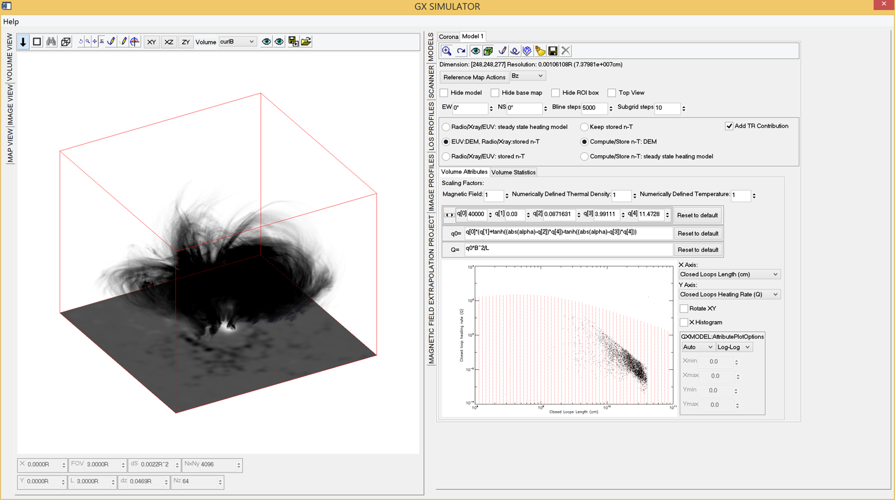
Product of a decade-long
Team Work
Gregory Fleishman
Alexey Kusnetsov
GS/GR Fast Codes
Maria Lukicheva
Chromospheric Models
Eduard Kontar
X-ray Simulation
Codes
Alexey Stupishin
Optimized NLFFF Extraploation Codes
Jim Klimchuk
Nicki Viall
Coronal Magneto Thermal Structures
and EUV Simulation Codes
Sergey Anfinogentov
Automated 3D Model Production Pipeline

Slide 3
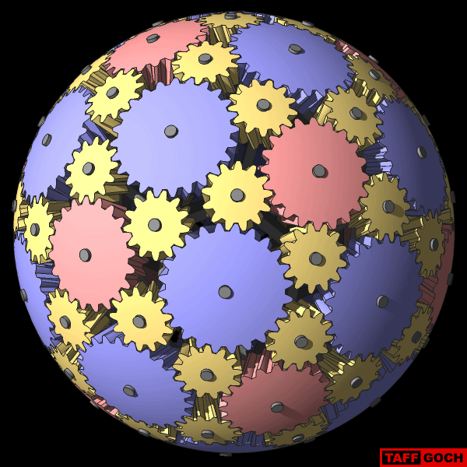
GX Simulator Framework
Puts together different observational inputs, theoretical methods, simulations and modeling to create data-constrained modeling of a 3D volume of interest

Slide 4
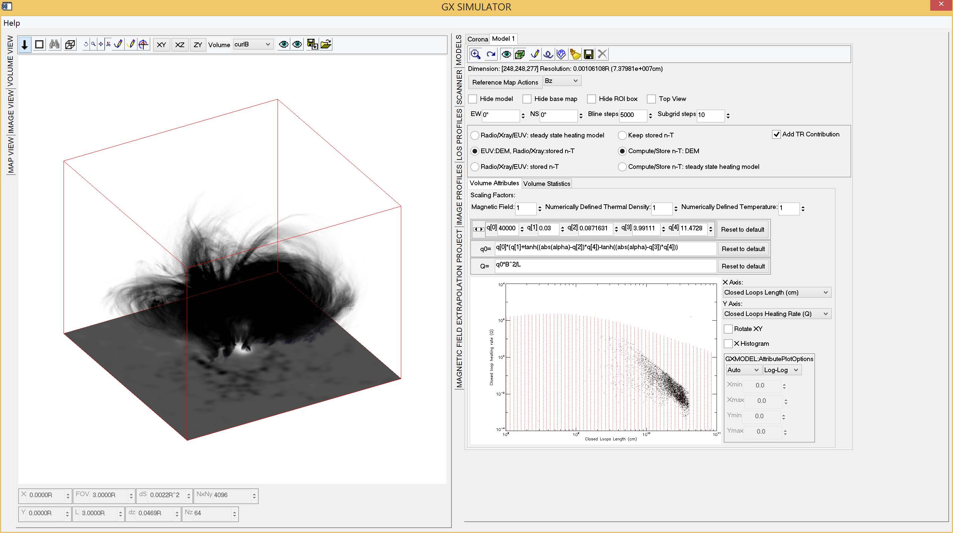
GX Simulator 3D Modeling Package
Nita, Fleishman, Kuznetsov, Kontar, & Gary 2015, ApJ 799, 236
Nita, Viall, Klimchuk, Loukitcheva, Gary, Kuznetsov, & Fleishman, 2018 ApJ 853, 66
Open-source IDL implementation running on Windows, Unix and Mac platforms distributed through SolarSoftWare (SSW) repository
Ability to import numerically defined chromospheric and coronal models
Integrated tools for generating data-driven chromospheric and coronal models
Integrated tools for building and populating magnetic field loops
Generation of Microwave, EUV, and X-ray maps based on the combined chromospheric and coronal models

Slide 5
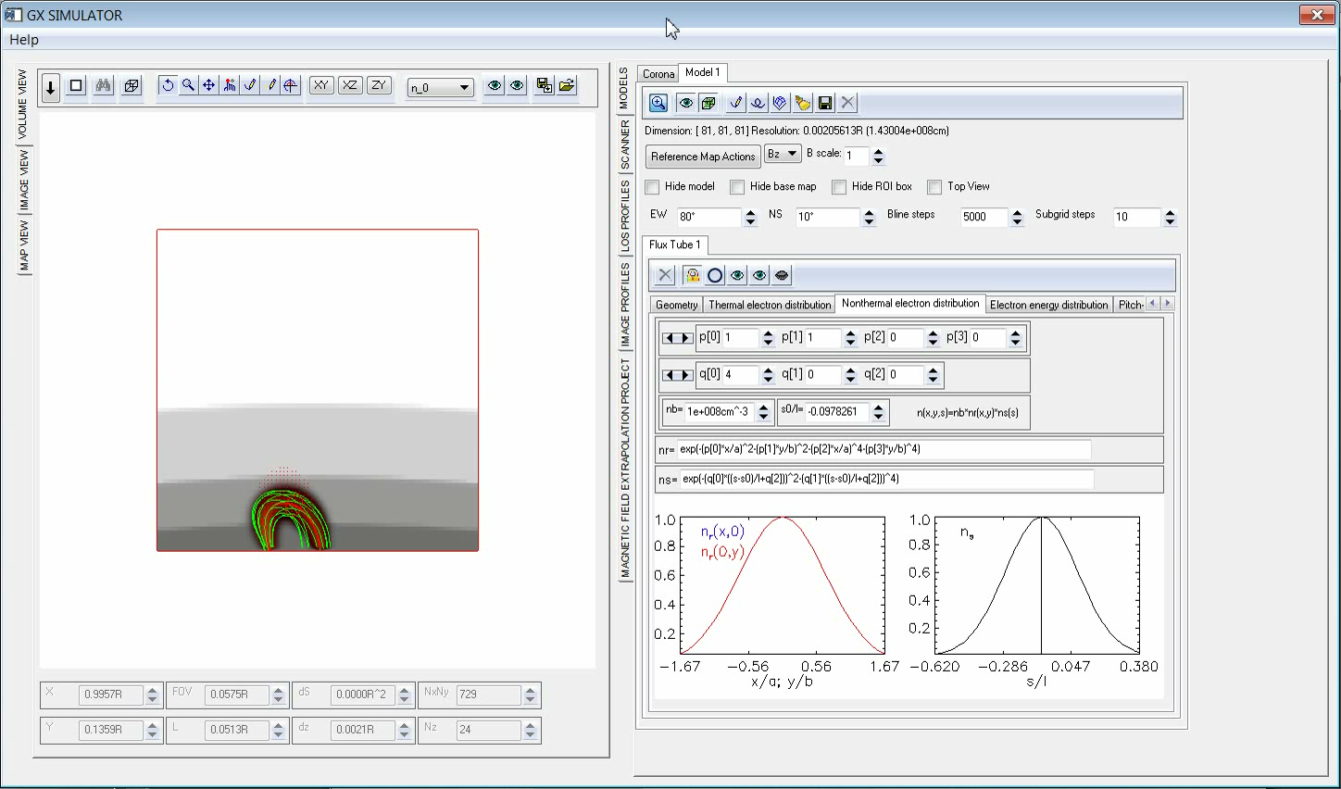

Slide 6
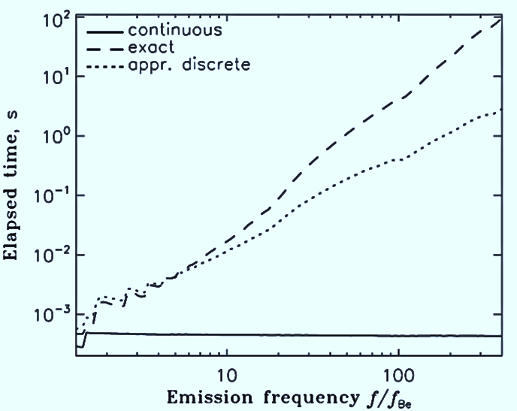
Fast Gyrosynchrotron Codes
Fleishman & Kuznetsov (2010) developed a new, efficient, and precise algorithm and implemented it into publicly available libraries for fast calculation of gyrosynchrotron spectra—enabling realistic, bulk 3D modeling and practical forward fitting.
This algorithm consists of extending the approximations by Petrosian (1981) and Klein (1987) and making them far more accurate and more widely applicable, e.g., for the anisotropic case.
The calculations were made more accurate and applicable by finding an accurate Gaussian approximation of the integrand over the pitch angle.
The calculations were also made more accurate and widely applicable by melding exact calculations at low harmonics with approximate calculations at high harmonics.
The gain is several orders of magnitude in computation speed.

Slide 7
Automatic GX Model Production Pipeline
Nita, Anfinogentov, Kuznetsov, Stupishin, Fleishman, 2018 TESS Meeting
Selection of time, position and spatial resolution of the model
Initial potential field extrapolation
MAC
&
UNIX
OS
NLFFF optimization
(Windows OS only)
Automatic download of SDO HMI/AIA data
closest to the time requested
Computation of the length and averaged magnetic field for all voxels crossed by closed magnetic field lines, to be used by GX Simulator to assign parametrized differential emission measure and density and temperature distribution models of the corona
WCS coordinate transformation of HMI data to create the base of the subsequent extrapolations
Creation of an empty-box structure containing a WCS-compatible index, LOS Bz, Ic, and the requested AIA UV/EUV reference maps
Adding non-LTE density and temperature distribution models of the chromosphere

Slide 8
GX Model Pipeline Sequence
;Documentation:
;\ssw\packages\gx_simulator\util\Step-by-step instructions for creating GX Simulator models.html
time='2017-09-04 20:34:42’ ;time to search for SDO data
center_arcsec=[250,-250] ;center pixel in arcseconds
size_pix=[160,120,120] ;box size in voxels
dx_km=1000 ;resolution in kilometers
tmp_dir='C:\jsoc_cache’ ;local data input repository
out_dir='C:\gx_models\' ;local model output repository
;calling sequence
gx_fov2box, time, center_arcsec=center_arcsec, size_pix=size_pix, dx_km=dx_km, out_dir=out_dir,tmp_dir=tmp_dir, /cea, /euv, /uv ,/nlfff_only
% GX_FOV2BOX: Data not found in the local repository, downloaded in 146.127 seconds
% GX_FOV2BOX: Creating the box structure
% GX_FOV2BOX: Box structure created in 17.315 seconds
% GX_FOV2BOX: Performing initial potential extrapolation
% GX_FOV2BOX: Potential extrapolation performed in 2.928 seconds
% GX_FOV2BOX: Potential box structure saved to
C:\gx_models\2017-09-04\hmi.M_720s.20170904_202242.W119S8CR.CEA.POT.sav
% GX_FOV2BOX: Performing NLFFF extrapolation
% GX_FOV2BOX: NLFFF extrapolation performed in 252.11 seconds
% GX_FOV2BOX: NLFFF box structure saved to
C:\gx_models\2017-09-04\hmi.M_720s.20170904_202242.W119S8CR.CEA.NAS.sav

Slide 9

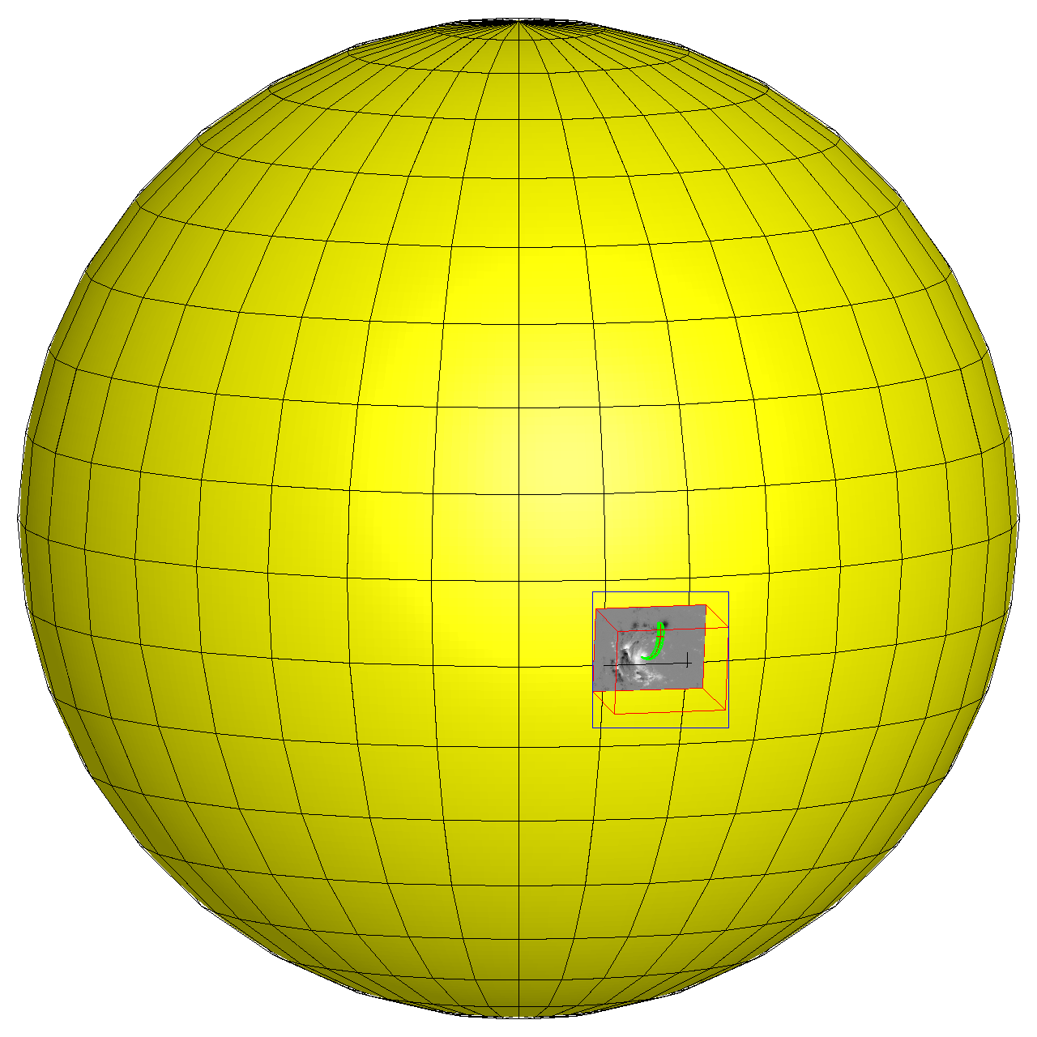
GX Model Production Pipeline Tutorial

Slide 10
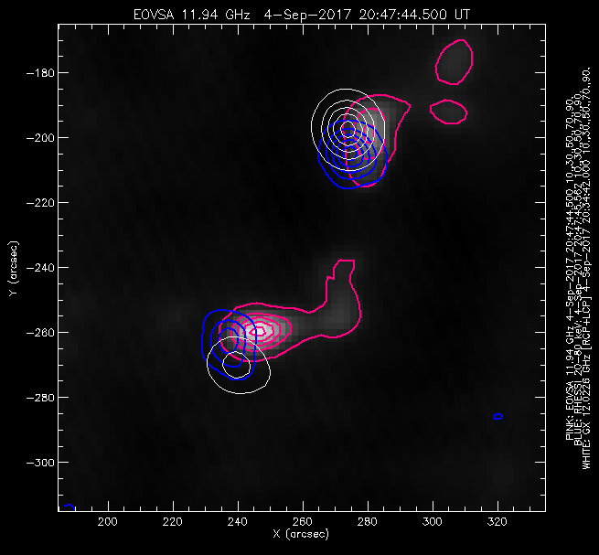
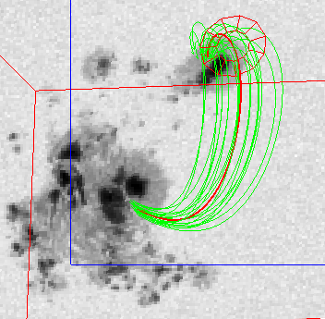
Example: 2017 September 04 SEP Event
Need For 3D Forward-Fit Modeling
  Start with magnetic field model (extrapolation or MHD)
  Identify field line that matches source structure, and create loop
  “Dress” the loop with plasma and accelerated particles (use parameters OSPEX fit as a guide
  Calculate emission from the model (microwave, hard X-ray, EUV)
  Convolve with instrument resolution, and compare with observations.

Slide 11
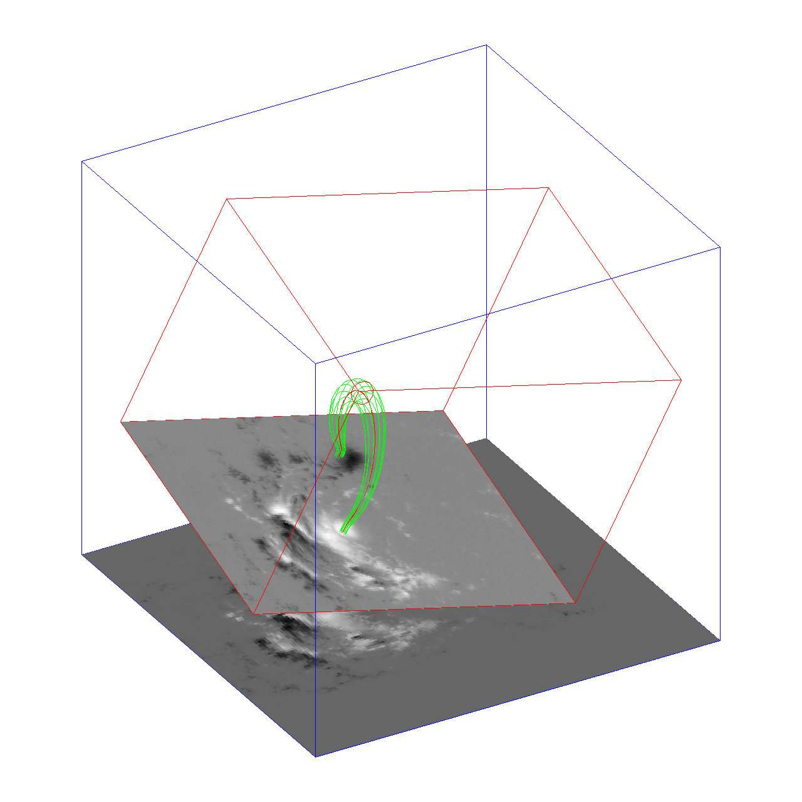
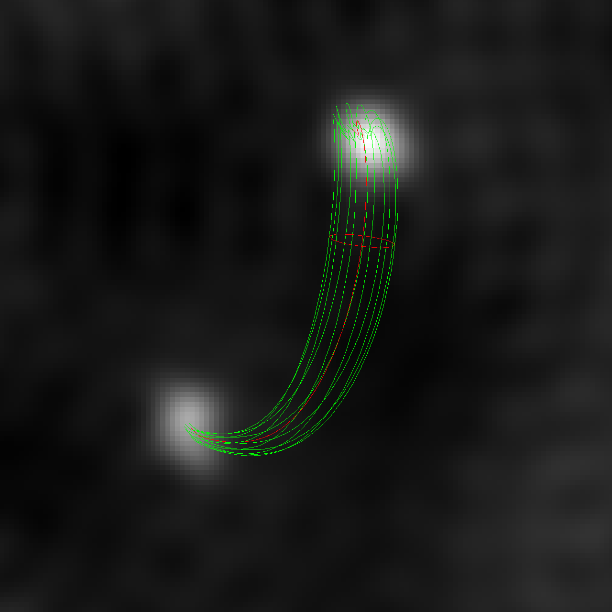
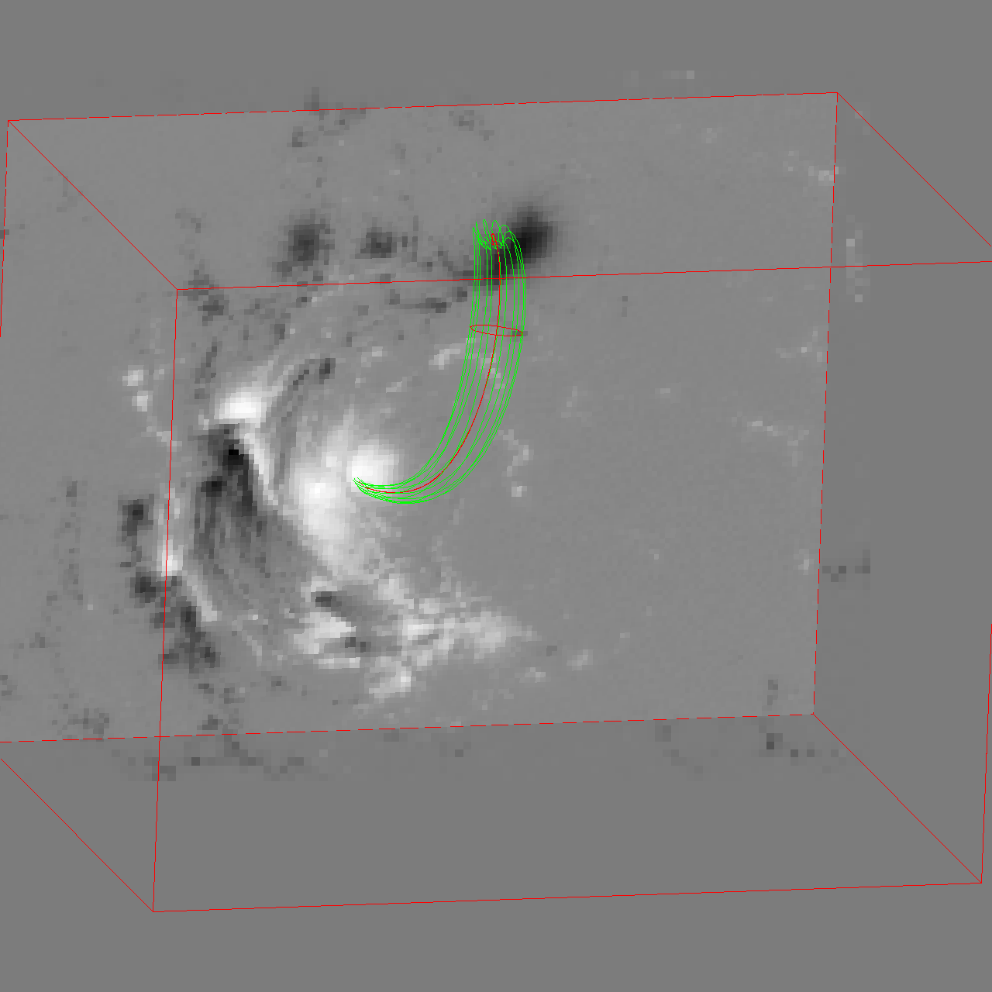
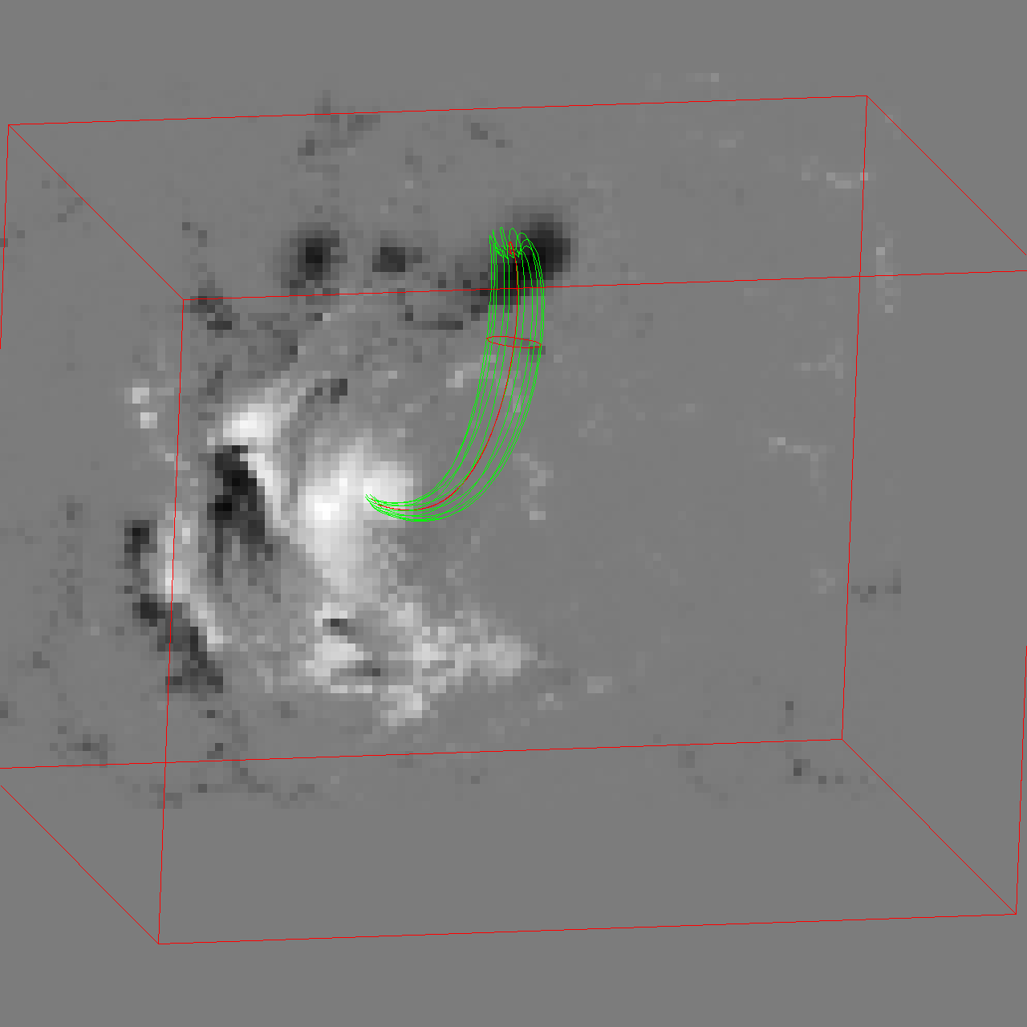
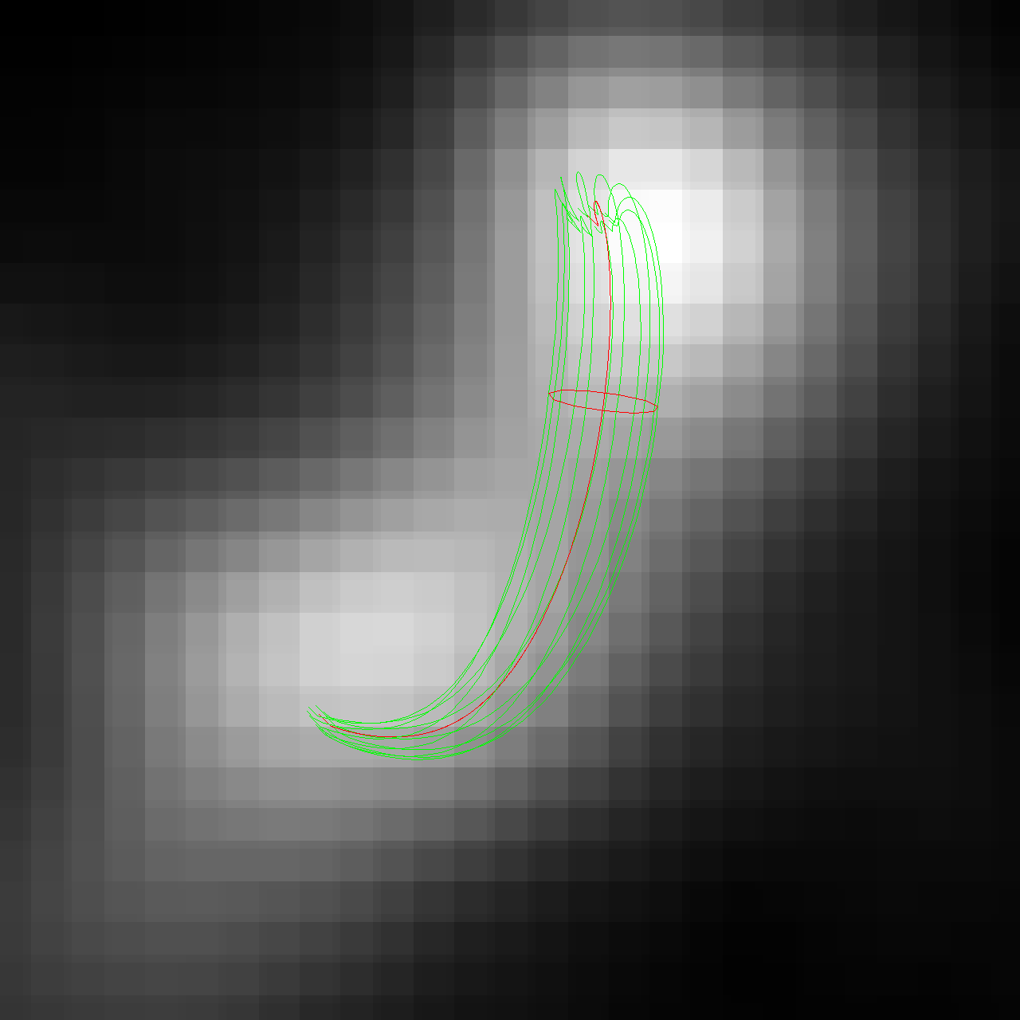
2017-09-04 20:34:42 Flaring Loop Model
RHESSI 20-80 keV
Box Base Bz
LOS Bz
EOVSA 4GHz

Slide 12
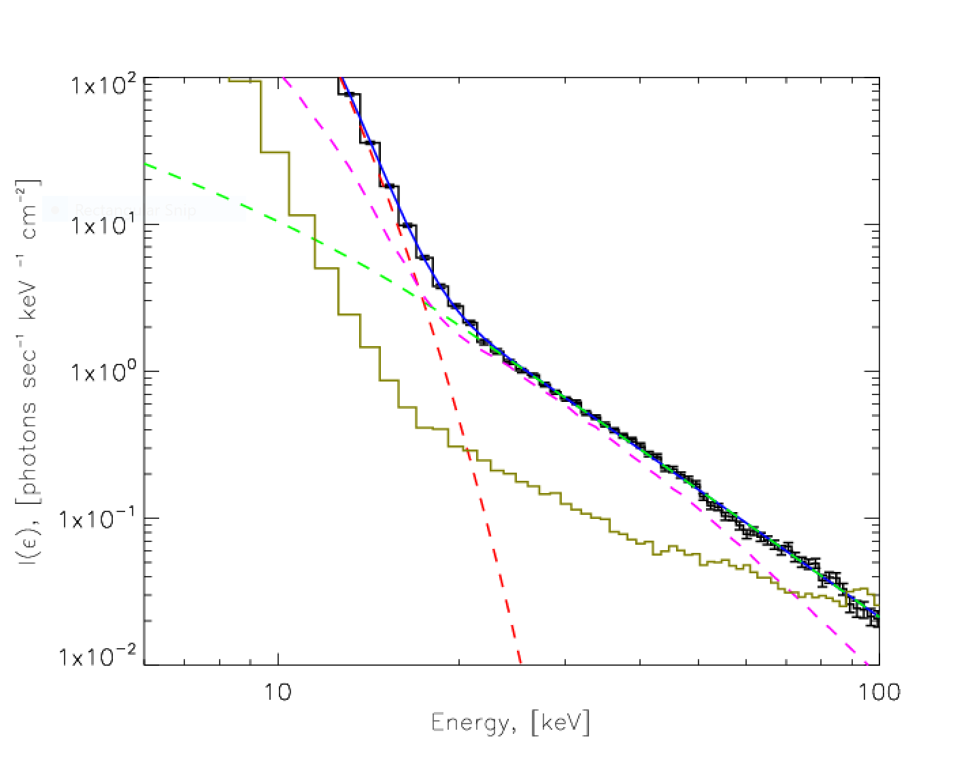
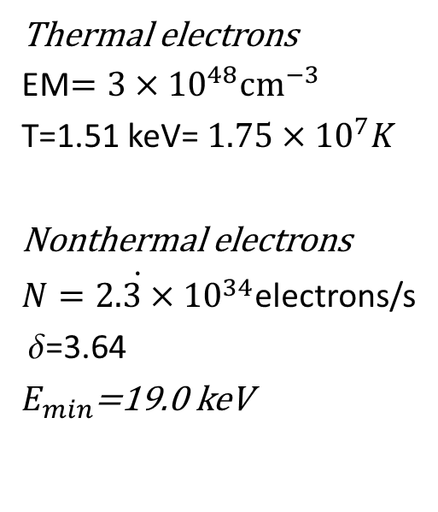
RHESSI OSPEX FIT
Photon Flux Spectrum
Thermal electrons
EM$=3×{10}^{48}{cm}^{−3}$
T=1.51 keV= $1.75×{10}^{7}K$
Nonthermal electrons
$\dot{N=2.3×{10}^{34}}$electrons/s
 =3.64
$E_{min}$=19.0 keV

Slide 13
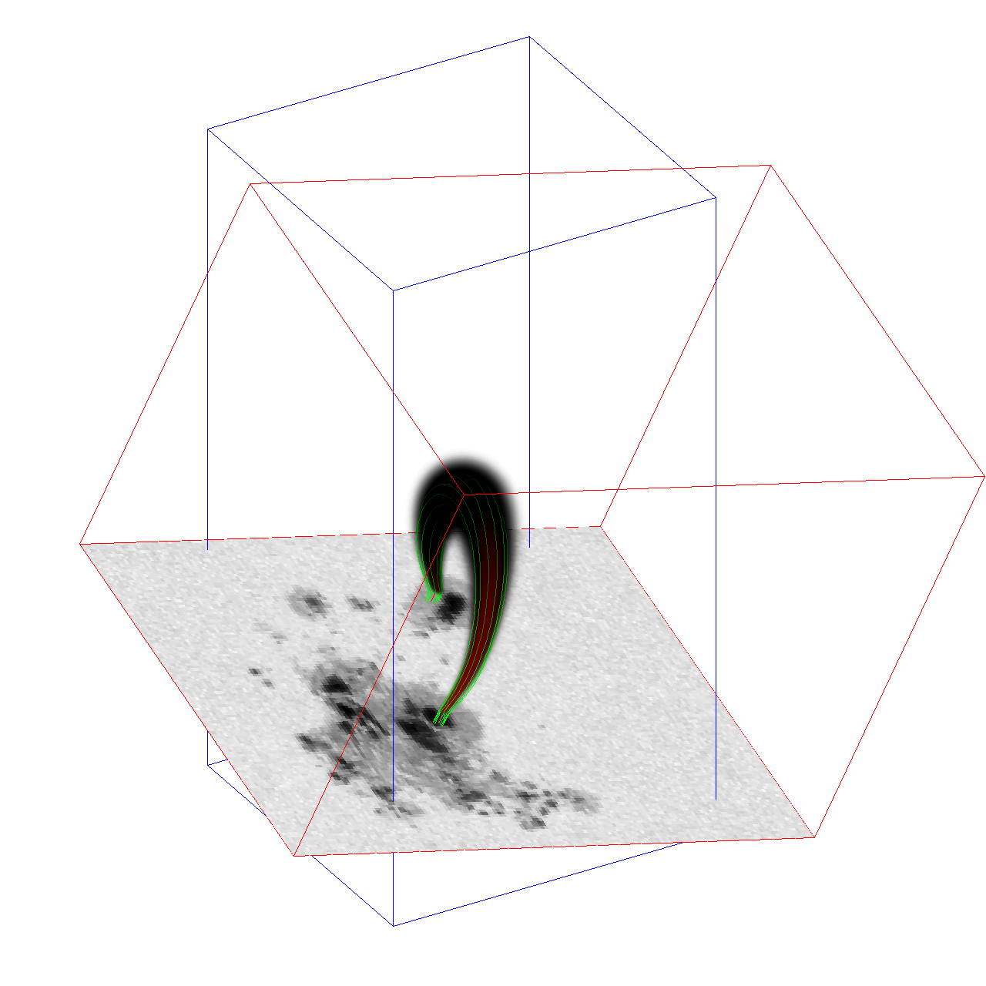
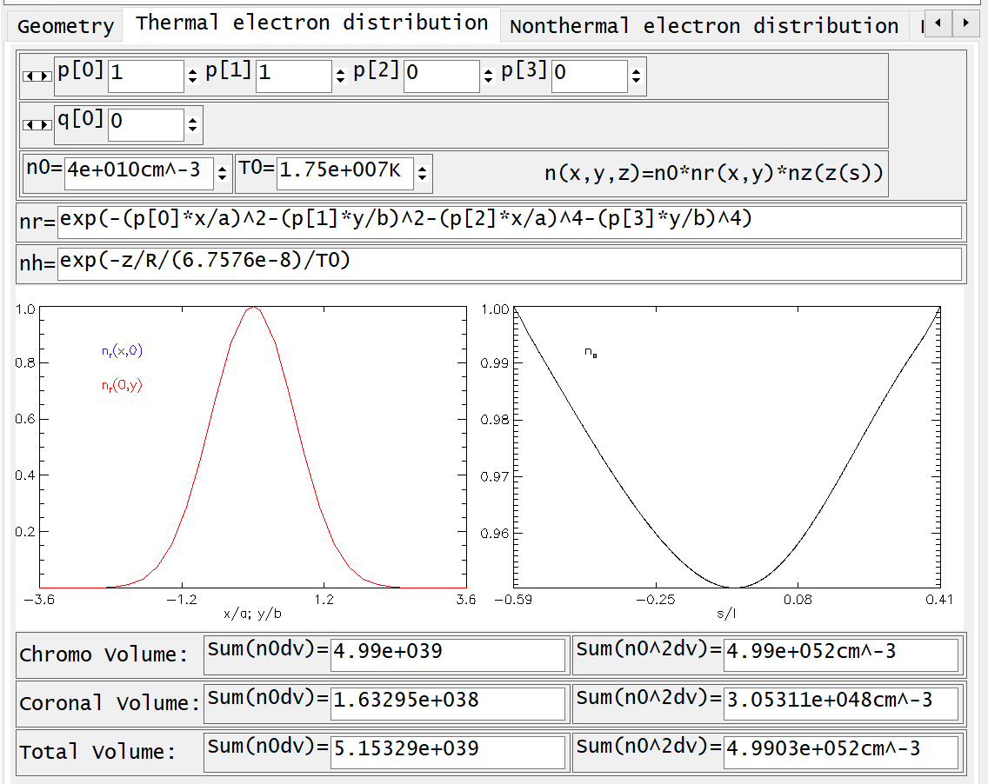
Thermal Electrons Distribution

Slide 14
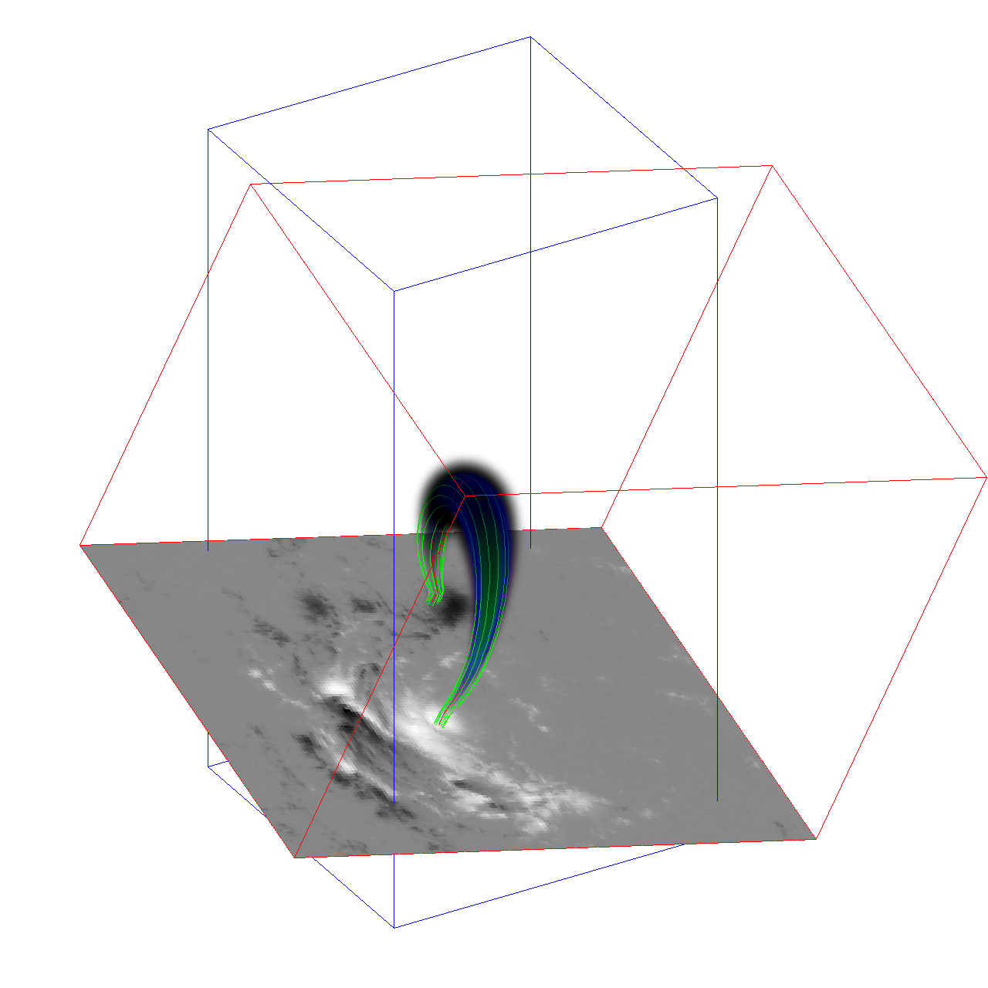
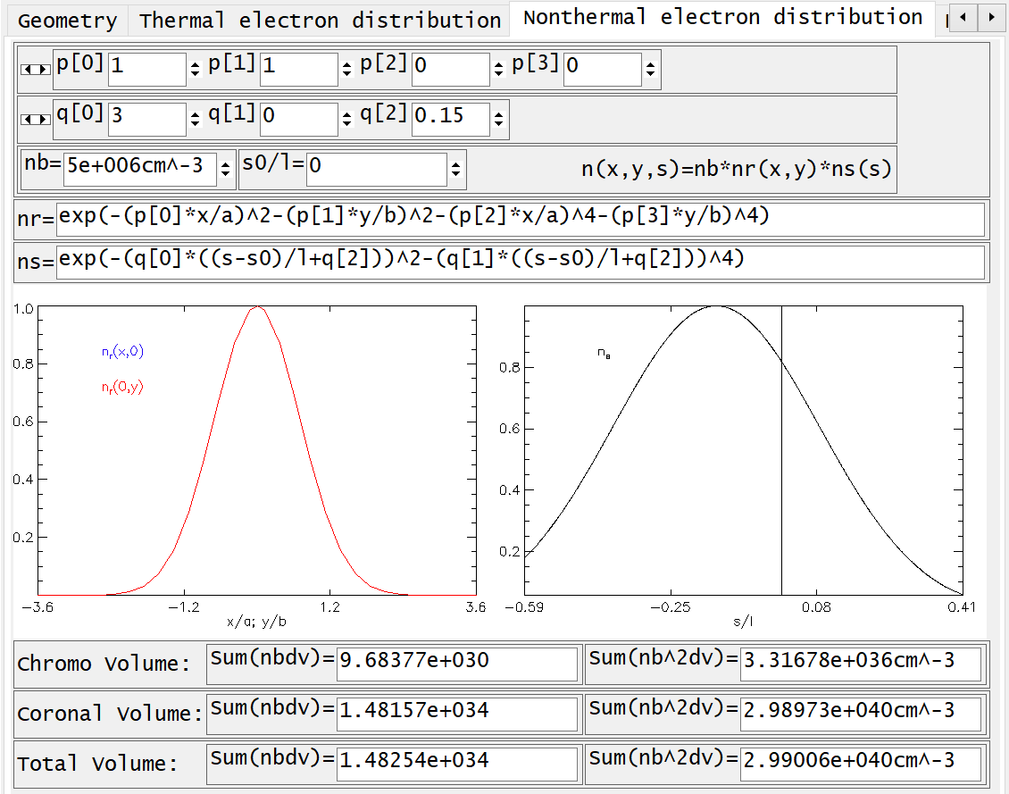
Nonthermal Electrons Distribution

Slide 15
Recent upgrade of the X-ray GX Routine
Computes ion lines by using the SSW CHIANTI database
Allows for user-defined anionotropy of the electron beam
Computes Thick-Target contribution from footpoints
Computes albedo contribution similar to OSPEX implementation, by taking in consideration the geometrical location of the model and employing the SSW Compton Green functions

Slide 16
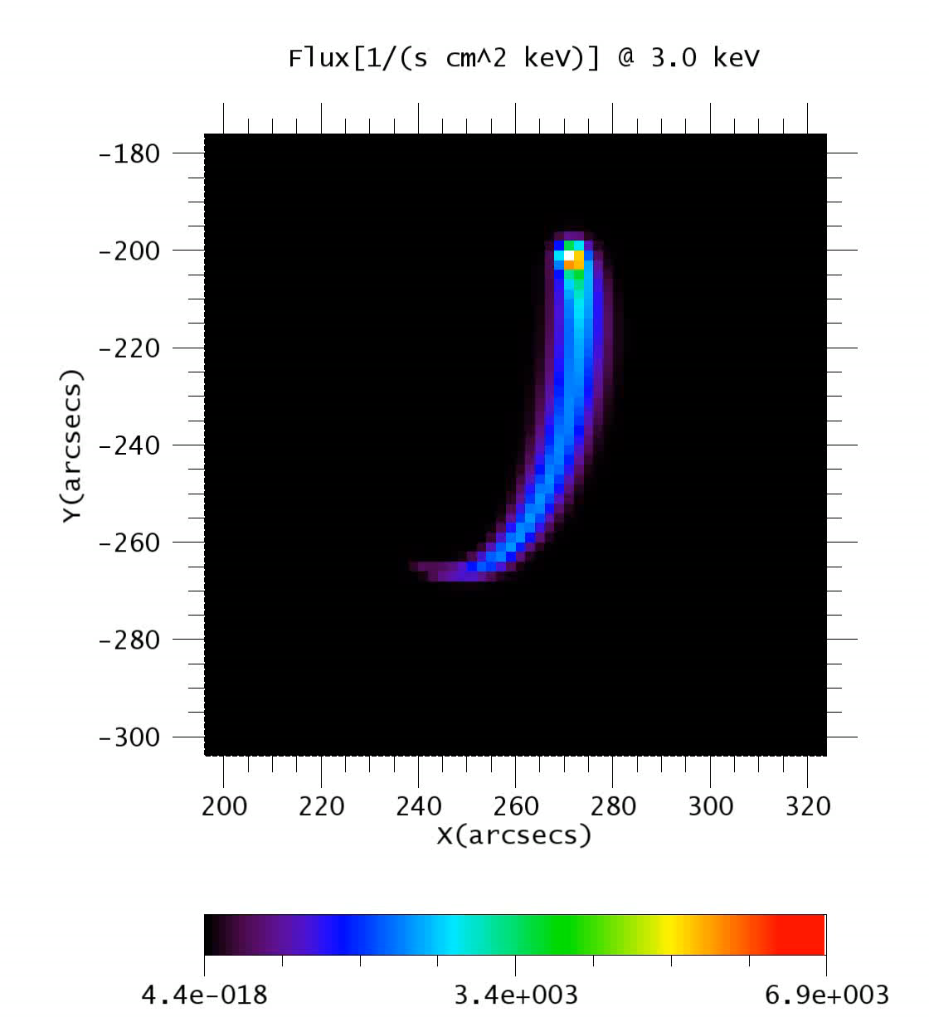
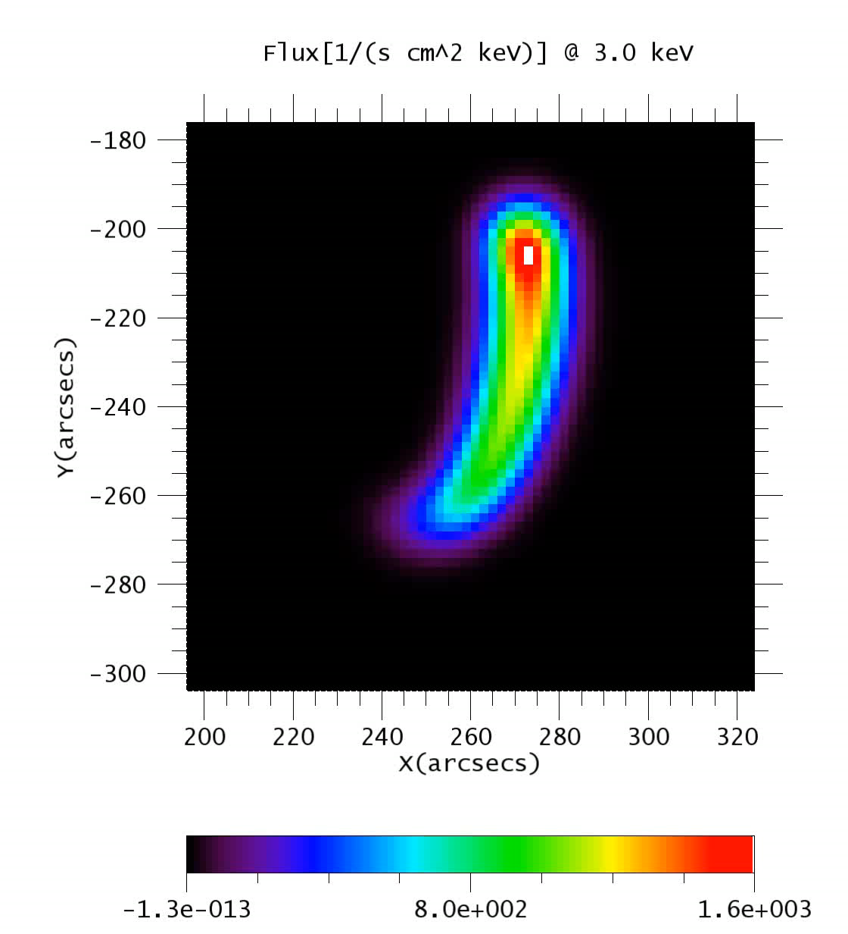
X-ray GX Synthetic Images
GX raw images (2” pix)
GX convolved images (5.4” beam)

Slide 17
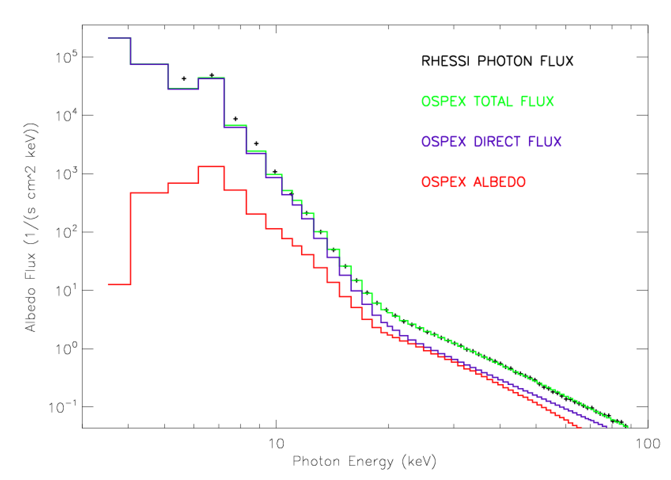
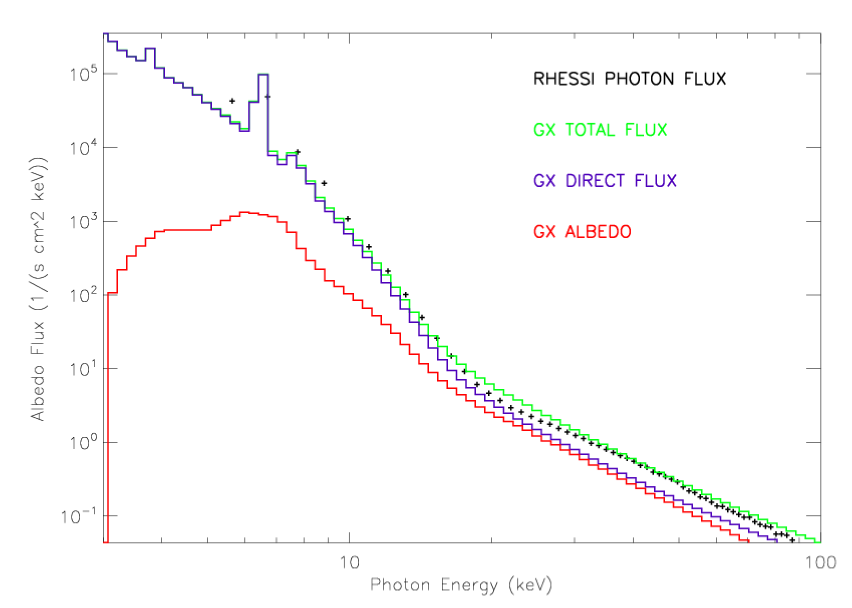
Models to Data Comparisons

Slide 18
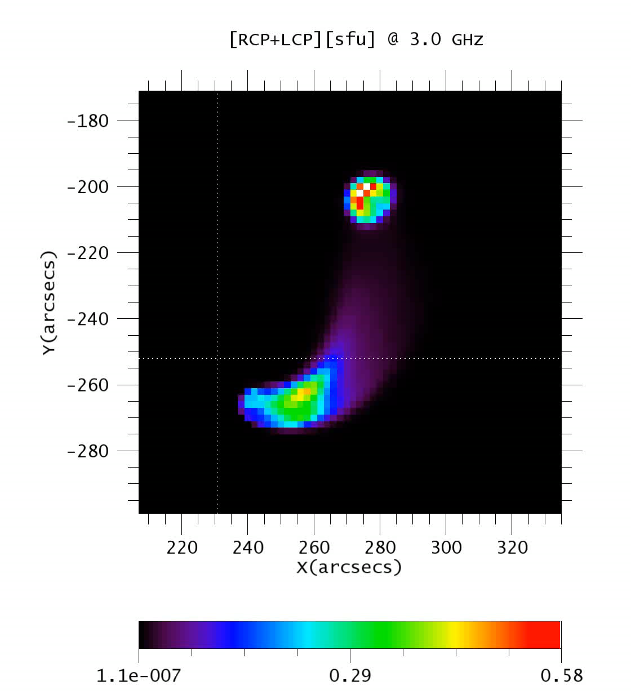
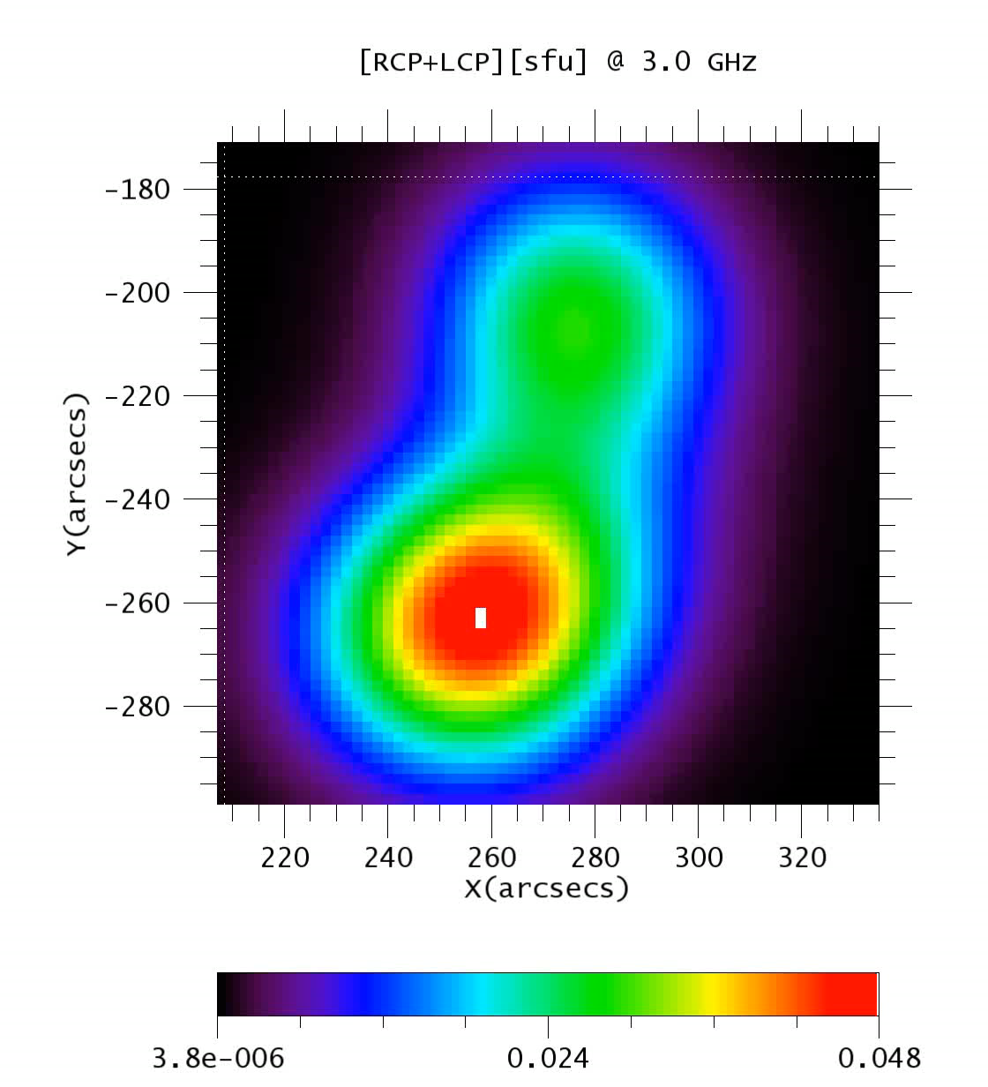
Microwave GX Synthetic Images
GX raw images (2” pix)
GX convolved images (57”/ beam)

Slide 19
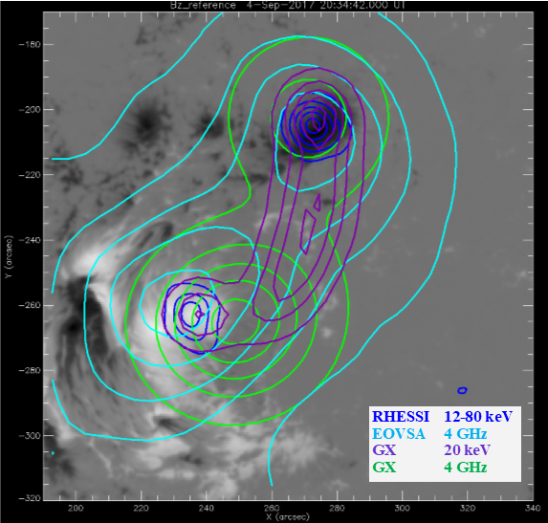
GX Synthetic Images
RHESSI & EOVSA

Slide 20
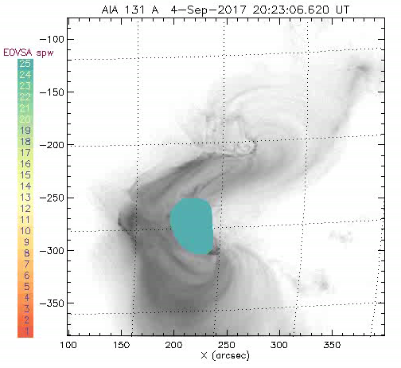
EOVSA color coded multifrequency observations of the 2017 September 04 SEP Event
More work to be done to model dynamics!
Animation courtesy of Dale Gary

Slide 21
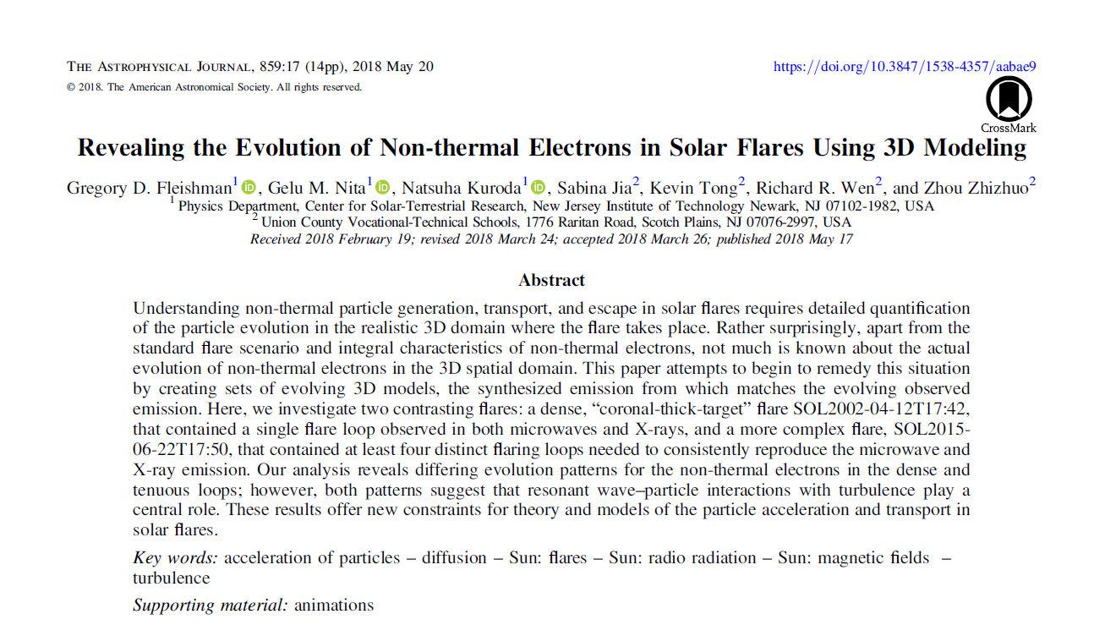

Slide 22
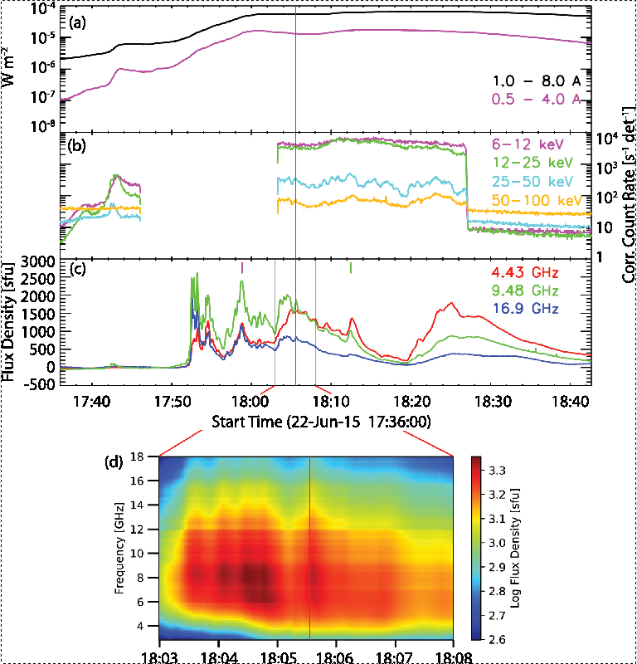
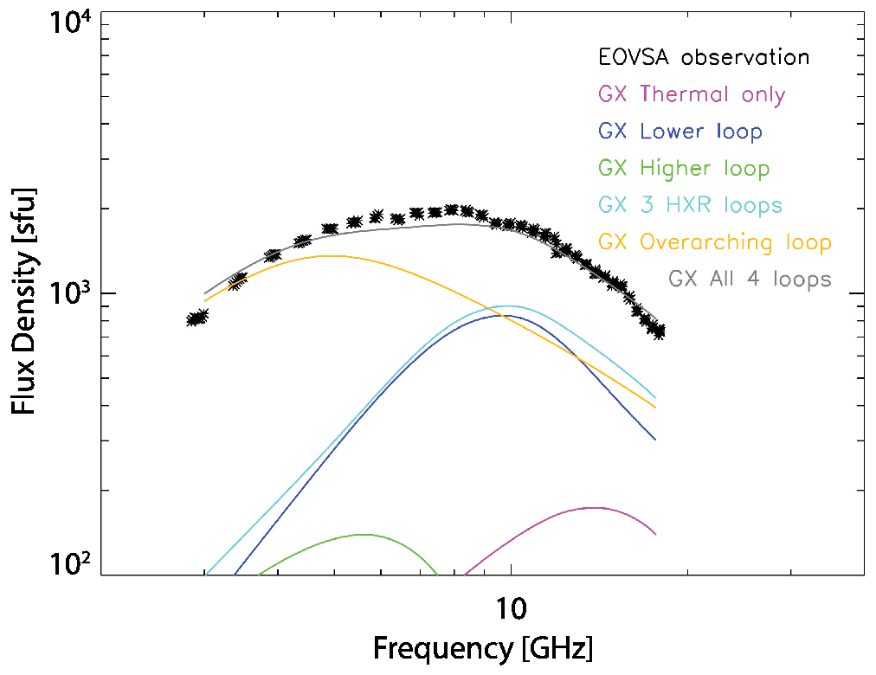
Three-dimensional Forward-fit Modeling of the Hard X-Ray and Microwave Emissions of the 2015 June 22 M6.5 Flare
Kuroda t a. 2018, ApJ, 852 (1), 3
MW emission required two distinct loops contributing in different frequency ranges

Slide 23
Nonthermal evolution in 3D
2015 June 22 M6.5 Flare

Slide 24
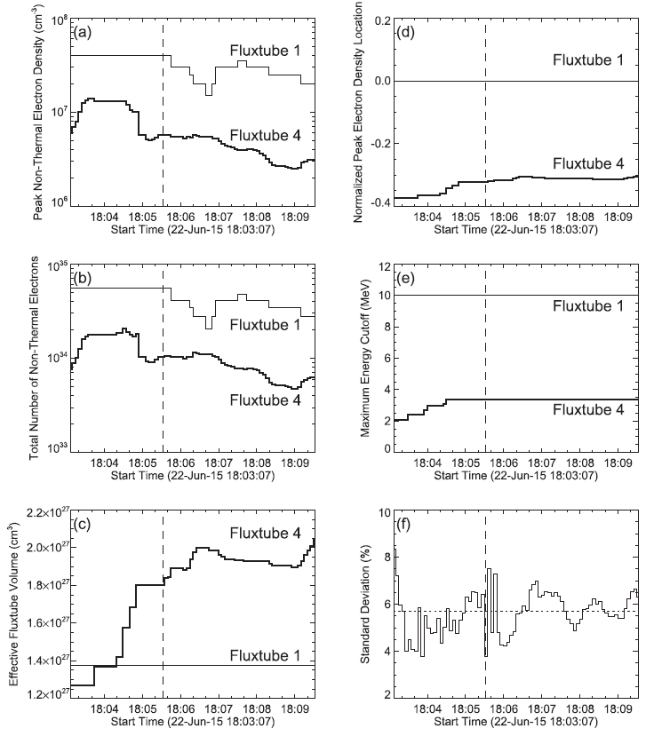
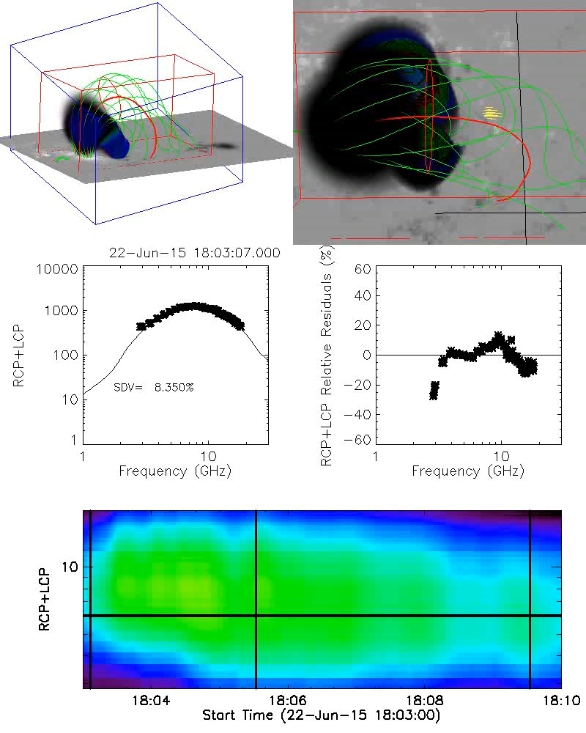
Recovered evolution of nonthermal electron in the SOL2015-06-22T17:50
Notes:
So, in this video, you see the 3D and top views of the nonthermal electron distribution, gathered in each simulation of the model. Here on the right is a dynamic intensity plot, which plots the intensity of the modelled simulation against that of the observed data for each timeframe. The standard deviation of each simulation is also included. On the left is a residual plot which is used to check the deviation of the model from the data. An ideal residual plot is one with low residual values scattered randomly in both positive and negative directions, indicating that the simulations have little systematic errors. Lastly, on the bottom is an spectrum of the entire time modelled, which is synthesized from multi-frequency intensity maps simulated using GX Simulator during each timeframe. The video was created using an IDL code in order to better visualize the nonthermal electron distribution of the flare throughout time.
*plays video*
So, as you can see, the distribution grew in size leading up to the flare, which is indicated by this black line. After the peak, the distribution almost seems to maintain its size, only fluctuating a little but not as much as before. This matches the spectrum of the flare, which I have on the right. Leading up to the peak, there is a much more dramatic change in intensity, but the intensity change fluctuates a little more afterward, increasing sometimes and staying almost constant at others, with more dramatic decreases occurring in intervals.

Slide 26
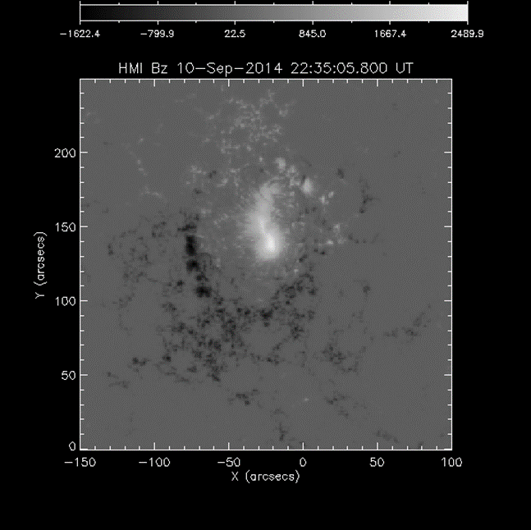
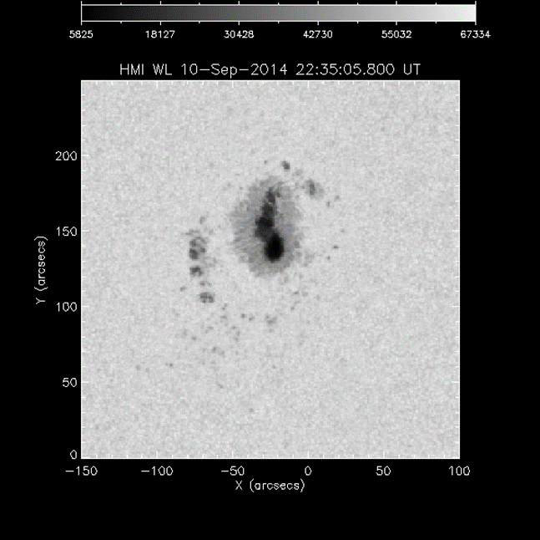
AR Modeling
Photospheric Input to Chromospheric Model

Slide 27
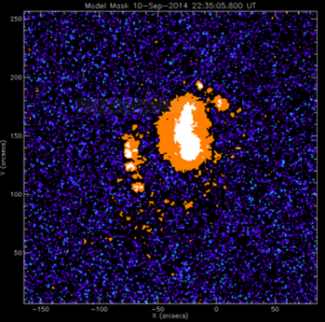
Chromospheric Model Mask
(Fontenla et al. 2009)
Photospheric Decomposition
IN (Inter Network)
NW (Network)
Enhanced NW
Sunspot Penumbra
Sunspot Umbra
Facula
Plage

Slide 28
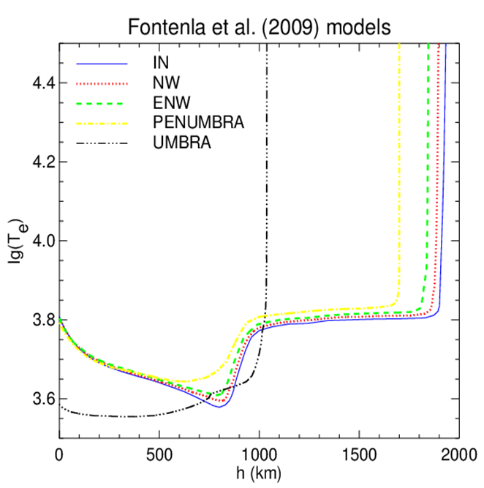
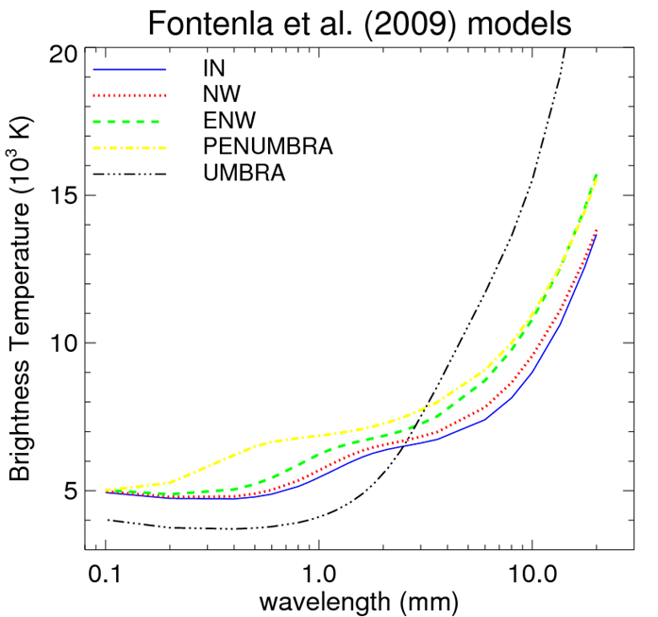
Fontenla et al. (2009) Models
Temperature as a function of height for a number of components from 1D static solar atmospheres
Brightness temperature spectra computed from the 1D models

Slide 29
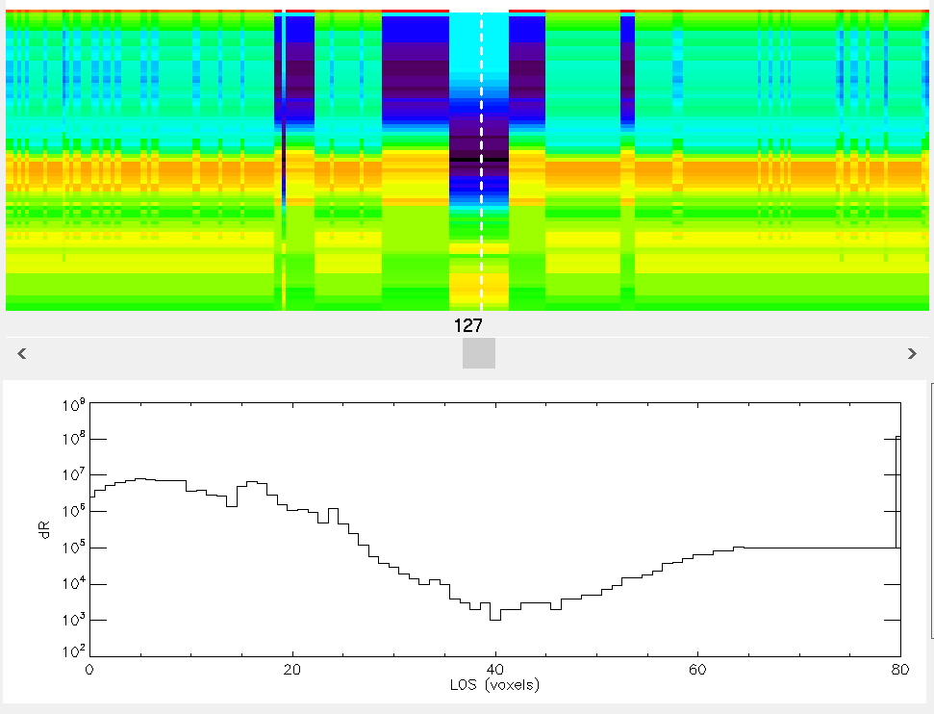
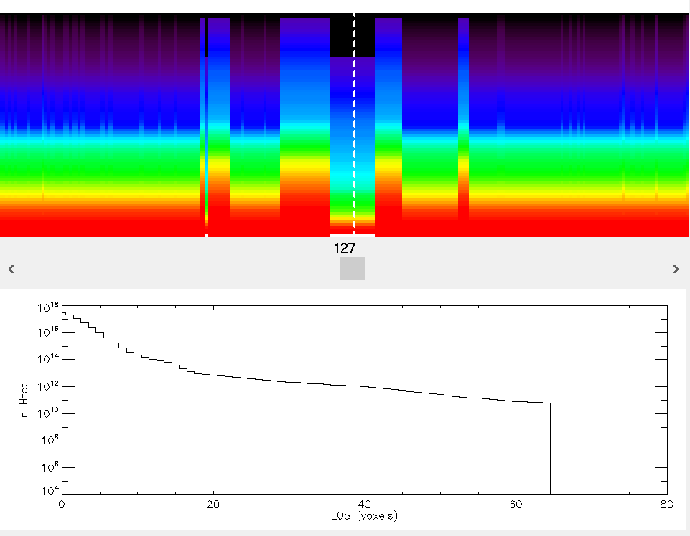
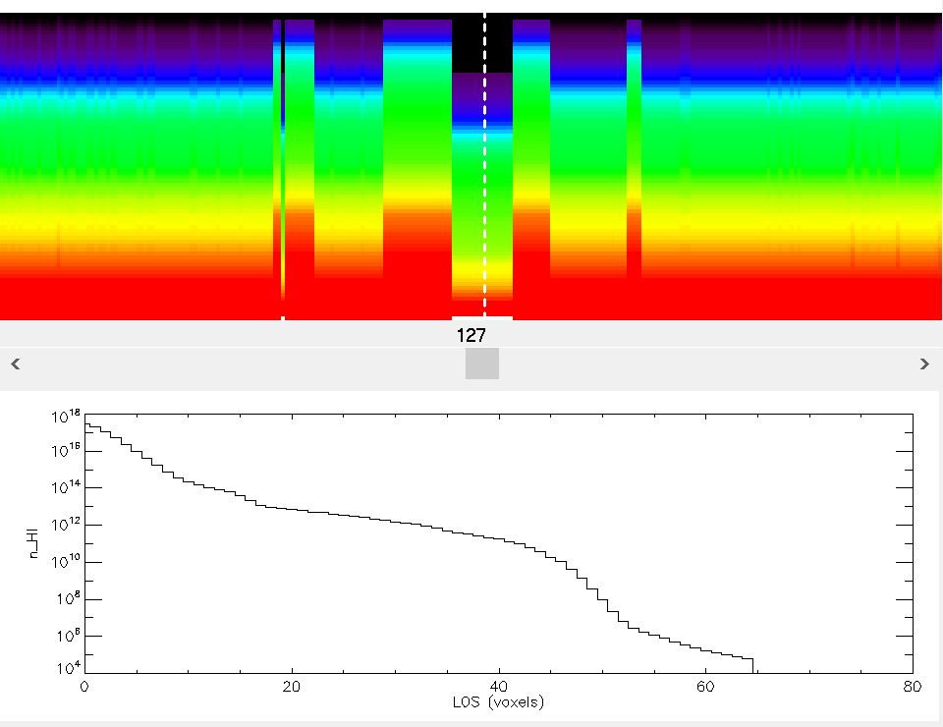
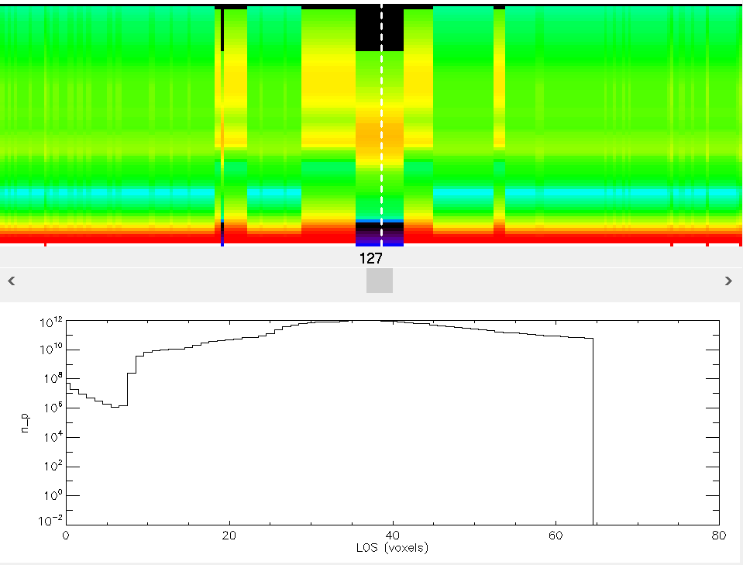
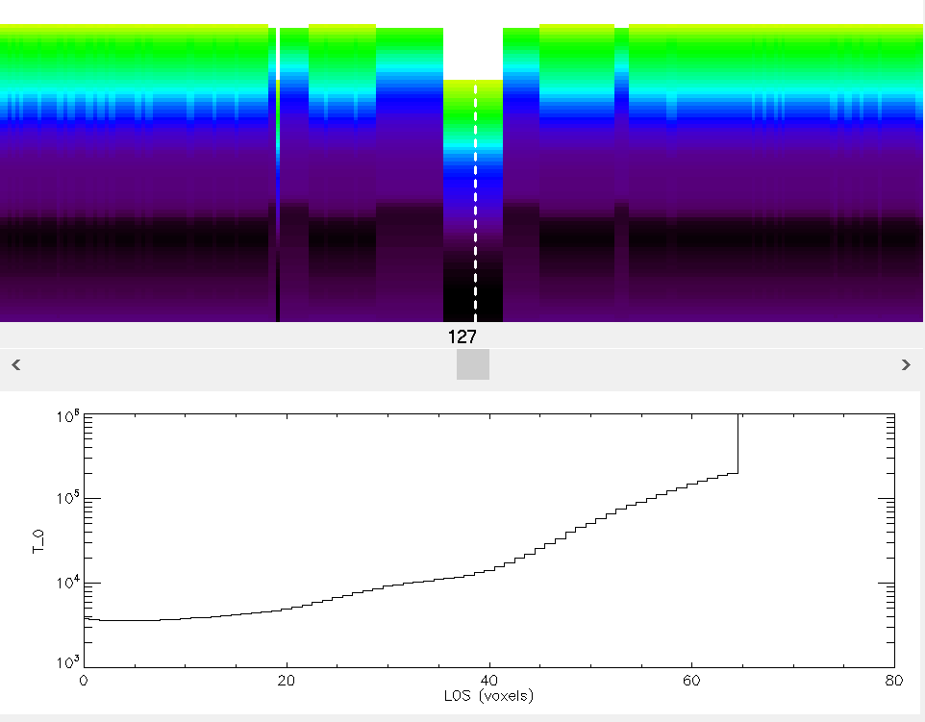
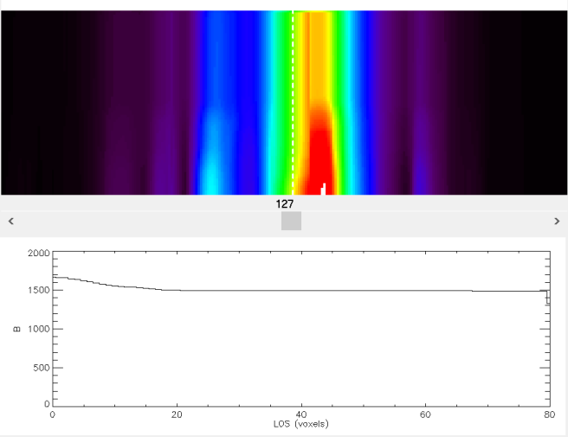
Chromo Model Vertical Slices
Voxel Height
Total Hydrogen Density
Neutral Hydrogen Density
Proton Density
Temperature
Magnetic Field

Slide 30
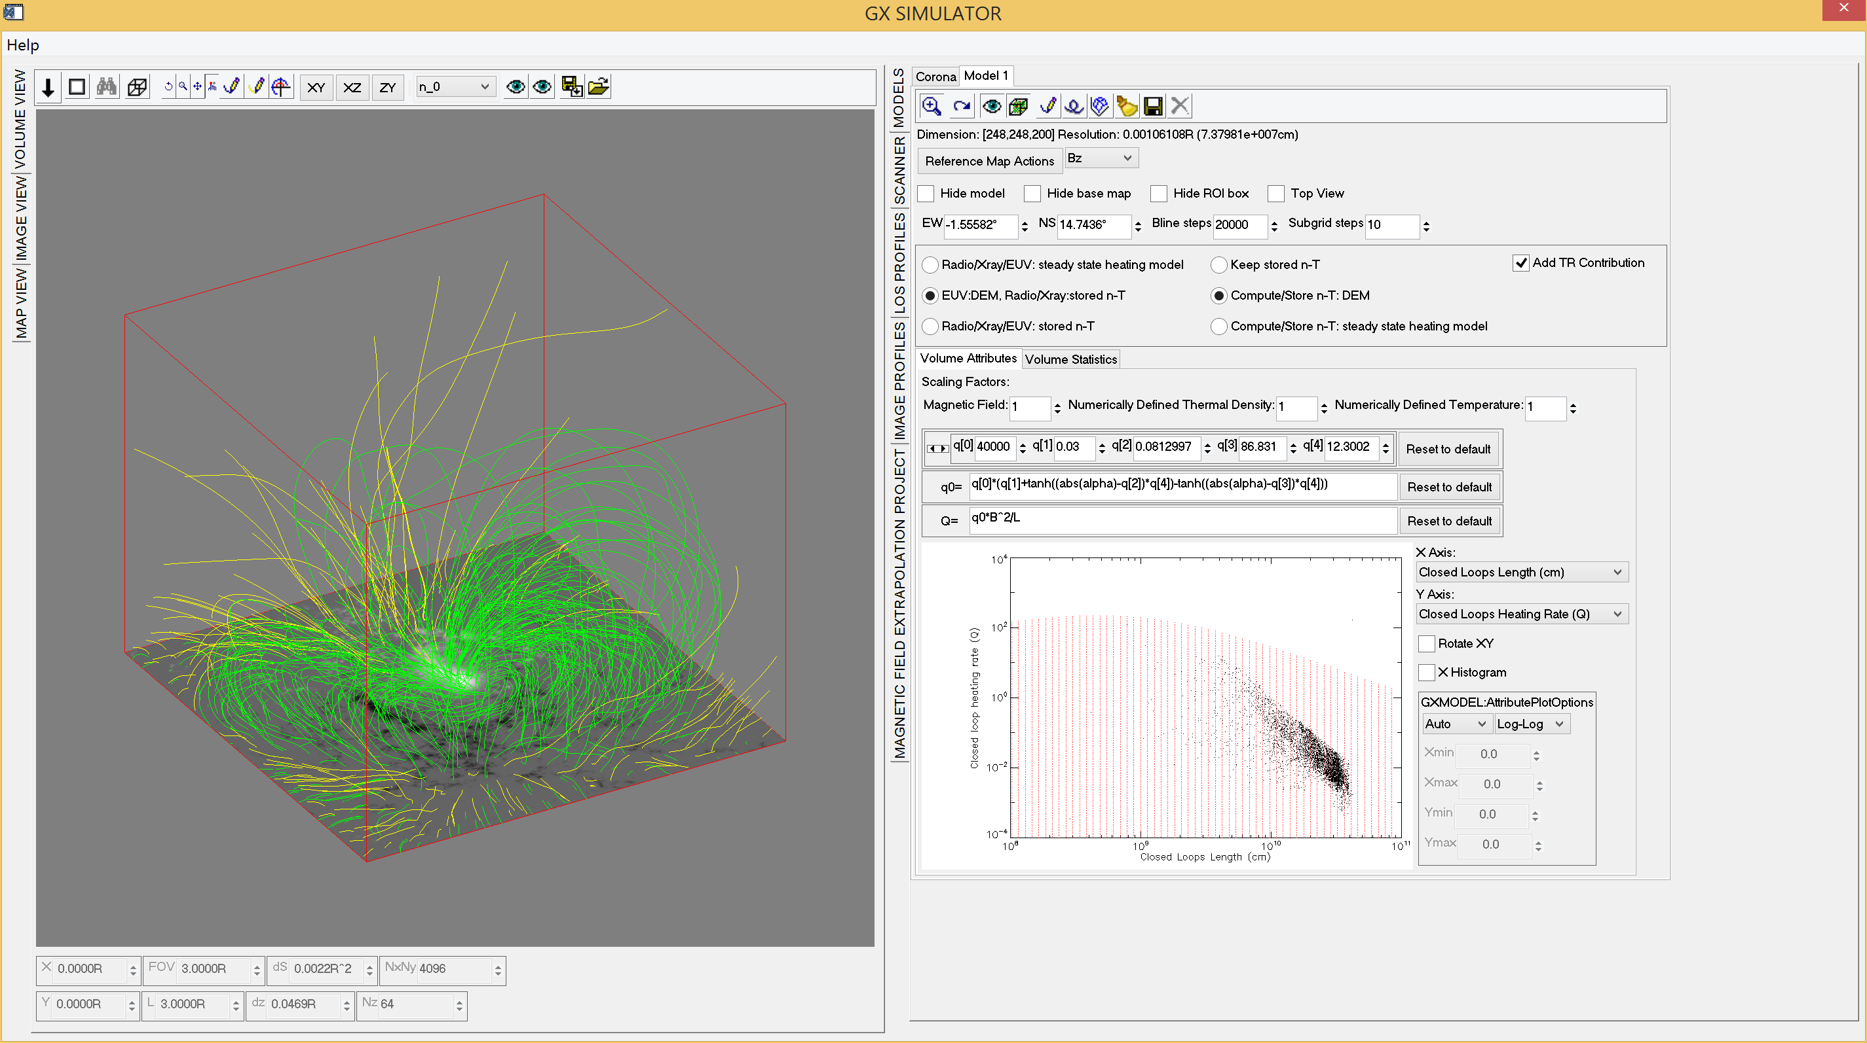
GX Simulator Coronal Model Project Page
Q(x,y,z)=Q(Bmed, L, alpha)→DEM(x,y,z)

Slide 31
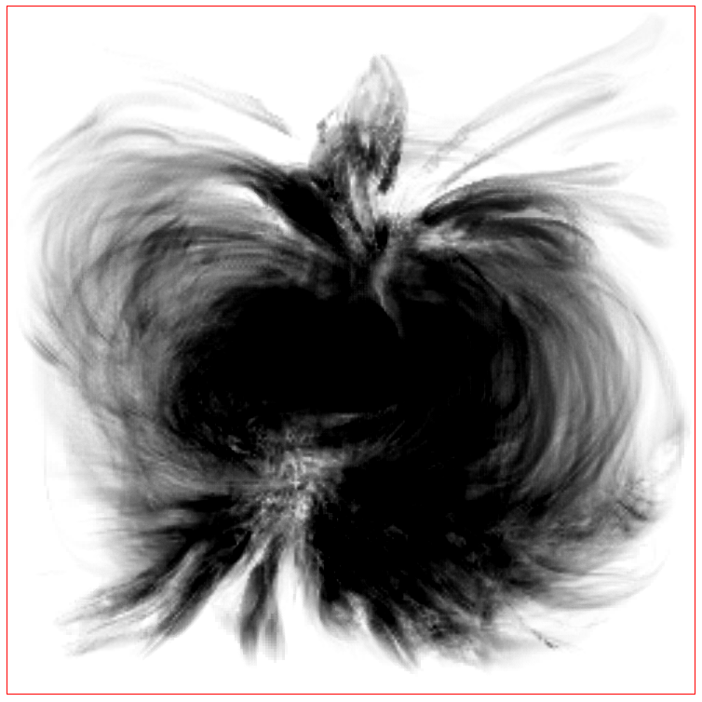
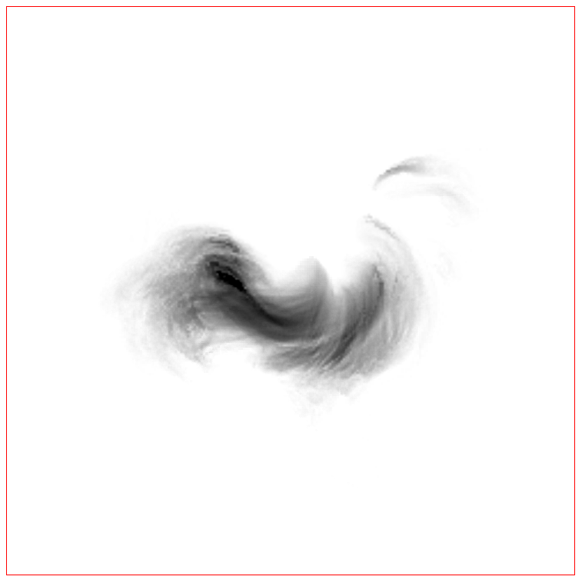

Interactively Defined Heating Rate
$$Q\left(x,y,z\right)=Q_{0}\left(α\right)B^{2}L^{−1}$$
$$Q_{0}\left(α\right)=q_{0} \left\{q_{1}+q_{4}\left[\begin{aligned}+tanh\left(\left|α\right|−q_{2}\right) \\ −tanh\left(\left|α\right|−q_{3}\right)\end{aligned}\right]\right\}$$
Closed Magnetic Field Lines alpha
Closed Loop Heating Rate

Slide 32
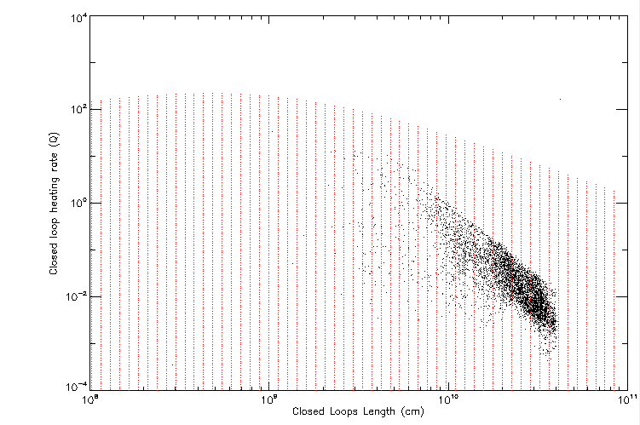
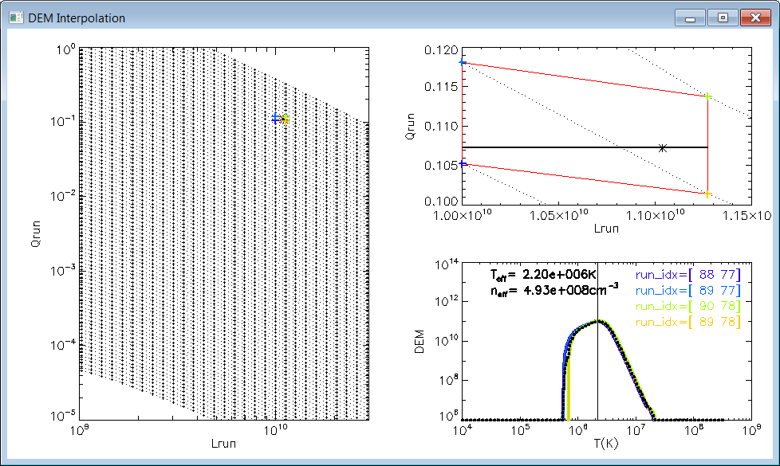
DEM Interpolation
(EBTEL runs- Klimchuk et al. 2008)

Slide 33


Density and Temperature Derived from DEM Moments
Density Slice
Temperature Slice

Slide 34




Combined Chromospheric and Coronal Models
Temperature Model
Density Model

Slide 35



Dressing the Coronal Magnetic Extrapolations of Active Regions with a Parameterized Thermal Structure
G. M. Nita , N. M. Viall , J. A. Klimchuk , M. A. Loukitcheva , D. E. Gary, A. A. Kuznetsov , and G. D. Fleishman
The Astrophysical Journal, 853, 2018
Data to Model Comparison: AR 11072 on 2010 May 23
FOV Integrated EUV Observed and Synthetic Emissions

Slide 36

Data to Model Comparison: AR 11072 on 2010 May 23
Observed and Synthetic Microwave Emissions at 5.4 GHz (SSRT) and 17 GHz (NoRH)

Slide 37


GX SIMULATOR: Synthetic Microwave Brightness Temperature and Polarization Maps Covering EOVSA, VLA, and ALMA Observing Ranges

