Slide 1
Heliospheric Distributed In-Situ Constellation (HelioDISC)
A mission to untangle the dynamic mesoscale Sun-Earth connection
Robert C. Allen, M. Leary, J. Vievering, S. K. Vines, L. Jian, L. Willson III,
G. Li, S. Lepri, S. Livi, J. M. Raines, B. J. Anderson, G. C. Ho, P. Mostafavi,
E. Smith, R. F. Wimmer-Schweingruber, S. Krucker, D. Malaspina,
J. Borovsky, P. Whittlesey, B. Maruca, D. Verscharen, & N. Lugaz

Slide 2
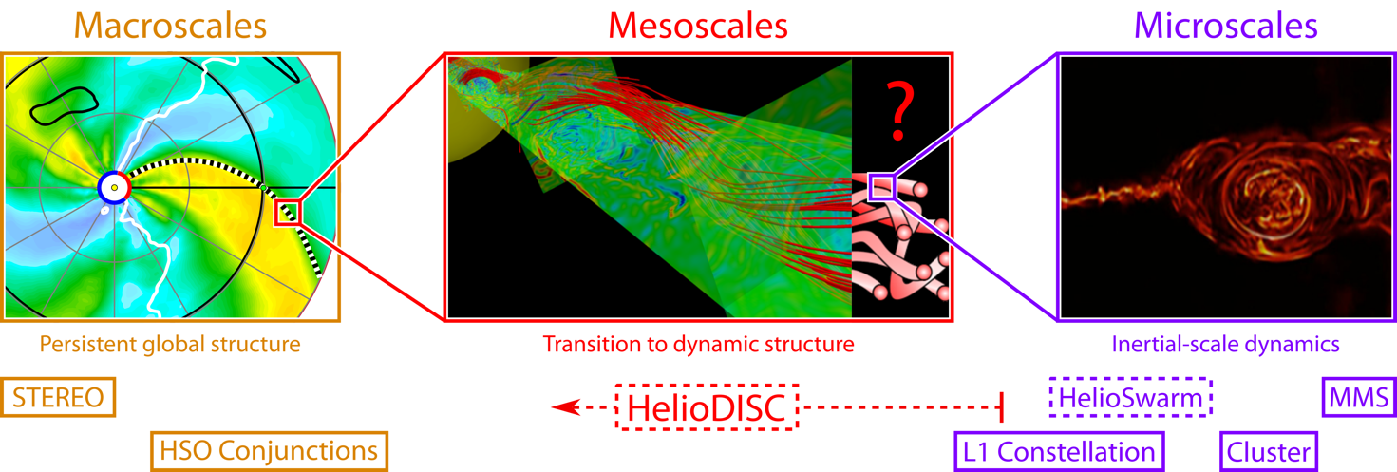
Mesoscales: A critical gap in our understanding
Across all of space physics, mesoscale structuring and dynamics has been a critical gap in our understanding and in our observations
In the context of the solar wind at 1 au, mesoscales range from 100’s of R_{E} to a few degrees in heliographic longitude, i.e., the spatiotemporal scale sizes and dynamics bridging the gap between large-scale structures and kinetic processes and are not well-captured by models or observations from past and current missions
HelioDISC Science Thrusts: (1) Fundamental mesoscale structure of the solar wind & transients, (2) Effects of mesoscale structure and variability on particle acceleration, (3) Effects of mesoscale structure and variability on particle transport.

Slide 3
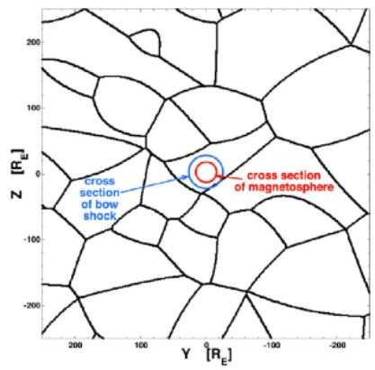
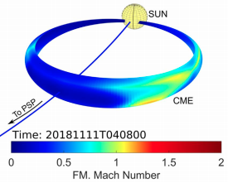
HelioDISC mission at a glance
In order to explore the mesoscale structure and variations of the solar wind, and subsequent effects on particle acceleration and transport, we need multipoint observations with small inter-spacecraft separations.
HelioDISC will consist of 4 spacecraft in Earth-trailing heliographic orbit.
  The relative drift rates from Earth will be different for each spacecraft such that the inter-spacecraft separations will vary from 0.5 Mkm (100s R_{E}) early in the mission to 10’s Mkm (few degrees in heliographic longitude) late in the mission, allowing HelioDISC to scan through mesoscale-relevant scale sizes.
Hu et al., 2018
Giacalone et al., 2020
Borovsky, 2018
Bain & Li, 2021

Slide 4
Science Objectives
Overarching Goal | HelioDISC Objectives | Targeted Science Questions
Investigating the fundamental mesoscale nature of the variable solar wind and impacts on particle acceleration, evolution, and transport. | 1. Explore the mesoscale variability of the background solar wind and transient solar wind structures | 1.1 What do the predominant scale sizes of the mesoscale solar wind and IMF reveal about the origins of these structures?
 |  | 1.2 How do large-scale, persistent structures transition into dynamic turbulence?
 |  | 1.3 How do mesoscale variabilities manifest in seed particle properties and composition?
 |  | 1.4 How does the mesoscale solar wind imprint itself on solar wind transients and interplanetary shock structures?
 | 2. Understand and characterize the impact of these mesoscale variations on particle acceleration | 2.1 How does mesoscale solar wind variability and intermittency impact variability in particle acceleration?
 |  | 2.2 What is the role of mesoscale variability of seed particle populations in the variability of suprathermal to energetic populations?
 |  | 2.3 How does mesoscale structuring of solar wind transients and interplanetary shocks affect particle acceleration?
 | 3. Understand the impact of these mesoscale variations on particle transport | 3.1 How do mesoscale variations of the background solar wind impact the connectivity of an observer to the solar source or acceleration site?
 |  | 3.2 How do mesoscale dynamics such as field line meandering and stochastic motion affect the diffusion of particles in the solar wind?
+1 bonus science topic

Slide 5
HelioDISC Science
Mesoscale structuring of the solar wind

Slide 6
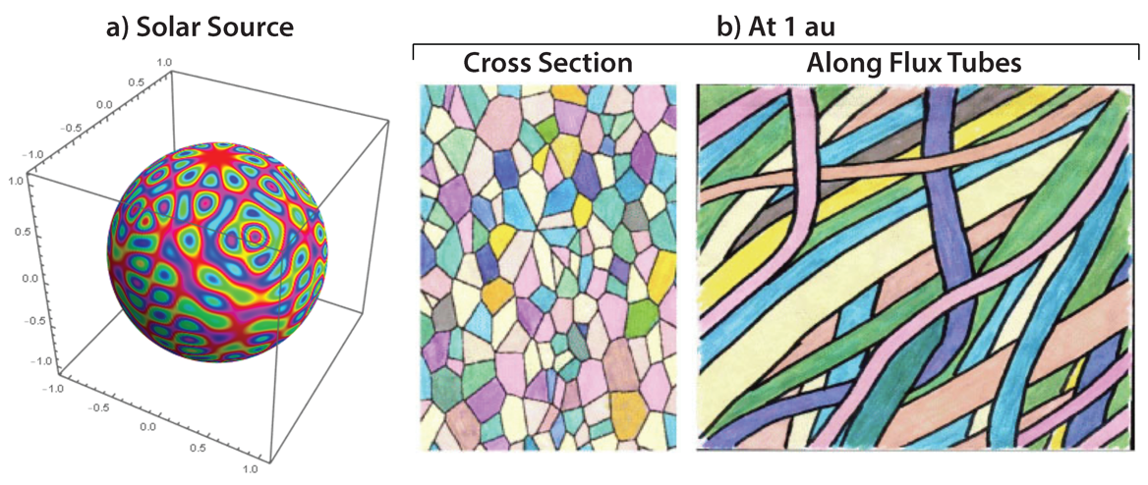
Origin, variability, and mesoscale structure of the solar wind and transients
The solar source is known to have small-scale topological variations in magnetic structures
As these structures convect outward to 1 au, they can undergo processes such as expansion and stochastic meandering, but may preserve their characteristics as granule to supergranule relics on the Sun
The nature of flux tube structure at 1 au remains a fundamental open question.
Bain & Li, 2021
Borovsky, 2008

Slide 7
Origin, variability, and mesoscale structure of the solar wind and transients
Adapted from Verscharen et al., 2019
The origin of injection range variations is not well understood, nor is the break between the injection range and inertial range (i.e., where persistent large-scale structures may transition to dynamic structures).
Single spacecraft observations cannot distinguish between temporal variations and those from convection of spatially-variable solar wind over the spacecraft.
HelioDISC
Multi-point observations of solar wind turbulence are needed to deconvolve spatial-temporal variations.

Slide 8
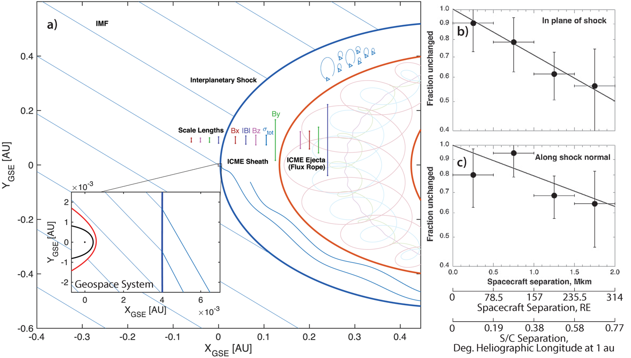
Origin, variability, and mesoscale structure of the solar wind and transients
Neugebauer et al., 2006
The few studies that have investigated the mesoscale structuring of CMEs found that CME shocks and magnetic ejecta have smaller-scale structuring, and that energetic particle profiles often change over mesoscales.
These observations indicate that the “large-scale-only” view of the solar wind is an incomplete picture of the fundamental structure of the solar wind and the important processes that define its evolution.
This has implications for solar wind-magnetosphere interactions
Dedicated multi-point observations are needed to better constrain and understand these variations.
Ala-Lahti et al., 2020

Slide 9
HelioDISC Science
Effects of mesoscale dynamics on acceleration in the solar wind

Slide 10
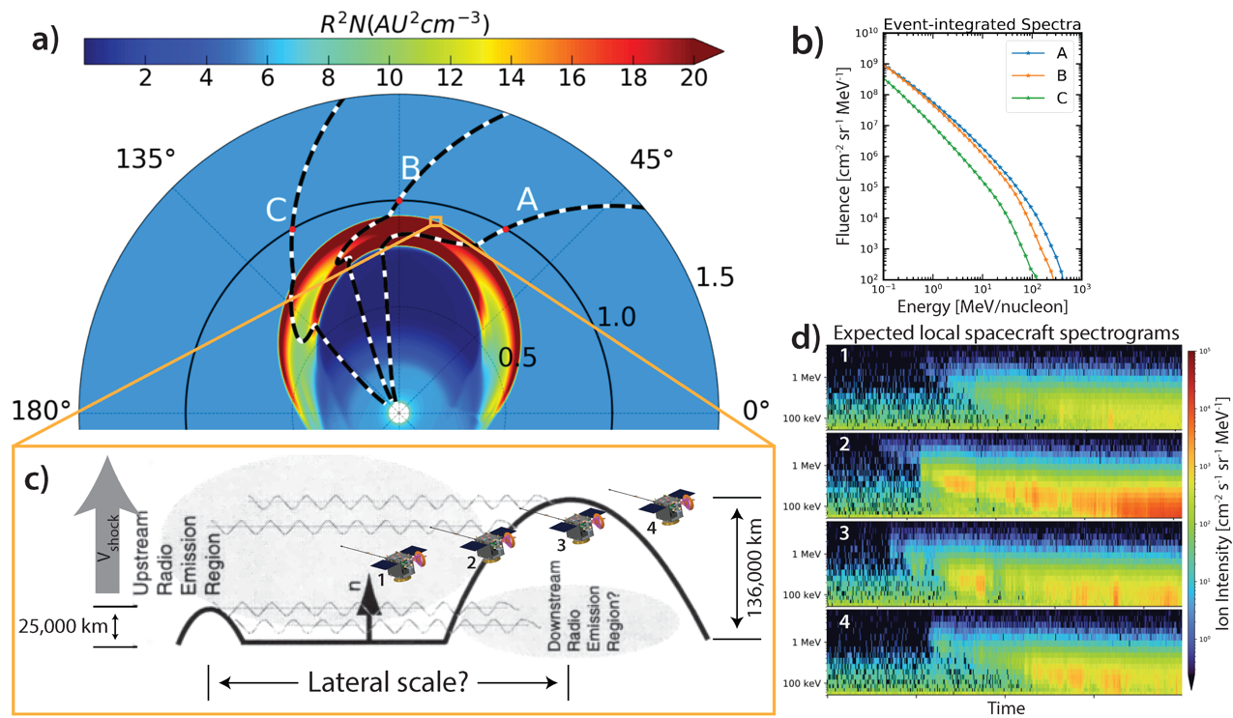
Impacts of mesoscale structure on shock acceleration
Radio wave observations have revealed that shock structure can vary on mesoscales (e.g., Bale et al., 1999).
While current models can reproduce large-scale variation in event-integrated particle spectra along an interplanetary shock, these approaches are unable to capture the effects of mesoscale structuring on shock acceleration or short time cadence evolution in particle populations.
For example, an event-integrated spectra includes particles accelerated from various locations along the shock structure, but the seed populations and freshly accelerated ions will be more localized to the mesoscale variations of the structure and exhibit finer time variability.
Understanding the role of mesoscale structuring in the variability of particle acceleration along an IP shock is critical for investigating the causes of observed variation between events and potential seed populations.
Bale et al., 1999

Slide 11
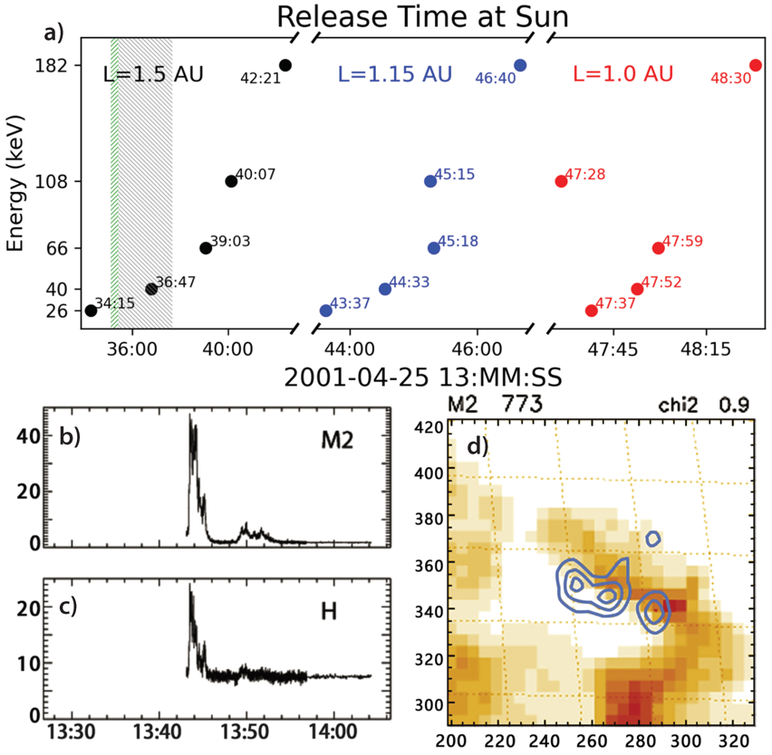
Bonus: Understanding coronal acceleration mechanism through revealing mesoscale solar wind structure
Li et al., 2020
Li et al. (2020) found that the injection timing of flare-associated energetic electrons compared to hard X-ray observations suggests the presence of two distinct electron populations in an impulsive solar energetic electron event.
The presence of these electron populations may indicate different reconnection mechanisms occurring at the flare site (e.g., interchange reconnection vs. reconnection between two closed field lines).
The determination of the path length that the energetic electrons traversed from the flare to the observer is the primary source of ambiguity in these observations.
Observing energetic electrons at multiple spacecraft with a constellation span of <10° allows for the deduction of acceleration time scales of electrons at solar flares, and so for differentiating among proposed reconnection mechanisms at flare sites.
New multi-point observations at mesoscale separations provide further constraints on flare-related particle acceleration processes.

Slide 12
HelioDISC Science
Effects of mesoscale dynamics on particle transport

Slide 13
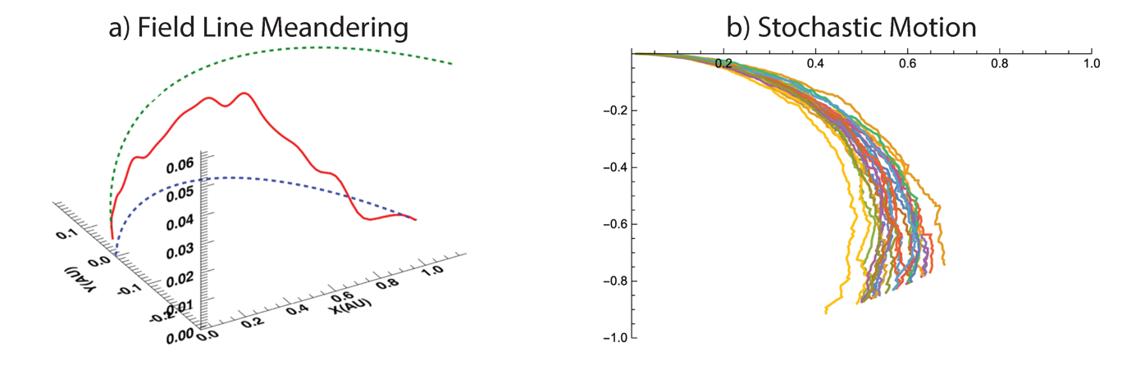
Effects of mesoscale structure on suprathermal and energetic particle transport and propagation
Field line meandering and/or stochastic motion can lead to uncertainties of where a source region may map to of up to 10° in longitude at 1 au.
Cross-field diffusion and other transport processes are also poorly understood in the solar wind.
For example, it is currently unclear how much of what has been interpreted as cross-field diffusion in previous observations is instead a result of field-line meandering and/or stochastic motion, and how the relative importance of these various processes change in time.
Only a multi-spacecraft vantage point, with mesoscale separations, can provide the critical measurements needed to constrain particle diffusion and field line motion and evolution in the solar wind.
Ashraf & Li, 2019
Bain & Li, 2021

Slide 14
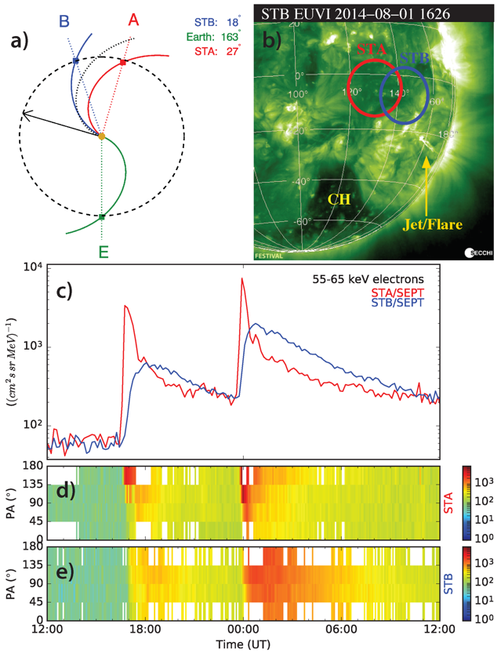
Effects of mesoscale structure on suprathermal and energetic particle transport and propagation
Klassen et al., 2016
The complexities of transport between the corona and 1 au are apparent in impulsive SEP events.
Klassen et al. (2016) reported a flare event from an active region near the footpoints of both STEREO spacecraft, but observations indicate different connectivity than expected.
Transport of these flare-accelerated energetic electrons depends on background solar wind structure, particle acceleration at flare sites, and the mechanisms driving cross-field diffusion.
This presents a clear example of the importance of mesoscale variations on the transport of energetic electrons from the flare site in the corona to 1 au.
As such, a robust multi-point investigation at mesoscale separations is required to disentangle the complexities of particle transport in the inner heliosphere.

Slide 15
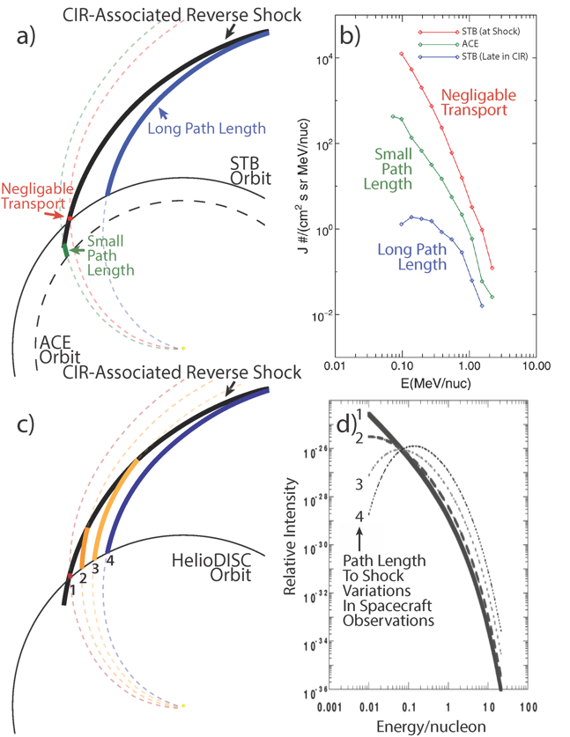
Effects of mesoscale structure on suprathermal and energetic particle transport and propagation
Zhao et al., 2016
As energetic particles propagate along a field line away from an acceleration site, such as from reverse shocks at CIRs, various processes (e.g., adiabatic cooling and particle scattering) leading to hardening of the lower-energy spectra are thought to occur (e.g., Fisk & Lee, 1980).
However, this spectral hardening has not been observed as often, or as significantly, as expected.
To try to explain this discrepancy, several theories have been developed, such as compressive, non-shock related acceleration (e.g., Giacalone et al., 2002; Fisk & Gloeckler, 2006) and/or modifications to the magnetic topology, such as sub-Parker spirals (e.g., Murphy et al., 2002; Schwadron et al., 2020).
While these processes explain the seemingly weak modulation of observed particle spectra, Zhao et al. (2016) reported a CIR observation that suggested strong path length-dependent modulation can also occur.
Mason et al., 1999
Only an investigation using simultaneous, multi-point observations from different points within a CIR and its rarefaction region allows for differentiation between path-length dependent modulation and competing transport and acceleration processes.

Slide 16
HelioDISC Mission Architecture

Slide 17
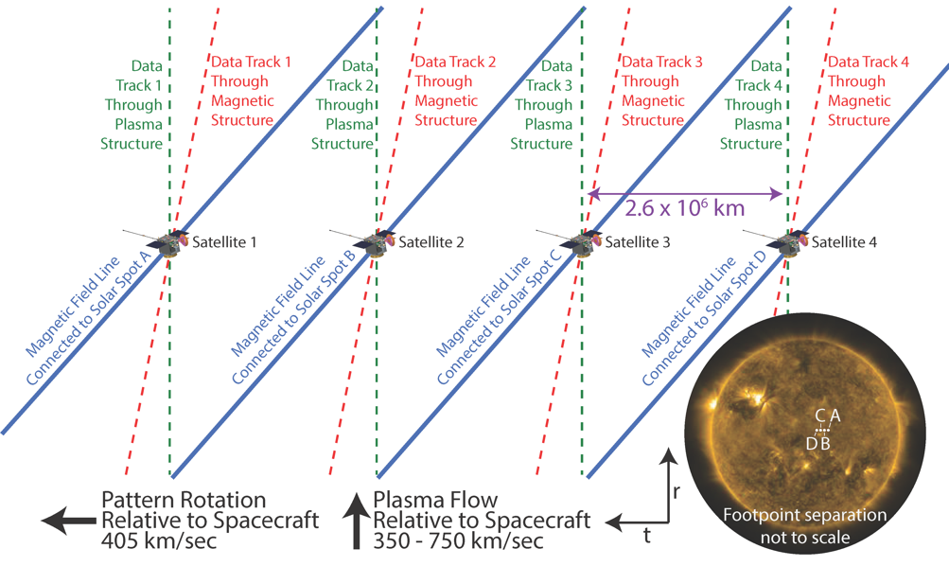
HelioDISC mission architecture
Baseline mission includes 4 spacecraft put into Earth-trailing heliographic orbit.
  The relative drift rates from Earth will be different for each spacecraft such that the inter-spacecraft separations will vary from 0.5 Mkm (100s R_{E}) early in the mission to 10’s Mkm (few degrees in heliographic longitude) late in the mission, allowing HelioDISC to scan through mesoscale-relevant scale sizes.
The baseline observations from each HelioDISC spacecraft includes:
  Bulk solar wind
  Thermal to suprathermal ion composition
  Suprathermal to energetic ion composition
  Energetic ion composition
  Low energy electron distributions
  Energetic electrons
  DC magnetic field
  AC/radio electric field
  Hard X-rays*
  * On one or two spacecraft only

Slide 18
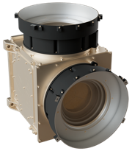
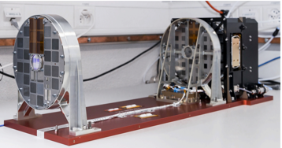
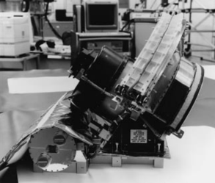
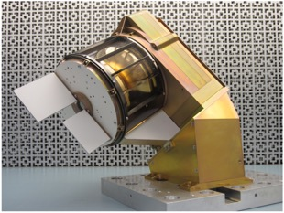
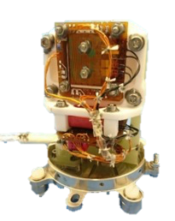
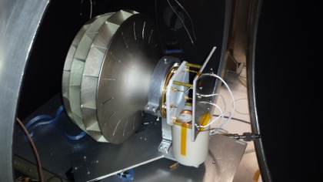
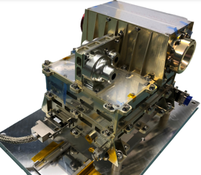
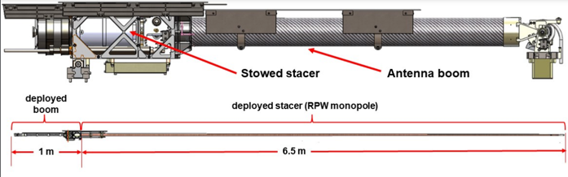
Mock Payload
Bulk ions
Energetic ion composition
Hard X-ray indirect imager
Low energy electron
Fluxgate magnetometer
Thermal ion composition
Suprathermal ion composition
Energetic electron/ion
Electric field radio waves

Slide 19
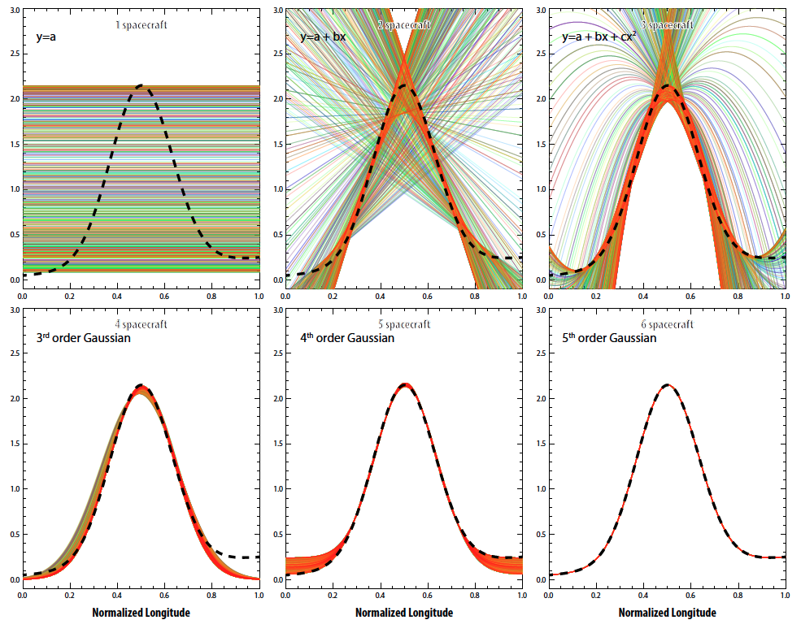
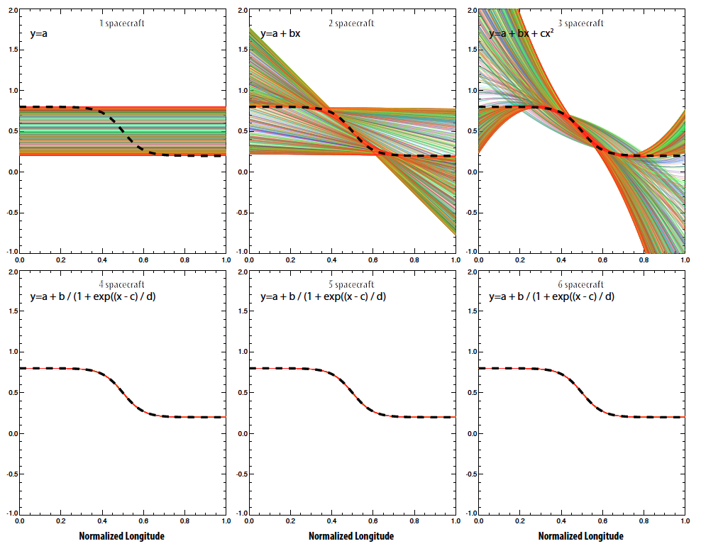
Why Four Spacecraft?
Gaussian Variations
Sigmoidal Variations

Slide 20
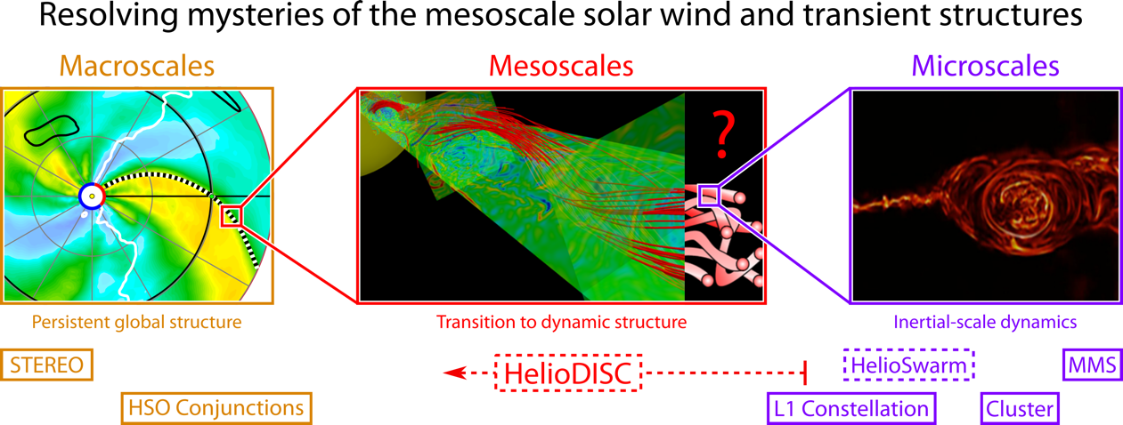
The need for HelioDISC
Fundamentally understanding the mesoscale structure of the solar wind and transients and its subsequent effects on particle acceleration and transport will be paradigm shifting in our vantage point and insight into the heliosphere, as mesoscale dynamics are critical for resolving long-standing questions of the community. HelioDISC will fill an observational gap in the current HSO as mesoscale solar wind structure and dynamics falls between the global scales studied by the in situ instrumentation on STEREO and occasional opportune conjunctions within the HSO, and the kinetic-scales unlocked by MMS, Cluster, and the potential HelioSwarm mission. With coronal source mesoscale structuring to be revealed by PUNCH, HelioDISC will explore the evolution of coronal structures reaching 1 au. As such, a new mission with an enabling, multi-point architecture is essential to address these objectives.

Slide 21


Next steps for HelioDISC
Our Heliophysics Mission Concept Study (HMCS) proposal was selected!
  Pre-study report can be found at: https://go.nasa.gov/3IeZjx2
Under the HMCS ROSES call, we will be submitting:
  White paper on science targeted by HelioDISC to the Helio Decadal Survey
  White paper on the HelioDISC mission architecture to the Helio Decadal Survey
  Mission concept study report to NASA
We are actively working on focusing the science traceability matrix and flow-down to mission requirements in preparation for a full mission development study in early February.
Your feedback and suggestions for the mission concept as we go into the mission design work is really important!
Our team would also like to coordinate and encourage the submission and endorsements of HelioDISC-relevant science white papers to the Helio Decadal Survey
If you are interested in the HelioDISC concept and science, please fill out our community response form: https://forms.gle/4abeQ5WZUJS4etWG7
Pre-study Report
Call for community input
Community Input
Form

Slide 23
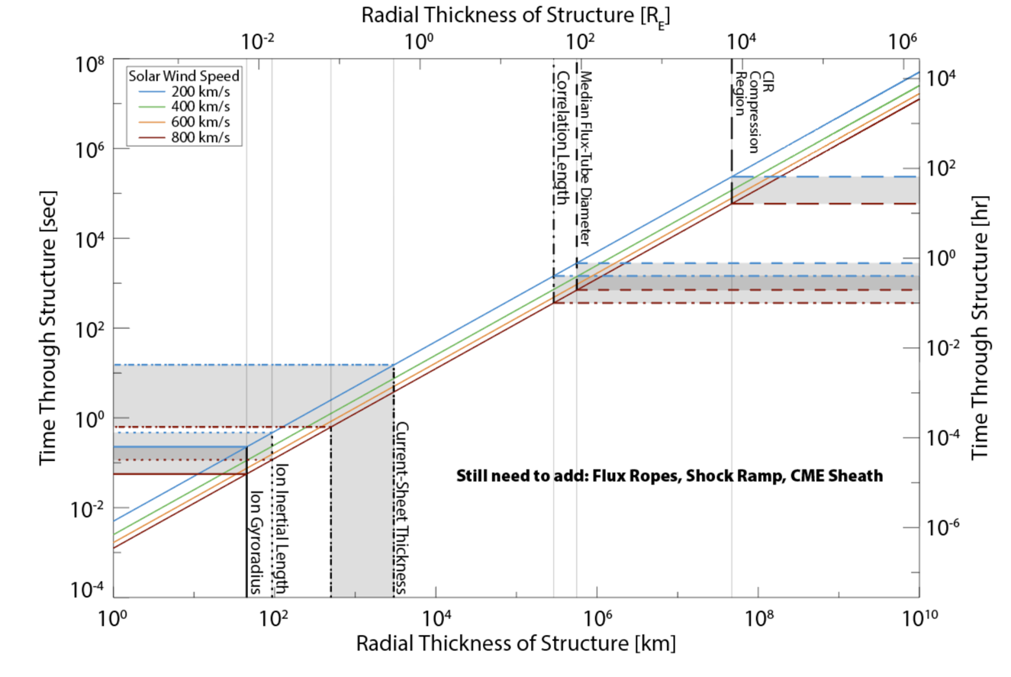
Measurement Requirements
Need bulk ion measurements at the ~1 sec range
Need thermal ion composition at ~1 min cadence

