Slide 1
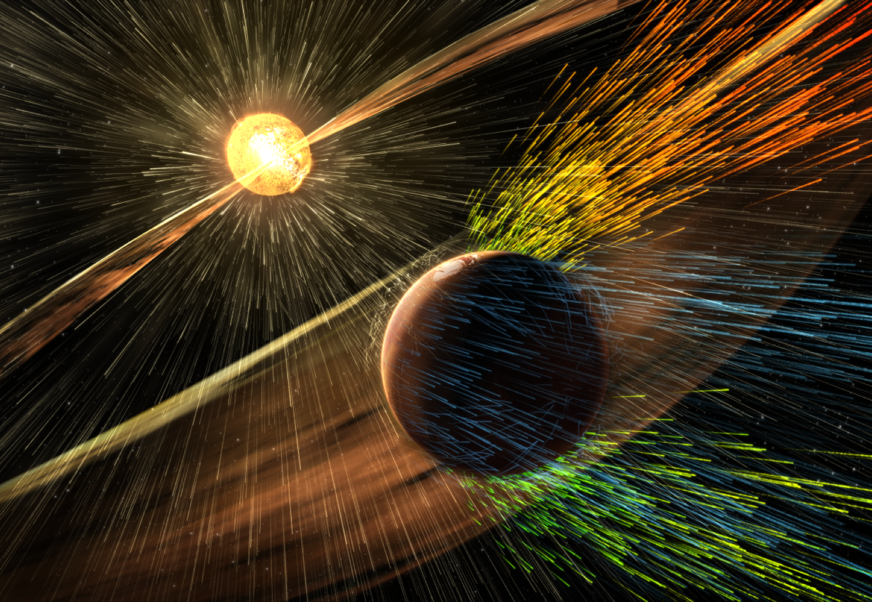

Observations of small scale plasma fluctuations in the solar wind
Maria O. Riazantseva
orearm@gmail.com
Space Research Institute (IKI)
Russian Academy of Sciences,
Moscow, Russia

Slide 2
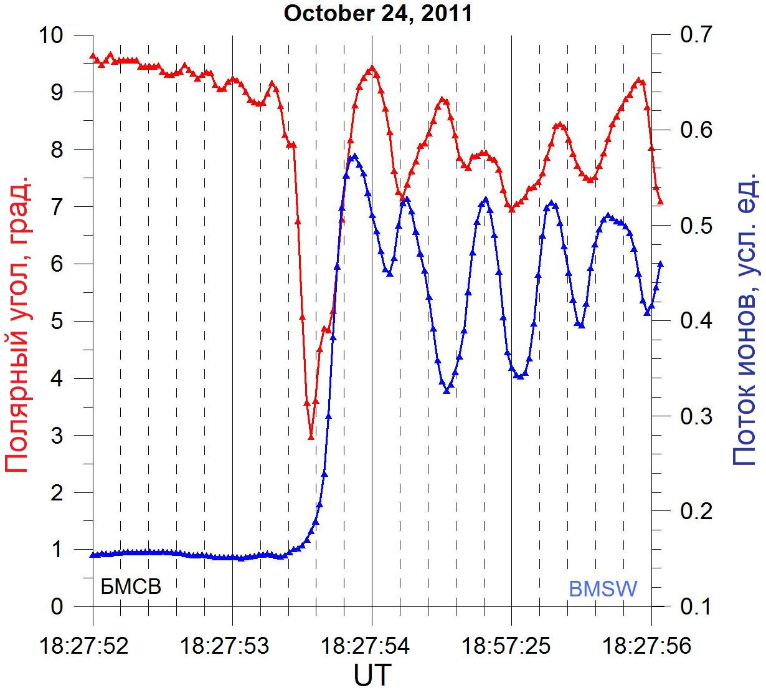
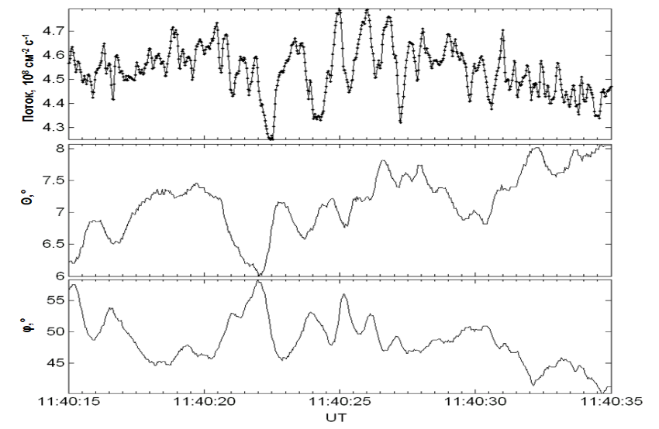
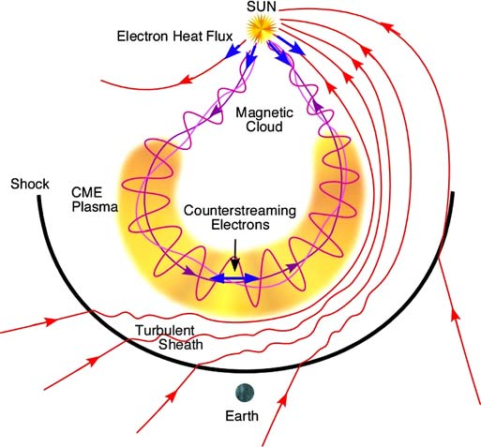
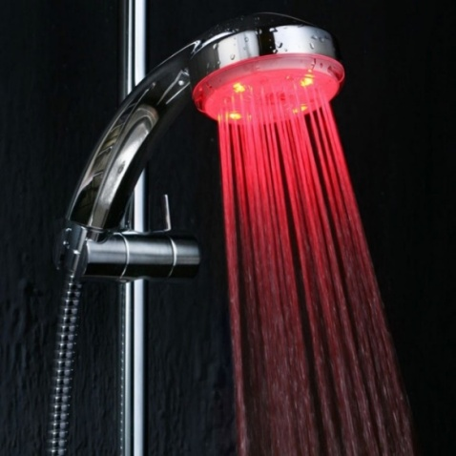
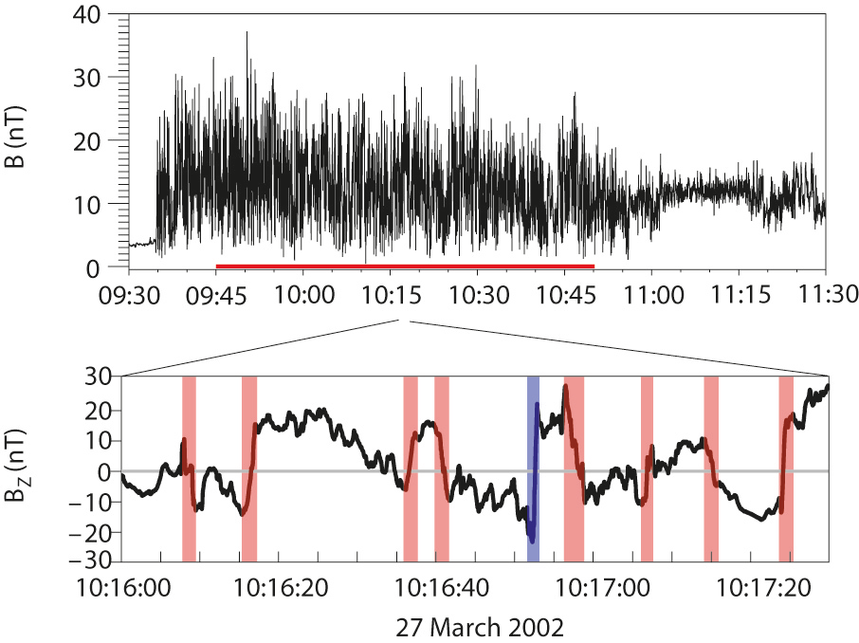
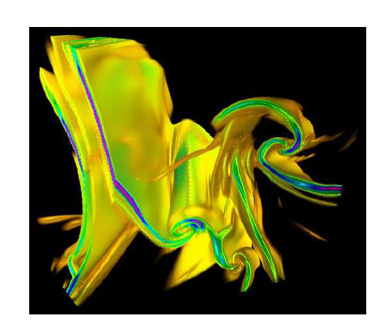
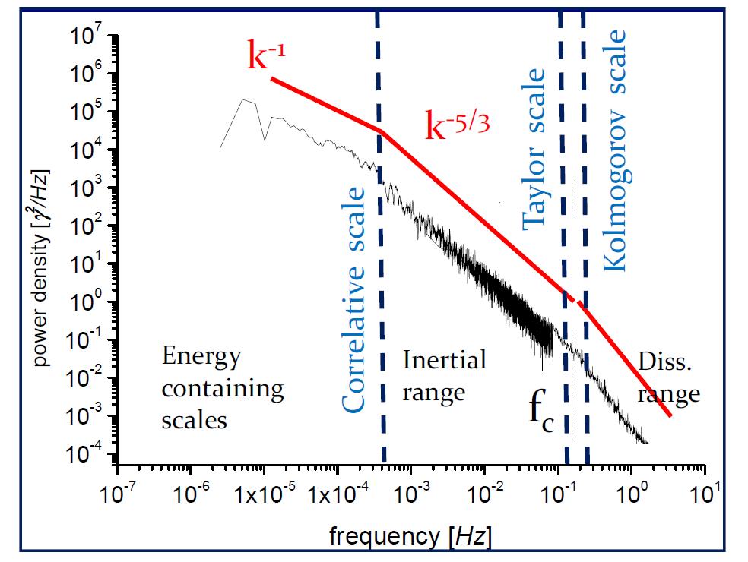
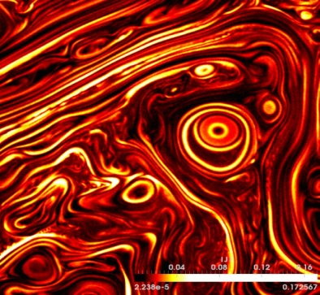
Tasks of small scale plasma measurements in the solar wind
Thin structure of the interplanetary shocks
Jet thin character of the solar wind
24/10/2011
1 sec, ~ 400 km
Kinetic current sheets
Solar wind turbulence at ion kinetic scale

Slide 3
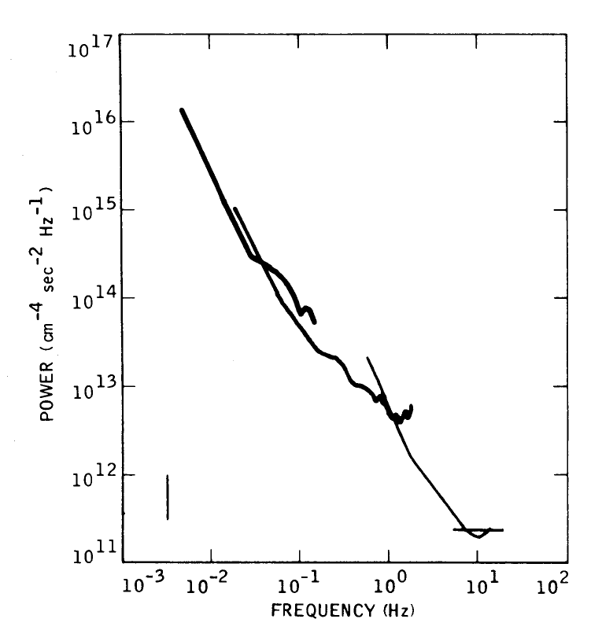
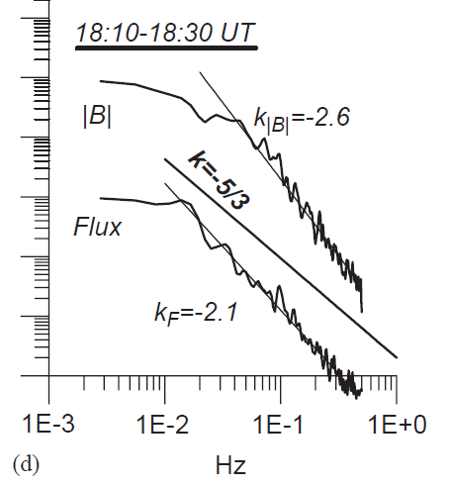
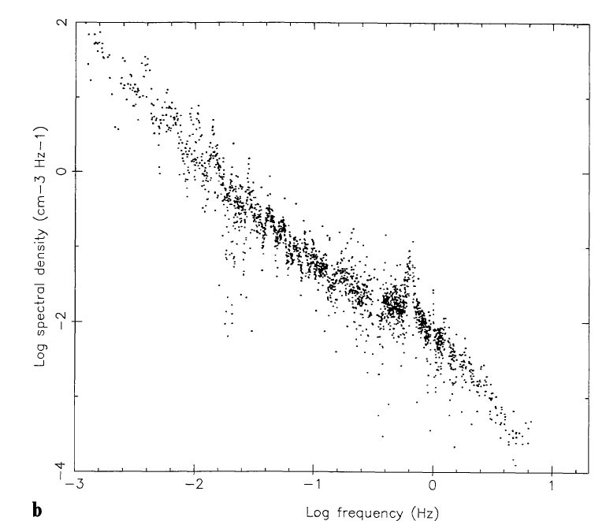
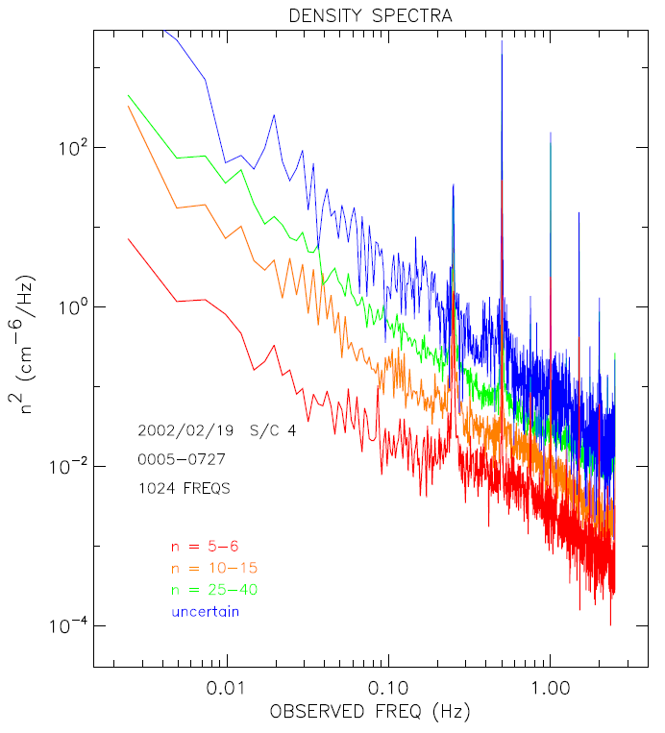
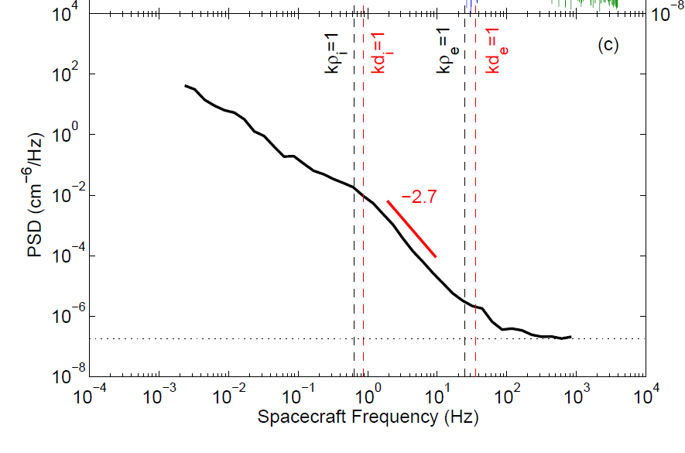
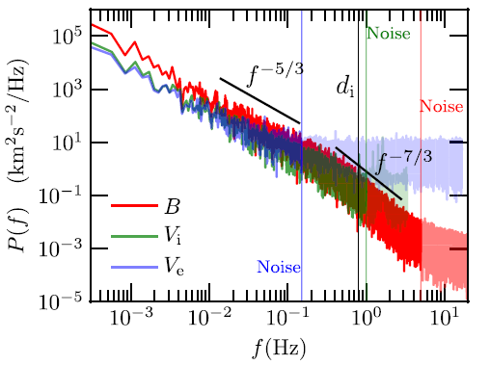
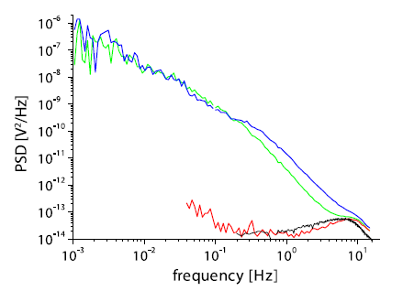
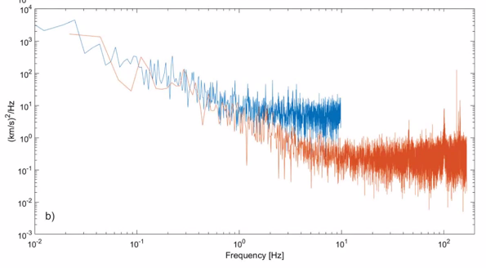
The history of fast plasma measurements in the solar wind
Electron measurements
Proton measurements
ISEE-1, 2 5 Hz (Celnikier et.al.,
Astron. Astrophys. 1983)
Cluster 2.5 Hz (Kellogg & Horbury, Anngeo, 2005 )
OGO-5 13.3 Hz
(Unti et.al., APJ 1973)
Interball 1 1 Hz
(Shevyrev et.al., PSS 2005)
ARTEMIS >100Hz (electron density from spacecraft potential) Chen et.al., PRL 2012.
MMS electrons ~30 Hz ~ 6 Hz protons (Bandyopadhyay et al., APJ 2018)
Spektr-R 32 Hz (Safrankova et al., SSR 2013)
Parker Solar Probe up to 128 Hz
(Kasper et.al., SSR 2016)

Slide 4
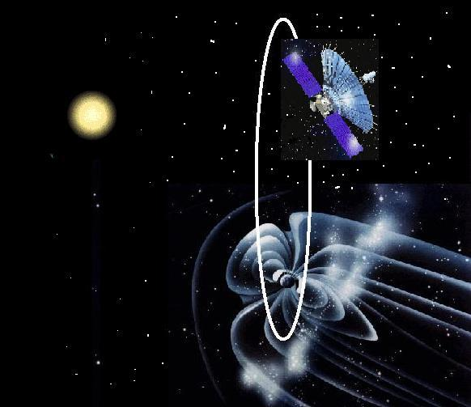
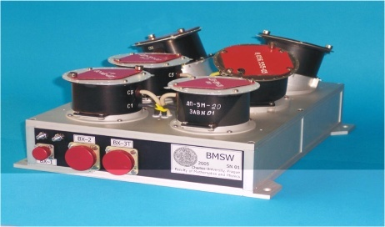
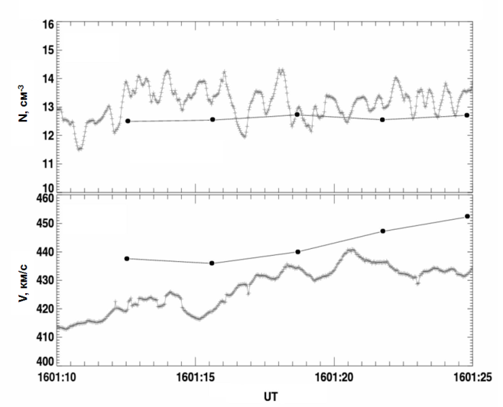
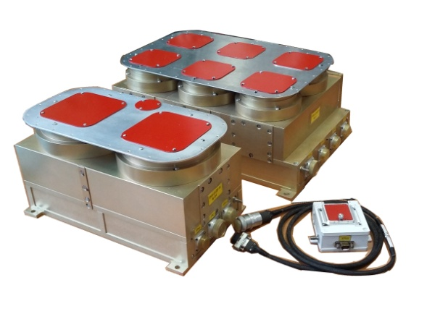
BMSW instrument (experiment PLASMA-F, spacecraft SPEKTR-R)
Highly elliptical orbit (apogee 340000 km = 53 R_{Е} )
Long time series in the SW+BS crossings+ Flang MSH
Data 08/2011 – 01/2019
Measurements:
  F (ion Flux vector) ( 31 ms )
  N_{p}, V_{p}, V_{thp} (31 ms –adaptive mode)
  N_{p}, V_{p}, V_{thp}, N_{α}, V_{α} ( 3 s - sweeping mode)
Spektr-R
BMSW at Spektr-R
Safrankova et al., Sp. Sci. Rev., 2013
Zastenker et al, Cos.Res., 2013;
Collaboration:
Space research Institute (IKI) RAN (Russia)
Charles University in Prague (Czech Republic)
SPEKTR-R (31 ms)
N, cm⁻³
Future missions:
Luna-26
Resonans-MK (Strannik)
Gamma-400
Interheliozond
Solaris (Monitor-SW)
WIND (3 s)
V, km/s
BMSW for Luna-26 mission
(Russia – plan 2024)
UT

Slide 5
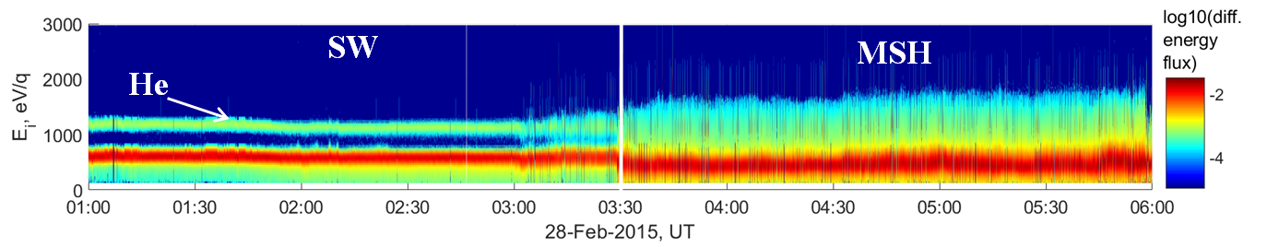
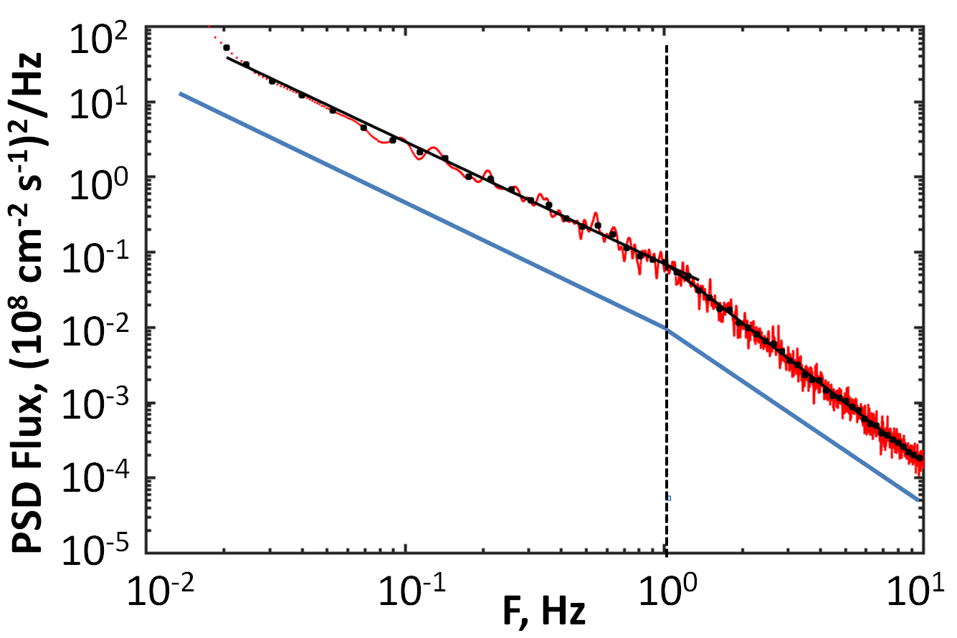
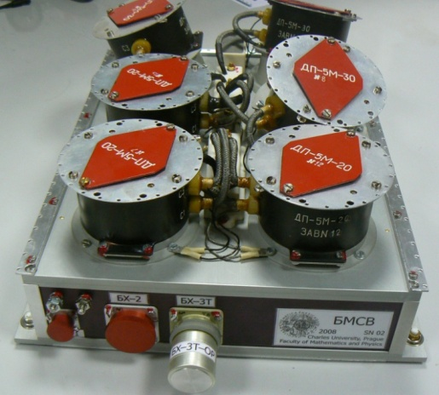
High resolution plasma measurements at BMSW instrument
Science objectives:
Plasma turbulence in the solar
wind and magnetosheath
Thin structure of shock fronts
Small scale plasma structures
Fast variations of helium abundance
Monitoring of the solar wind
MHD scale
P₁=-1.6
BMSW measurements
-5/3
Kolmogorov turbulence
BMSW – First systematic direct measurements at ion kinetic scale.
Ion kinetic
scale
P₂=-2.7
The limit of systematic direct measurements
before the SPEKTR-R
-7/3
KAW turbulence
Fluctuations of the ion flux as a rule show the density fluctuations(Neugebauer et al., JGR 1978; Pitna et al., APJ 2016).
Riazantseva et. al, Phil. Trans. R. Soc. A. 2015

Slide 6
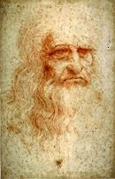
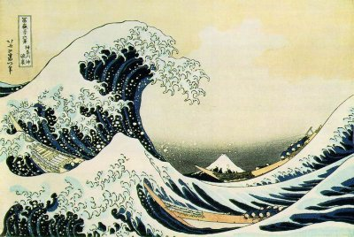
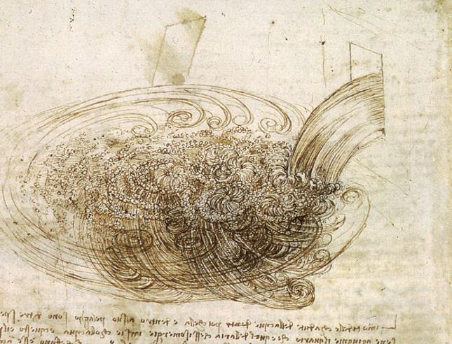
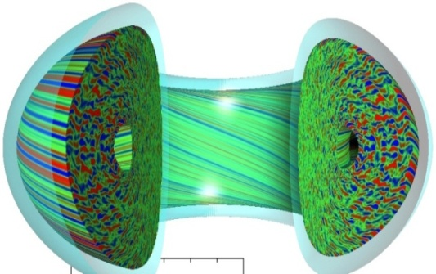
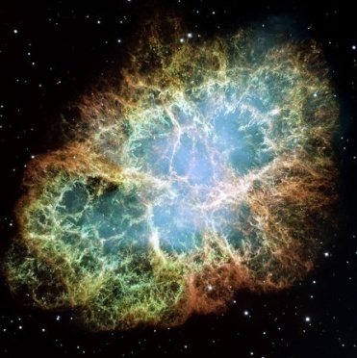
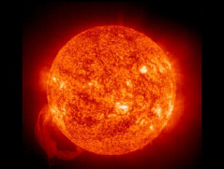
The phenomenon of turbulence
La turbolenzasince Leonardo da Vinci.
From latin “turba” - «A crowd of disordered people, with an idea of annoying intimidation, each strolling around following a given direction».
Katsushika Hokusai
The Great Wave of Kanagawa
Turbulence in laboratory and space plasma

Slide 7
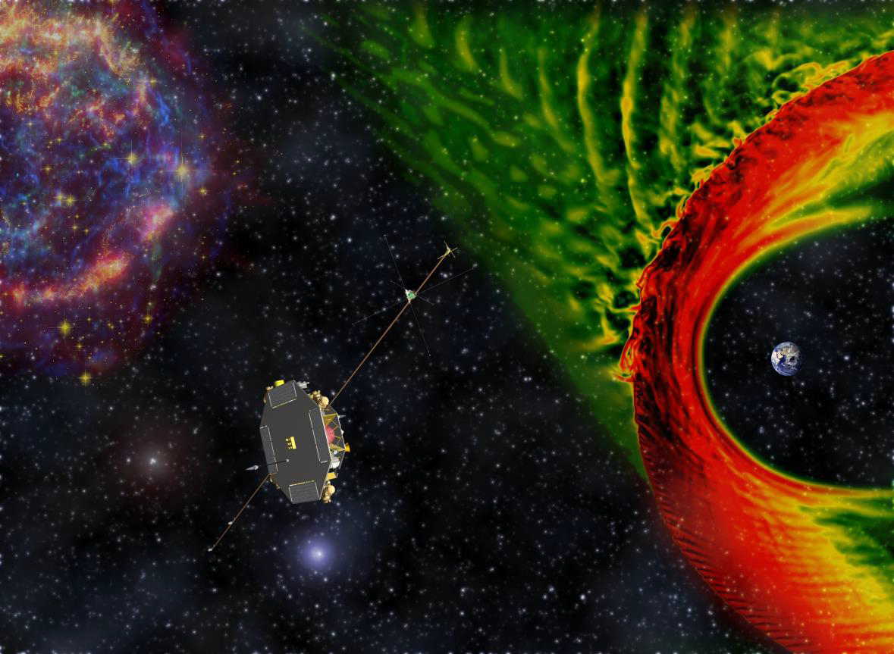

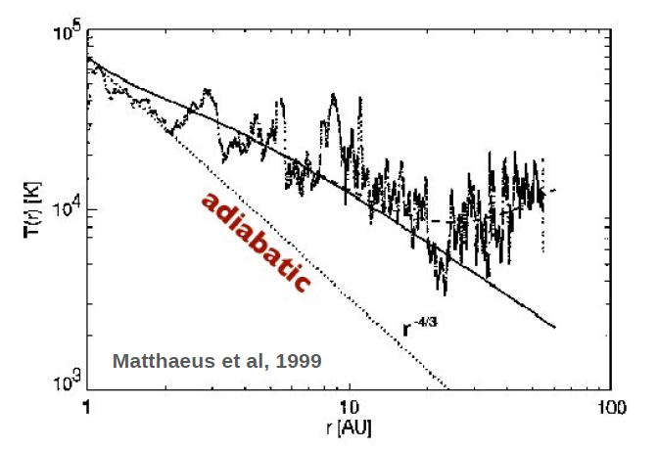
The solar wind as a laboratory of turbulence
General processes of energy exchange between the structures of different time and spatial scales.
Solar wind plasma heating and acceleration.
The proportion of the dissipated energy between heating and acceleration of electrons, protons and heavier ions
Development of correct models of plasma expansion from the sun to the Earth and inside to the magnetosphere.
Voyager 2
Space plasma– collisionless turbulent medium with high Reynolds number (∼3⋅10⁵ at 1 AU)
Charged particles interact via electromagnetic forces (electric and magnetic fields);
Turbulent
Most of the plasma energization is expected to occur at kinetic scales ( particle gyroradii and below) - In the solar wind we can look "inside" the dissipation process in hot plasma
Non-adiabatic decay of proton temperature with distance (Matthaeus et al., PRL 1999)

Slide 8
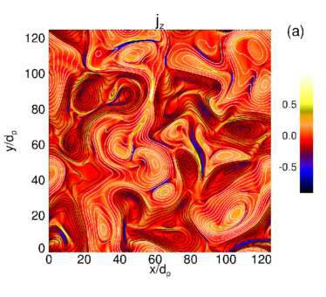
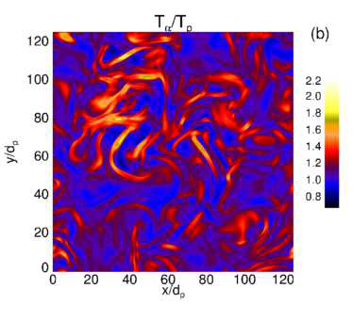
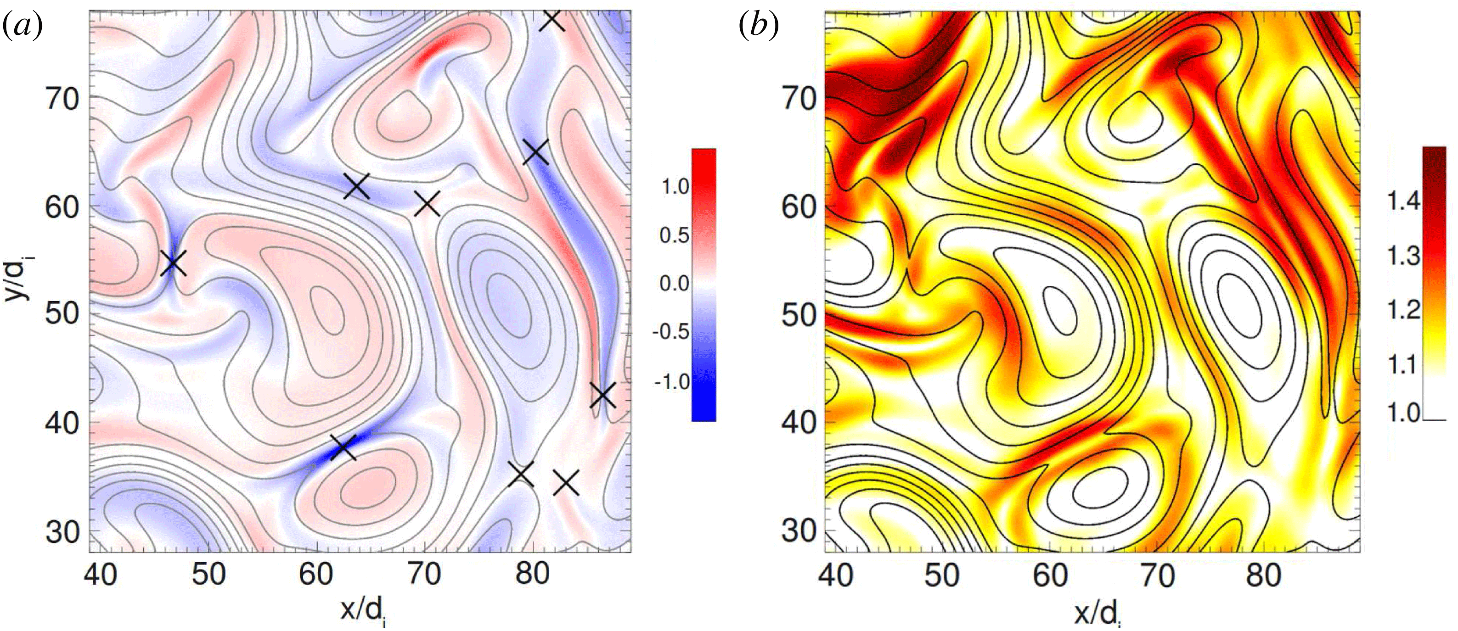
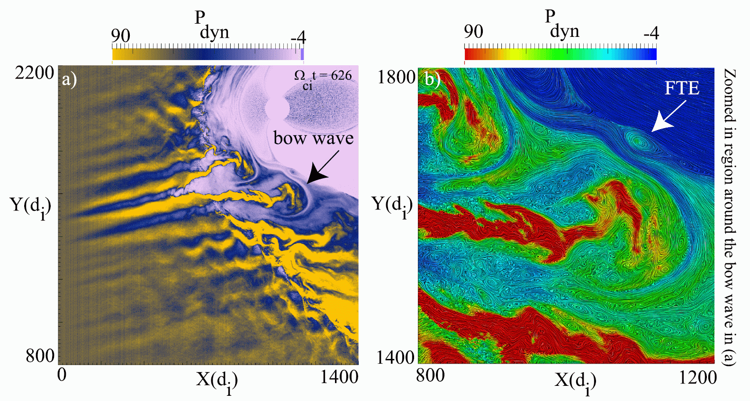
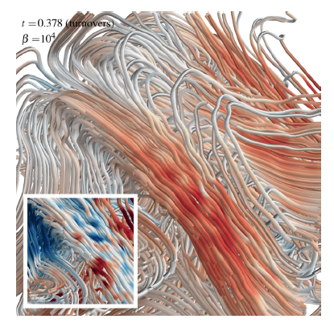
Simulation of the solar wind turbulence up to smallest scales
Eulerian Vlasov simulation
(Vallentini et al., Phys. Sp.Phys, 2016)
hybrid Vlasov-Maxwell model
(Servidio et al., PRL 2012 )
Numerical simulations are a powerful tool to investigate the kinetic dynamics of plasmas coupled with the study of experimental measurements
hybrid Vlasov-Maxwell model (Rincon et al., PNAS, 2016)
hybrid simulation (electron fluid, kinetic ions)
(Karimabadi et al., Phys Pla 2014)

Slide 9
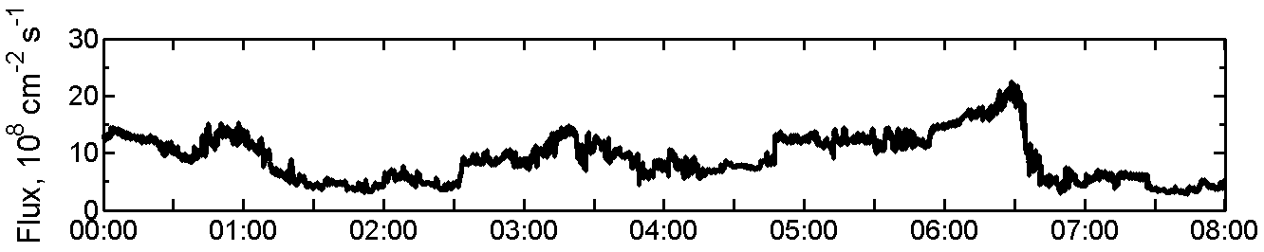
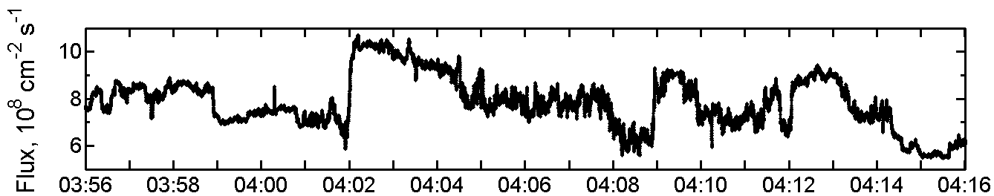
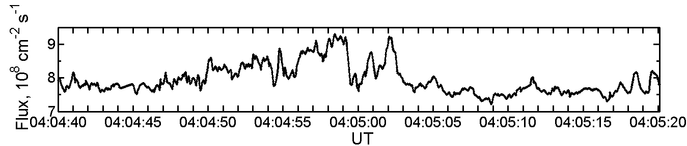
Plasma fluctuations at different scales: turbulent cascade
8 hours
a)
Large scale – energy pumping
Middle scale – energy transfer
Small scales - dissipation and heating
Large plasma structures in the solar corona
Magnetohydro-
dynamic approach
is working
20 min
b)
~ 10⁶ km
ω_{c}
-1
~100-1000 km
Energy containing range
-5/3
dissipation and heating
Power spectral density
40 sec
c)
Inertial range
-7/3
~1 km
-?
ω
Integral
scale
MHD
scale
Kinetic
scale
Solar wind Ion flux fluctuations at different scales 2012 /07/15 BMSW, Spektr-R, (Riazantseva,et al.,
Phil. Trans. R. Soc. A. 2015)
Ions
electrons
Schematic cascade of SW turbulence
The high level of variations is observed at all scales → multiscale solar wind structures
→ energy transfer from large to small scales

Slide 10
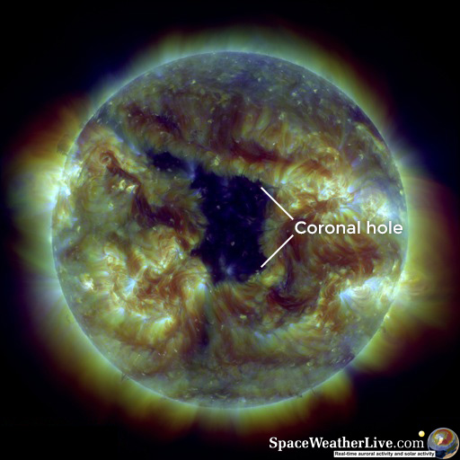
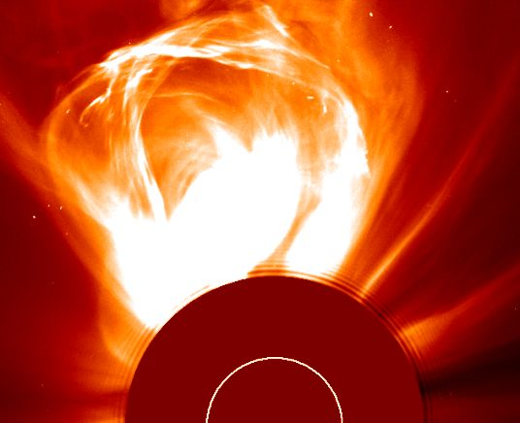
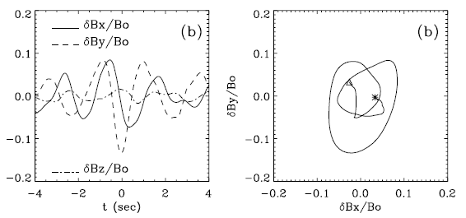
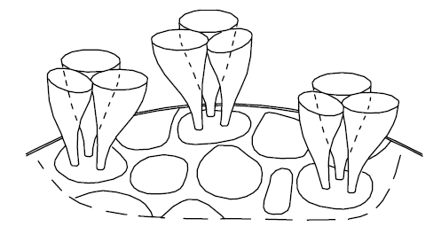
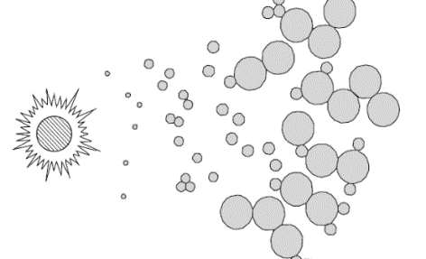
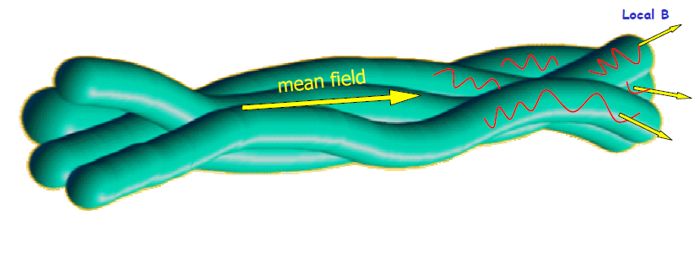
Solar wind structures at different scales
Large scale structures
Small scale structures
Coronal holes (Fast streams)
Coronal Mass Ejections (Ejecta/MC)
Corotation and Stream interaction regions
Heliospheric current sheet
Small scale vortices
Waves
Sharp discontinuities and shocks
current sheets at the kinetic scale
Kinetic current sheets (Retinò et al. , Nature Physics, 2007)
See also the review Khabarova et. al., SSR 2021
Middle scale structures
remnants of the magnetic structures of the photosphere
Flux tubes (mapped to scales of granule and supergranule at the photosphere)
Alfven waves
Alfven Vortex (Alexandrova et al. ,JGR, 2007)
Structures of the solar origin connected to the topology of the source regions at the sun
Structures of the local (interplanetary) origin - connected to the non-linear dynamics of the fluctuations
Bruno et al ,PSS 2001

Slide 11
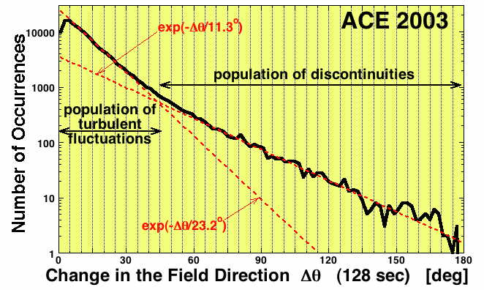
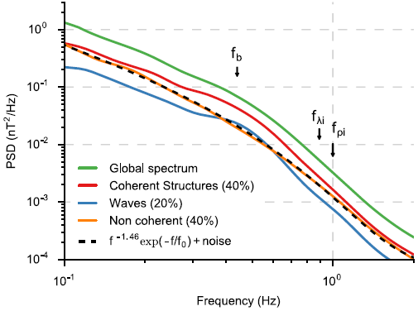
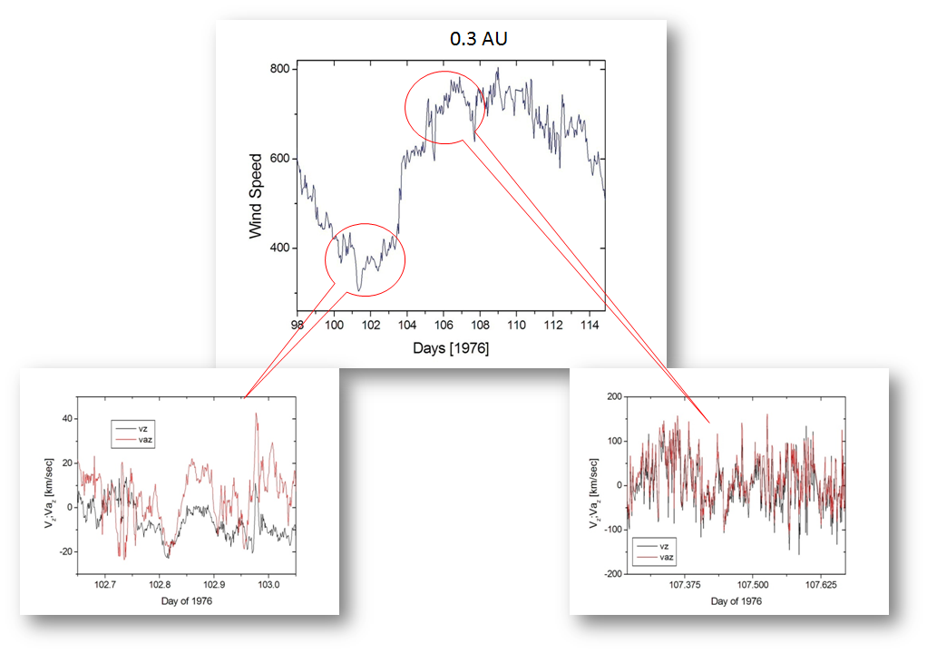
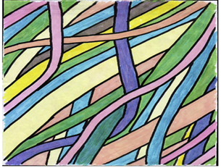
Structures composing the solar wind turbulence
Turbulence is mainly a mixture of random propagating fluctuations including Alfvénic , coherent and noncoherent structures advected by the wind
WIND
ion transition range
Borovsky et al. JGR 2008, PRL 2010
Helios-2
Lion et al., Apj. 2016
Core of the distribution=inner part of the tubes
Tail of the distribution= walls of the tubes
Bruno et al, Liv. Rev. 2013
flux tube texture of the solar wind plasma (Borovsky et al. JGR 2008)
Fluctuations are Alfvénic in the fast solar wind
Non Alfvenic in the slow solar wind

Slide 12
Spectrum of turbulent fluctuations in the solar wind. General view.
Integral scale:
-1 slope at large scale determined by solar activity
MHD scale:
-5/3 (Kolmogorov slope) - strong turbulence, incompressible Alfvenic fluctuations (Goldreich & Sridhar, APJ 1995). (Magnetic field and Density fluctuations).
-3/2 - weak turbulence (Kraichnan , Phys. of Fluids 1965 ) (velocity fluctuations)
Kinetic scale:
-7/3 - kinetic Alfvenic turbulence (KAW), ion cyclotron waves (Schekochihin et al., APJSS 2009)
-8/3 KAW + 2-D structures ( Boldyrev & Perez , APJ 2012)
Strongly depend on solar wind conditions
k^{-7/3}
Typical interplanetary magnetic field power spectrum at 1 AU (Bruno & Carbone Liv. Rev., 2013)
In solar wind V>> V_{A}
Taylor hypothesis (Taylor, RSPSA, 1938) Fluctuations observed at a single point in space can be interpreted as spatial variations in the flow passing by the spacecraft with the bulk velocity.
Violated for whistler waves! (Klein et al., APJL 2014)

Slide 13





Spectrum turbulence at the kinetic scale in the solar wind.
Mean Spectra slope is ~2.7-2.9 both for magnetic field and density fluctuations (close to predicted -8/3)
Small scale fluctuations are predominantly the kinetic Alfven turbulence, the contribution of whistler turbulence is weak
-2.7
magnetic field fluctuations by HELIOS-2 and WIND (Bruno et. al.,2004)
magnetic field and electron density
Fluctuation of ARTEMIS (Chen et.al, PRL 2013)
magnetic field fluctuations by Cluster (Alexandrova et. al., PRL 2009)
Ion flux fluctuations by Spektr-R (Riazantseva et. al., JPP 2017)
Density fluctuations by Spektr-R (Safrankova et. al., APJ 2016)

Slide 14




The break frequency at the spectrum of turbulence is the solar wind.
Ion cyclotron frequency F_{ci} =q_{i} B₀/2πm _{I} ( Goldstein et al., ARAA 1995)
Ion thermal gyroradius R_{T}=V_{t}/ ω_{c} ( scale F_{ρi} =V/2πR_{T} ) (Schekochihin et al., APJSS 2009). Scale of the transition of Alfvenic turbulence to the kinetic regime .
Ion inertial length λ_{i} = с/ ω_{p} (scale F_{λi} =V/2πλ_{i} ) (Galtier, JPP 2006 ).
In case if turbulence has a large parallel component ( current sheet)
combined scaling F_{λi} =V/2π(λ_{i} +R_{T}) - minimum wavenumber at which the resonant dissipation would be important (Leamon et al., JGR1998)
Magnetic field
F_{br} /F_{ρi}
F_{br} /F_{λi}
β_{p⊥}
Characteristic plasma scale of the break is still under debate.
β<<1 и β>>1 (scaling F_{λi} and F_{ρi} well separated) (Chen et al., 2014 JRL)
all β
low β
The break point at different distance
from the Sun (Bourouaine et al., Apj, 2012)
F_{br} /F_{ρi}
F_{br} /F_{λi}
Density
Density
β_{p}
β_{p}
Safrankova et al., ApJ 2015, 2016

Slide 15




Spectra with flattening in the vicinity of the break
Three different spectral slopes with two clear break are revealed in the density spectra
the magnetic field and bulk and thermal speeds exhibit only one break point between ranges
Chandran et al, 2009 predicted that plateau is more distinct for low β and low level of density fluctuations
Turbulence in the MHD range is dominated by non-compressive Alfvenic fluctuations, the role of compressive fluctuations is increased at the small scales
kinetic range
Ion inertial length
plateau
-5/3
Slope 3
MHD range
Slope 1
Slope 2
Break 1
Break 2
Spectra of density fluctuations. Spektr-R
(Safrankova et al, ApJ, 2015 )
β =0.43
β =0.01
First measurements of plateau at ion kinetic scales (Unti et.al., APJ 1973)
Superposition of Alfvénic turbulence and Kinetic Alfvénic turbulence (Chandran et al., APJ, 2009 )

Slide 16




Spectra with anomaly steepening at kinetic scales
Spektr-R
IP shock
Such with anomaly steepening can be observed for high speed streams in the SW, for example downstream the interplanetary shocks shocks or inside the magnetic clouds
upstream
PSD, (nT² Hz⁻¹)
Downstream
Magnetic field
Pitna et.al., APJ 2016
F,Hz
Bruno et.al., APJ 2014
Spektr-R
Bruno et al. (APJ 2014) - the dependence of spectral steepening on SW velocity might be related to some dissipative mechanism, such as Landau damping and/or ion-cyclotron resonance.
Voitenko et al (2016) - steepening is mainly nonlinear, due to collisions among co-propagating waves (co-collisions). The resulting spectra are steep, non-universal, and depend on the turbulence imbalance.
Riazantseva et.al., JPP 2017

Slide 17



The Variety of shapes of turbulent spectra in different large scale SW structures.
50%
The observed frequency spectra do not often correspond to the existing models of turbulence due to lack of local balance between energy inflow and outflow along the spectrum
As a rule models describe the behavior of freely developing plasma turbulence in steady solar wind flow
Actually the development of turbulence is limited by boundaries between streams of different speed and nature
32%
6%
Velocity shears near the boundaries of large-scale structures can play a critical role in the development of turbulent cascade
Dissipation process can be changed in different regimes of turbulence (Pristine solar wind, Flow interaction regions, Shocks and sheath regions behind shocks)
Riazantseva et al. JPP 2017, GIA 2017; Rakhmanova et al. JGR 2018

Slide 18

Dynamic of spectrum of turbulent fluctuations.
Spectra of ion flux fluctuations by BMSW (Spektr-R) 12/02/09 10:29-12:02
Spectra with bump in the vicinity of the break - signature of instabilities or localized coherent structure

Slide 19


The comparison of ion flux fluctuation spectra in slow steady solar wind
and in the disturbed streams by Spektr-R measurements
Slow steady SW – close to the prediction of models (at MHD scale -5/3 – Kolmogorov model,
at kinetic scale -7/3 – prediction of KAW model)
CIR, Sheath are characterized by the highest spectral density (PSD), and the most steep spectrum at the kinetic scale , the break is shifted to high frequencies
F_{br}
F_{br}
F_{br}
F_{br}
F_{br}
F_{br}
F_{br}
-7/3
-7/3
SW Type | Slow SW | SHEATH MC | MC
β_{p} | 0.3 | 0.5 | 0.02
P₁ | -1.3 | -1.8 | -1.6
P₂ | -2.3 | -3.7 | -3.0
Fbr₂, Hz | 0.6 | 2.9 | 1.8
F_{c}, Hz | 0.05 | 0.18 | 0.19
F_{λi}, Hz | 0.5 | 1.6 | 0.7
F_{ρi}, Hz | 0.9 | 2.2 | 5.0
SW Type | Slow SW | CIR
β_{p} | 1.2 | 1.2
P₁ | -1.57 | -1.61
P₂ | -2.2 | -3.1
Fbr₂, Hz | 0.6 | 1.6
F_{c}, Hz | 0.06 | 0.09
F_{λi}, Hz | 0.6 | 1.0
F_{ρi}, Hz | 0.6 | 0.9
Riazantseva et al. Cos. Res. 2019-2020;
Petrukovitch et al., UFN 2020

Slide 20



The properties of ion flux fluctuation spectra in different types of solar wind streams
-5/3
P₁ MHD scale
SHEATH МС, CIR and MC - the highest spectral density (PSD), and the most steep spectrum at the kinetic scale. The turbulent properties at the ion kinetic scale are strongly different from model predictions, and can be the signature of the disbalance between energy pumping over the spectrum and dissipation, which in turn can lead to the intensification of dissipation processes and additional heating.
P₂ kinetic scale
-8/3
SW type | PSD₁ | P1 | P2 | Fbr₂, Hz
Slow | 0.53 | -1.56±0.01 | -2.79±0.01 | 1.0±0.02
Fast | 0.63 | -1.62±0.02 | -2.79±0.02 | 1.2±0.04
EJECTA | 1.00 | -1.69±0.01 | -2.91±0.01 | 1.5±0.03
SHEATH EJECTA | 0.65 | -1.6±0.02 | -2.9±0.02 | 1.2±0.04
MC | 1.02 | -1.61±0.02 | -3.04±0.02 | 1.7±0.05
SHEATH MC | 3.02 | -1.68±0.02 | -3.17±0.02 | 1.9±0.05
CIR | 2.57 | -1.63±0.02 | -3.08±0.02 | 1.6±0.03
-7/3
F_{br2}

Slide 21




The characteristic scales of the break frequency in different large-scale SW types
F_{br2 /}F_{ρi}
F_{br2 /}F_{λi}
The break frequency is statistically related: In Sheath and CIR with the gyroradius of the proton,
and in a steady slow solar wind with the inertial length of the proton (partly Riazantseva et al. Cos. Res. 2020)

Slide 22



Intermittency in the solar wind
Intermittency is universal feature of turbulence:
high activity regions area alternate with quiescence regions
Energy dissipation is more efficient when it occurs in vortices distributed inhomogeneously in space.
Large numbers of sudden ion flux changes by Interball-1 data unevenly inhomogeneously in space (Riazantseva et al., JGR 2005)

Slide 23


Multi-scaling process of plasma eddies in the solar wind.
Roman broccoli
Multiscale process: (Zelenyi & Milovanov, UFN 2004)
Monofractal structure of eddies: Isotropic process of Kolmogorov type, probability distribution functions of fluctuations are Gaussian → trivial self similarity
Multifractal structure of eddies: long-range correlations with memory effect, probability distribution functions of fluctuations are not Gaussian → extended self similarity ?
Roman
broccoli
Solar wind observations demonstrate the absence of trivial self-similarity
Self-similar object is exactly or approximately similar to a part of itself

Slide 24



Non gaussian statistic in the solar wind turbulence
Helios 2
Selfsimilar - statistical properties of the signal do not depend on the position of the selecting window
Intermittent - statistical properties of the signal strongly depend on the position of the selecting window
The variation of the solar wind parameters are gaussian at the large scale and have flatter tails at the small scale (not gaussian PDF- extreme events more probable)
multifractal signal and high level of intermittency
Cluster
Spektr-R
Sorriso et. al., GRL 1999
Traditional models of turbulence assume self-similarity flow and do not take into account the statistical properties of solar wind flow (non Gaussian statistic)
Riazantseva,et al.,
Phil. Trans. R. Soc. A. 2015
Kiyani et. al., PRL 2009

Slide 25


The flatness as a measure of intermittency
Flatness (4th order of moment):
F_{τ}=S _{τ}⁴/(S _{τ}²)²
Structure function:
S _{τ}^{p}=<|Xt+τ)- X(t)|^{p}>
τ- the length-scale of variations
27-28/09/2011 23:00-09:00 UT
Noise
Flatness of magnetic field fluctuations by Cluster data (Alexandrova et al., PSS 2007)
P₁=-1.7
Flatness is strongly increase to the dissipation scale - multifractal intermittent character of the flow (Frish, Turbulence, Cambridge 1995)
<F_{b}>=2.2Hz
P₂=-3.2
Fourier Spectrum and Flatness of ion flux fluctuations by Spectr-R data ( Riazantseva et. al, Phil. Trans. R. Soc. A. 2015 )

Slide 26


Intermittency and high order statistic.
q=5
Structure function of q order:
q=4
τ- is the length-scale
q-the order of structure function
q=3
S_{q}(τ)~τ ^{q/3} Gaussian PDF
S_{q}(τ)~ τ ^{ζ(q)} Non Gaussian PDF
q=2
q=1
Extended self similarity
(Benzi et al., Phys. Rev. 1993)
Kiyani et el., PRL , 2009
In accordance with (Benzi et al, 1993), linear dependence of the structure function of q-th order from the structure function of 3-th order in a wide range of scales demonstrate the extended self similarity and generalized multi-scale invariance at time scales >> linear correlations (long range order correlations)
Riazantseva et el., JPP, 2017

Slide 27
Log-Poisson models of intermittent turbulence
07 October 2011
01:00 - 09:35
S_{q}(τ)= <(|F(t)-F(t+τ)|)^{q}> S_{q}(τ)~ τ ^{ζq}
Isotropic 3D structures She –Leveque model
(She & Leveque, PRL 1994; Dubrulle, PRL 1994):
Kolmogorov (K41) q/3
Two-dimensional dissipative structures (Biskamp and Mueller, Phys.Rev. 2000)
Biskamp
& Mueller
She –Leveque
One-dimensional filament-like dissipative structures ( Budaev, Phys. Let.2009 )
Riazantseva et al., JPP 2017
Non-linear scaling of the structure functions is strongly differed from Kolmogorov model scaling and it is predominantly close to the log-Poisson models (models with intermittency)
Parameterization of structure functions by the log-Poisson models shows that filament structures have dominant contribution in formation of plasma turbulence in the solar wind.
Spaghetti flux model: Bruno et al ,PSS 2001

Slide 28





Turbulence in the magnetosheath
Magnetosheath plasma :
Compression
Deceleration
Heating
Flow rotations
Turbulization
Magnetosheath is region behind the Bow shock with high level of non predicted fluctuations
The value of Mach number and plasma β in incoming SW flow are critical parameters which determined the fluctuation pattern behind the Bow shock
Formisano, 1977
.
Hybrid model of turbulence in magnetosheath. (Karimabadi et al., Phys. Plasmas, 2014).
Shevyrev et al., PSS, 2005

Slide 29



Why turbulence in the magnetosheath is so important?
Magnetosheath is part of solar-terrestrial relation chain
Magnetosheath turbulence includes solar wind turbulent fluctuations and fluctuations born inside the magnetosheath
Open questions:
How does turbulence evolve behind the bow shock?
Which factors affect the development of the turbulent cascade behind the bow shock?
The development correct models of solar wind – magnetosphere interactions, Including nonstationary processes in MSH
MHD models in MSH:
Predict mean values of plasma and magnetic field parameters
Not predict nonstationary turbulent processes behind the bow shock
Interball-1
Interball-1
Model
Model
Bz correlation in SW and near MP
(Pulinets et al., ASR 2014)
The comparison of Spreiter model prediction and Interball-1 measurements (Nemecek et al., GRL 2000; Zastenker et al., PSS 2002)

Slide 30


Dynamic of turbulent cascade in the magnetosheath
Magnetosheath turbulence develop between two nature boundaries Bow Shock and magnetopause. The conditions of free development of turbulence are violated , and spectrum deviation from model view is observed
Magnetic field fluctuations (up to electron scales): AMPTE, ISEE, Cluster, Themis, MMS
Plasma fluctuations (up to ion scales) : Spektr-R
near BS
Middle MSH
near MP
Theory predictions
Slopes of turbulent cascade of magnetic field fluctuations in different MSH regions by Cluster data (Huang et al., 2017)
PSD Ion Flux, rel.un.
Directly behind the Bow shock Spectrum is become flatter at MHD scales and steeper at kinetic scales
Spectra return to model view during the plasma moving to magnetopause
compression fluctuations suppressed behind the Bow Shock and develop again with further plasma motion inside the magnetosheath.
MHD scale
Kinetic scale
Frequency, Hz
Spectra of ion flux fluctuations in different MSH regions by Spektr-R data (Rakhmanova et al., JGR 2018, APJ 2020)
See also the review Rakhmanova et. al., FSPAS 2021

Slide 31
Summary remarks:
Classical Spectra of solar wind turbulent fluctuations (Kolmogorov slope ‑5/3 at MHD scale and -7/3 at kinetics scale) can be observed only in the pristine solar wind (case of freely developing turbulence).
Velocity shear near the boundaries of large scale solar wind structures can be strongly affected by the formation of the turbulent cascade in the solar wind. In Sheath and CIR transition regions spectra are more powerful and steeper at the kinetic scales. The character of dissipation can probably be change during the transition from the slow solar wind to the region of streams interaction.
The position of the break frequency is also strongly affected by the solar wind type. It is usually controlled by the scale of the proton gyroradius in the Sheath and CIR plasma compression regions. And by ion inertial length In the steady slow solar wind.
The turbulent spectra can be significantly modified at the bow shock, and return to model view during the plasma moving to magnetopause.
High level of Intermittency in the solar wind is a common phenomenon. The universal statistical properties can be observed in the solar wind regardless of various spectral properties. The log-Poison model with dominant contribution of filament like dissipative structures can be selected as the best description of the statistical properties in the intermittent solar wind plasma.

