Slide 1
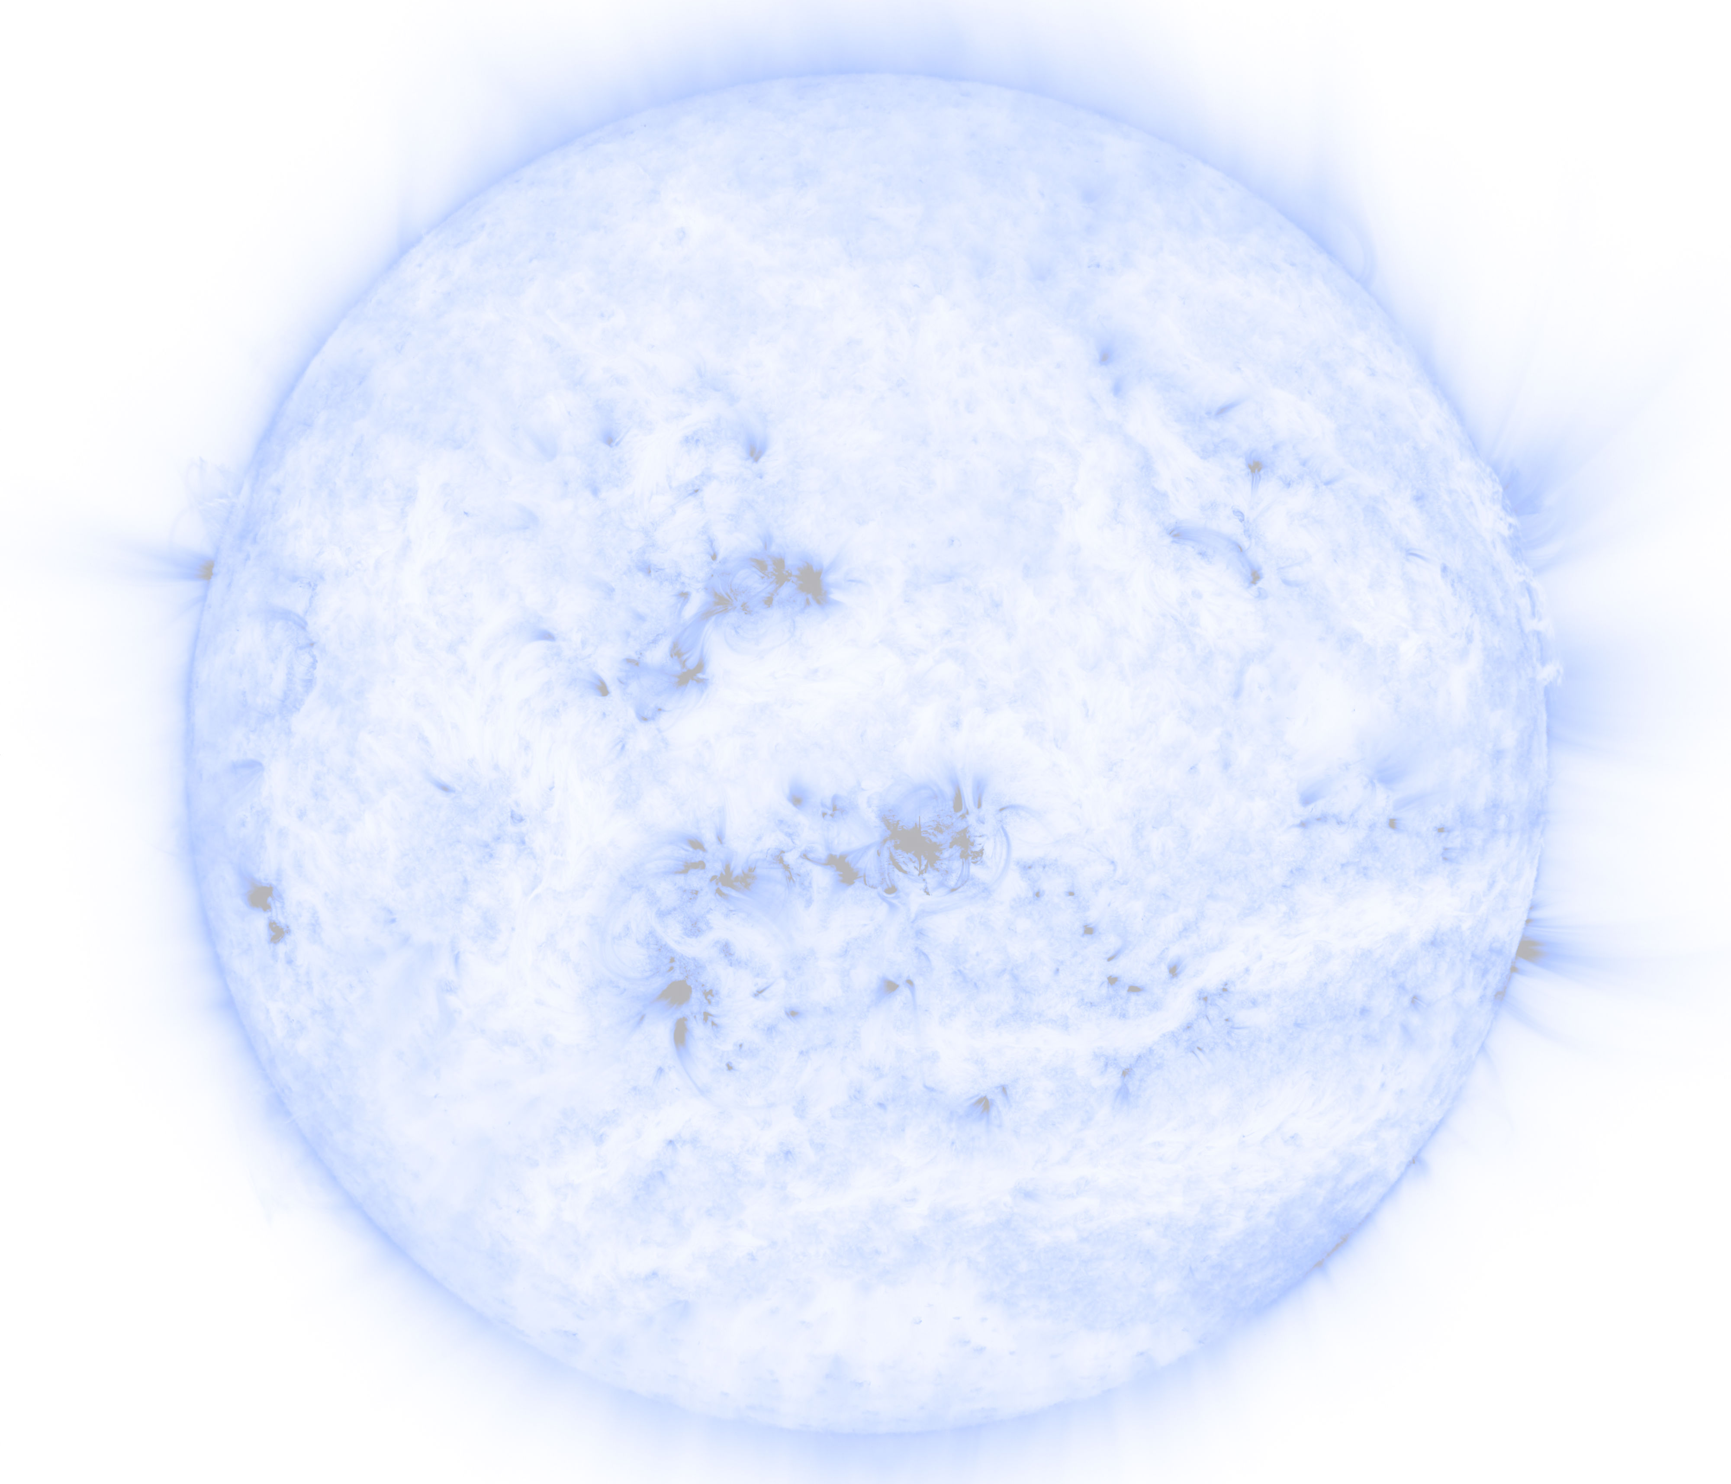

Interactive Multi-Instrument Database for Studying Solar Flares
Viacheslav Sadykov, Alexander Kosovichev, Gelu Nita
(Department of Physics, NJIT)
Rishabh Gupta, Vincent Oria
(Department of Computer Sciences, NJIT)
Alexander Frolov
(High-school student)

Slide 2
OUTLINE
Introduction
Brief look at https://solarflare.njit.edu/
Technologies, Sources and Processing:
  Background data sources
  Daily updated flare catalogs
  Merging and inclusion of other sources
Examples of usage
Discussion and Future plans

Slide 3
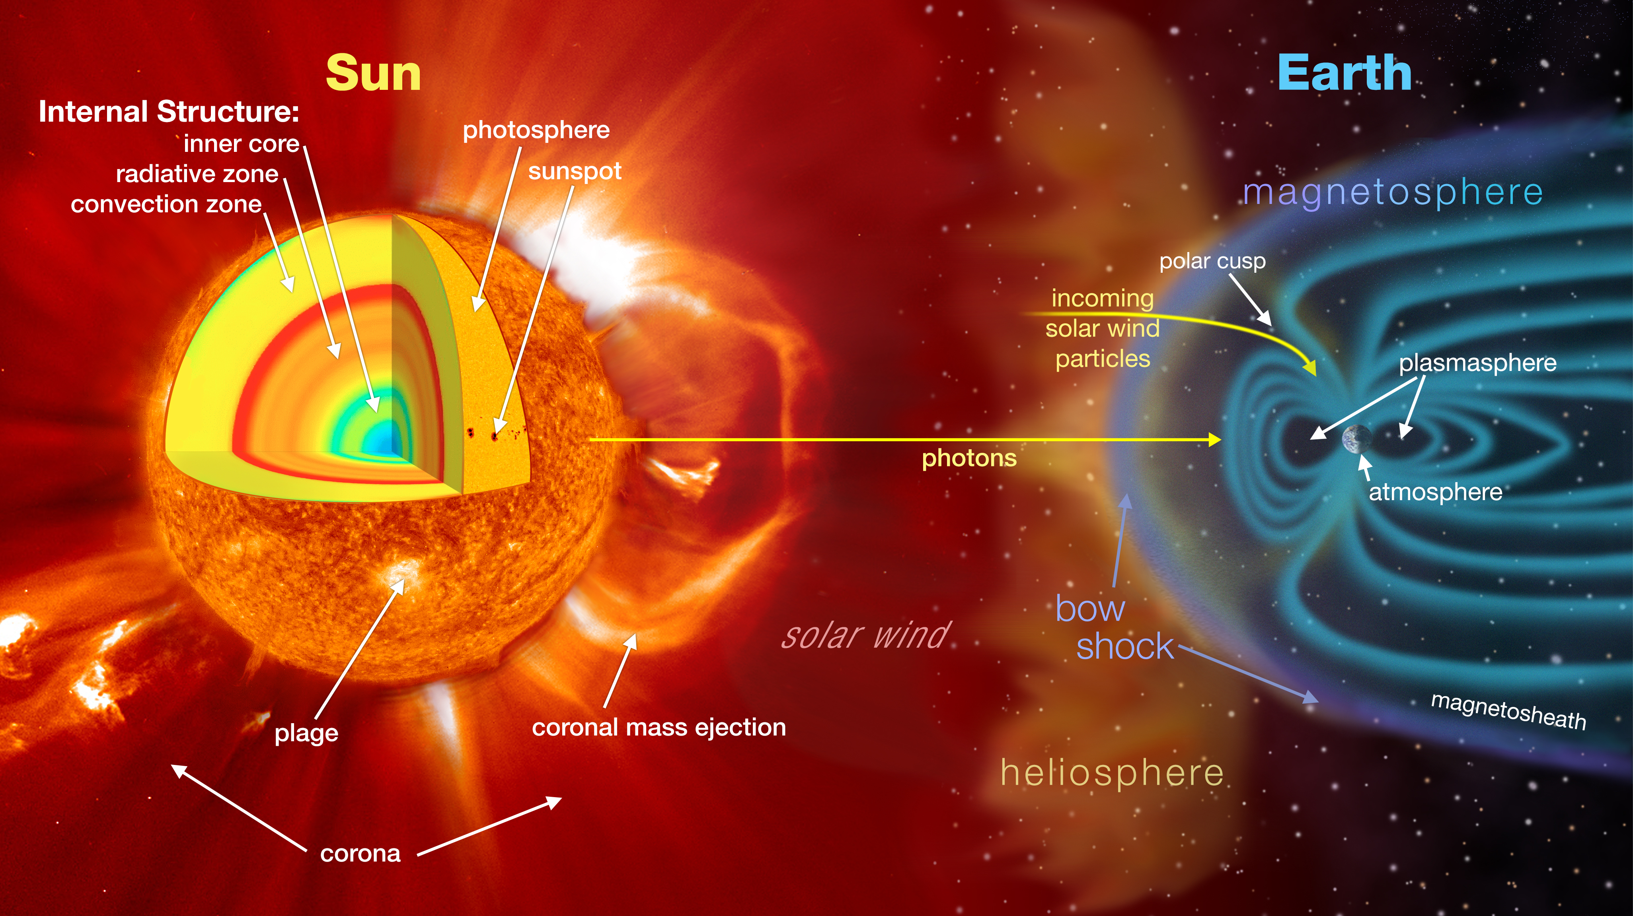
INTRODUCTION
Solar flares play especially important role in the Solar-Terrestrial interactions: primary source of powerful geomagnetic storms, high-energy radiation and particles that affect the Earth’s space environment, technological and biological systems.
They cover the whole range of electromagnetic radiation spectrum, from radio- to gamma-rays, observed by numerous space missions and ground-based observatories. Large amounts of scientific data are produced, and needs to be classified according to their physical properties.

Slide 4
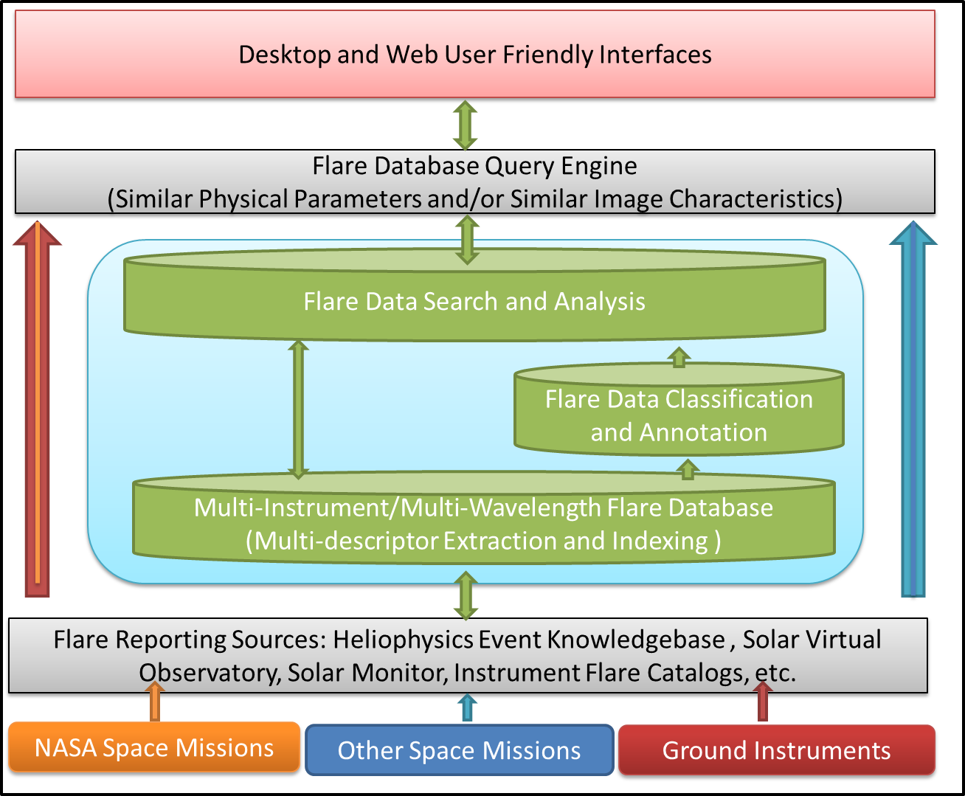
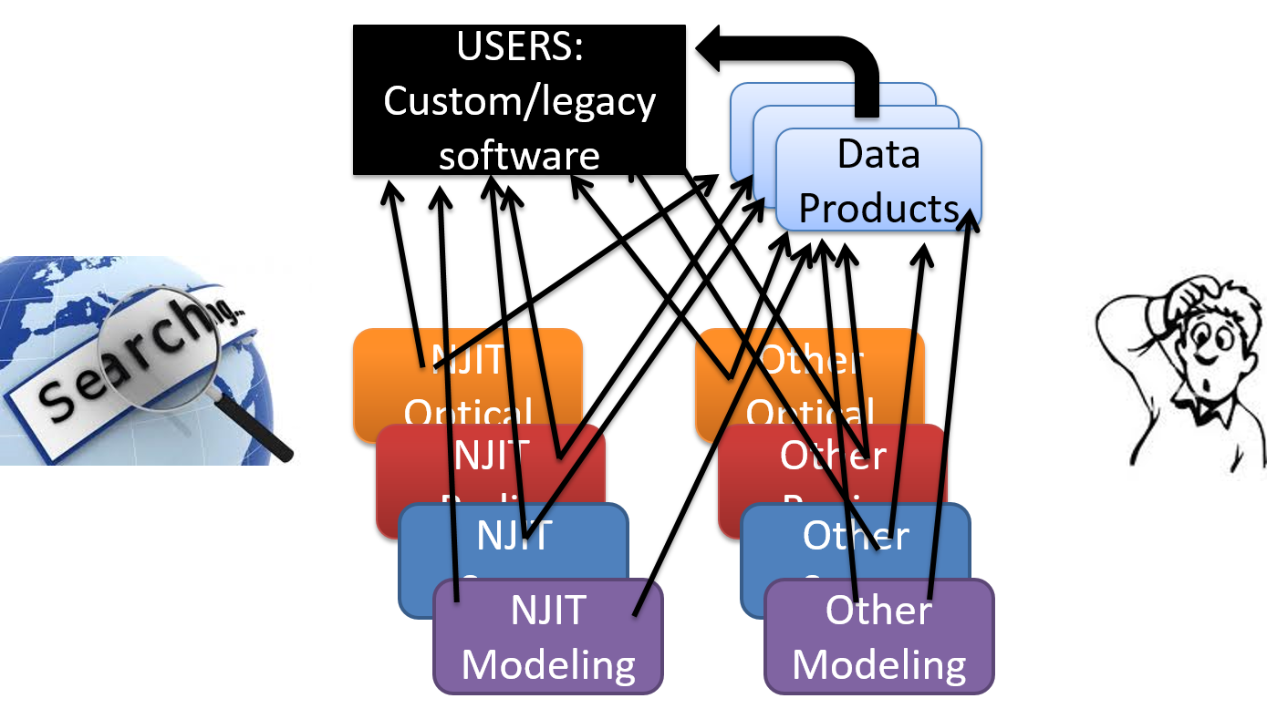
MAIN IDEA
Our main current task is to develop a comprehensive flare database by integrating data from the existing various databases, allowing us to identify the unique-matching events and apply a search based on event descriptors (i.e. availability of observations for the event and its physical properties)

Slide 5
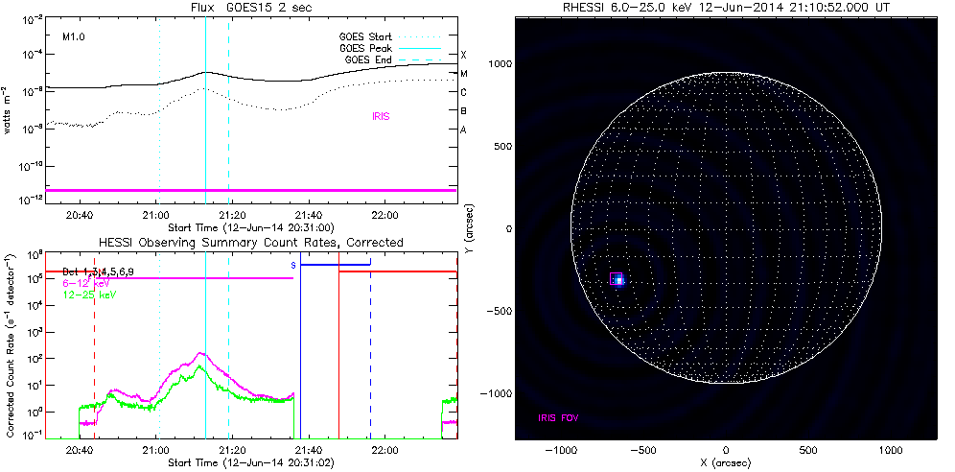
ATTEMPTS TO INTEGRATE SOLAR DATA
https://www.lmsal.com/isolsearch (Presentation of flares from AIA, GOES and other sources; possibility to search based on flare characteristics)
http://sprg.ssl.berkeley.edu/~tohban/browser/ (Presentation of GOES and RHESSI light curves, coverage of the event by IRIS/EVE/Hinode)
What if we want to search for all the GOES events observed by RHESSI, covered by IRIS SJI observations and study their GOES Temperatures?
Example of IRIS coverage from http://sprg.ssl.berkeley.edu/~tohban/browser/.

Slide 6
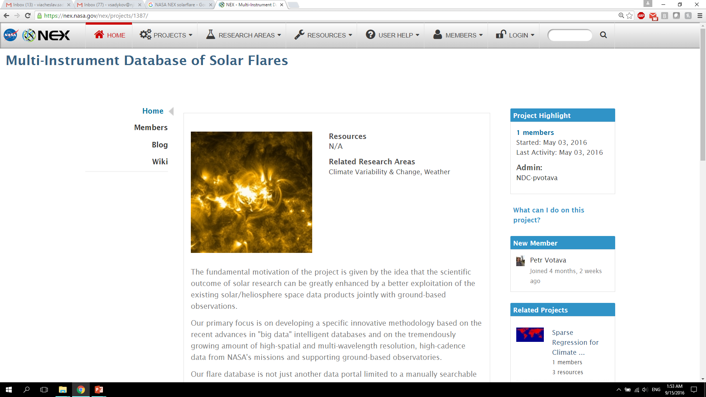
STEPS TOWARD IMPLEMENTATION
Active Project:
Design and Implementation of a
Multi-Instrument Database of Solar Flares
NASA NNX15AN48G (06/23’2015-06/22/2017)
PI Gelu Nita, Co-Is: Alexander Kosovichev and Vincent Oria
Joint NJIT-NASA Workshop
“Advances and Perspectives of Computational Heliophysics”
Jan. 12-14, 2016, NASA Ames Research Center
Supported by 2015 Faculty Seed Grant from NJIT
(PI Alexander Kosovichev)
Webpage link at NEX systems

Slide 7
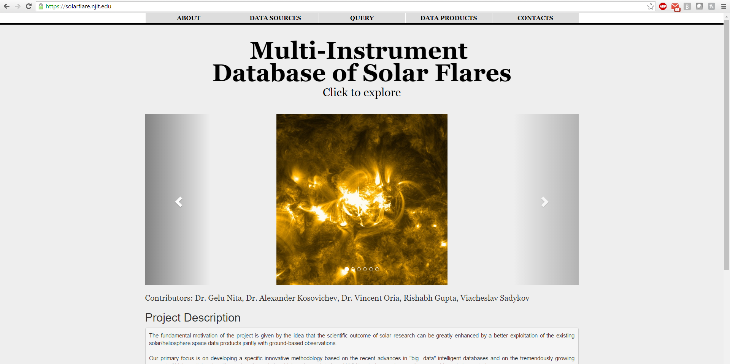
BRIEF LOOK AT https://solarflare.njit.edu/

Slide 8

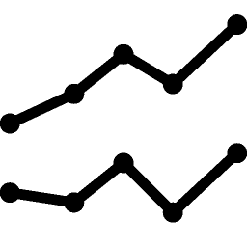




TECHNOLOGIES
Website (https://solarflare.njit.edu/): hosted on NJIT’s AFS machine.
Database Management System: MYSQL (Relational). Separate database tables created for every flare catalog or background data source. Indexing is applied to speed up querying
Scripting: PHP and Python. Scripts are used for downloading the data, processing the downloaded files, insertion of them into the database and database querying
Visualization: Google Charts. The Google charts are used to create plots and integrate them into the website
Front end: HTML/CSS and JavaScript.

Slide 9
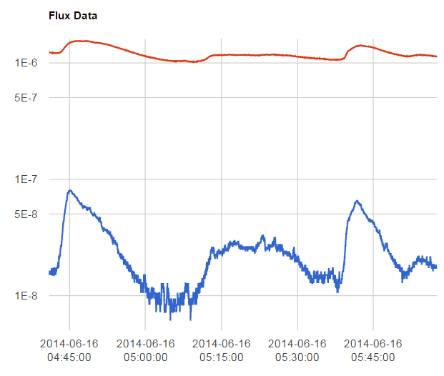
BACKGROUND DATA SOURCES
GOES flux data (http://satdat.ngdc.noaa.gov/sem/goes/data/new_full/). Represent GOES XRS 2s/3s resolution fluxes in the 0.5-4Å and 1-8Å diapasons.
SDO/EVE ESP light curves (http://lasp.colorado.edu/eve/data_access/evewebdata/products/level1/esp/). Data represents the EUV flux in 4 different channels (18nm, 26nm, 30nm, 36nm). The ESP database is updated with 1 day delay. There is a 10s averaging applied to the data.
Nobeyama RP light curves (ftp://solar-pub.nao.ac.jp/pub/nsro/norp/xdr/). The Nobeyama Polarimeter data, as well as ESP/EVE data, are averaged for each 10 seconds. Data represents fluxes of I and V polarizations in 1GHz, 2GHz, 3.75GHz, 9.4GHz, 17GHz, 35GHz
Example of the GOES light curves from https://solarflare.njit.edu/.

Slide 10
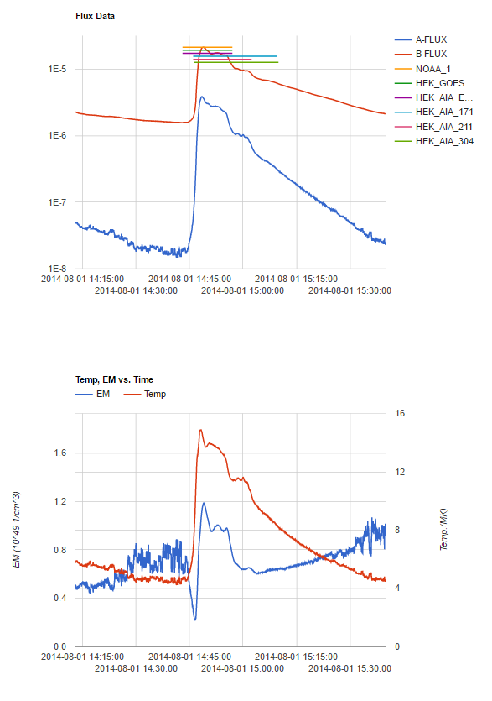
BACKGROUND DATA SOURCES
The daily processing of the files and database update is done by Python and PHP scripts
In addition, we calculate Temperature and Emission measure in one-temperature approximation (Thomas et al., 1985, Solar Physics, 95, 323) from the GOES fluxes
Example of the T and EM light curves from https://solarflare.njit.edu/.

Slide 11
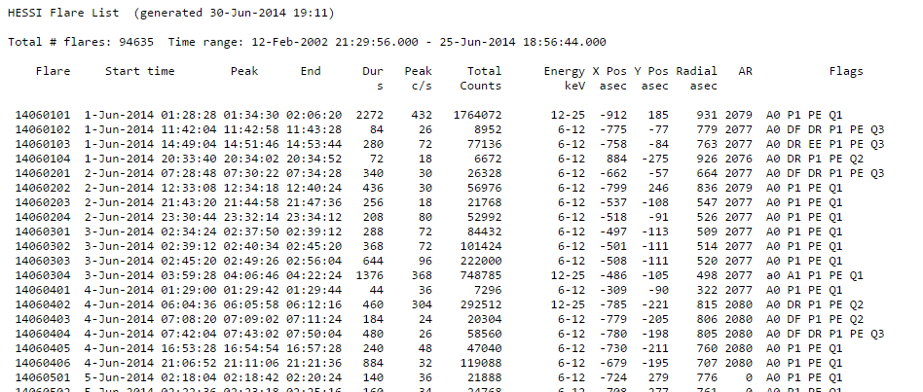
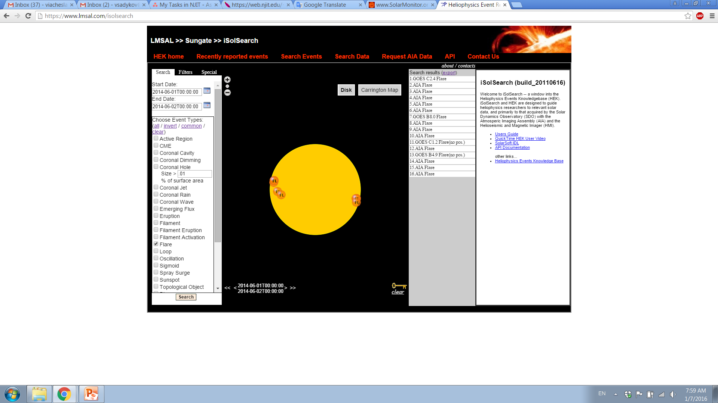
DAILY UPDATED FLARE CATALOGS
GOES events (ftp://ftp.swpc.noaa.gov/pub/warehouse/). XRS events are in our particular interest, and represent the flare reports from the GOES XRS sensor.
RHESSI flare list (http://hesperia.gsfc.nasa.gov/hessidata/dbase/). Represent the flare events from the RHESSI satellite’s X-Ray data.
HEK register flare records (https://www.lmsal.com/isolsearch). HEK includes activity reports detected by different instruments (SDO/AIA and GOES/XRS for flare events).
Example of RHESSI flare list (http://hesperia.gsfc.nasa.gov/hessidata/dbase/)
Example of the HEK query (https://www.lmsal.com/isolsearch)

Slide 12
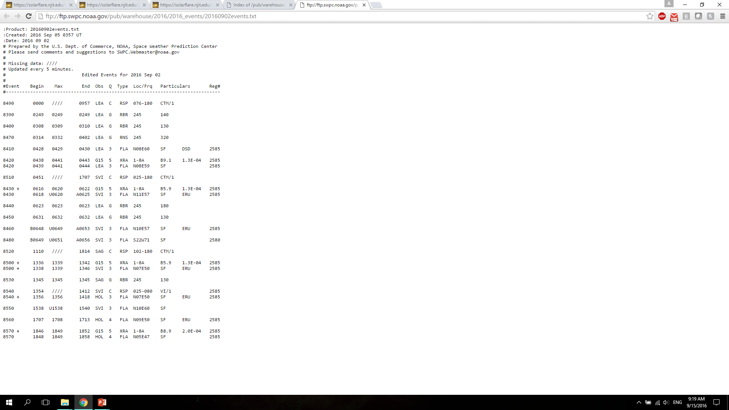
DAILY UPDATED FLARE CATALOGS
The maximum values of T and EM for the GOES events, and instantaneous values for the for the X-ray peak time are stored in the DB.
If the flare class is <C5.0, the T and EM maximum values are thought to be equal to T and EM during X-ray peak (because of problems with EM calculation)
Finally, we receive GOES T and EM, as well as times of their peaks, as characteristics of the GOES flare
Current data losses:
  2.88% of GOES flares
  0.281% of RHESSI flares
  0.277% of HEK events
Example of GOES flare reports(https://www.lmsal.com/isolsearch)

Slide 13
MERGING: UniqueID assignment
  Select the event from GOES flare list which does not have UniqueID assigned, and assign UniqueID = “gev_yyyymmdd_hhmmss” (start time of the event)
  Check time overlap of the event with all the events from RHESSI and HEK databases (which do not have IDs). Select overlapping events
  For each of these events, apply:
    If event has the same AR as GOES one, assign the same UniqueID
    If distance between the events is < 250’’, assign the same UniqueID
    If both coordinates and AR are missing for the event (or for the GOES event), assign the same UniqueID
    If the information does not match, skip the event
  Repeat the same for all GOES events first, and repeat the procedure for RHESSI-HEK pair (“rhessi*”) and HEK events (“hek*”)
Example of the GOES light curves and matching events from https://solarflare.njit.edu/.

Slide 14
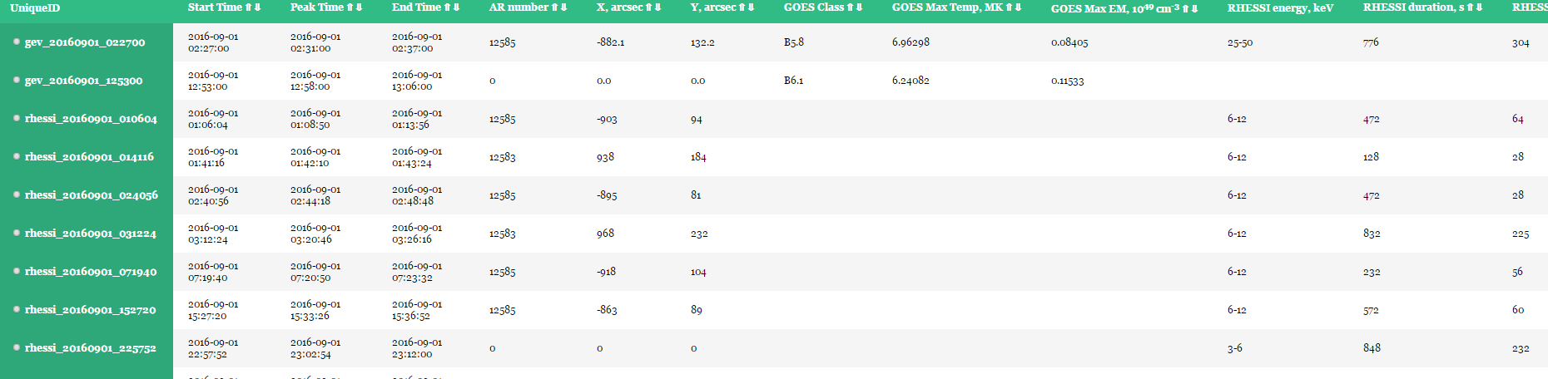
MERGING: final table
Example of the joint table of events from https://solarflare.njit.edu/.
  The table is created on-the-fly (there is no storage for this table)
  Sorting over the columns is available
  If the output contains more than 1000 entries, the table displays just first 1000 events. But the full list is available via download file
  Additional columns appear if the corresponding filters are selected

Slide 15
INCLUSION OF OTHER SOURCES (CATALOGS)
Hinode Flare Catalog (http://st4a.stelab.nagoya-u.ac.jp/hinode_flare/). Available: 01, November, 2006 - 31, July, 2016. Filtering can be applied based on number of observational sets of Hinode instruments.
Filament eruption catalog (http://aia.cfa.harvard.edu/filament/). Available: 24, April, 2010 - 19, October, 2014. Allows to select events with the filament eruptions observed nearby. Variety of filters can be applied.
Konus-WIND flare catalog (http://www.ioffe.ru/LEA/Solar/index.html). Presented for: 01, January, 2002 - 23, July, 2016. Last sync was made on August, 29th, 2016

Slide 16
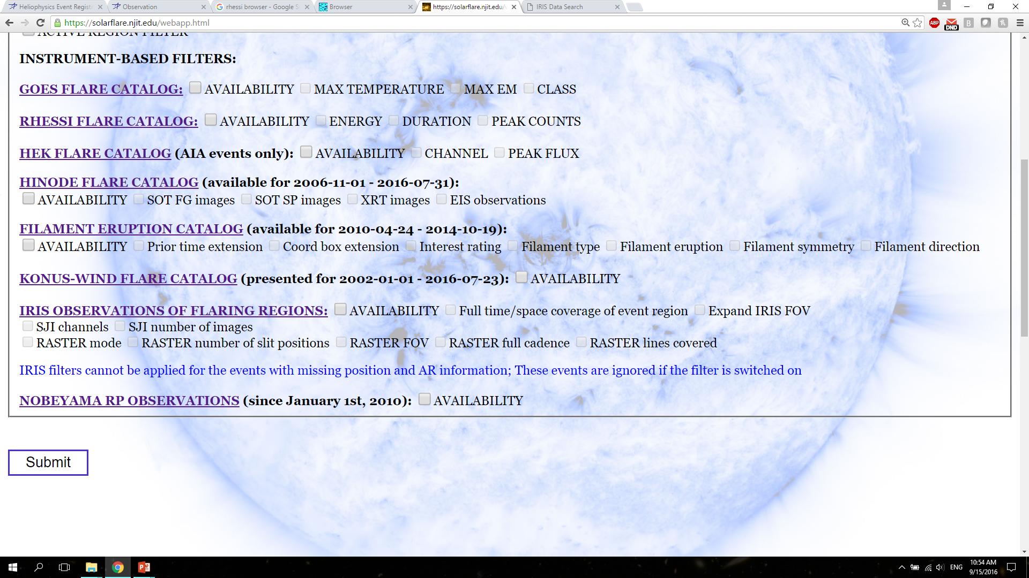
INCLUSION OF OTHER SOURCES (OBSERVATIONS)
Nobeyama RP observations (ftp://solar-pub.nao.ac.jp/pub/nsro/norp/xdr/). Selects only the events with NoRP data available.
IRIS observations (http://iris.lmsal.com/search/). Select only the event-candidates covered by IRIS observations with the selected properties.

Slide 17
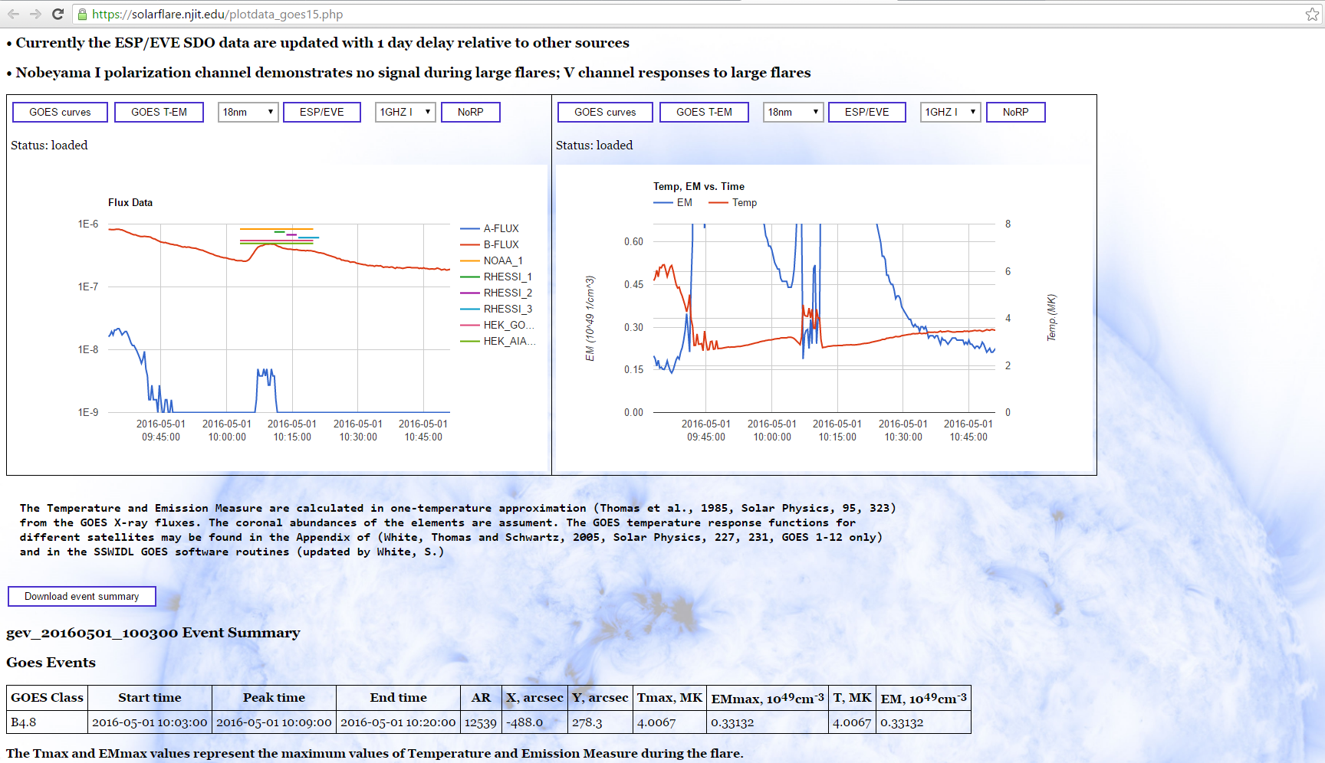
“PLOT DATA” PAGE

Slide 18
SUMMARY
Currently implemented:
Web application. The technologies include the usage of MySQL, PHP, Python, Google Charts, and the HTML/CSS and JavaScript.
Three main daily-updated sources of flare reports (GOES events list, RHESSI flare list, Heliophysics Event Knowledgebase Flares), and three additional catalogs (Hinode flares, Filament eruption catalog, Konus-WIND flares)
Check of coverage by NoRP and IRIS instruments
Integration of data from the selected catalogs with application of the selected filters
Possibility to download the result of the query
Plots of GOES X-ray data, T and EM, ESP/EVE data, NoRP data for the selected event.

Slide 19
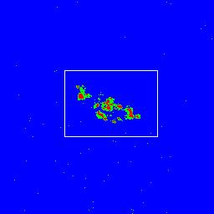
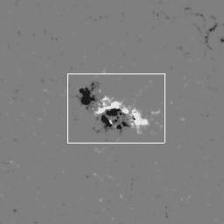
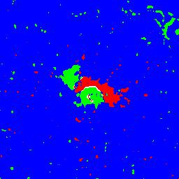
SUMMARY
Planned to be implemented:
Database or AR characteristics: extraction of characteristics from SDO/HMI magnetograms and continuum images

Slide 20
QUESTIONS TO ANSWER
Minor:
Data overcheck (search of missing events and neighborhood UniqueID reassignments)
More stable daily updates (currently: large log files)
Autocomplete of missing position information
Stability of the system
Major:
Inclusion of event recognition from data (Sasha Frolov, high-school student)
Semantic input text analysis for automatic query construction (Rishabh Gupta, CS student)
Inclusion of additional sources

Slide 21
Thank you for your attention!

