Slide 1
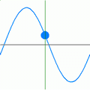


О связи динамики источников рентгеновских пульсаций с магнитной конфигурацией вспышечных областей Солнца
Иван Зимовец^{1,2,3} & co

Slide 2
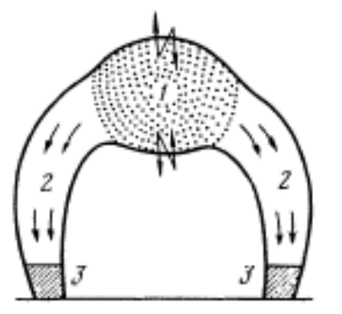
On the importance of spatially-resolved HXR (>25 keV) observations
Zaitsev & Stepanov (1982)
Artemyev & Zimovets (2012)
Ledentsov & Somov (2016)
?
?
t₁, t₂, t₃
t₁, t₂, t₃
?
?
t₃
t₁, t₂, t₃
t₁, t₂, t₃
Kliem et al (2000)
t₂
t₁
Nakariakov et al (2006)

Slide 3
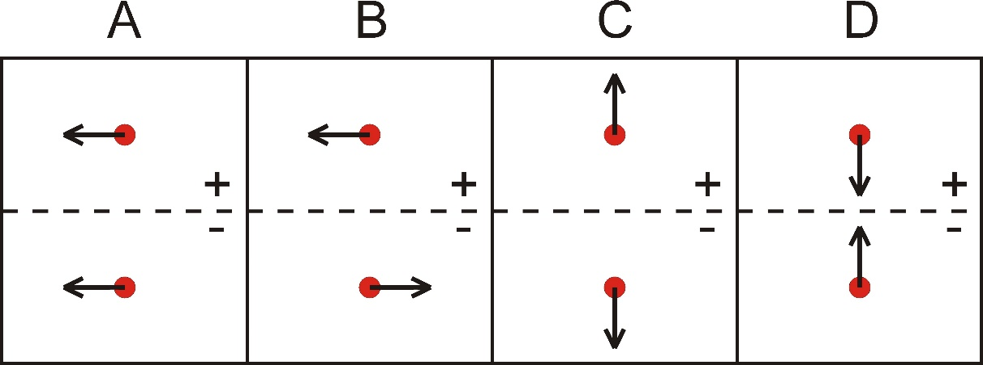
Spatially-resolved observations of dynamics of HXR footpoint sources in flares (based on HXT/Yohkoh & RHESSI observations)
It is known that the footpoint HXR sources are usually not stationary – their locations change during flares (e.g., Bogachev et al., 2005; Ji et al., 2006, Gan, Li & Miroshnichenko, 2008; Yang et al., 2009).
There are four main types of HXR source displacements (and their various combinations):
(Type A) S+ and S− move in the same direction parallel to an MPIL;
(Type B) S+ and S− move in opposite directions parallel to an MPIL;
(Type C) S+ and S− move away from and perpendicular to an MPIL;
(Type D) S+ and S− move toward and perpendicular to an MPIL.
The questions are:
Is this valid in case of HXR pulsations, i.e., do footpoint sources of HXR pulsations also “move” or show no apparent motion during flares?
If yes, are there some preferred types of motions of the sources of HXR pulsations?
Does some link exist between types of motions and magnetic geometry of flare regions?

Slide 4
Case-studies of HXR pulsations with spatial resolution (RHESSI) - no systematic study was done before
Grigis & Benz (2005)
Zimovets & Struminsky (2009)
Is apparent motion of the sources of HXR pulsations a usual situation?
Are there some flares with motionless sources of HXR pulsations?

Slide 5
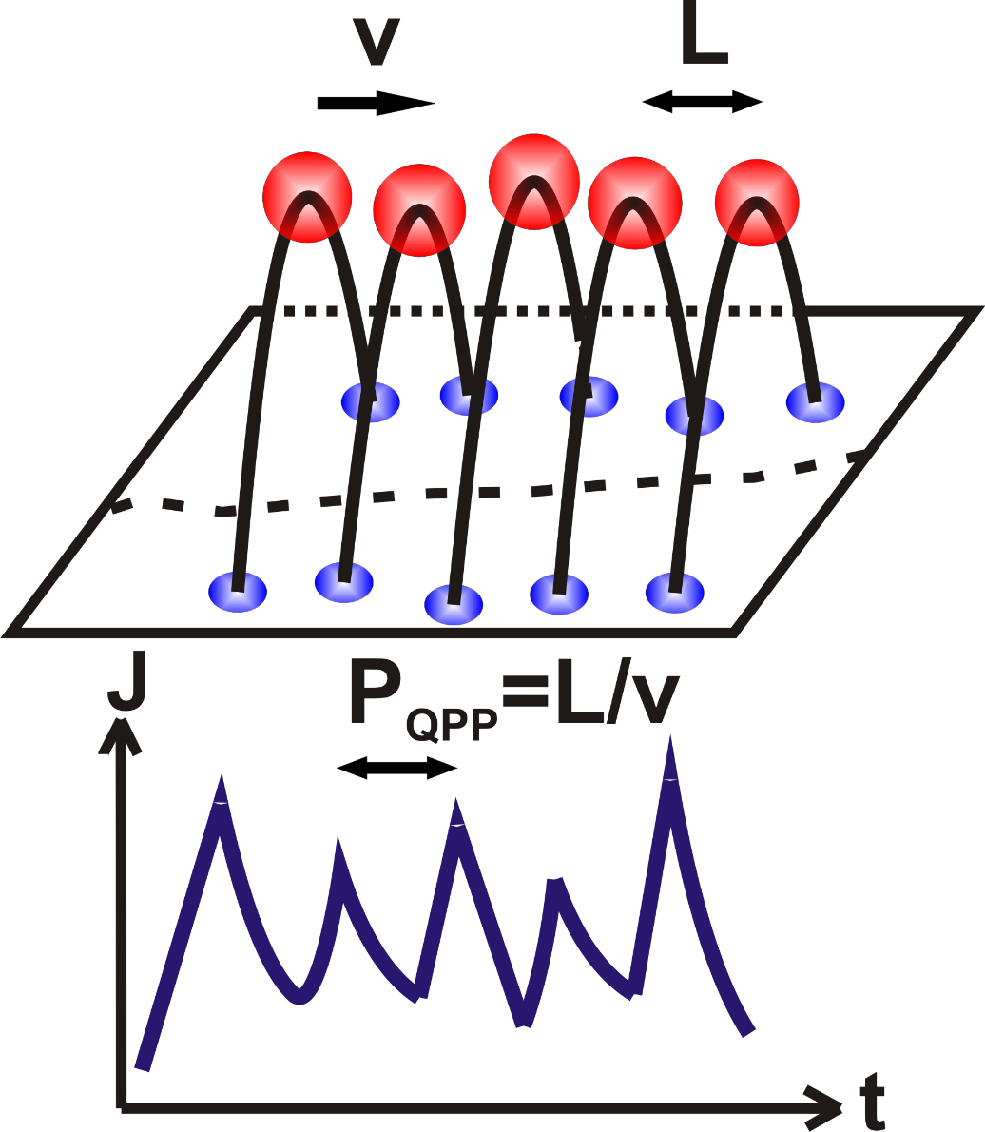
Preliminary summary of case-study results on HXR pulsations
Main features of the HXR pulsations:
Pulsations are usually not harmonic
Different pulsations are emitted from different loops of the flare arcade
Primary energy release sites are (most probably) near the apex of flaring loops
Energy release trigger propagates predominantly along the flare arcade’s axis and the PIL in ~50% of cases
10<V<300 km/s (V<V_{A} & V<V_{S})
L = 1000-10000 km
Зимовец (2010)

Slide 6
Part I. Our results on systematic study of dynamics of sources of HXR pulsations in solar flares with RHESSI (Kuznetsov et al, 2016)
For the first time, the systematic analysis of the dynamics of sources of the HXR (25-100 keV) pulsations (P~8-270 s) in a large sample of solar flares (2002-2015) is done.
Location of the sources of HXR pulsations is not fixed: the sources move from pulsation to pulsation in all 29 flares studied - “single-loop” models do not satisfy the observations.
Flares can be subdivided into two general groups by the character of motion of the HXR sources: (1) systematic (along-MPIL-dominated); (2) non-systematic (“chaotic”).
3D models are required (not 2D and 2.5D) for interpretation of HXR pulsations (P~8-270 s).
At least 85% of the flares investigated were accompanied by CMEs and, thus, were eruptive events. But not all.

Slide 7
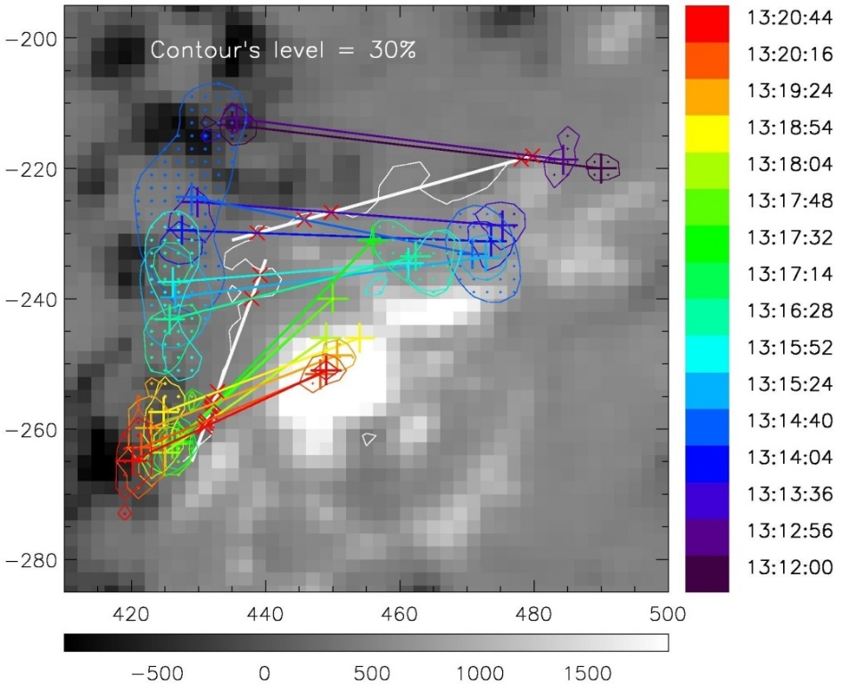
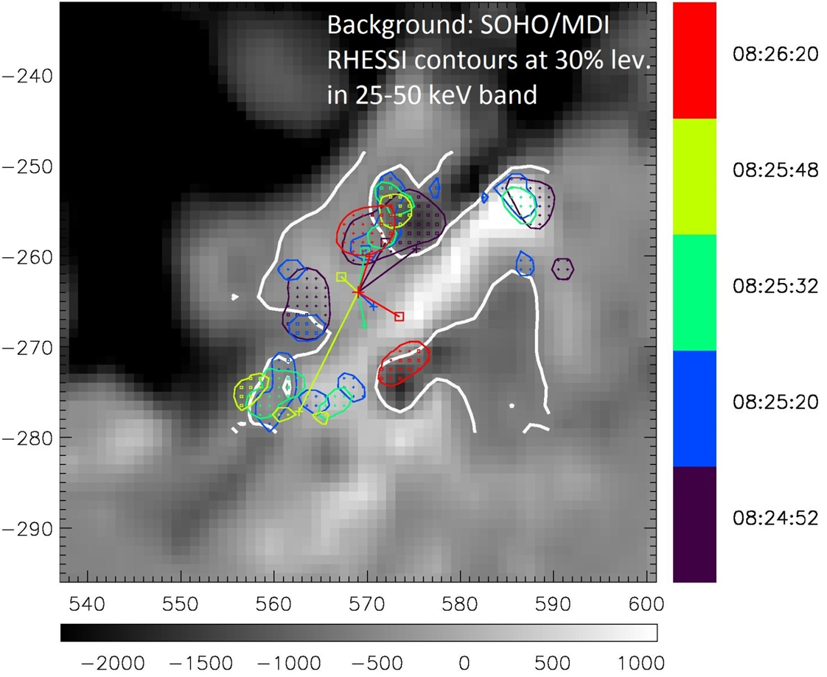
Sources of HXR pulsations show apparent motions in all flares studied!
Flares can be sub-divided into 2 general groups based on the character of the HXR source motion
Group-1
Group-2
SOHO/MDI 09-Nov-2002 13:16:28 UT SOHO/MDI 20-Aug-2002 08:25:32 UT
16 events (55%, two-ribbon flares)
HXR sources are located in regions of different magnetic polarities
Paired HXR sources move mainly along PIL with simple elongated shape
13 events (45% of all events)
Random dynamics of HXR sources
Presence of several MPILs of complicated shape in a parent AR
Kuznetsov et al (2016)

Slide 8
Types of systematic motion of the sources of HXR pulsations
For Group-1 flares
Kuznetsov et al (2016)

Slide 9
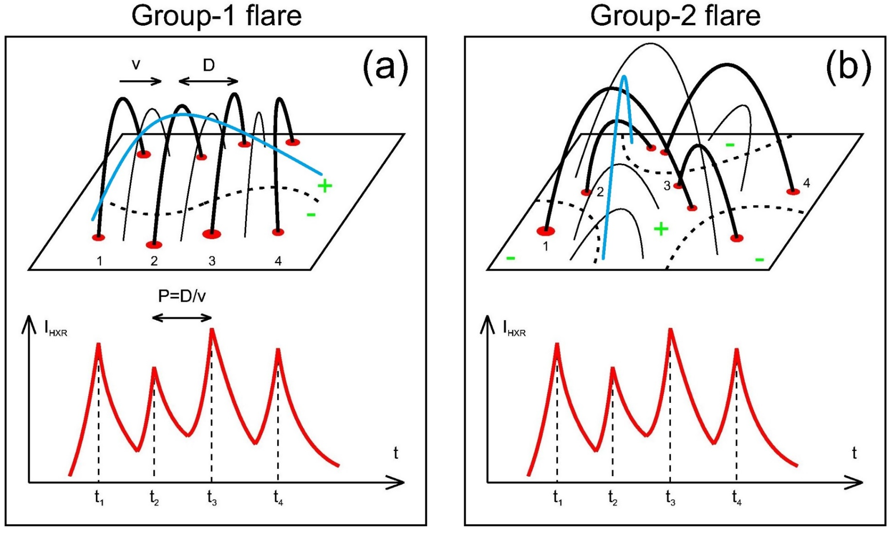
Our initial working hypothesis (in Kuznetsov et al., 2016):
Erupting magnetic flux-rope (MFR) as a possible trigger of energy release in multiple coronal loop systems
HXR pulsations (“Elementary Flare Bursts”) are resulted from successive interactions of different flux-rope parts with different surrounding loops
Complex magnetic
topology
Two-ribbon flares

Slide 10
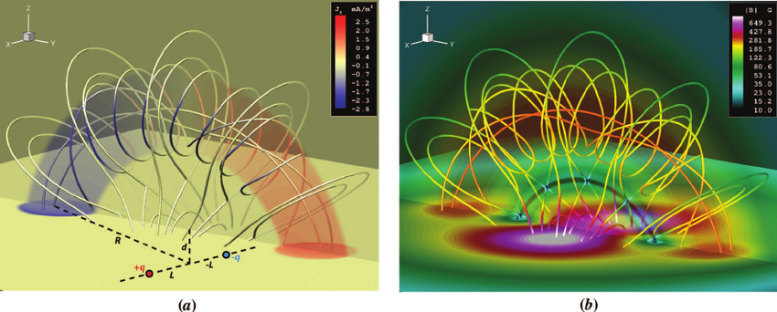
What is a magnetic flux rope (MFR)?
An MFR can be defined as a volumetric plasma structure with the magnetic field lines wrapping around a central axis.
Filippov et al (2015)
Roussev (2008)

Slide 11
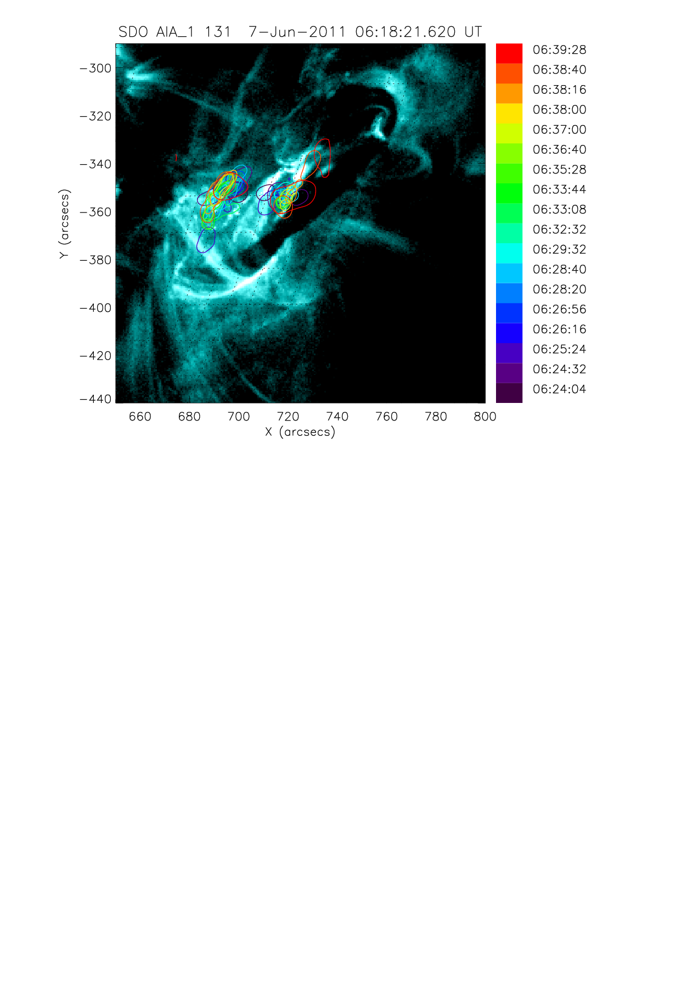

Example of an MFR eruption in one of events studied
MFR
Loops
Kuznetsov et al (2017)

Slide 12

Part II. Analysis of magnetic configuration of flare regions producing HXR pulsations
Zimovets et al (2018)

Slide 13
Our aims
To investigate magnetic configuration of flare regions accompanied by HXR pulsations (P~8-270 s) & to search for the presence of a flux-rope (MFR) in the flare regions (on the base of joint RHESSI and HMI/SDO observations & reconstruction of magnetic field in the NLFFF approximation)
By-product: To check whether there are correlations between characteristics of the sources of HXR pulsations and parameters of magnetic field (B) and vertical (radial) electric currents (Jr) on the photosphere

Slide 14
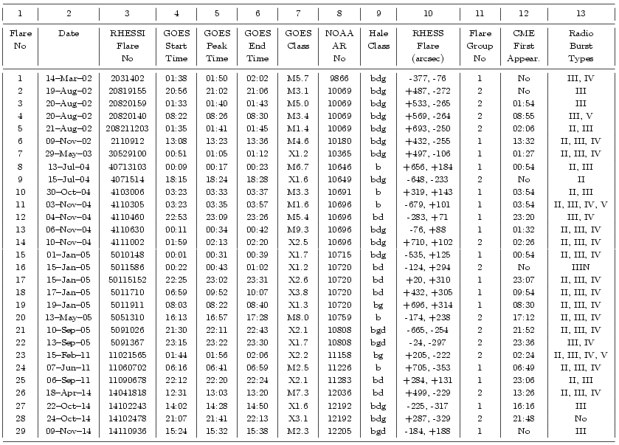
Our Flare
Catalogue
B
Joint
HMI/SDO
+
RHESSI
observations
Kuznetsov et al (2016)

Slide 15
What we did:
Reconstruct magnetic field in the NLFF approach (using Wiegelmann’s LINFF codes) in selected parent ARs
Find positions of the sources of different HXR pulsations
Plot magnetic field lines started from the HXR sources and from other places of parent ARs
Try to search for an MFR in parent ARs
Calculate Jr and different components of B, as well as their changes during flares
Calculate correlations between characteristics of HXR sources, Jr and B components, as well as of their changes
Aim-1
Aim-2
∼ I_{HXR}
Zaitsev et al (1998)
Zaitsev et al (2016)

Slide 16
What we did:
Example for one flare analysis
Бессиловое поле (при β<<0)
Итерационная минимизация функционала:
Wiegelmann (2004)
MFR
MFR

Slide 17
Result I – magnetic field structure in the flare regions studied
Zimovets et al (2018)

Slide 18
Magnetic structure of flare region with HXR pulsations
Case I. Sources of different HXR pulsations are in different threads of an MFR (2 of 7 flares)
MFR
MFR
MFR
MFR

Slide 19
Magnetic structure of flare region with HXR pulsations
Case II. Sources of HXR pulsations are in different loops surrounding an MFR (5 out of 7 flares)
MFR
MFR
MFR
MFR
MFR
MFR

Slide 20
Magnetic structure of flare region with HXR pulsations
Special case: Non-eruptive or confined eruption (3 of 7 events)
MFR

Slide 21
No significant correlations between geometrical characteristics of MFR and HXR pulsations
?

Slide 22
Result II – absence of correlation between I_{HXR} & J_{r}

Slide 23
Methodology
HXR images (50-100 keV) were synthesized with CLEAN & PIXON near HXR peaks, in the HPC coordinates
Using Sharp_CEA vector magnetograms made with HMI/SDO data, maps of Blos, Br, Bp, Bt, Bk, Bpol, as well as jr (Jr) were created in spherical coordinates before & after each selected flares
Spherical maps were projected to the HPC surface
HXR maps were differentially rotated to B & Jr maps; coordinate grid interpolation was done
HXR sources were superimposed to Jr(x,y), Blos (x,y), Br(x,y), Bk(x,y), etc. maps
Positions of HXR sources were analyzed with respect to Jr(x,y), etc.
More than 100 “electromagnetic” characteristics were calculated for the regions beneath each HXR source;
Statistical relations between these characteristics were found (such as I_{_HXR}(Jr), I_{_HXR}(Br), I_{_HXR}(Bpol), …)

Slide 24
Spatial relations between sources of HXR pulsations and Jr in flare regions
No obvious spatial relation between locations of HXR sources and Jr is found
HXR sources sometimes are close to strong Jr regions but out of the strongest Jr sites
As expected (Li et al, 1997)

Slide 25
No correlations between characteristics of HXR sources and Jr (and its changes during flares)

Slide 26
Conclusions
Zimovets et al (2018)
According to the NLFFF reconstructions, all (7) flare regions studied contain an MFR (or a highly sheared magnetic arcade along an MPIL)
In 2 events the sources of HXR pulsations are located in footpoints of different magnetic field lines wrapping around the central axis, and constituting an MFR themselves. In 5 other flares the parent field lines of the HXR pulsations were not a part of an MFR, but surrounded it in the form of an arcade of magnetic loops.
“Single-loop” models are not appropriate to interpret HXR pulsations (at least, in the flares studied; however, since the flares were chosen almost arbitrary, this result is common).
4 out of 7 flares are eruptive events, 3 - no. MFR eruption is not necessary or confined eruption is possible.
There are no significant correlations between intensity of the HXR sources and characteristics of vertical electric currents and magnetic field components (as well as of their evolution in time) on the photosphere beneath the HXR sources.
The results are in favor of the concept that the HXR pulsations (P~8-270 s) are a consequence of successive episodes of energy release in corona in different magnetic flux tubes (threads) of a complex AR due to: (a) non-uniform evolution (eruption) of an MFR in the solar corona or (b) shifting (zipping) reconnection in a sheared magnetic arcade.

Slide 27
Discussion: possible cartoons for eruptive & non-eruptive events (with HXR pulsations)
Flare impulsive phase (“zipping” phase)
Eruptive event Not necessarily eruptive event
Zipping-like filament (MFR) eruption Zipping reconnection in a sheared arcade above MFR
t₀
t₁
t₂
t₃
t₀
t₂
t₁
MFR should exist before eruption and flare
MFR can be formed during the reconnection process
Liu, Alexander, Gilbert (2009) Priest & Longcope (2017)

Slide 28
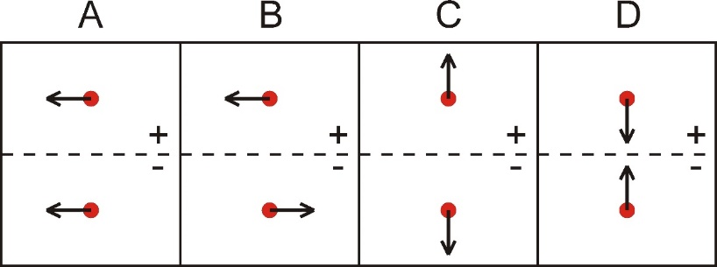
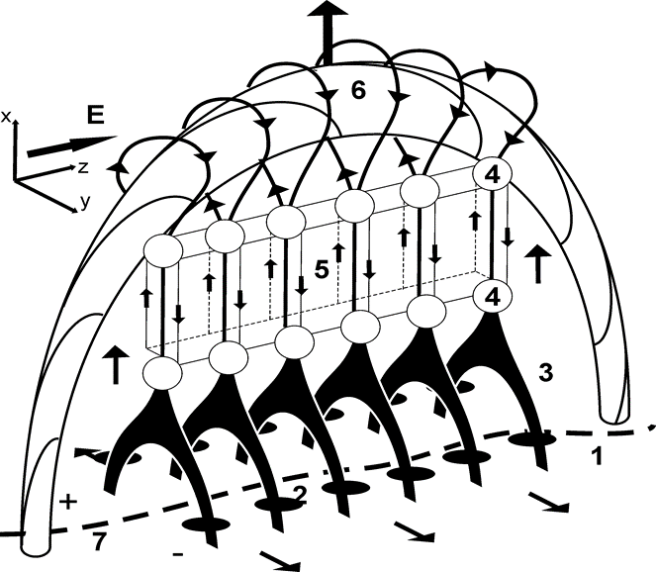
Discussion: standard 3D flare model is applicable
Flare decay phase
Type C HXR sources movement (separation of flare ribbons)

Slide 29
Some remaining questions:
Kliem et al. (2013)
Does NLFFF approach give reasonable results?
What is magnetic difference between flares with and without HXR pulsations?
Where and how electrons are accelerated to produce HXR pulsations (especially not clear for confined flares)?
What are the reasons for quasi-periodicity of HXR pulsations, i.e. QPPs, in some flares?
What is the “zipping” trigger and why v_{HXR}<300 km/s (i.e. <v_{A})?
?
?
?

Slide 30
Thank you!

