Slide 1
NUMERICAL MODELLING OF THE SOLAR INTERIOR AND LOWER SOLAR ATMOSPHERE: BRIDGING THEORY AND OBSERVATIONS
Sergiy Shelyag
Northumbria University

Slide 2
Sun and its simulation
A few facts about the Sun:
The Sun is much faster than computer simulation of it
Observing is relatively easy
Understanding is difficult
To find out the physical processes generating the radiation coming from the Sun, we simulate:
The Sun itself (including in it as much as possible known physics)
The detailed parameters of the radiation coming from it

Slide 3
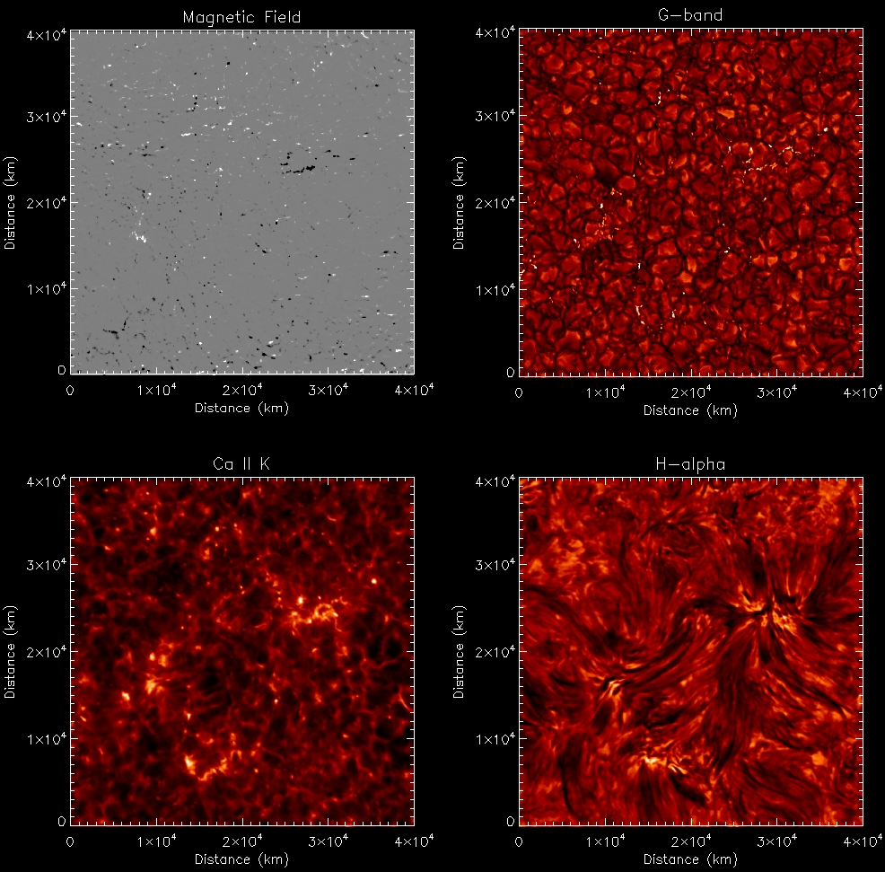
Faces of the Sun
Notes:
CaII K 3933 H alpha 6562.8

Slide 4
Radiative transport
RTE:
Formal solution of RTE:
In LTE - simpler, since S is determined by local plasma parameters. But integral: sums up everything in the formation range.
In non-LTE - not only (1). Source function depends on incident radiation – integral equation to solve.

Slide 5
Radiative energy transport
Energy transport:
Radiative heating rate goes in the RHS of MHD energy eq.
Notes:
Радиационный поток

Slide 6
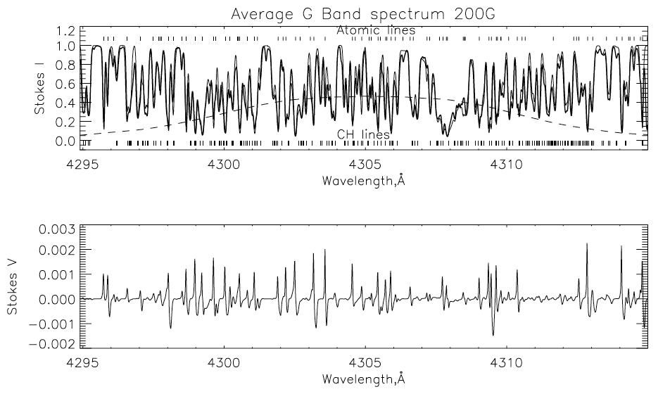
Radiative transport as a diagnostic tool, or “postprocessing”
Image from Shelyag et al. (2004)

Slide 7
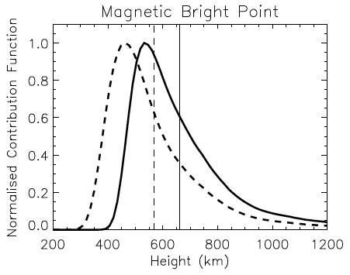
Height dependence: band contribution function in photosphere
Jess et al. 2012
Dashed – 417nm continuum
Solid – 430.5-431.5nm G-band
The radiation is formed between 500 and 1000 km. In this range:
Density and pressure change by ~2 orders of magnitude
Temperature changes by ~4000K
Plasma β changes from ~5 to ~0.1
Helpful: formation difference between 417nm and G-band is about 100 km.

Slide 8
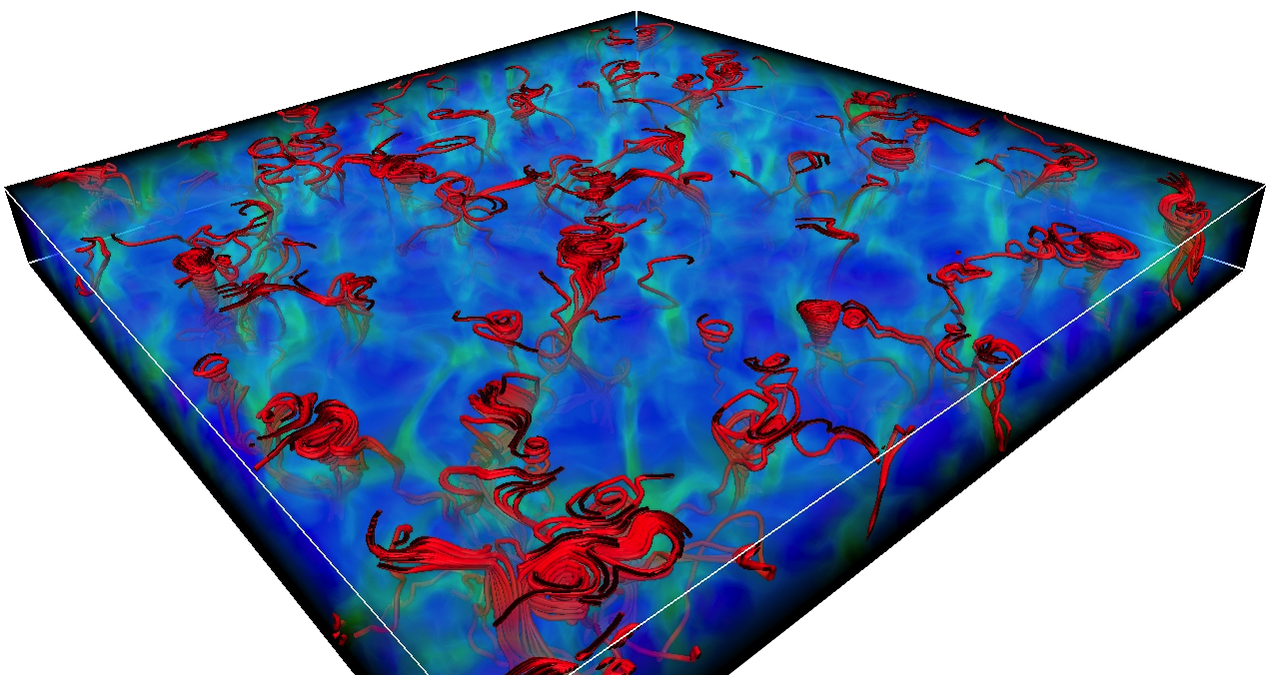
MURaM: Simulation of the solar photosphere
We use MURaM code
The code is 3D radiative MHD equations solver on a Cartesian grid
CD4, RK4, artificial diffusion stabilisation, periodic side boundaries, bottom open, top closed
Domain size is 12x12x1.4 Mm resolved by 480x480x100 grid cells
Reaches about 600 km above the continuum formation layer, covering photospheric lines formation depth range
12 Mm
12 Mm
1.4 Mm
Image from Shelyag et al. (2011)
Rendering with VAPOR

Slide 9
What simulations can do

Slide 10
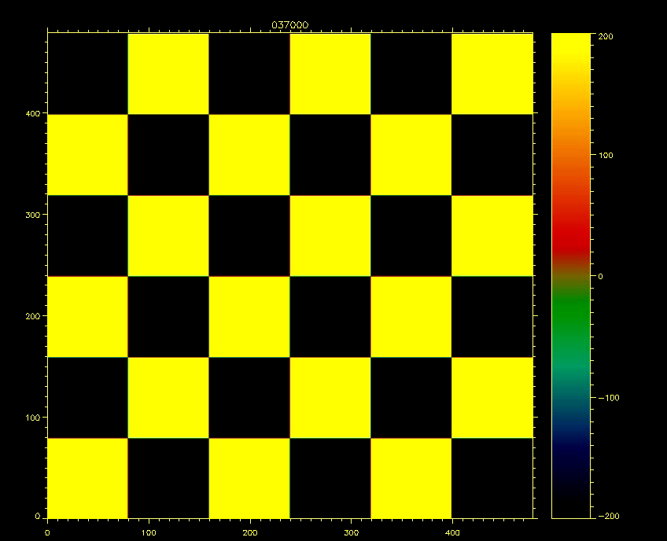
Small-scale reconnection in the photosphere
(Turbulence is one of those things you can stare at forever)

Slide 11
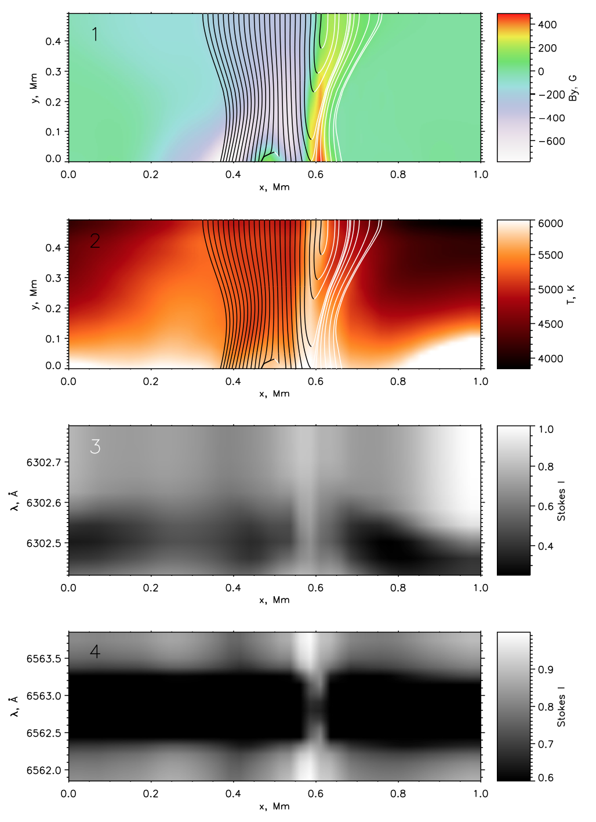
Small-scale reconnection in the photosphere
Apparently, we have Sweet-Parker type forced reconnection with magnetic flux pile-up (e.g. Litvinenko et al, ApJ 662 1302 2007).
FeI 6302A gaps in reconnection regions (raised core).
Ellerman bomb in H alpha

Slide 12
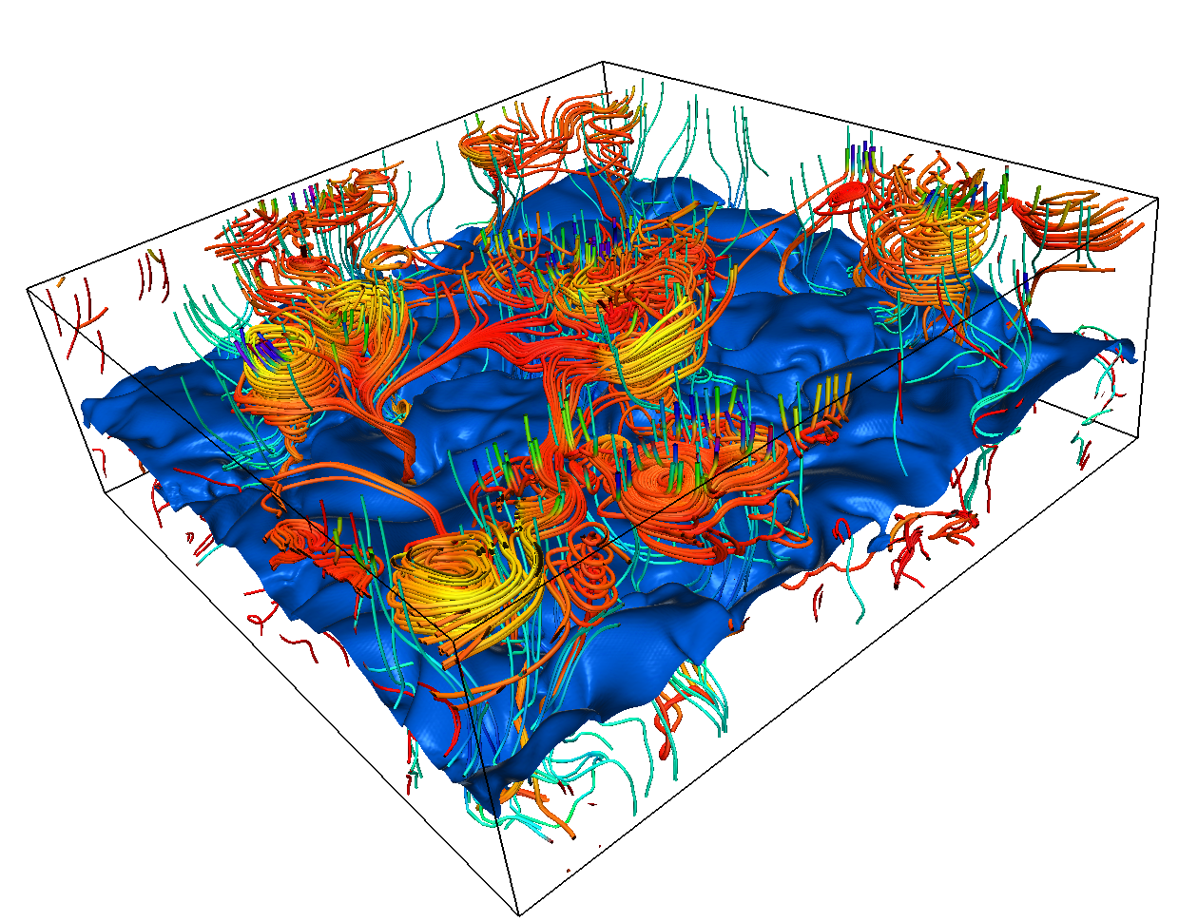
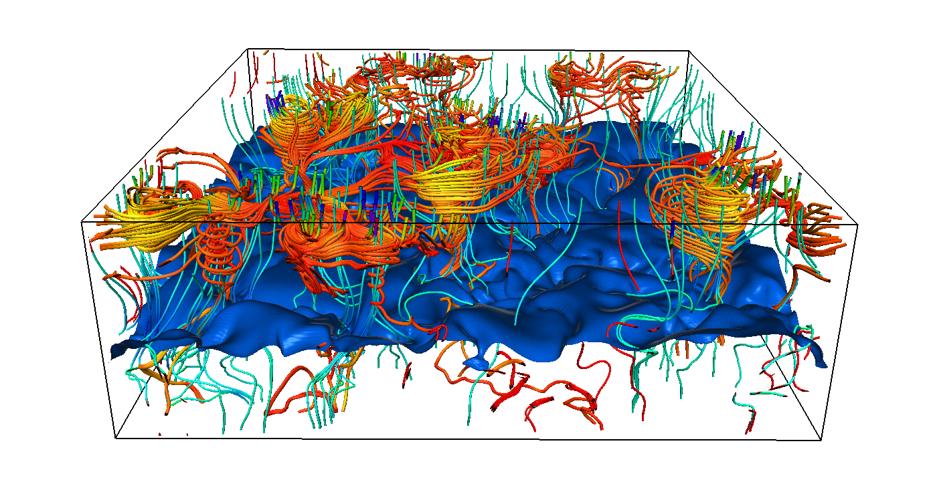
Vortices in intergranular lanes
Again, MURaM code (Vögler et al 2005)
Domain size is 12x12x3.2 Mm resolved by 480x480x320 grid cells
Reaches about 1200 km above the continuum formation layer, covering photospheric lines formation depth range; various top boundaries
50G / 200G unipolar initial magnetic field / bottom-boundary B advection
Photospheric vortices generation and their links to strong photospheric magnetic fields were described in Shelyag et al 2011.
Velocity field lines show vortex structures in strong magnetic field regions.
Single-fluid MHD: magnetic field is frozen into plasma.
Why the magnetic field lines do not show the same vortex structures?

Slide 13
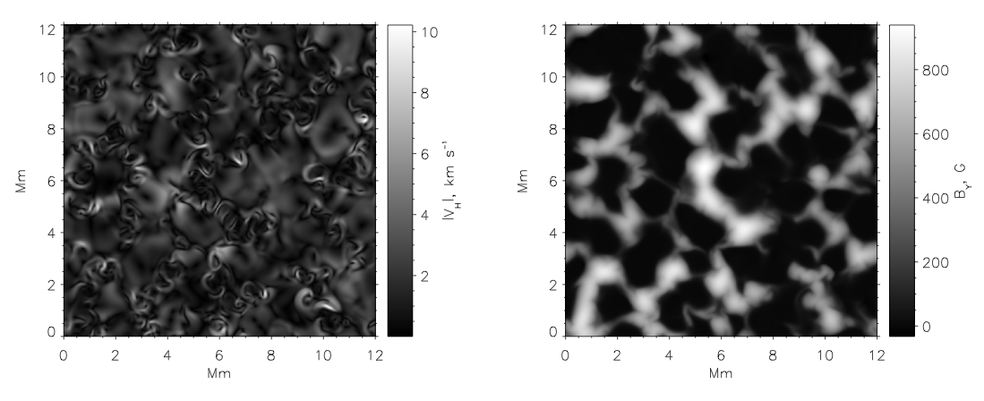
Simulated vortices
Horizontal vortices appear in the intergranular lanes in the upper photosphere, co-located with intergranular magnetic field concentrations. Note that velocities can be higher than in granular flows.
Image from Shelyag et al. (2011)

Slide 14
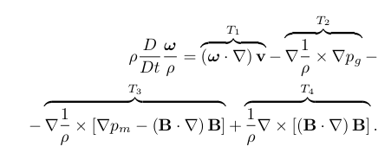
Vorticity equation and vortices
Taking curl of the MHD momentum equation and some rearrangement leads us to this (viscous dissipation neglected):
Vorticity is generated by:
T₁ – vortex tilting term
T₂ – hydrodynamic baroclinic term (orthogonal gradients)
T₃ – MHD baroclinic term (similar to T₂)
T₄ – tension term (not similar to anything)

Slide 15
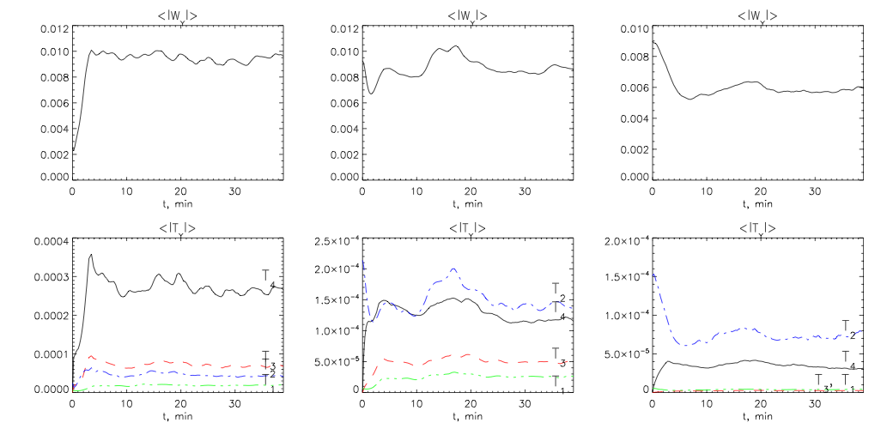
Vorticity evolution
Upper photosphere
Lower photosphere
Convection zone
T₄ is responsible for vortices in the upper photosphere.
T₄ and T₂ are equally important in the lower photosphere.
T₂ generates vorticity in convection zone, but suppressed by magnetic field.
Image from Shelyag et al. (2011)

Slide 16
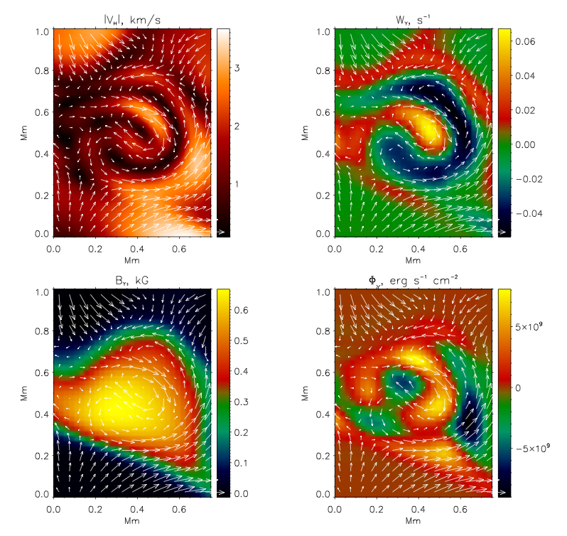
Horizontal cut through vortex
Individual intergranular vortex has an involved structure. Both clockwise and counterclockwise rotations are present.
The vortex generates net Poynting flux.
Image from Shelyag et al. (2011)

Slide 17
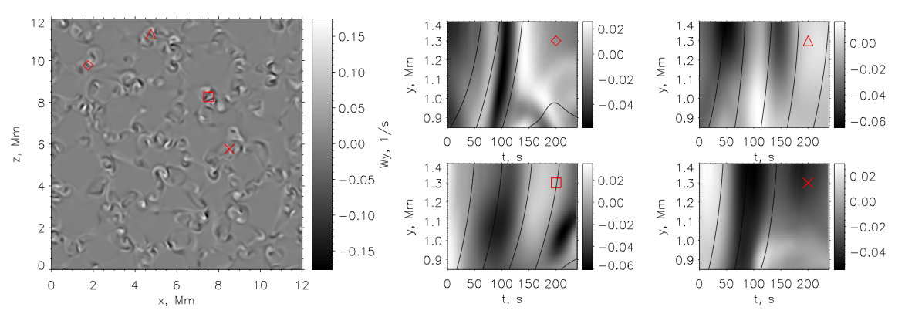
Alfvén waves
To identify wave types, we plot time-distance diagrams for vertical component of the vorticity in vortex structures. Also, overplot tracks for test particles moving with the local time-dependent Alfvén speed.
Shelyag et al, ApJL 2013
The domain is filled with the structures exhibiting rapid vertical propagation of vorticity perturbation.
Alfvén speed can reach 70 km/s, normally about 40 km/s in higher photosphere in the magnetic field regions. Flow speeds never exceed 5-15 km/s. Propagation of vorticity perturbation cannot be explained with flows. It propagates with Alfvén speed.
“Vortices” do not generate Alfvén waves: they look like they are Alfvén waves themselves.

Slide 18
Ways for observations
1
2
Alfven waves carry energy (Poynting flux). To prove need to observe.
Tracking horizontal motions in the solar photosphere/chromosphere. Bright points/chromospheric swirls.
Off-disk-center spectropolarimetry. Horizontal motions become line-of-sight motions.

Slide 19


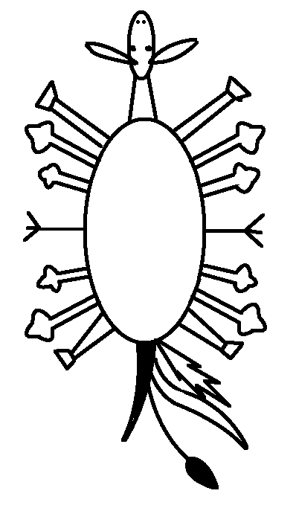
Limb vs disk solar observations
Limb
Obs
The Sun
Obs
Disk centre

Slide 20
Limb vs disk solar observations
Of course, it is not as simple and nice as that – mainly due to non-locality of radiative transport in optically thick regime + nLTE effects.
But:
Horizontal flows become line-of-sight
Horizontal magnetic fields become Stokes-V measurable
Radial structure becomes (probably) more apparent than at the disk centre
Generally, limb and disk observations together give 3D structure of the solar atmosphere

Slide 21

Off-centre simulated spectropolarimetry
NICOLE code by Hector Socas-Navarro (IAC, Spain) is used to compute the Stokes profiles.
Different viewing angles are achieved by shifting the layers of the MHD box and recalculating LOS and perp. magnetic field and LOS velocity. Note – whole sphere can be constructed.

Slide 22
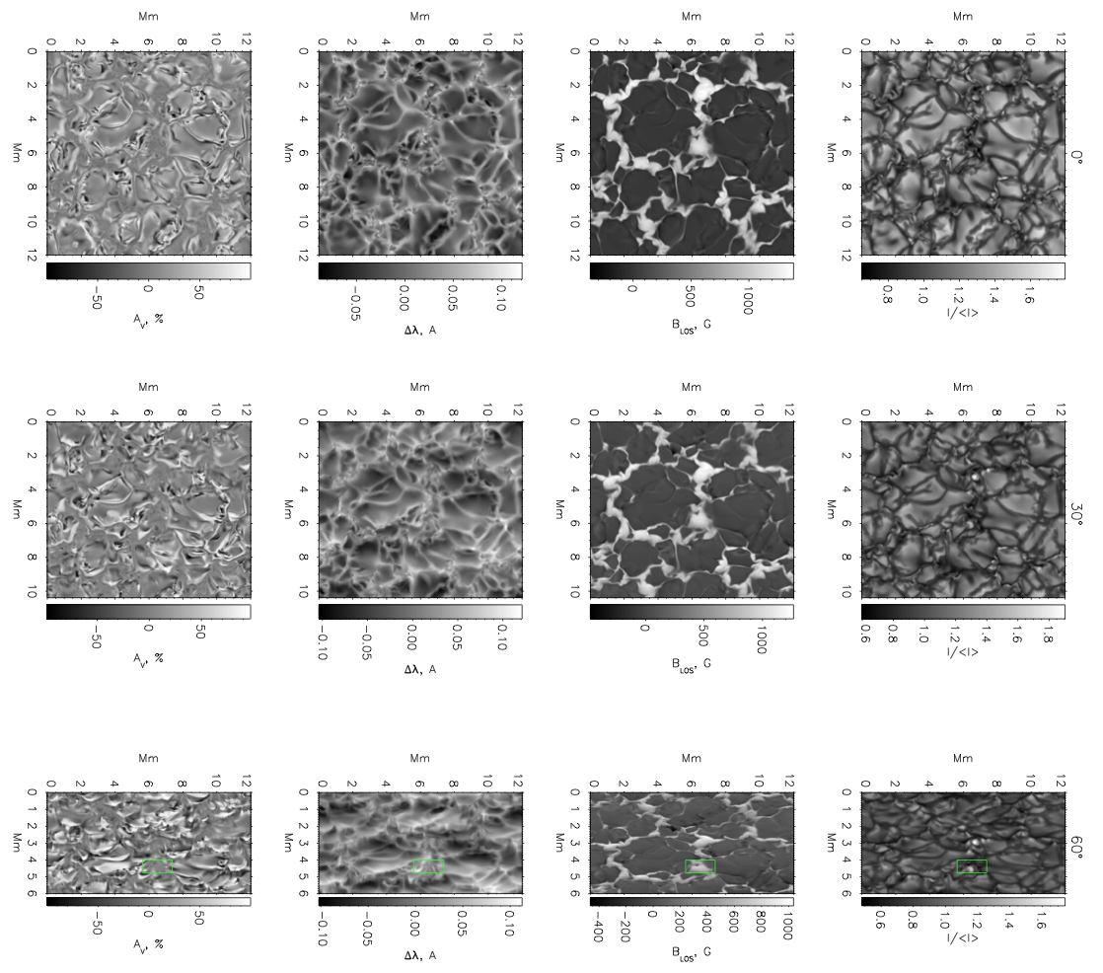
FeI 6302.5A line
Shelyag&Przybylski, PASJ, 2014

Slide 23
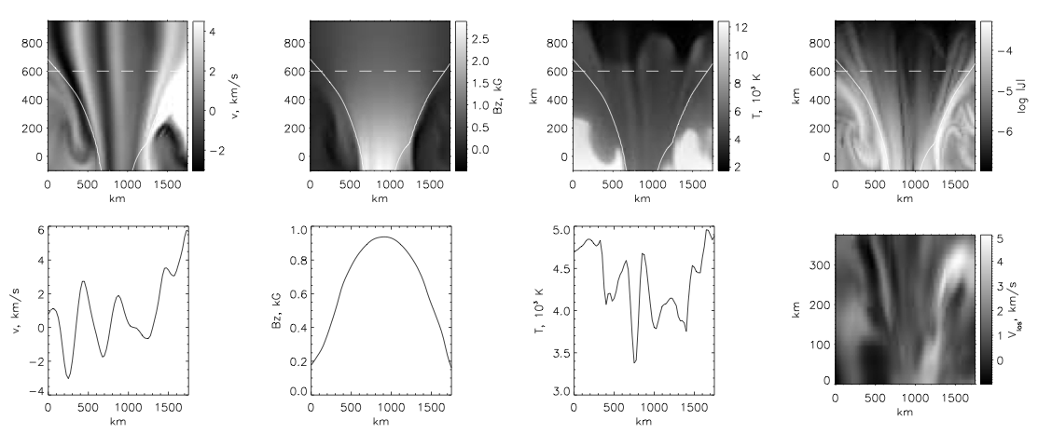
Plasma parameters and FeI 6302.5A line
Horizontal velocity
Vertical B
Temperature
Current
Vlos
Shelyag&Przybylski, PASJ, 2014

Slide 24
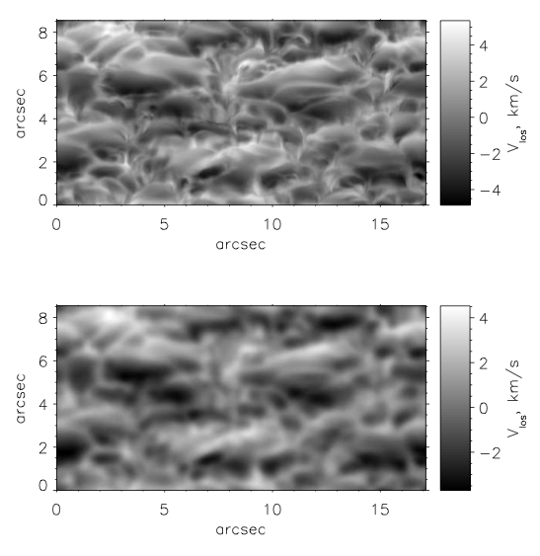
V_{LOS} from FeI 6302 at 60 degrees
Original resolution, 25 km
Degraded with Hinode PSF
Shelyag&Przybylski, PASJ, 2014

Slide 25
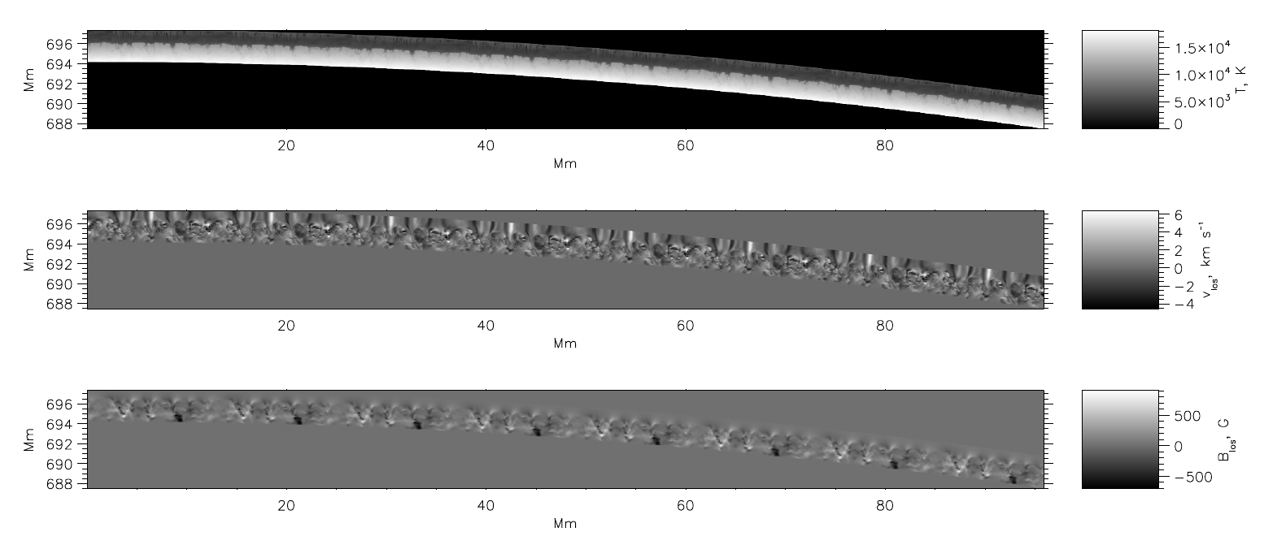
The limb simulation
16 MURaM models are stacked together and then curved to make the “spherical” (cylindrical, in fact) solar surface. Velocity and magnetic field are recalculated accordingly.
Shelyag, ApJ, 2015

Slide 26
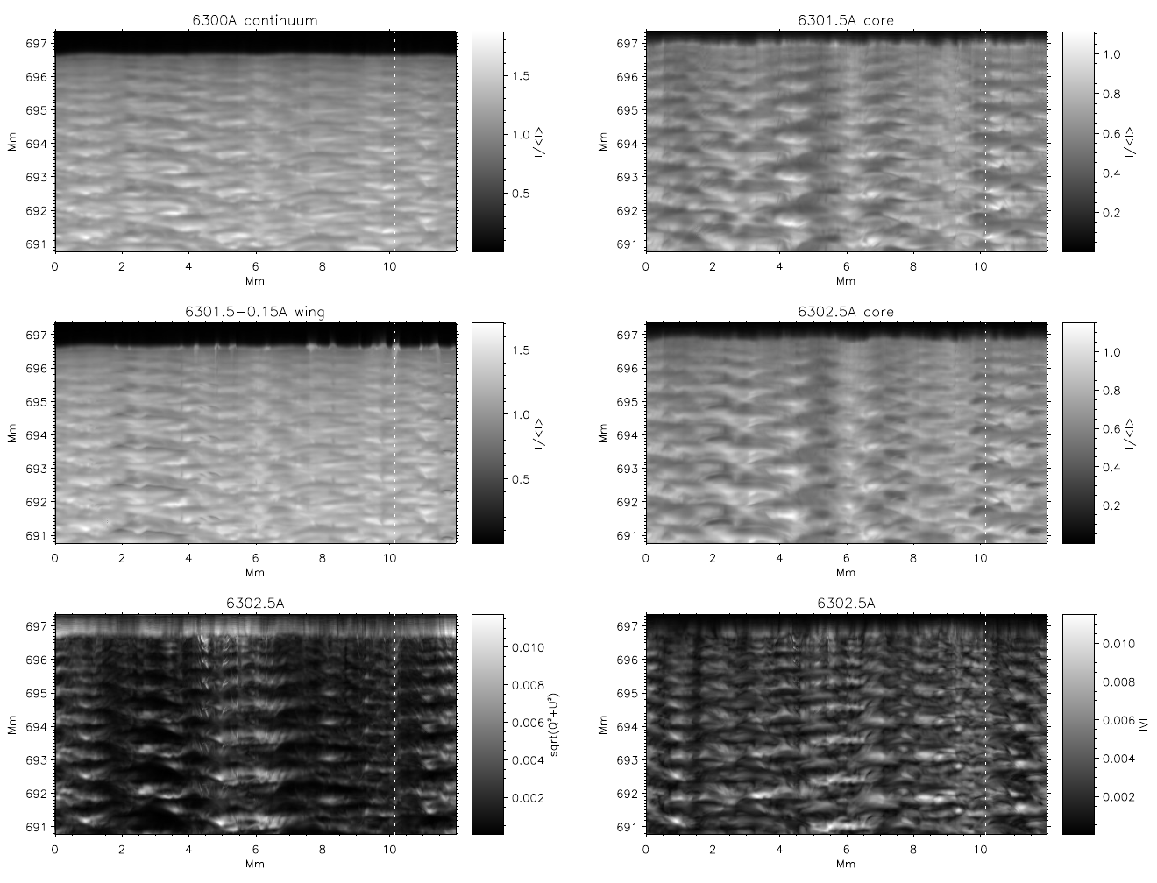
Simulated limb, images
Shelyag, ApJ, 2015

Slide 27
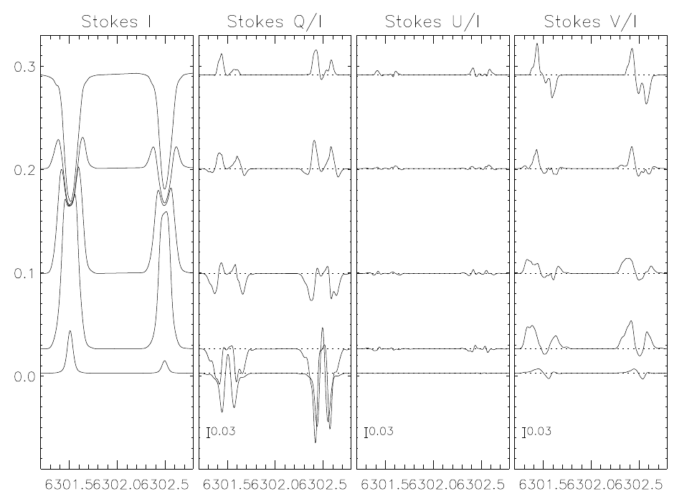
Simulated limb, average profiles
The 6302A line profiles go into emission. But the wings rise first.
Shelyag, ApJ, 2015

Slide 28
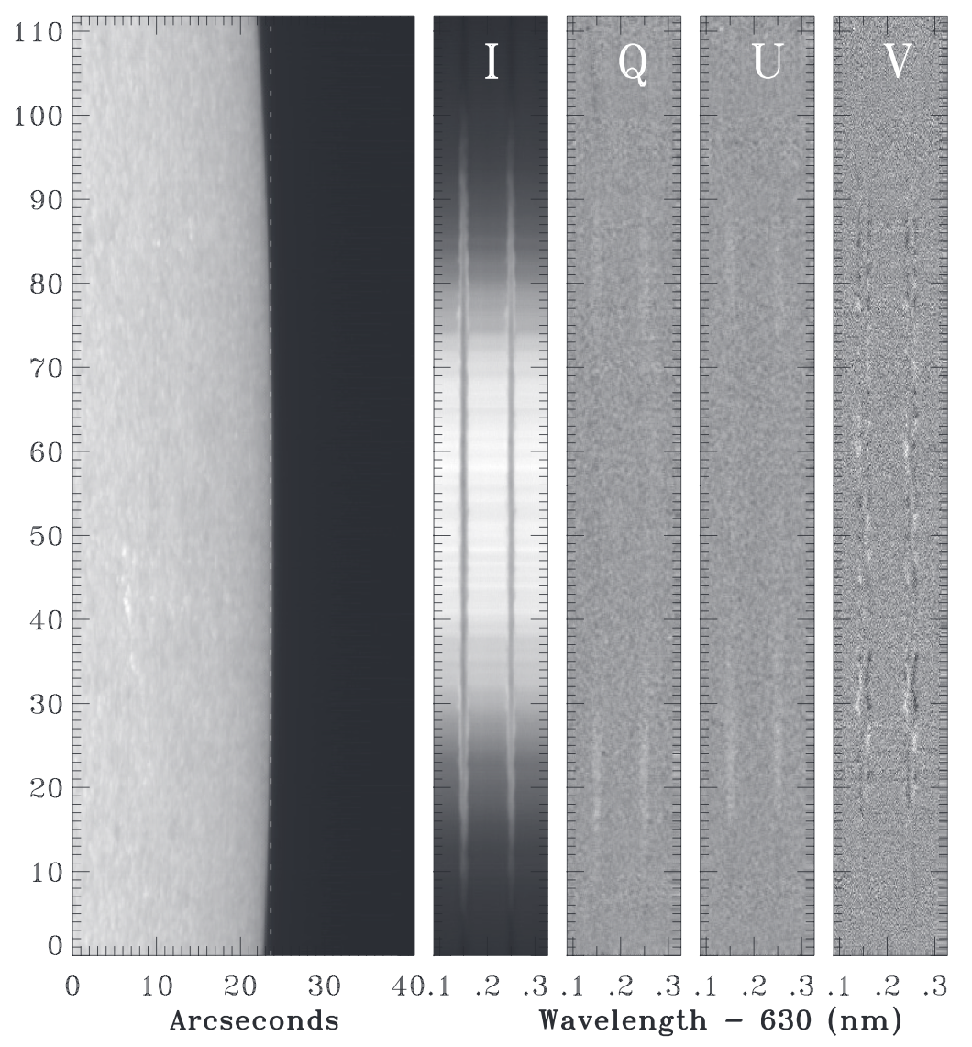
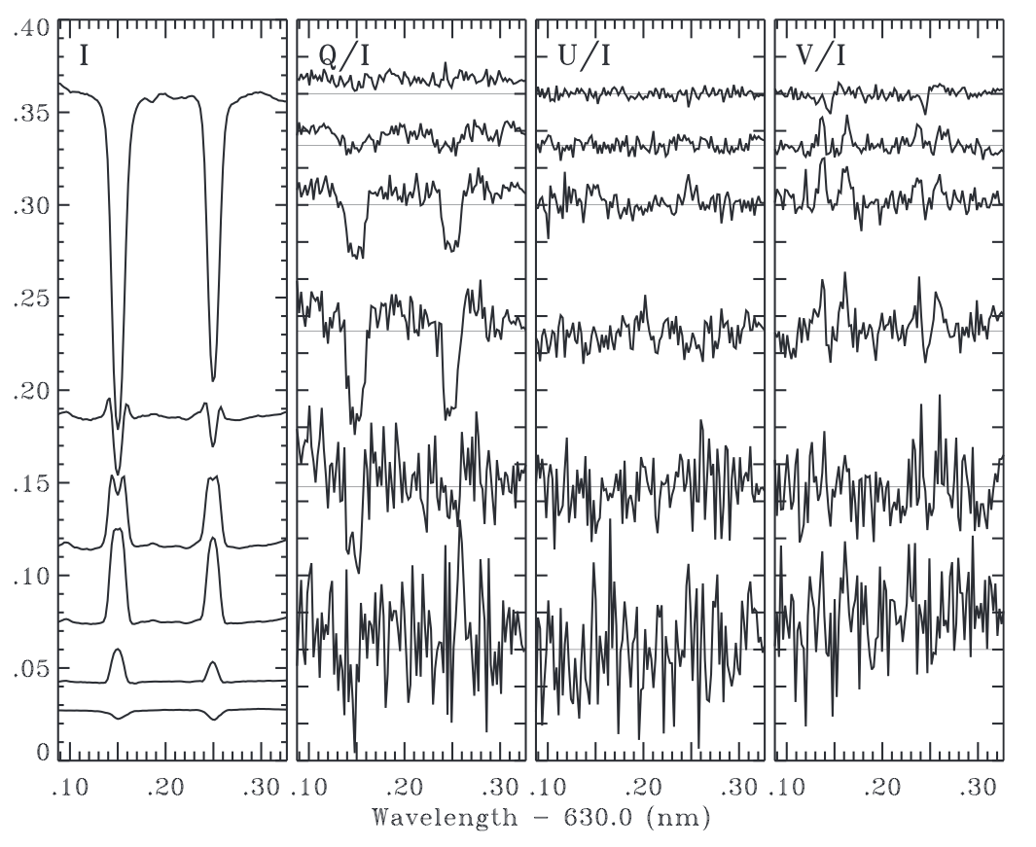
The only s-p observation of the limb: Lites et al 2010
Shows the same, hurray!
Lites et al (2010) show the same profiles. They say emission in the wings is due to 3D non-LTE scattering. Apparently, not only – we used 1D LTE.

Slide 29
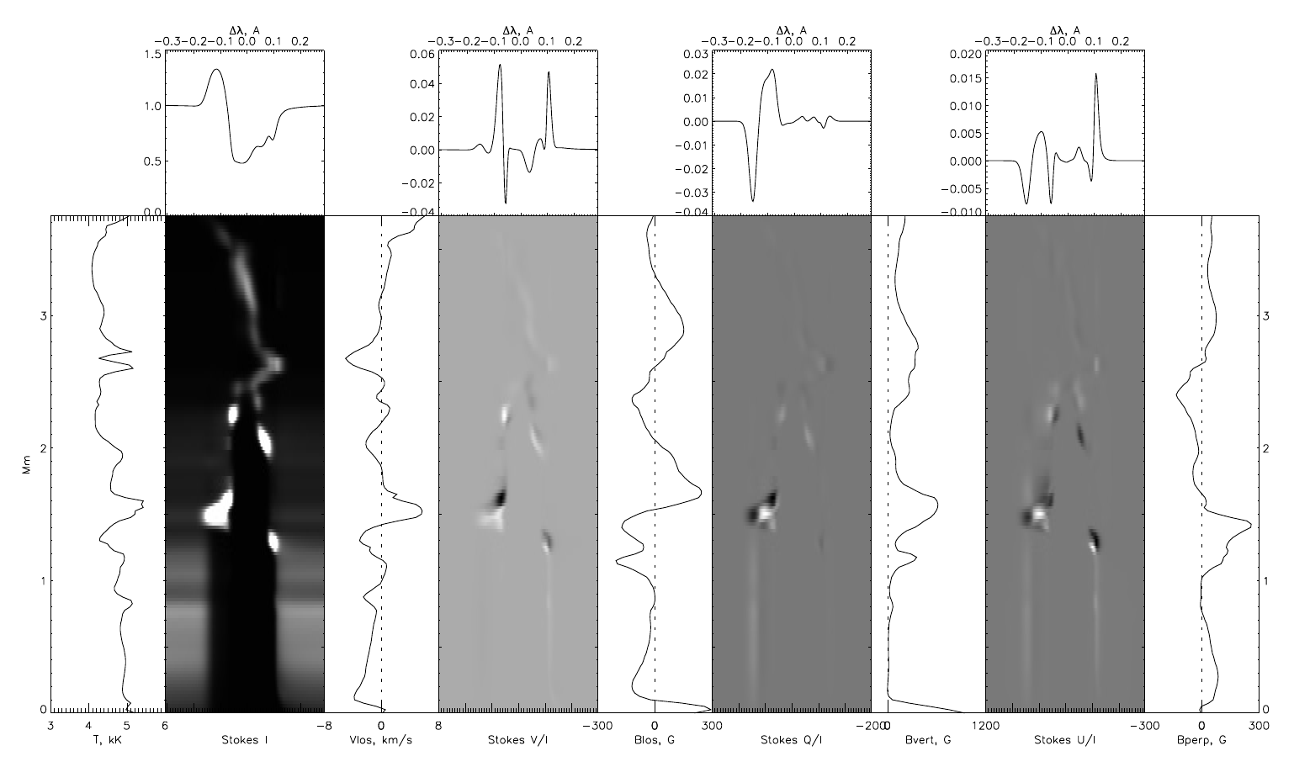
Simulated limb, 6302A FeI response functions
Shelyag, ApJ, 2015

Slide 30
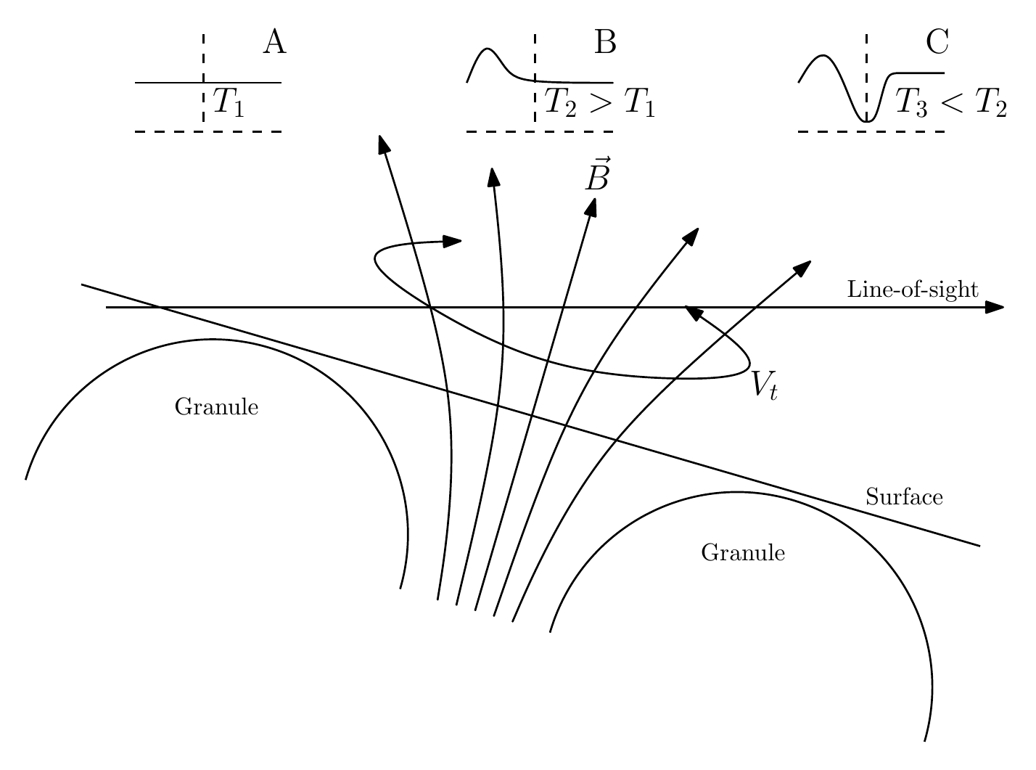
How the emission-absorption profiles are formed
Here, absorption-emission profiles are formed in three stages: (A) – continuum formation, (B) – Doppler-shifted emission profile in the positive T-gradient with torsional flow, (C) – normal absorption profile.
Shelyag, ApJ, 2015

Slide 31
The end

