Slide 1
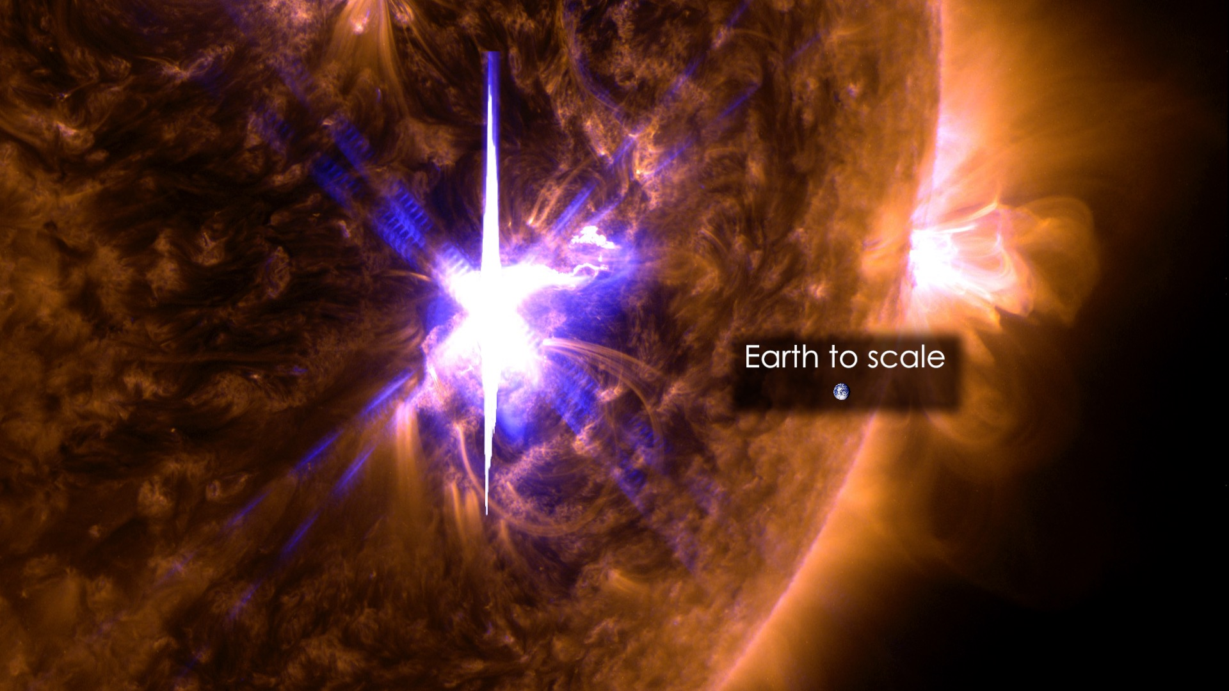


Efficient Nonthermal Ion and Electron Acceleration in 3D Magnetic Reconnection
Zhang+ 2021 PRL
Qile Zhang, Fan Guo, Bill Daughton, Xiaocan Li, Hui Li
SolFER Colloquium
11.19.2021

Slide 2
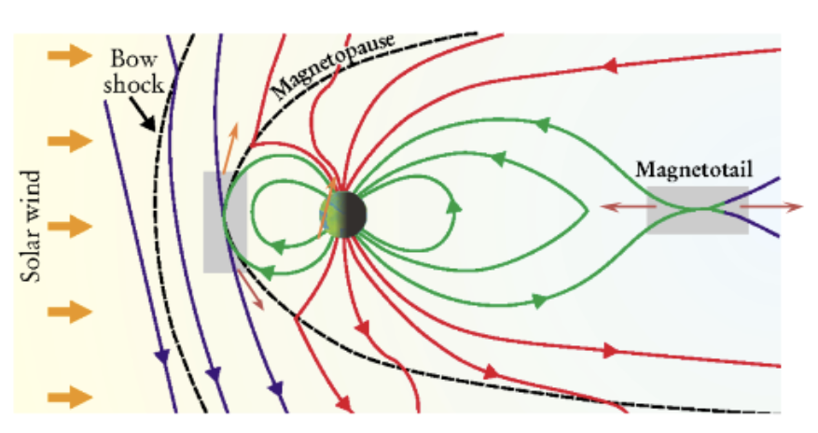
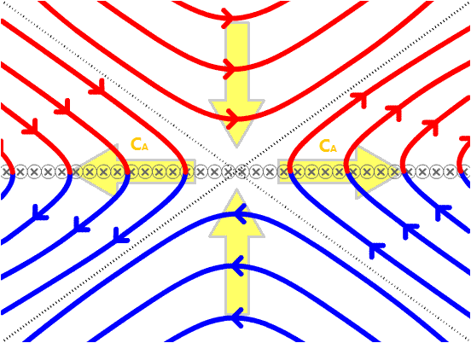
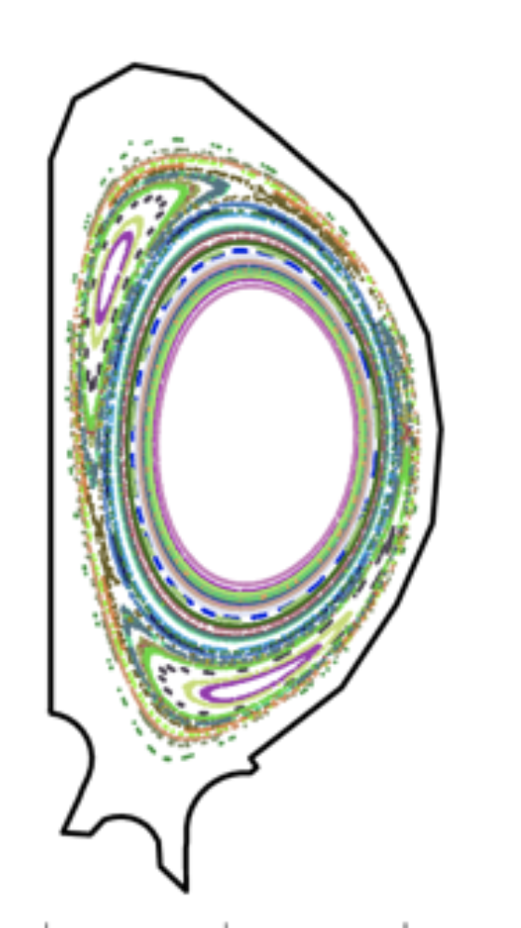
Magnetic reconnection releases magnetic energy
Earth’s magnetotail
Energy release
Energy release
Laboratory plasma
Guide field ⊗
Solar flares

Slide 3
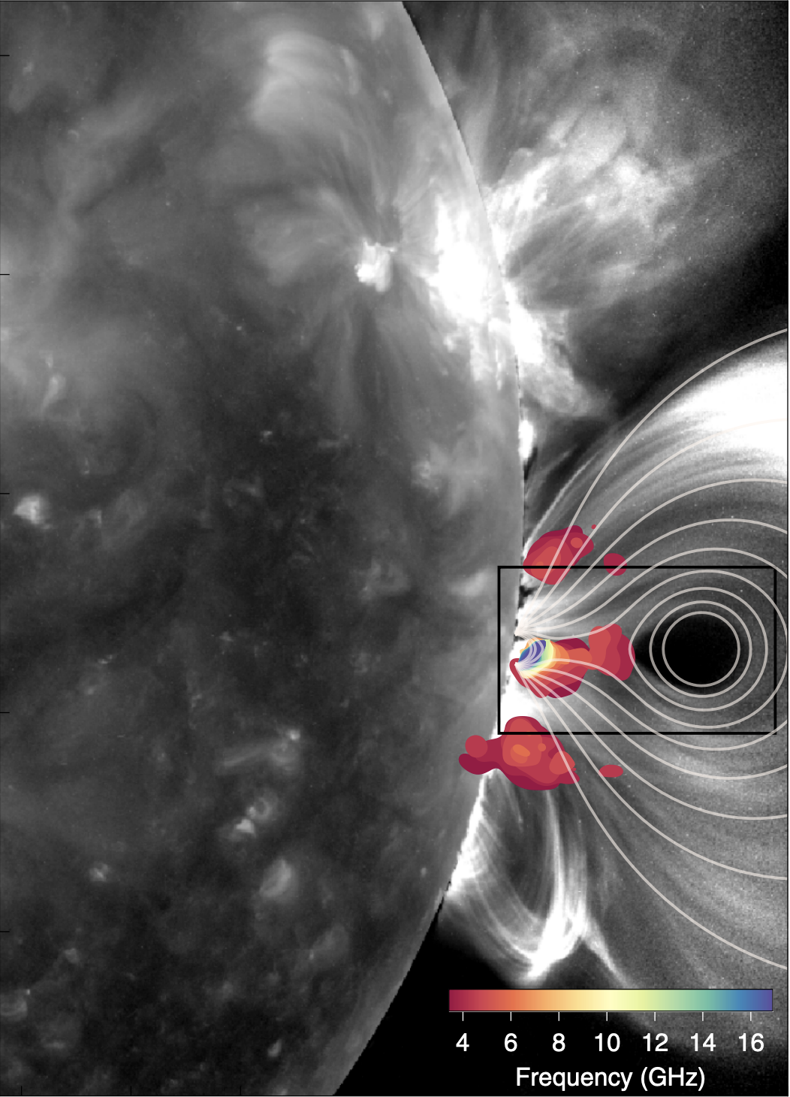
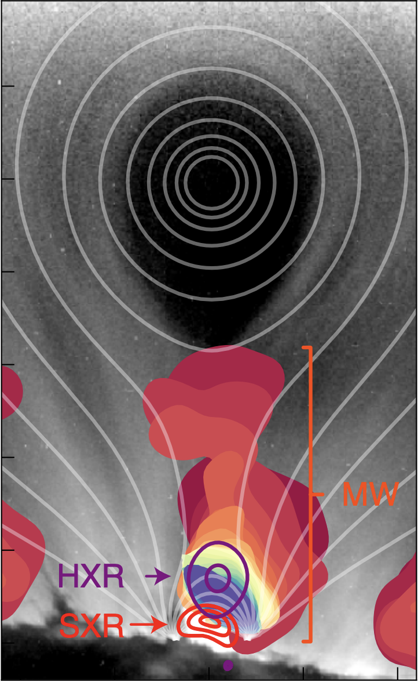
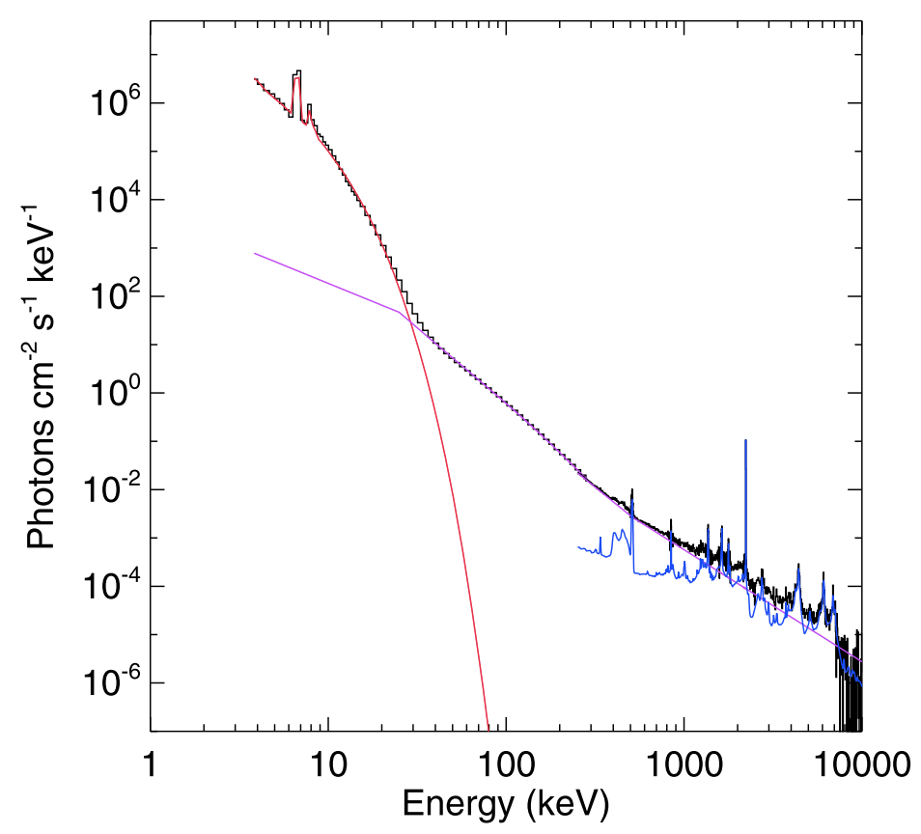
In solar flares, electrons are efficiently accelerated into power-laws
X-ray
Electron power-law
Lin+ 2011
Chen+ 2020

Slide 4
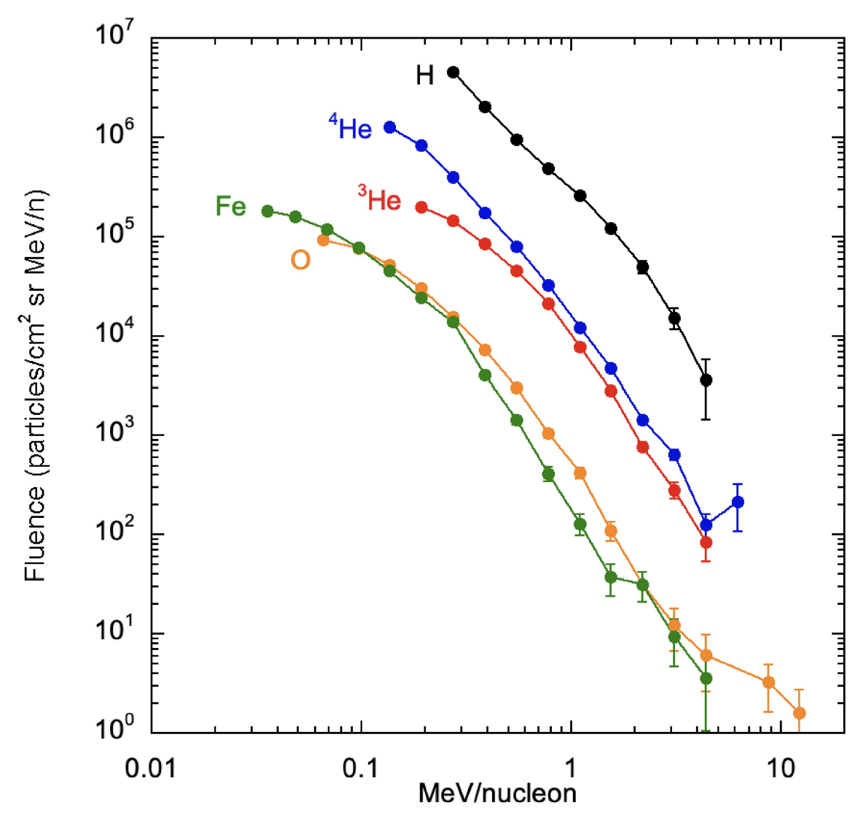
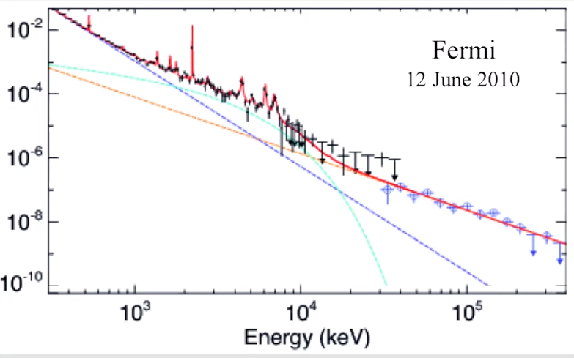
Ions are also efficiently accelerated into power-laws
Solar energetic particles
Gamma-ray
Proton power-law
Credits: M. Pesce-Rollins
Mason+ 2020

Slide 5
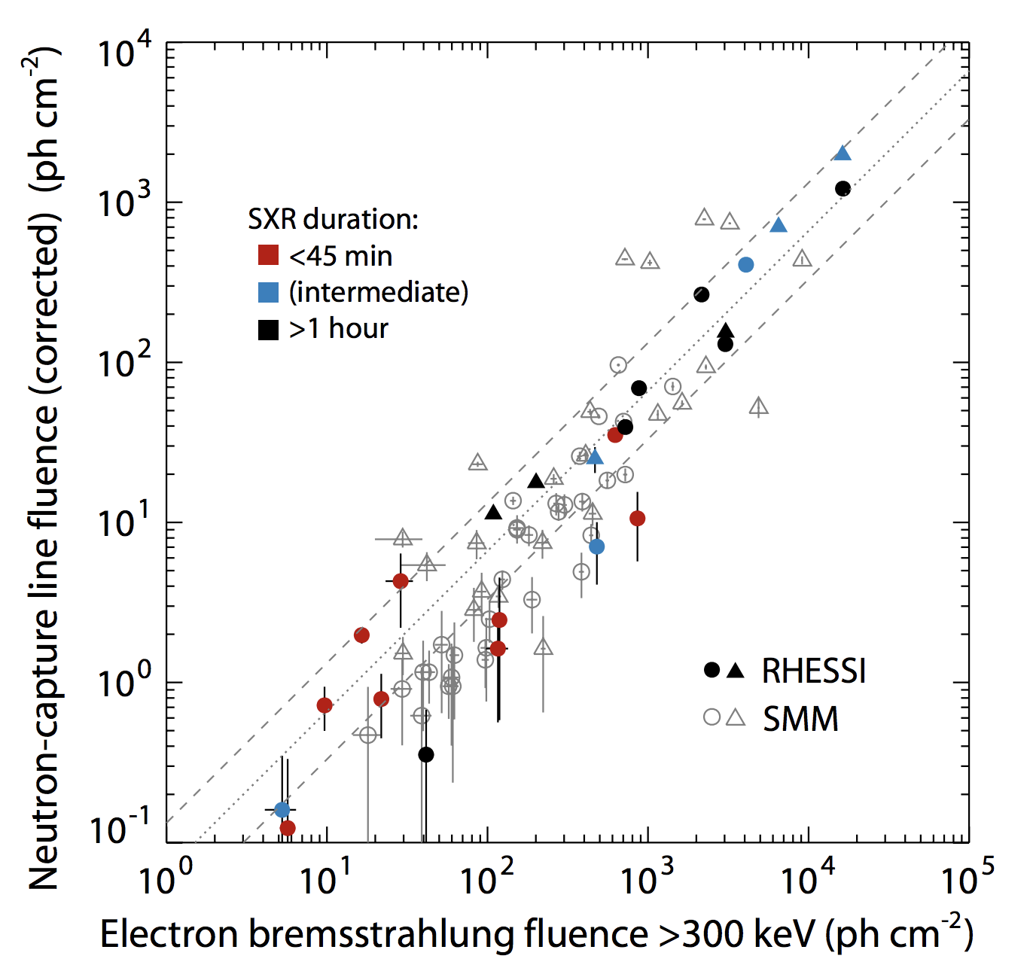
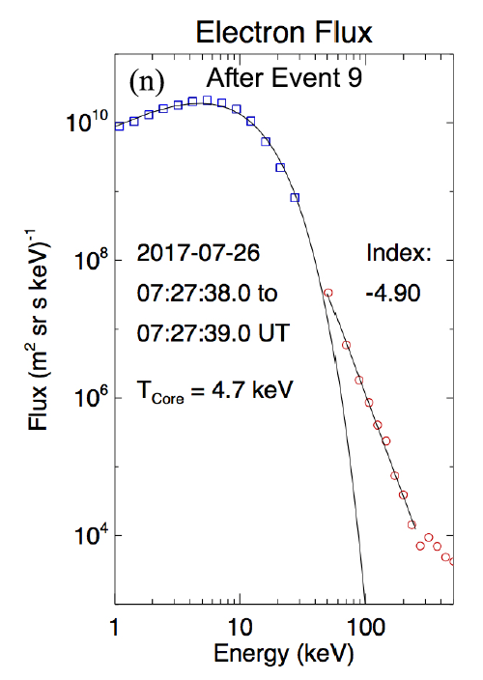
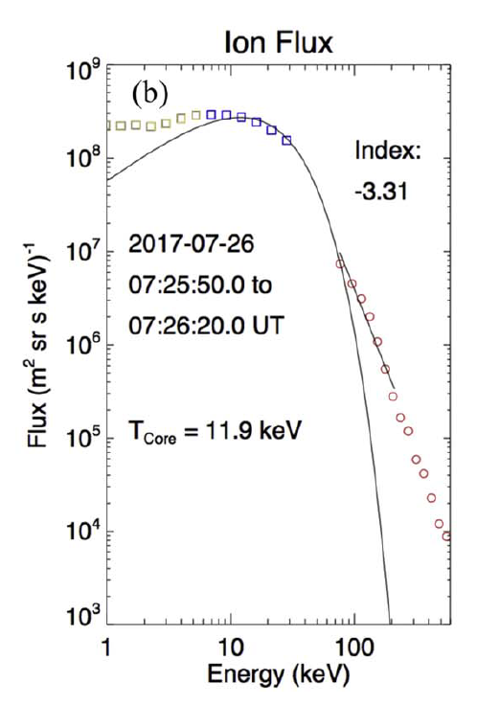
Simultaneous acceleration of electrons and protons in low beta reconnection
Solar flares
Magnetotail
Energetic protons
Shih+ 2009
Ergun+ 2020
Energetic electrons
But the underlying physics is not well understood.

Slide 6
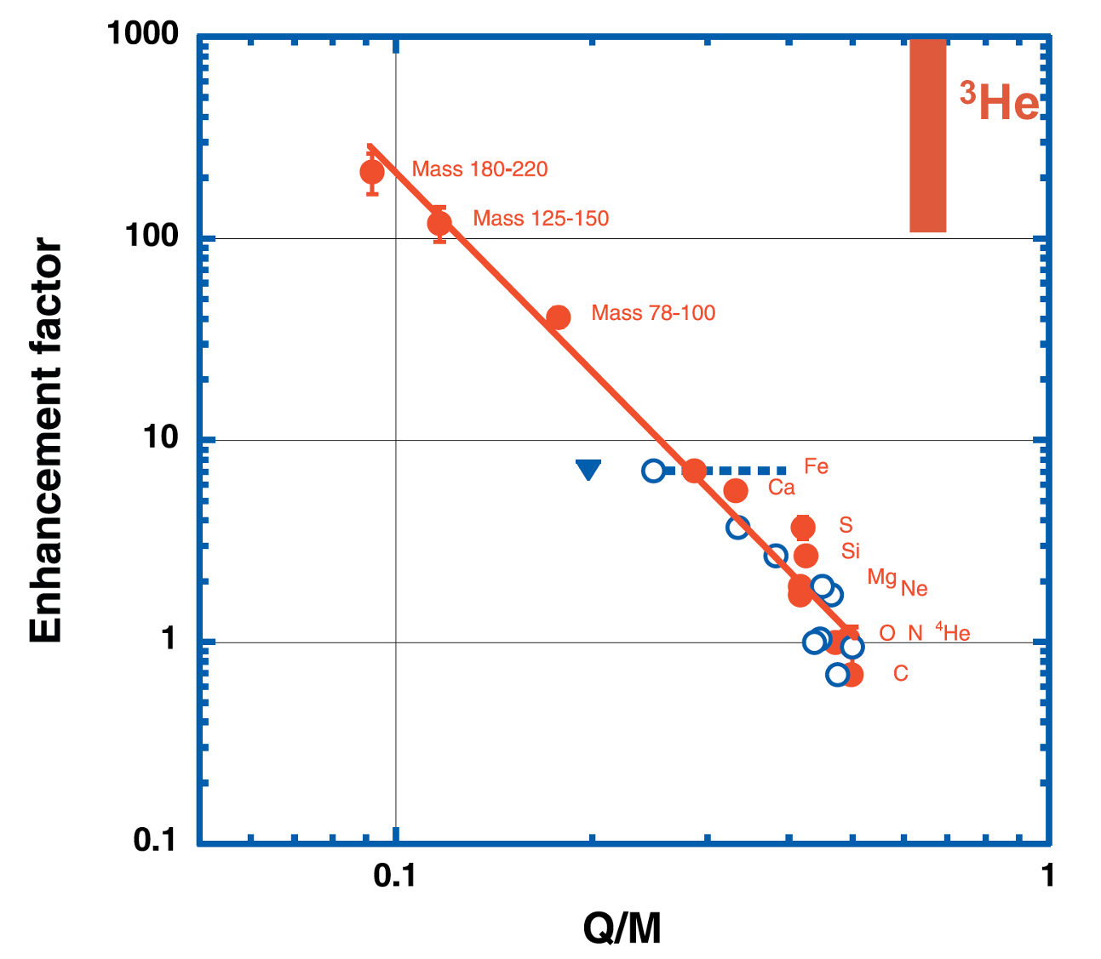
The preferential ion abundance enhancement is an open question
Mason+ 2020
Adapted from Mason+ 2004
Preferential enhancement: Q/M dependence and ³He
We focus on protons and electrons

Slide 7
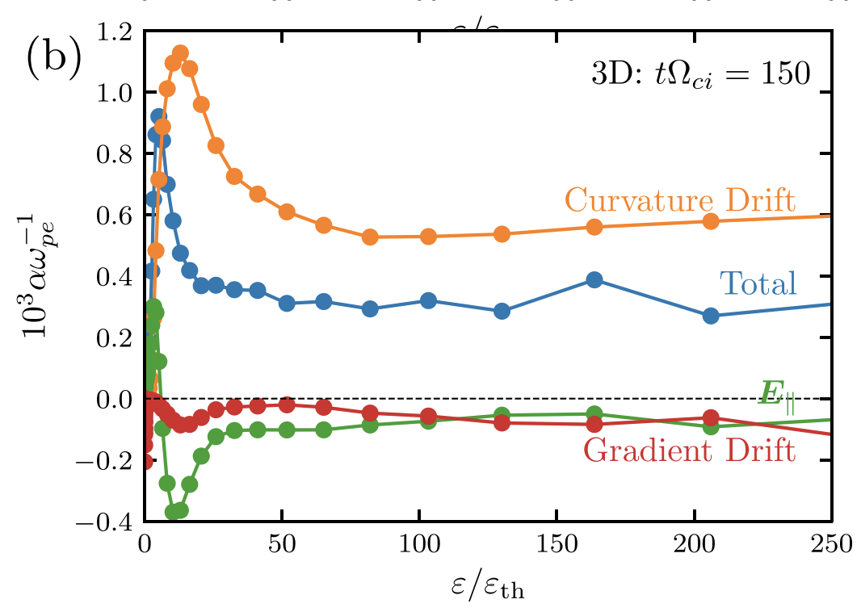
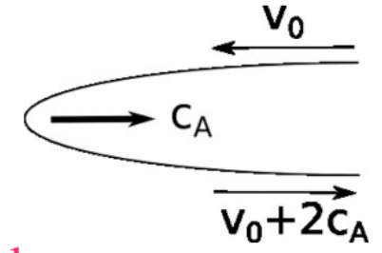
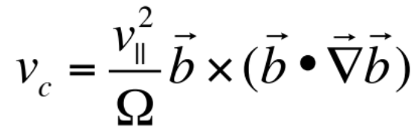
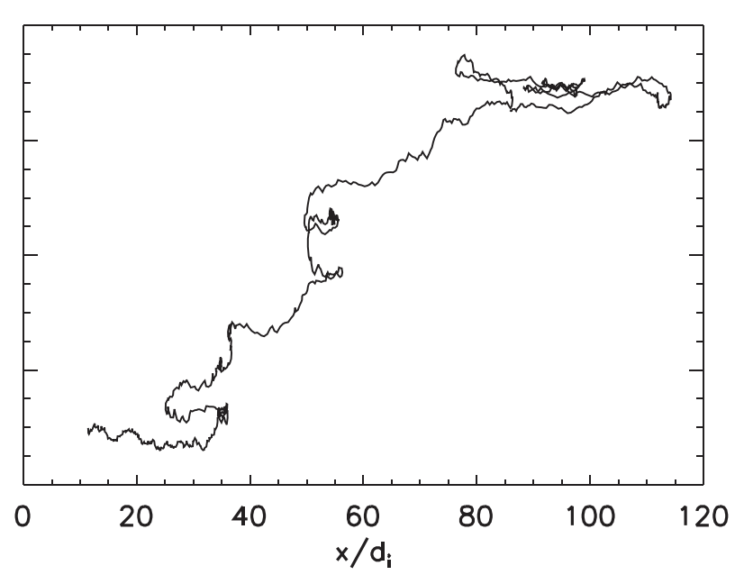
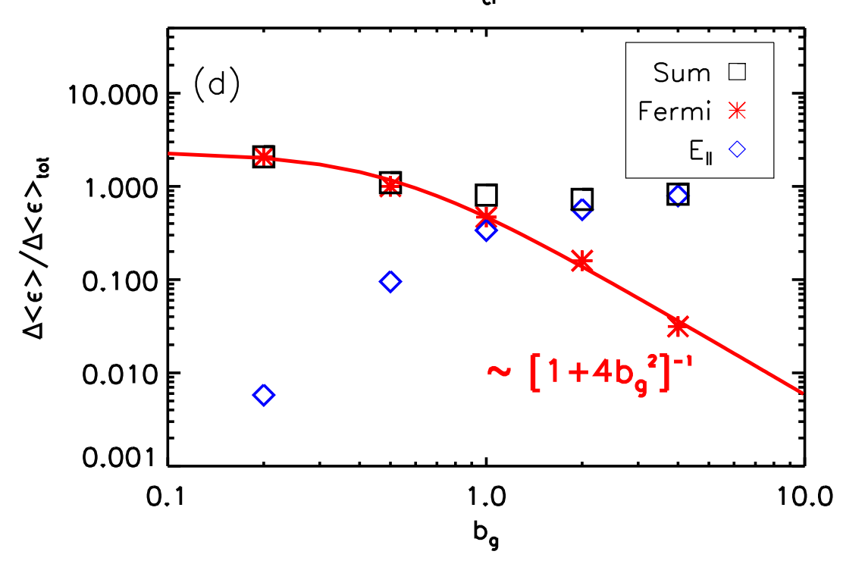

Fermi acceleration is efficient with low guide fields
B
LI+ 2019
Adapted from Dahlin+ 2014
Dahlin+ 2015
Dahlin+ 2016

Slide 8
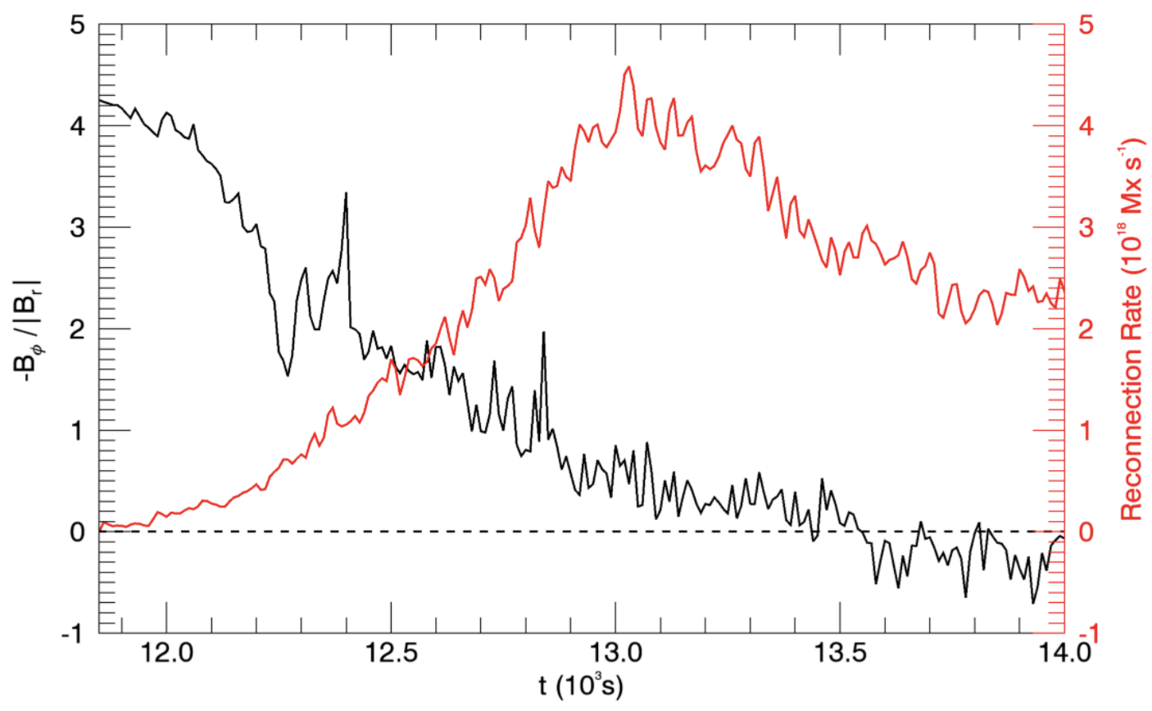
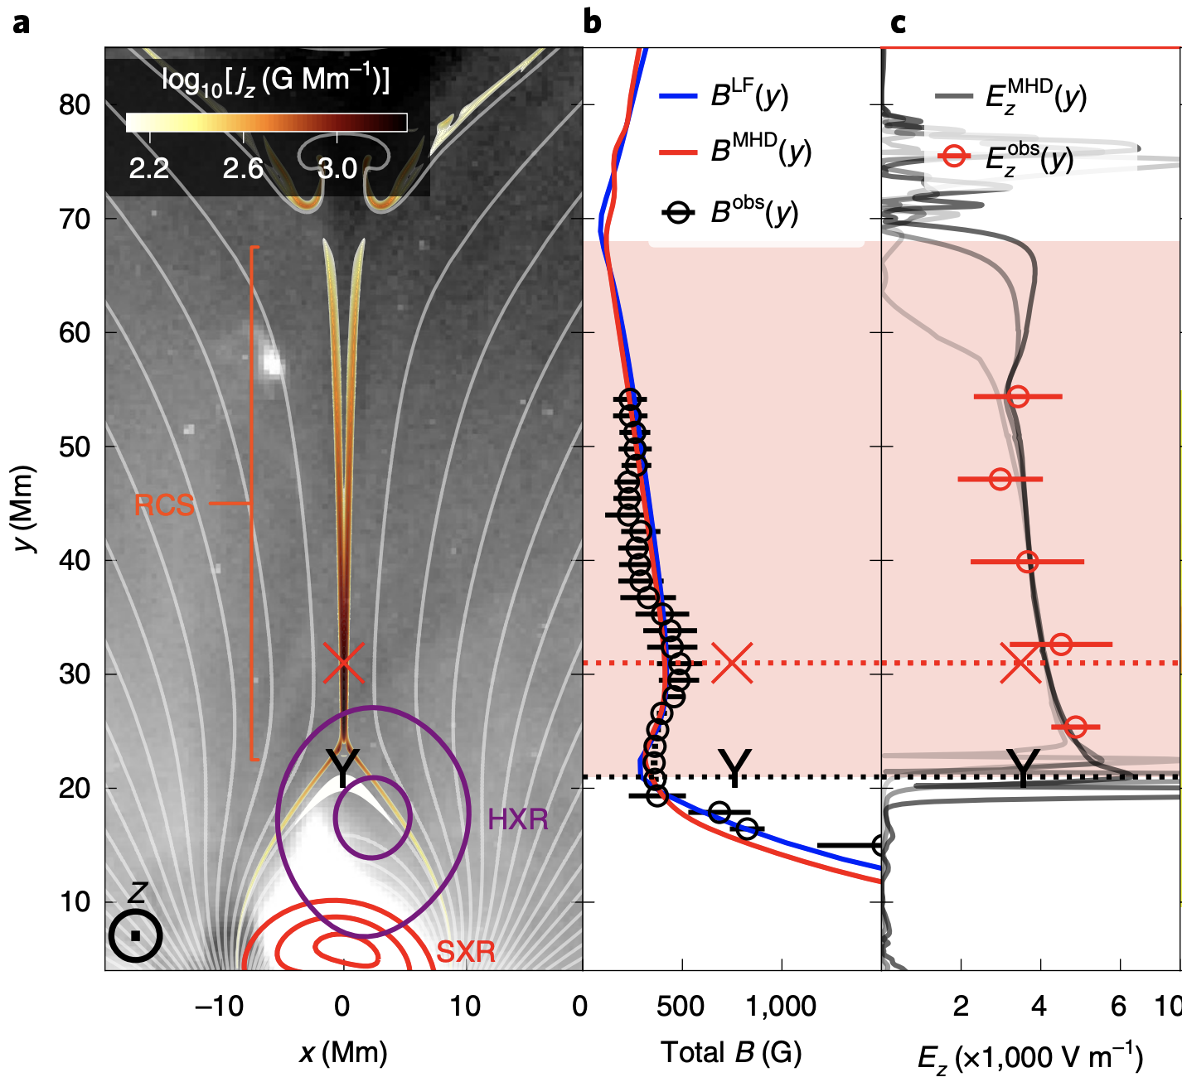
Observations also suggest low guide field reconnection
bg=0.3
Dahlin+ 2021
Chen+ 2020

Slide 9
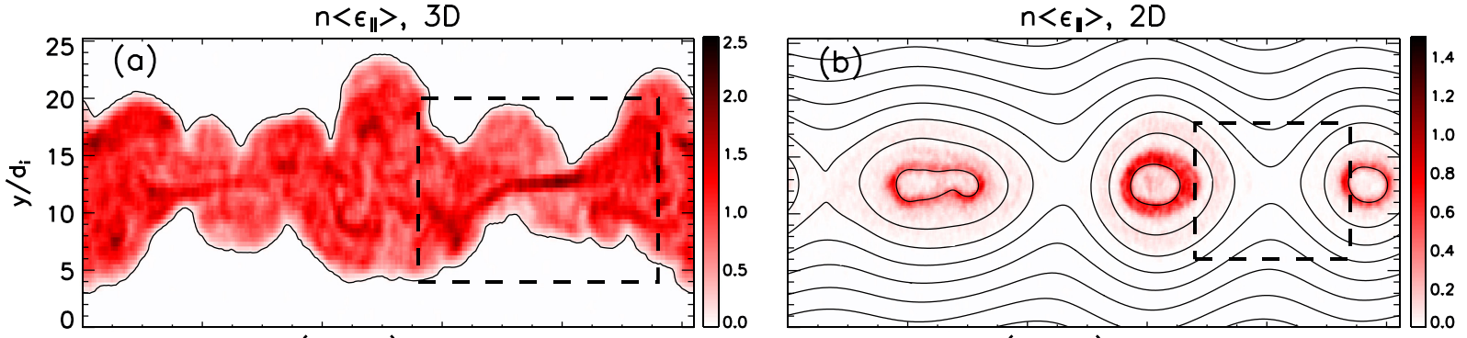
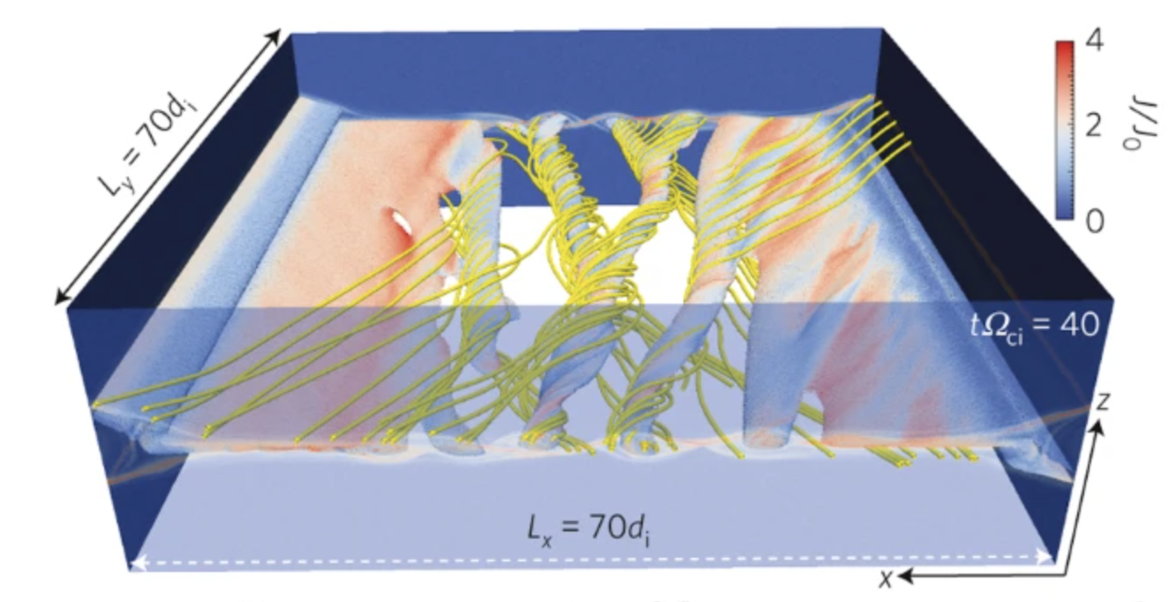
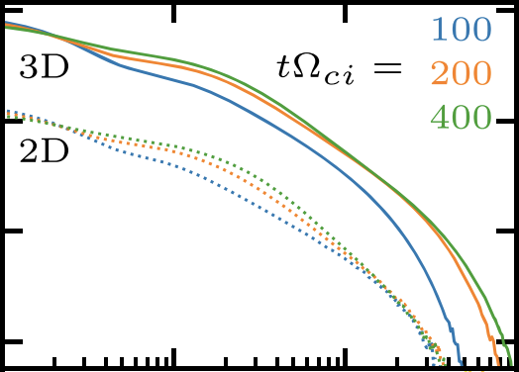


Fermi acceleration is more efficient with field-line chaos
Dahlin+ 2017
Li+ 2019
Daughton+ 2011

Slide 10
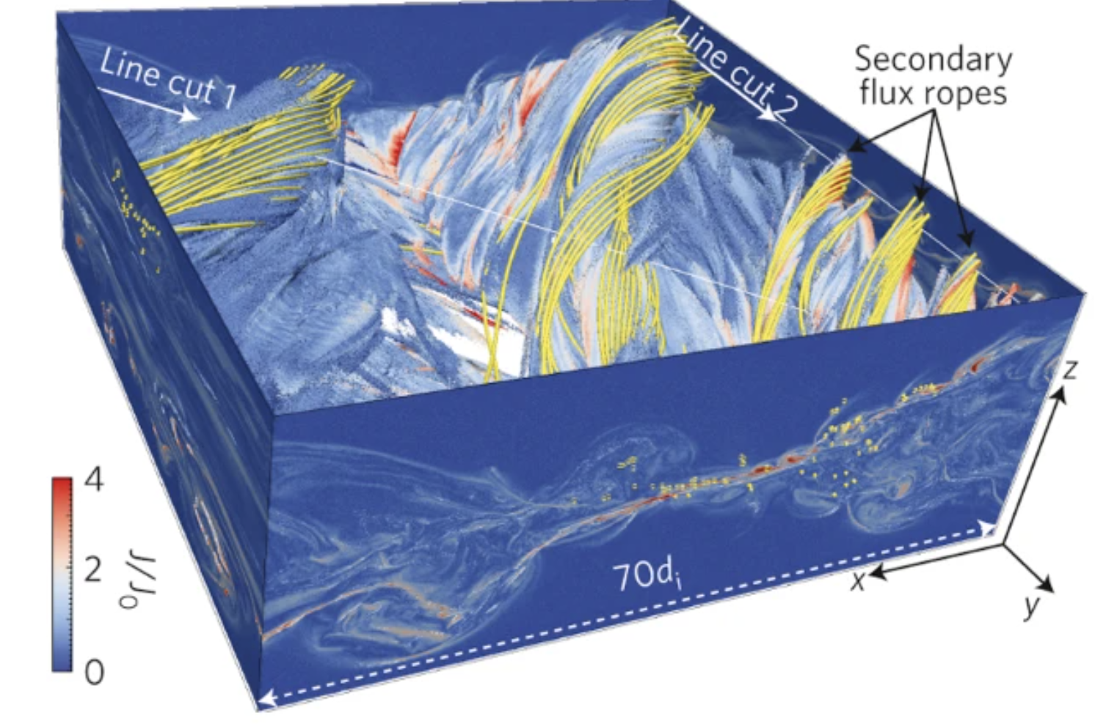
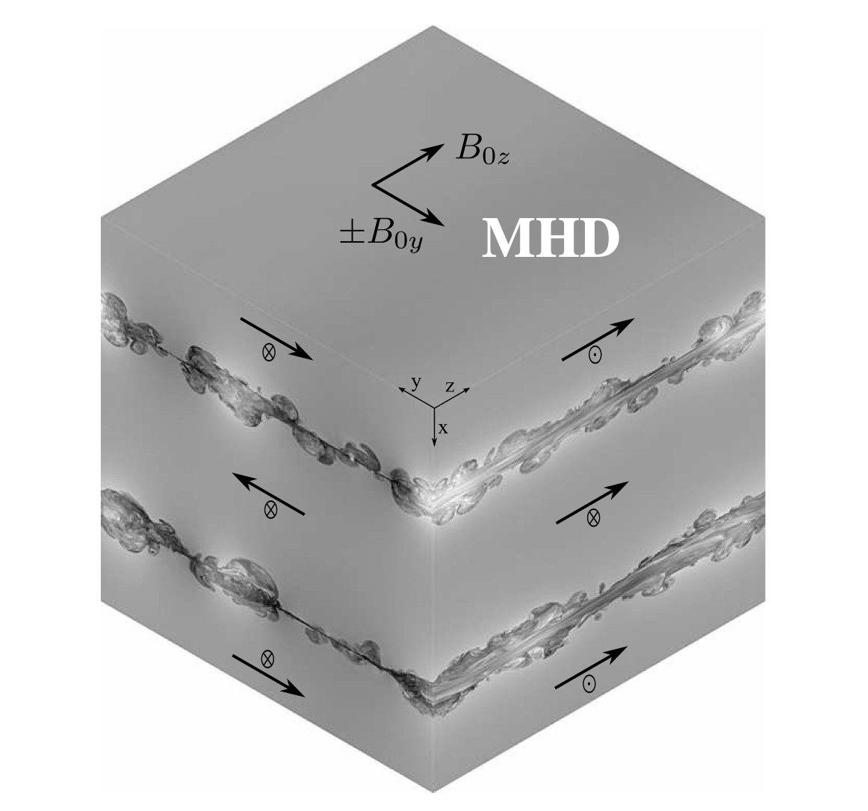
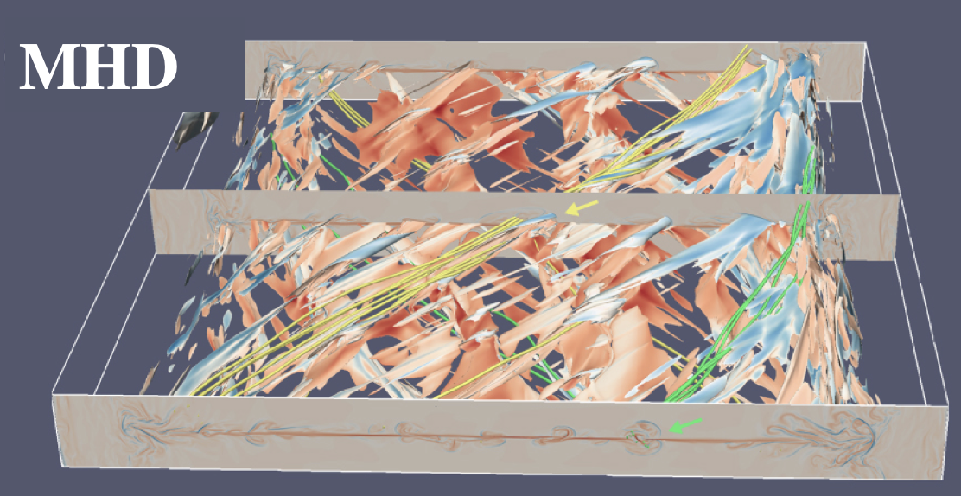
3D turbulent reconnection is a frontier of research
Kinetic
Kinetic
Kinetic
Daughton+ 2011, Liu+ 2013,
Beresnyak 2016, Oishi+ 2015
Huang+ 2016, Kowal+ 2017
Leake+ 2020, Guo+ 2021, etc.

Slide 11
We focus on 3D reconnection with low guide fields
A new mechanism for field-line chaos
Nonthermal power-laws for both species
Controlling physics of low-energy and high-energy bounds

Slide 12
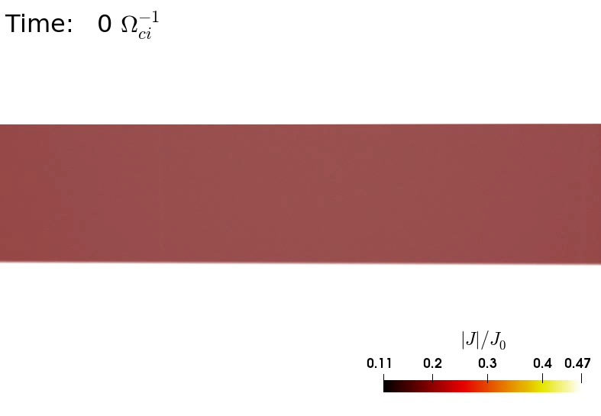


With low guide fields, flux-rope kink instability drives field-line chaos
guide field
reconnecting field
Kink instability criteria: safety factor q<1
Field-line chaos
Particle spreading

Slide 13
In contrast, below-threshold reconnection is nearly laminar
above threshold
below threshold

Slide 14
Field-line chaos leads to efficient particle transport out of flux ropes, allowing further acceleration
Above
threshold
Above
threshold

Slide 15
Electrons and protons form power-laws containing a large fraction of energy
index
index
Nonthermal components: ~ 20% number, 50% energy

Slide 16
High-energy cutoff is limited by system size
index
index
Increase with system sizes

Slide 17
Low-energy bound is determined by injection
index
index

Slide 18
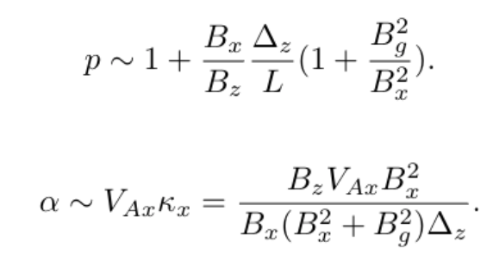
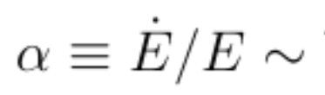
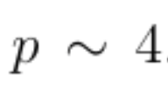



The Fermi acceleration process can be elucidated by a scaling analysis
Fermi acceleration at exhausts + particle acceleration theory gives:
t^{0.8}

Slide 19
Results are roughly consistent with observations
Solar flares
Power-law indices p~4: Electrons: x-ray (Oka+ 2018), microwave (Gary+ 2018)
Protons: gamma-ray (Omodei+ 2018), solar energetic particles (Cohen+ 2020)
Significant nonthermal fraction (Oka+ 2015, Aschwanden+ 2016)
Magnetotail
  In-situ spectra for both species
Power-law indices
p~4
  Low-energy bound “shoulder”
Ergun+ 2020

Slide 20
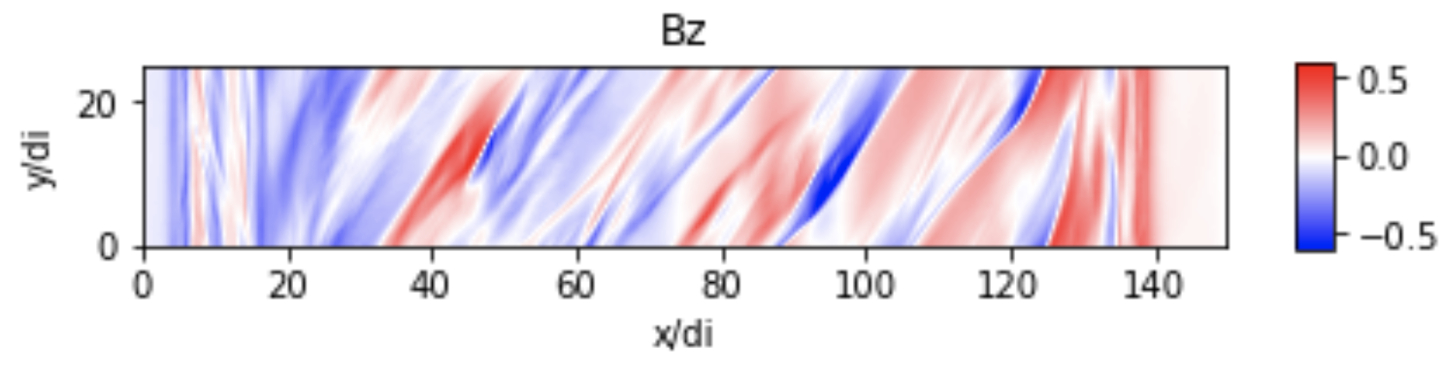
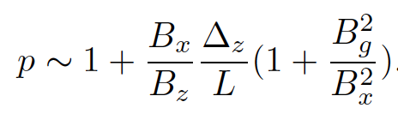
Related ongoing works in higher guide field regime
bg=1
30°
~7

Slide 21
Take-aways
3D reconnection drives efficient nonthermal acceleration for both protons and electrons.
Efficient Fermi acceleration is enabled by field-line chaos driven by flux-rope kink instability.
Low-energy bound is determined by injection; high-energy cutoff grows with system size.
Zhang+ 2021 PRL
qlzhang@lanl.gov

