Slide 1
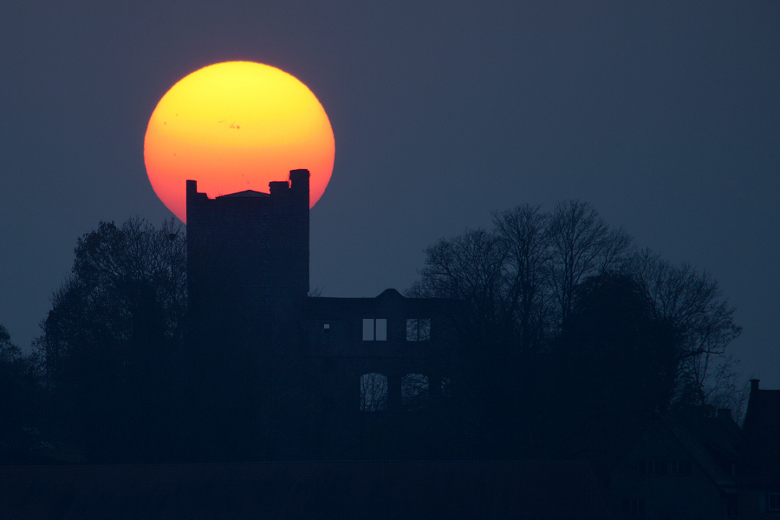

What sunquakes tell us about energy transport in solar flares
V.V.Zharkova
Department of Mathematics, University of Northumbria, UK
With thanks to: Sergei Zharkov (Hull University, UK),
Malcolm Druett (Stockholm University, Sweden)
Sarah Matthews (MSSL/UCL, UK)
Solar Physics Webinar 26 June 2019

Slide 2
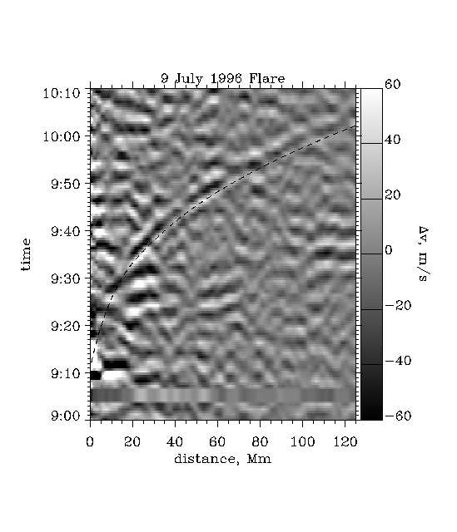
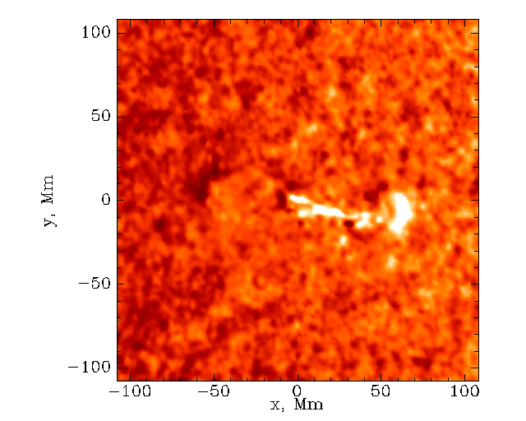

Sun-quakes discovered by Kosovichev & Zharkova, 1998
2
Notes:
The solar quake that the science team recorded looks much like ripples spreading from a rock dropped into a pool of water. But over the course of an hour, the solar waves traveled for a distance equal to 10 Earth diameters before fading into the fiery background of the Sun's photosphere. Unlike water ripples that travel outward at a constant velocity, the solar waves accelerated from an initial speed of 22,000 miles per hour to a maximum of 250,000 miles per hour before disappearing.

Slide 3
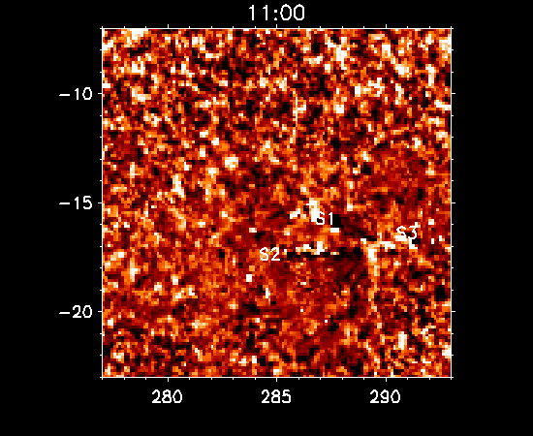
Reality more complex: October 28, 2003
Notes:
So what can we see in real data?
ripples, but only in a handful of cases;
need to use helioseismology for better detection

Slide 4
Time-Distance diagram technique
(Kosovichev and Zharkova, 1998)
Remapped dopplergrams with the centre in 1 pixel of the supposed impulse
Difference filter was applied to remove the background velocities.
Applied frequency filtering at 6 mHz (optional)
Fourier-transformed signals with respect to the azimuthal angle θ
Plotted Fourier coefficients for m=0 (circular wave), m=1 (dipole)
Repeated for 20x20 pixels to find the areas
θ

Slide 5
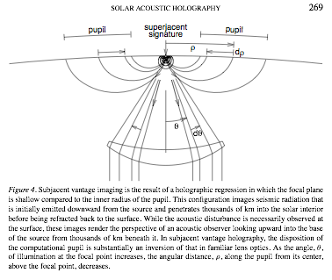






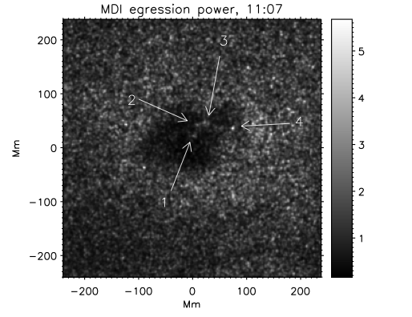
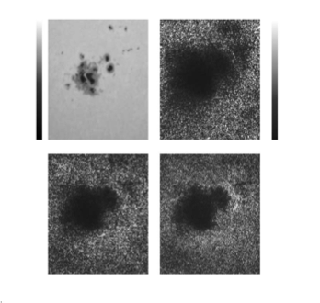

measuring acoustic egression power
Surface doppergram
observations (filtered)
Green function computed for
monochromatic point source
from Lindsey, Braun 2000
Oct 28, 2003 from Zharkov et al, 2011, ApJ
egression power provides stigmatic images of sub-surface sources that have given rise to the observed surface wave-field
a proxy for acoustic energy emitted from the location
integrated over several hours, shows sunspots as low acoustic emitters
data is frequency filtered -> timing uncertainty
Directional holography (Macrae et al, 2018)
5
(Donea et al 1999, Donea&Lindsey 2005, Lindsey&Donea 2008)
Notes:
this slide will be to quickly explain/give an intro for acoustic holography

Slide 6
Source 1 TD 28 October 2003 with frequency filtering at 6mHz (ZZ2007)

Slide 7
TD for source 2 28 October 2003 with frequency filtering at 6mHz (ZZ2007)

Slide 8
TD for source 3 28 October 2003 with frequency filtering at 6mHz (ZZ2007)

Slide 9
Downward velocities (m/s) in seismic sources S1, S2, S3 and S4 (ZZ07) 22/10/03 flare
Source 4,1
Source 2, 3

Slide 10
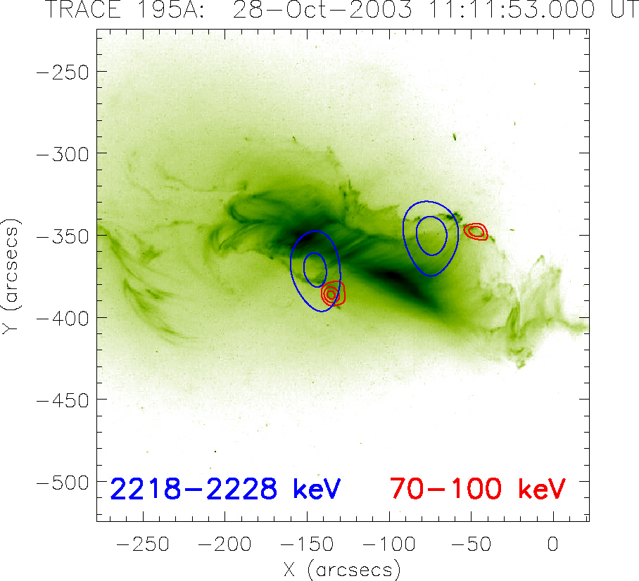
The seismic sources from TD
TD sources Zharkova and Zharkov, ApJ 2007 Different quakes have different : a) First ripple location, b) momenta, c) horizontal velocities |  |  |  |  |  | Times & Horizontal displacement
Name | Area/ Pixels | Area, cm² | V_{vert,} Km/s | Me_{HD}, g cm/s | M_{TD}, g cm/s | Time | T_{diff} min | V_{horiz,} Km/s
S1 | 3 x 3 | 5.05 10¹⁷ | -2.15 | 0.9 10²¹ | 3.8 10²² | 11:06-11:55 | 49 | 40.8
S2 | 3 x 2 | 3.34 10¹⁷ | -1.98 | 0.8 10²¹ | 3.1 10²² | 11:06-11:58 | 53 | 38.0
S3 | 2 x 2 | 2.22 10¹⁷ | -1.70 | 0.7 10²¹ | 2.9 10²² | 11:06-12:05 | 59 | 35.4

Slide 11
What does it mean…?
A stronger acoustic response is associated with a transient change in magnetic field (induced by particles?)
Penumbral decay, umbral darkening and growing UV loops rooted in region of changing field suggest field becomes more vertical, rather than more horizontal.
Particle precipitation/flare heating known to distort line profiles, producing magnetic transients and increased non-thermal ionization that can affect Doppler signals
  dominant effect in producing the sun-quake is particle precipitation and related effects (shocks)
  what is role of magnetic field?
  why white light emission accompanied many sunquakes

Slide 12
Magnetic field and HXR sources flare 23 July 2002 (Zh et al, 2005, JGR) JGR)

Slide 13
Acoustic emission – first sun-quake observed by GONG for December, 14 2006 X-class flare
Time-distance diagrams
with theoretical travel
time ridge overplotted –
start time 22:12 UT
Southern
source
Northern source

Slide 14
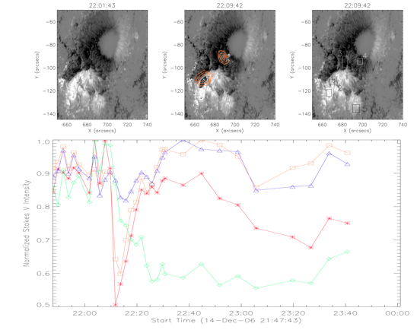
December 14, 2006 X-class flare: associated with magnetic field changes

Slide 15
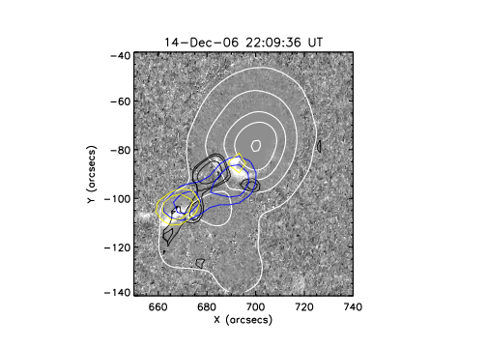
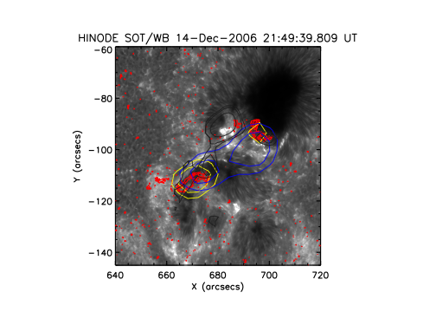
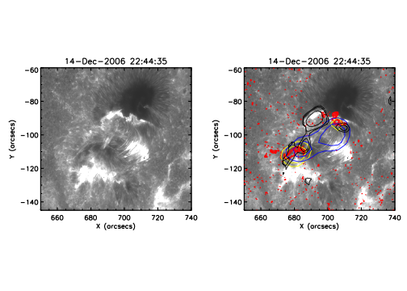

December 14, 2006 X-class flare
December 14, 2006 flare
Top left: Gray-scale difference image of the flare in the G-band (Hinode SOT), with contours of the sunspot overlaid in white.
Rest: Hinode SOT Ca II images taken before and during the flare, showing two ribbon structure; 6mHz egression power contours are black;
RHESSI hard X-ray contours are in blue (20-30 keV) and yellow (40-100 keV). The red contours represent G-band emission as seen in Hinode SOT data.
Matthews et al, 2011, ApJ

Slide 16
Life is complicated…
Solar quakes (4) observed by GONG spatially coincide with magnetic transients
2 of them coincide with WL/HXR sources while other 2 do not show any WL or HXR.
Southern WL, HXR and magnetic transient feature is stronger than in N spot.
‘Permanent’ change in magnetic flux seen in 1 source in the southern region and 1 in the northern one;
similar step-like change seen in total +ve flux for the region.

Slide 17
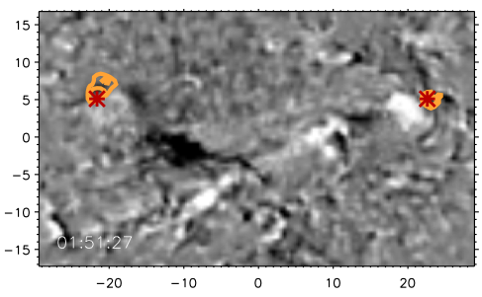
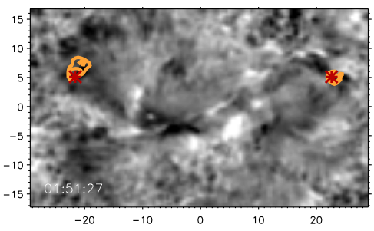
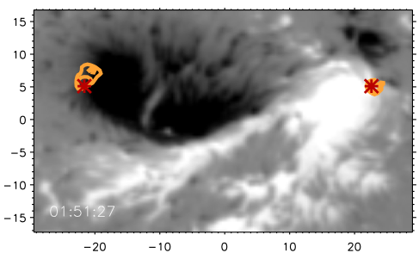
Feb 15 2011: egression contours & td sources
S.Zharkov et al, ApJL, 2011
17

Slide 18
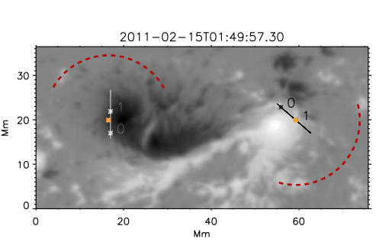
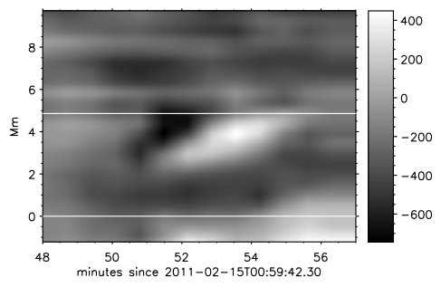
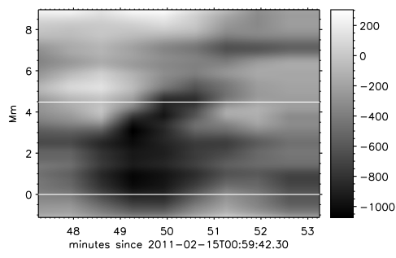
Feb 15 quakes: supersonic transients (Zharkov et al, 2011)
13 − 25 km/s
14 − 22 km/s
Supersonic movements can produce acoustic wave beams in the direction of the velocity due to acoustic cut-off frequency effect, S.Zharkov ( 2013)

Slide 19
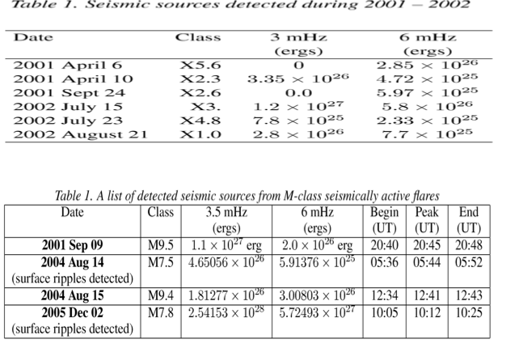
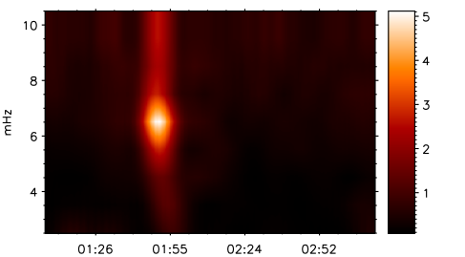
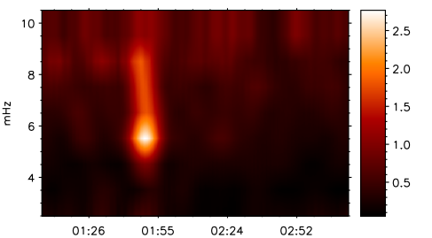
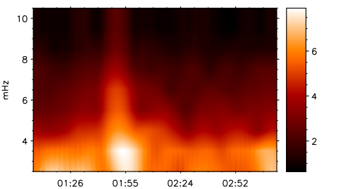
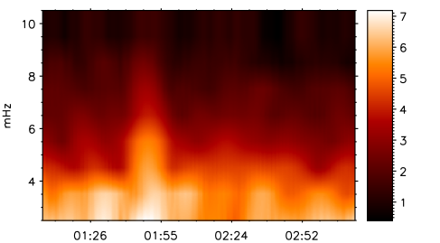
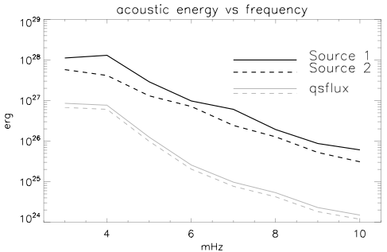
egression power distribution vs frequency
Flare 15 February 2011
Total acoustic energy released (estimate):
source 1: 2.91 10²⁸ ergs
source 2: 1.24 10²⁸ ergs

Slide 20
6 September 2011 flare (Macrae et al, 2018)

Slide 21
Flare 6 September 2011 (Macrae et al, 2018) lost and found sunquake

Slide 22
Conclusions 1
Seismic sources in 17 flares are well distinguished with TD diagram (8) and holographic techniques (17) seen up to the distance of 120 Mm
Areas of the seismic sources are small and vary in (1 – 10)x10¹⁷ cm²
Most large X-class flares are acoustically inactive because energetic particles deposit the bulk of their energy in the corona via collisions and Ohmic losses
M-class flares show much more acoustic activity because they associated with HE particles of moderate fluxes which can reach deeper layers
The momentums measured from seismic sources vary in flares as (0.1- 3.1-5)x10²² g cm/s and they are comparable with those delivered by HD-shocks caused either electron or proton beams

Slide 23
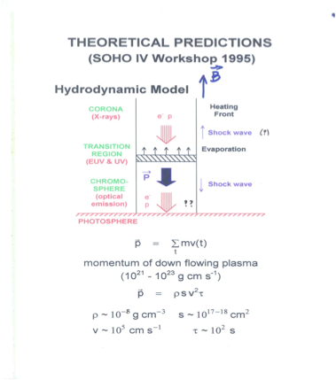
Possible mechanisms associated with sunquakes:
1. Hydrodynamic shocks:
Plasma T, n and V is governed hydrodynamics of the ambient plasma to e or p heating (KZ98, ZZ07, ZZ15)
2. Backwarming heating by HXR, UV and WL radiation in flares
(Donea et al, 2006)
3. Fast magnetic field changes during flares (irreversible or transient ones??) (Hudson et al, 2008, Fisher et al, 2012)
Indeed, magnetic reconnection sets the whole flare phenomena while producing energetic particles, which, in turn, can produce HD (or MHD) shocks producing magneto-acoustic waves.
How are these mechanisms acting?
23

Slide 24
The scheme of proton/electron acceleration and precipitation Zharkova et al, 2011
Electron-rich beams, compensated by return current, precipitate in 1s
Followed by jets -10s
Proton-rich beam
compensated
by ambient
electrons
P & jets precipitate
about 10s

Slide 25
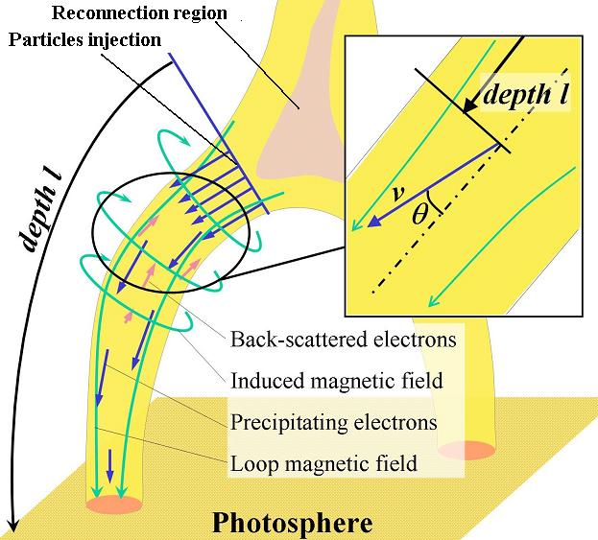
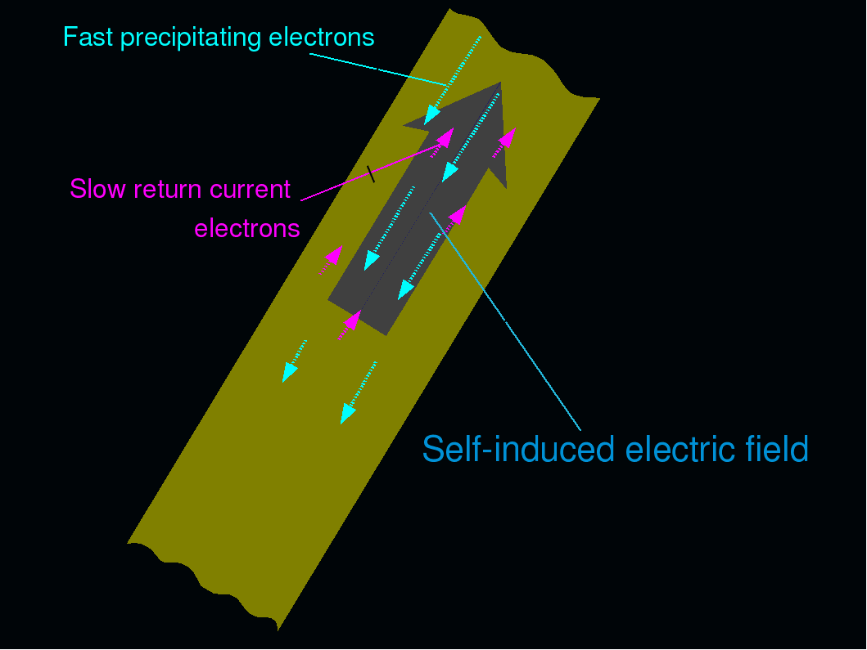
PARTICLE PRECIPITATION – Fokker-Planck-Landau equation,
Zharkova et al, 1995, Zharkova and Gordovskyy, 2005, Siversky and Zharkova, 2009

Slide 26
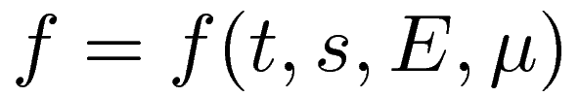
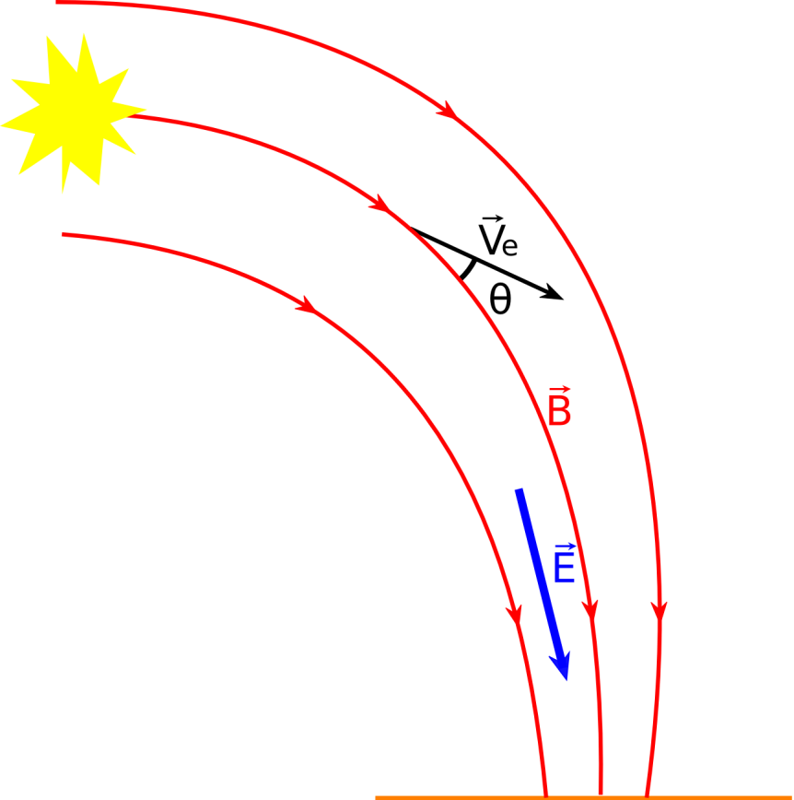
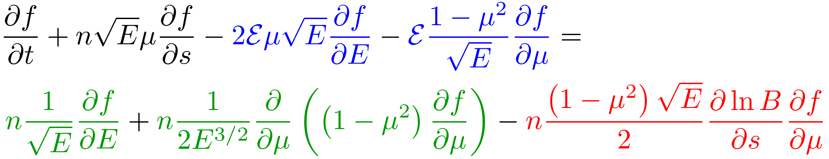
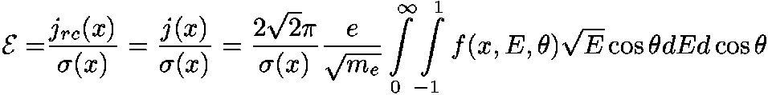
Fokker-Planck equation
t – time
s – column depth
E – energy
μ – pitch angle cosine
self-induced (return current) electric field
collisions with ambient plasma
converging magnetic field
n(s) and T(s) are taken from the hydro-dynamic model (Zharkova, V. & Zharkov, S., ApJ, 664, 573, 2007)‏

Slide 27
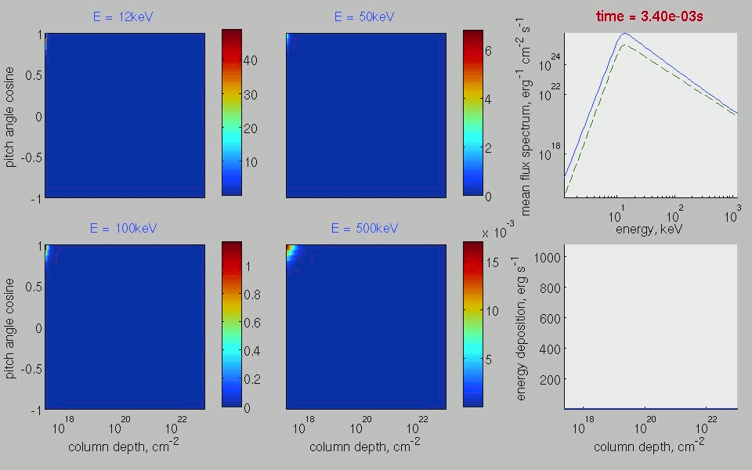
Impulsive injection:
e (>80 keV) reach the photosphere
Siversky&Zharkova, 2009, A&A
F₀= 10¹² erg cm⁻² s⁻¹. Colls, Power law index = 3.

Slide 28
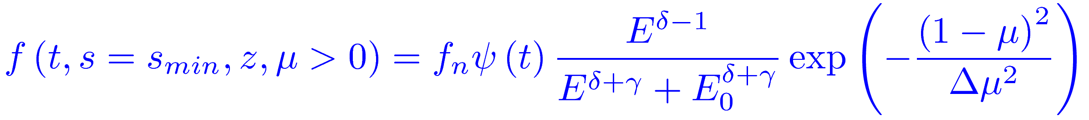
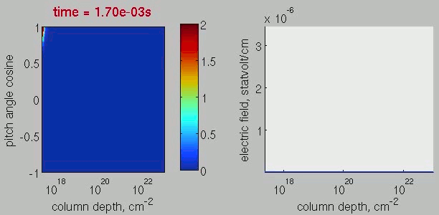
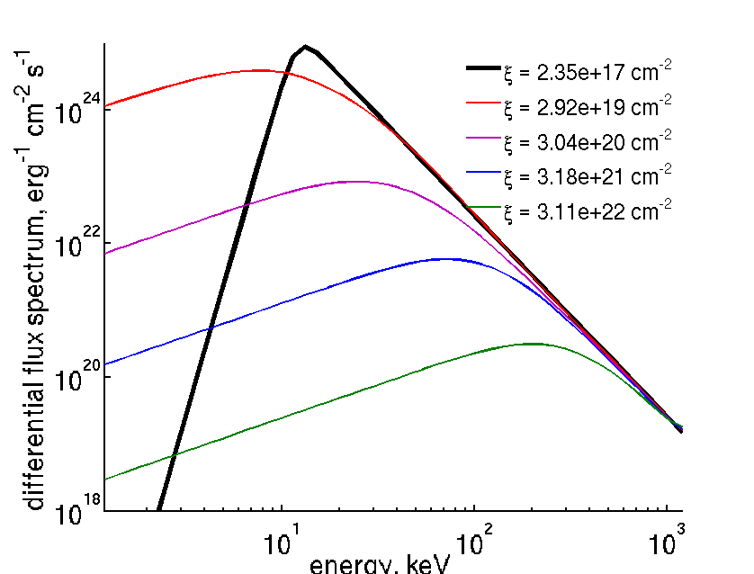
Stationary injection – establish an electric circuit
Siversky&Zharkova, 2009, A&A, 2010, 2011, 2012
Distribution function of the injected beam
Initial power law index of high energy electrons γ = 3
Initial pitch angle dispersion Δμ = 0.2
Lower energy cut-off E₀ = 12 keV, upper – 10 MeV
Energy flux on the top boundary is F₀ = 10¹⁰ erg cm⁻² s⁻¹
Relaxation time is ≈ 0.07 – 0.1 s for circuit to establish

Slide 29
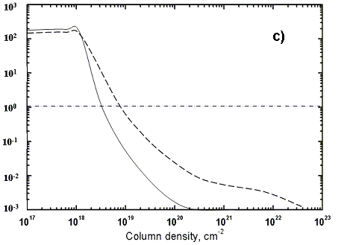
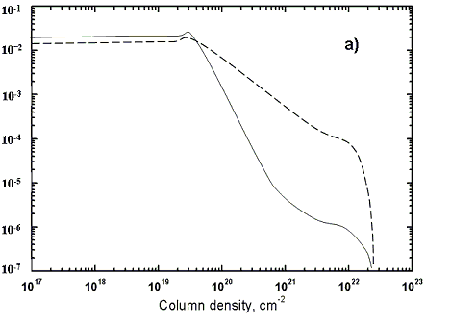
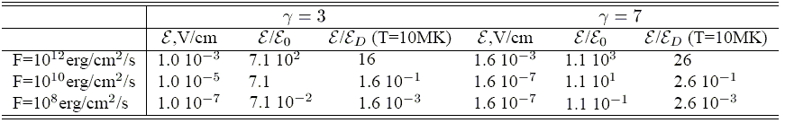
Induced electric field by beam electrons found from full kinetics (ZG05)
10¹² erg/cm²/s
10⁸ erg/cm²/s

Slide 30
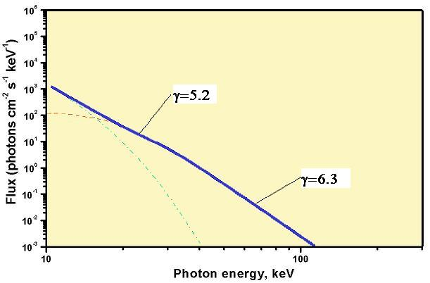
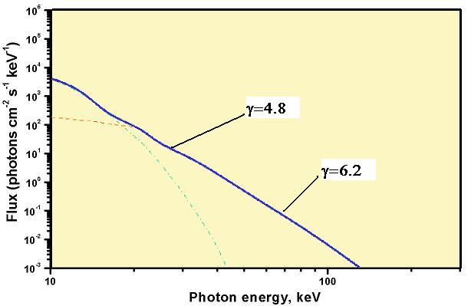
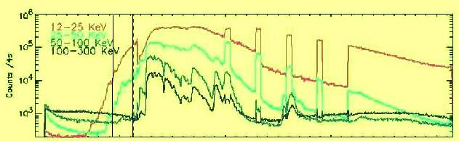
RESULTS – Comparison with observations
Flare July 23rd, 2002 (presented by Holman, 2003)
γ_{beam} = 5.0 (deduced with a return current correction), turning point at 33 keV
Fluxes: 00:23:44 UT (left plot) - Measured flux: 10⁹ erg/cm2/s, corrected for return current: 3x10⁹ erg/cm²/s
00:25:32 UT (right plot) Measured flux: 4x10⁹ erg/cm2/s, corrected for return current: 10¹⁰ erg/cm²/s

Slide 31
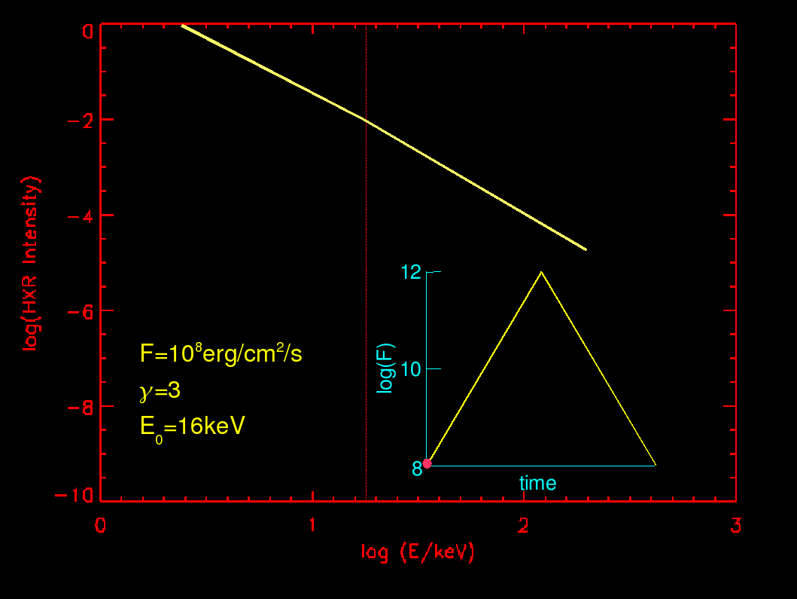
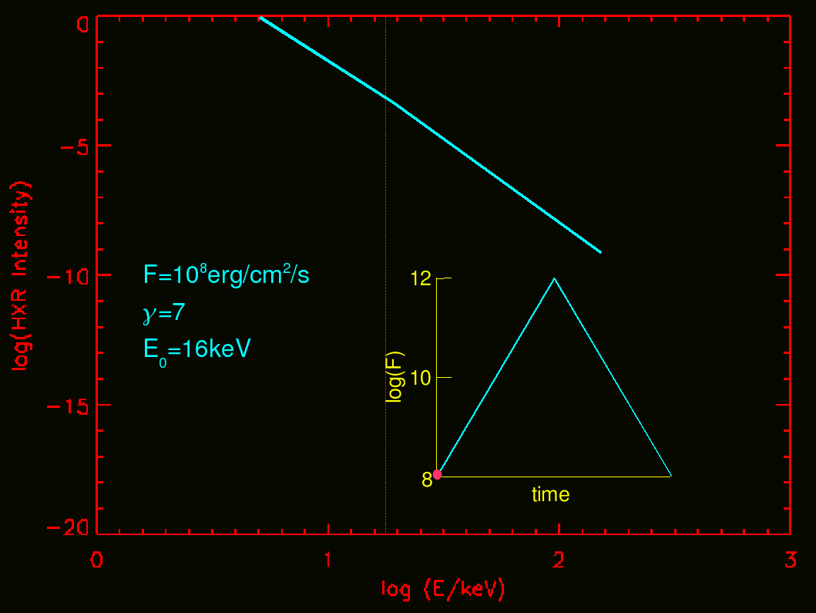
Photon energy spectrum and electron beam parameters RHESSI nugget 25,
Zharkova et al, A&A, 2010

Slide 32
Hydrodynamic response 1 (of flaring atmosphere)
Somov et al, 1981, Zharkova and Zharkov, 2007, Druett et al, 2017
Continuity equation
∂n/∂t+n² ∂v/∂ξ =0;
Momentum equation
∂V/∂t+1/μ(nk_{b}[T_{i}+T_{e})]= 4/3μ ∂/∂ξ[η_{i}n ∂v/∂ξ] +g_{sun}
Energy equation for ions
nk_{b} /(γ-1)∂T_{i}/∂t-k_{b}T_{i} ∂n/∂t= 4/3η_{i}n²(∂v/∂ξ)² +Q(n,T_{i},T_{e})
Energy equation for electrons
nk_{b} /(γ-1)∂(xT_{e})/∂t-xk_{b}T_{e} ∂n/∂t+nκ ∂x/∂t=
=n∂/∂ξ(k_{b} n ∂T_{e}/∂ξ) +P(n,ξ) -L(n,T_{e} )-Q(n,T_{i},T_{e})

Slide 33
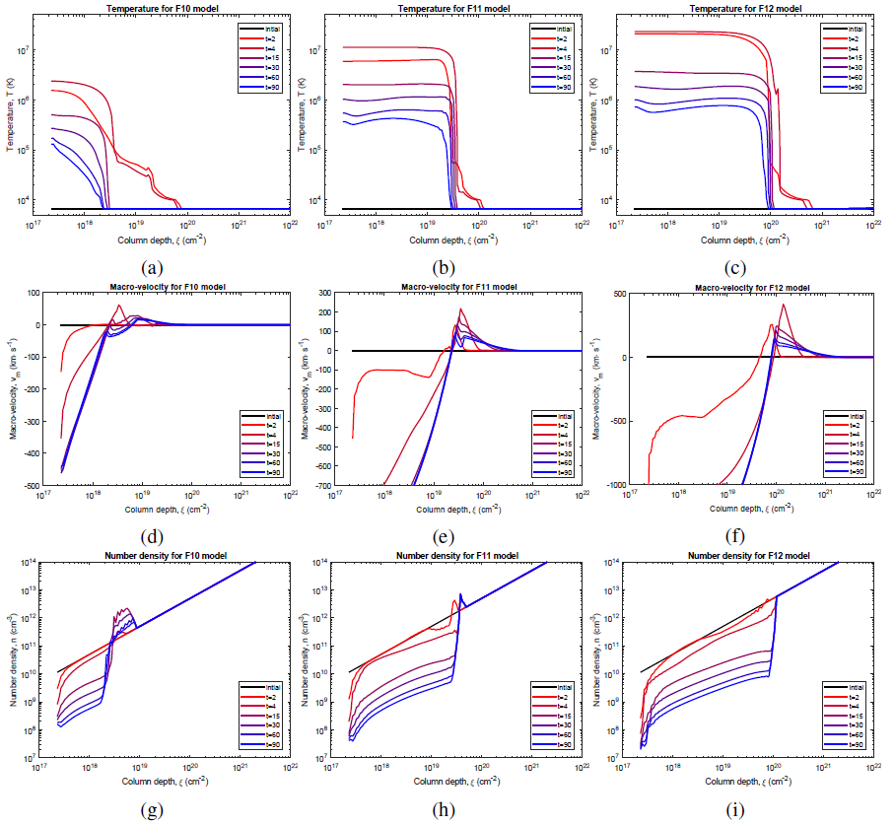
Hydrodynamic models Druett et al, 2017, Nature Comms; Druett&Zharkova, 2018, A&A

Slide 34
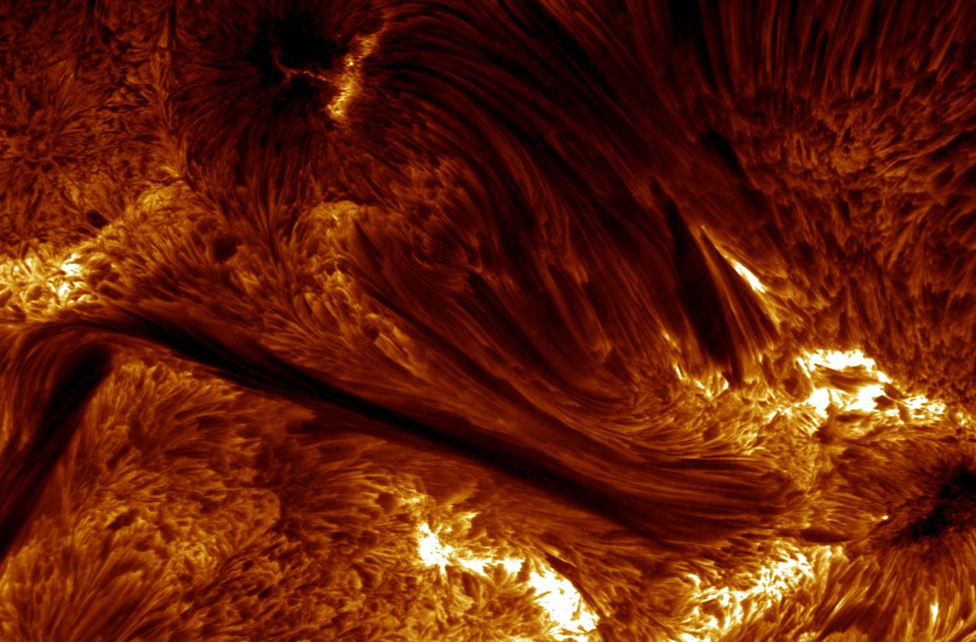

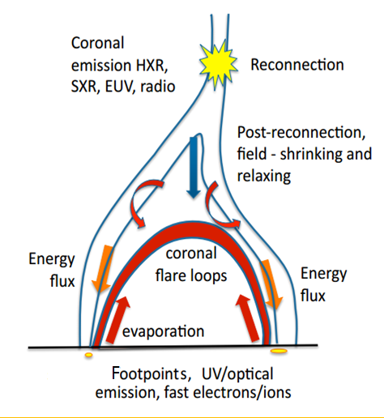
Balmer and Paschen Emission during a Flare Onset
Paschen continuum is white light emission
(Druett et al, 2017, NC; Druett and Zharkova, 2018
Malcolm Druett (Northumbria)
Valentina Zharkova (Northumbria)
1D flux tube
Fully non-LTE radiative code
Atom: 5 levels plus continuum
Response to injection of non-thermal electron beam with power-law energy distribution
Hydrogenic Atmosphere
Plasma depth scale used

Slide 35
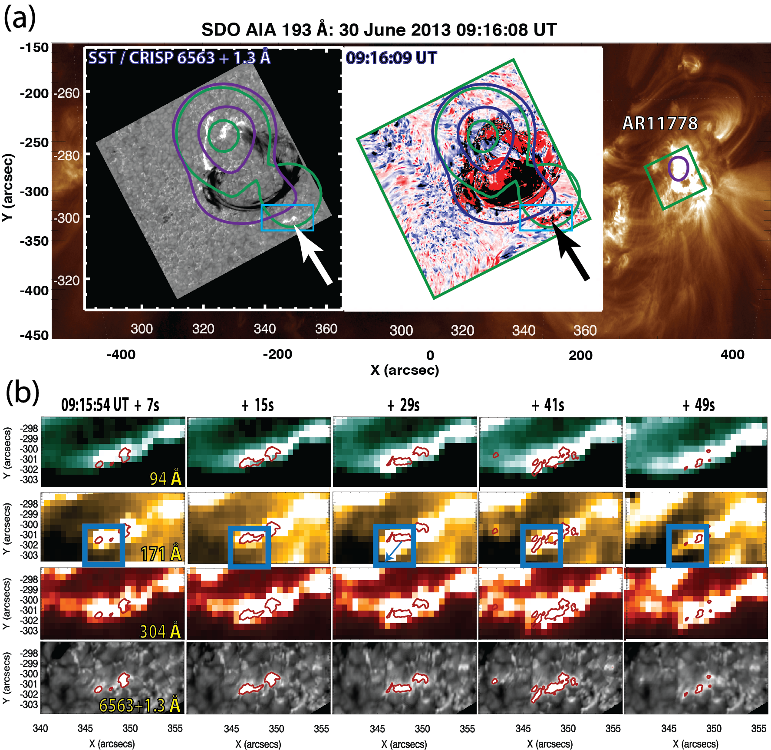
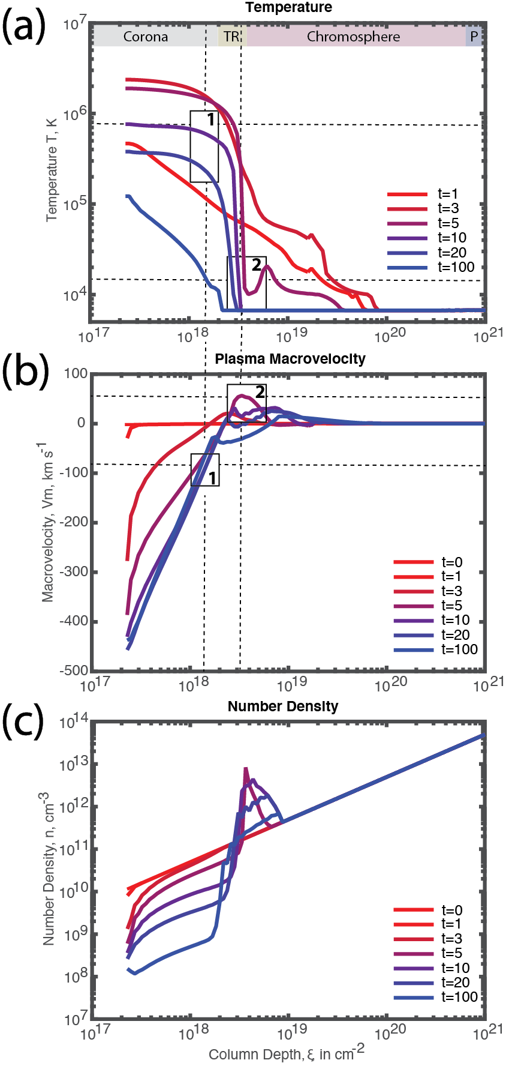

Slide 36

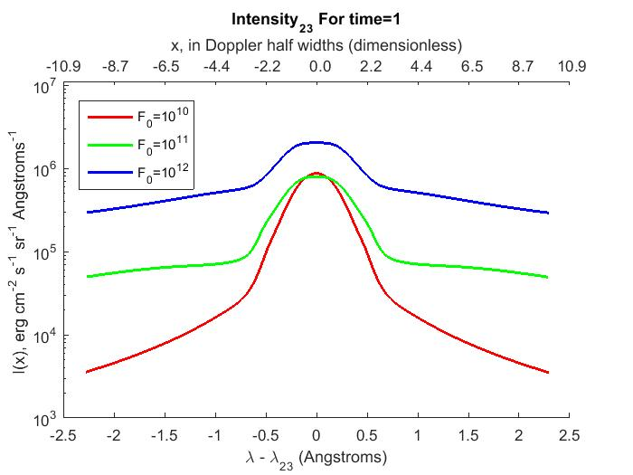
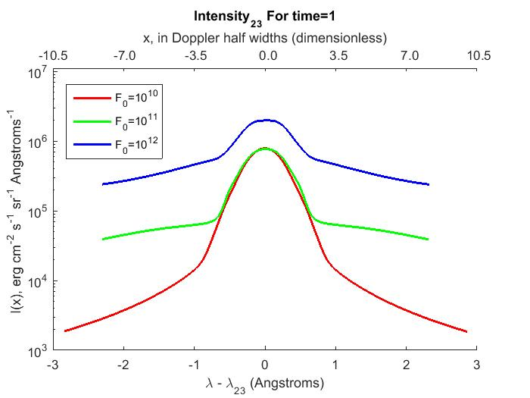



Slide 37






Slide 38






Slide 39






Slide 40






Slide 41


H-alpha and P-alpha profiles – 4x10¹¹ erg/cm²/s
Ionisation degree

Slide 42

Flare 30 June 2013 observed with SST
(Druett et al, 2017, Nature Comms)

Slide 43


Simulations Vs Observations (Druett et al, 2017)
C Class Flare, 30th June 2013, Observed using SST, beginning UT 9:15:54
Simulation (5 sec) Observation (7 sec)
Simulations(5 sec) Observations(7 sec)

Slide 44
Ionization degree in HD atmospheres by electron beams: from 10⁻⁶ to 0.6 within a sec Zharkova, 2008, Sol.Phys.
γ=6 and γ=4,
F=10¹⁰ erg/cm²/s

Slide 45
Paschen continuum contribution functions for ionisation by electron beam (DZ2018) beam+thermal (left) and thermal electrons (right)
P continuum forms white light (WL) emission in flares
Druett and Zharkova, 2018
Reproduces the depths of WL formation (Martinez et al, 2012)

Slide 46
Flare 6 September 2011 (Macrae et al, 2018) WL emission by electron beam – good fit!

Slide 47
Hydrodynamic shock motion (Macrae eyal, 2018) in the quiet sun atmosphere F=4x10¹¹ erg/cm²/s

Slide 48

Another HD model 2 in the solar interior
Zharkov, 2013, MNRAS
the outcome of HD1 used as the initial condition for HD2:
If the HD1 shock speed is supersonic, it generates, as HD2 response, acoustic waves in the interior

Slide 49

Acoustic waves in the solar interior generated by shock (Zharkov, 2013)
acoustic source
just below the surface
surface
depth
below
the
Surface

Slide 50
Hydrodynamic response 2 of the interior and acoustic cutoff frequency (Zharkov, 2013, ZZ15)
Skipping distance to the first bounce on the surface:
horizontal speed of wave
m– polytrope index, g= 2.67x10⁴ Mm/s²
Minimal horizontal speed at the first bounce point

Slide 51
Acoustic waves in the interior induced by the shock for 2011 flare (Macrae et al, 2018)

Slide 52
Hydrodynamic response 2:
Acoustic waves in the solar interior
(Zharkov, 2013, Zharkova and Zharkov, 2015)

Slide 53
Conclusions
Seismic sources in more than 100 flares are well distinguished with TD diagram (40) and holographic techniques (~100) seen up to the distance of 120-180 Mm
Sunquakes are part of flaring process and thus are associated with:
  Magnetic field reconnection;
  Generation of energetic particles, which generate transit magnetic field;
  Hydrodynamic response of atmosphere to beam injection, formation of shocks.
High-energy particles have dual effect on a flaring atmosphere:
1) heating it via hydrodynamics and
2) producing non-thermal ionization and excitation → WL emission and H-alpha lines with large red shifts up to 4-5 A
Hydrodynamic shock are deposited beneath the quiet photosphere
These shocks if traveling with a super-sound velocity, produce acoustic waves in the interior
These acoustic waves are reflected at the lower turning point back to the photosphere where they reflected to the interior at the upper turning point causing a ripple on the surface at skipping distance ∆(k_h, ω)
The ripple heights, distance from the impact and horizontal velocity of propagation on the surface depend on the local speed of sound in the interior and acoustic cutoff frequency (Zharkov, 2013).

