Slide 1
О механизмах излучения мягких гамма повторителей, и наблюдательном тесте
Г.С Бисноватый-Коган
ИКИ РАН
Физика и астрофизика — от фундаментальных констант до гамма-всплесков и космологии Конференция памяти Д.А. Варшаловича и Е.П. Мазеца 19 — 20 ноября 2024 г., Санкт-Петербург

Slide 2
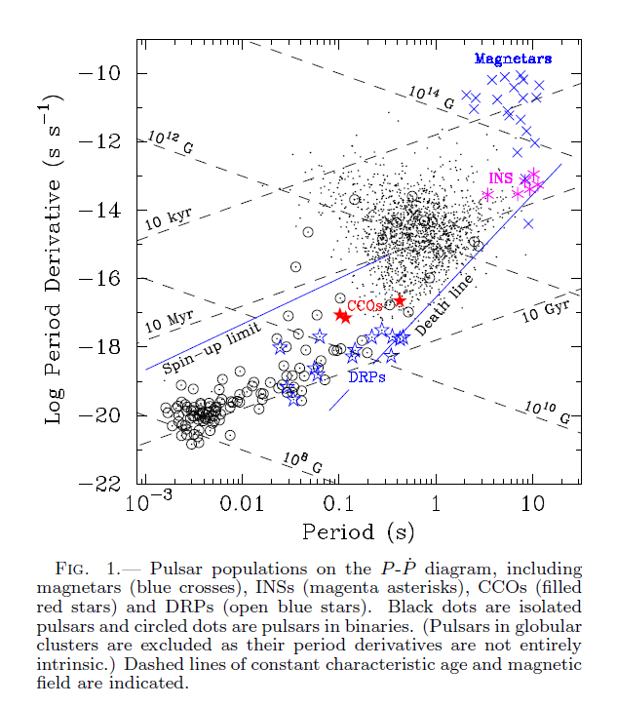
E. V. Gotthelf
et al., 2013

Slide 3
Soft gamma repeaters (SGR) are discovered observationally in the year 1979 as a giant burst with recurrent gamma flares in the KONUS device, and soon were connected with the discovered short gamma ray bursts (GRB) as a separate class of GRB. They are identified now as single neutron stars (NS) inside the Galaxy, or nearby galaxies, with sporadic transient gamma radiation. A total number of discovered SGR, including relative Anomalous X-ray pulsars (AXP), is few tens of objects. Some of them show periodic radiation, connected with NS rotation, with periods 2-12 s.
The slow rotation is accompanied by small rate of loss of rotational energy, which is considerably smaller than the observed sporadic gamma ray luminosity, and is many orders less that the luminosity during giant bursts, observed in 4 SGR.
BUT,
MAGNENIC FIELD IS ESTIMATED USING RADIOPULSAR METHOD.
It was suggested that the source of energy is their huge magnetic field, 2
or 3 orders of magnitude larger than the average field in radiopulsars. Such objects were called magnetars. Therefore the energy source is usually connected with annihilation of very strong NS magnetic field. Another model is based on release of a nuclear energy stored in the NS nonequilibrium layer (BK et al. 1975) We suggest here an observational test which could distinguish between these two models.

Slide 4
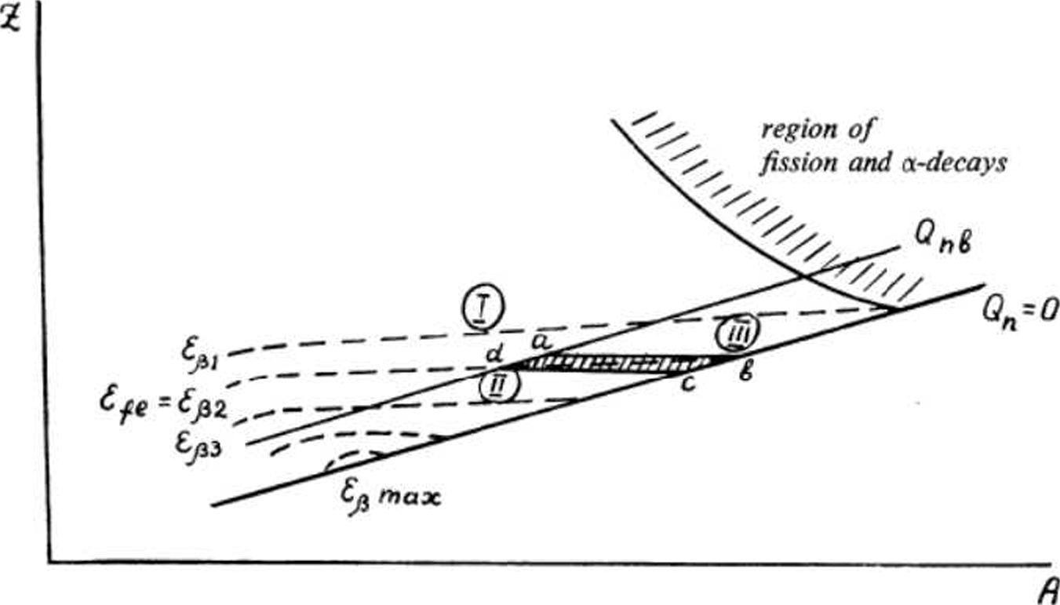
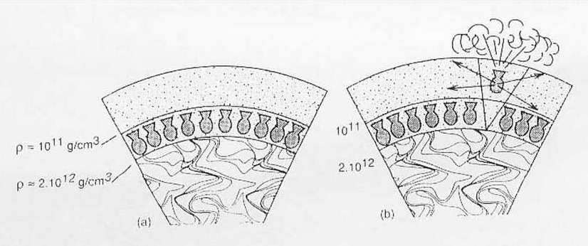

Slide 5
We suggest that this difference should be visible in the
behavior of pulsation phases, what could be derived
from observations.
Extremely precise time stability of pulses in radiopulsars is connected with a very stable NS rotation, with practically fixed anchoring of the magnetic field to the NS body. In SGR the precision of observation is incomparably worse than in radiopulsars, so only sufficiently strong phase shifting in observations could be noticed and measured. NS in SGR is considered as single object, so there is no motion in binary, and very small GR effects are not be visible in their timing data. The reason for strong phase shift in the SGR pulsations could be expected due to motion of the burst location over the NS surface from one burst to another one. Such motion is unlikely to be possible if the transient bursts are connected with magnetic events, but this shift is expected when the explosion mechanism is not connected directly to the magnetic field large scale structure, namely, when chaotic explosions are connected with processes in the NS non-equilibrium layer.

Slide 6
A low-magnetic-field Soft Gamma Repeater
N. Rea et al. (2010)
We report on a soft gamma repeater with low magnetic field, SGR0418+5729, recently detected after it emitted bursts similar to those of magnetars. X-ray observations show that its dipolar magnetic field cannot be greater than 7:5 10^12 Gauss
Radiopulsars with very high magnetic fields and slow rotation
1. PSR J1119-6127, P = 0.407 s, B = 4:1 10^13 G;
2. PSR J1814-1744, P = 3.975 s B = 5:5 10^13 G.
3. PSR J1847-0130, P = 6:7 s, B = 9:4 10^13 G.
“the properties of this pulsar prove that inferred dipolar
magnetic field strength and period cannot alone be responsible for the unusual high energy properties of the magnetars and create new challenges for understanding the possible relationship between these two manifestations of young neutron stars.“ McLaughlin et al.(2003)
4. PSR J1718-37184, P = 3.4 s, B = 7:4 10^13 G.
5. PER J2144-3933, P = 8.51 s B = 2 10^12 G. longest period among
radiopulsars
Manchester et al.(2001), McLaughlin et al. (2003,2004), Young et al.(1999)

Slide 9
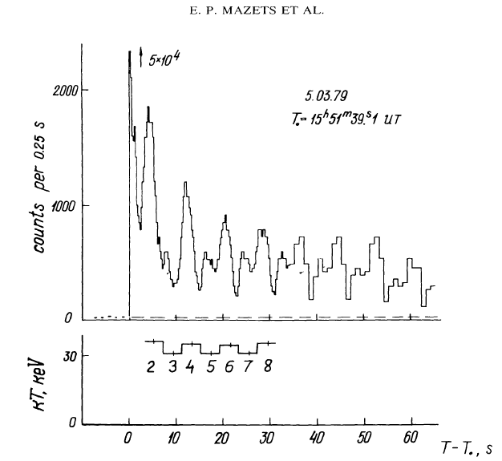
Phase shift observations in SGR
The pulsed radiation of SGR
was first discovered in the famous
5 March 1979 burst by Mazets et al., 1979.
(SGR 0526-66).
Subsequently it was visible very distinctly in the afterglows of two other giant bursts SGR 1900+14 and SGR 1900+14. Analysis of many recurrent bursts in the last two objects had shown the periodic component in their radiation, with almost the same, slightly growing period.

Slide 10
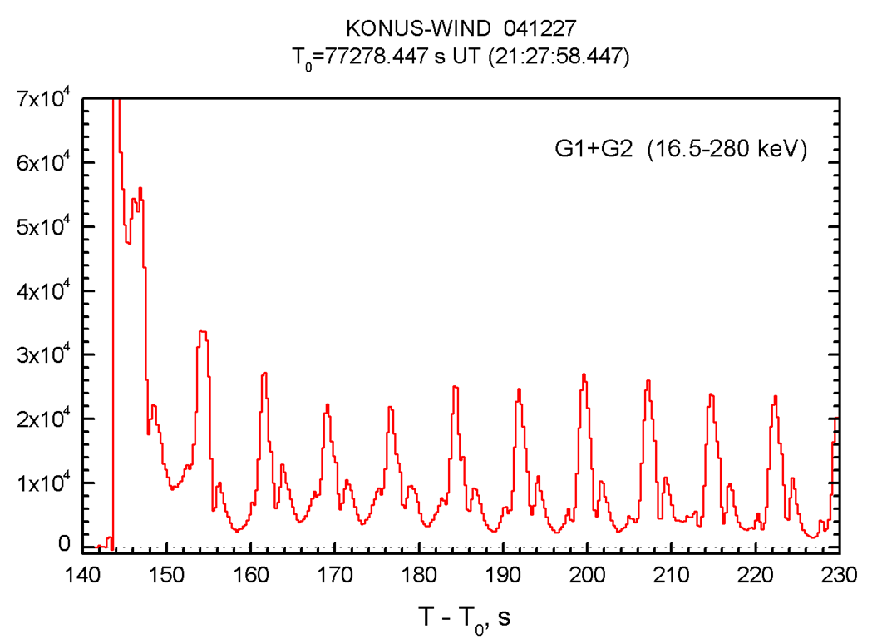
SGR 1806-20
The pulsed signals with the period 7.47 s. had been discovered in, 1998, 6 years before the giant burst in this SGR. After observations of the giant burst in December 2004, periodic pulsations in this SGR had been visible in its radiation during subsequent observations in several X-ray bands.

Slide 11
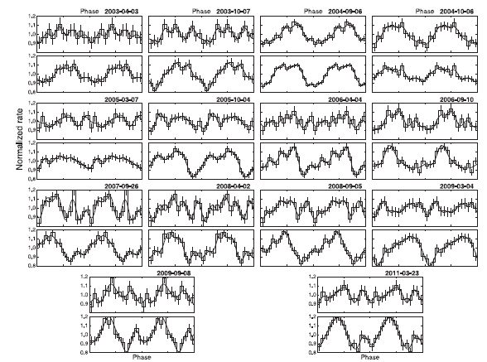
Background-subtracted PP of all XMM-Newton observations in two energy bands. Two cycles are shown for clarity. The upper rows show the 1.5–4 keV range for each observation and the lower rows show the 4–10 keV range (Younes, Kouveliotou, and Kaspi. 2015)

Slide 12
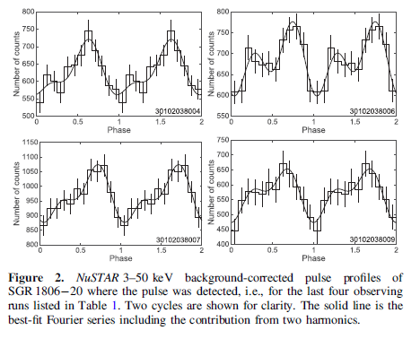

Slide 13
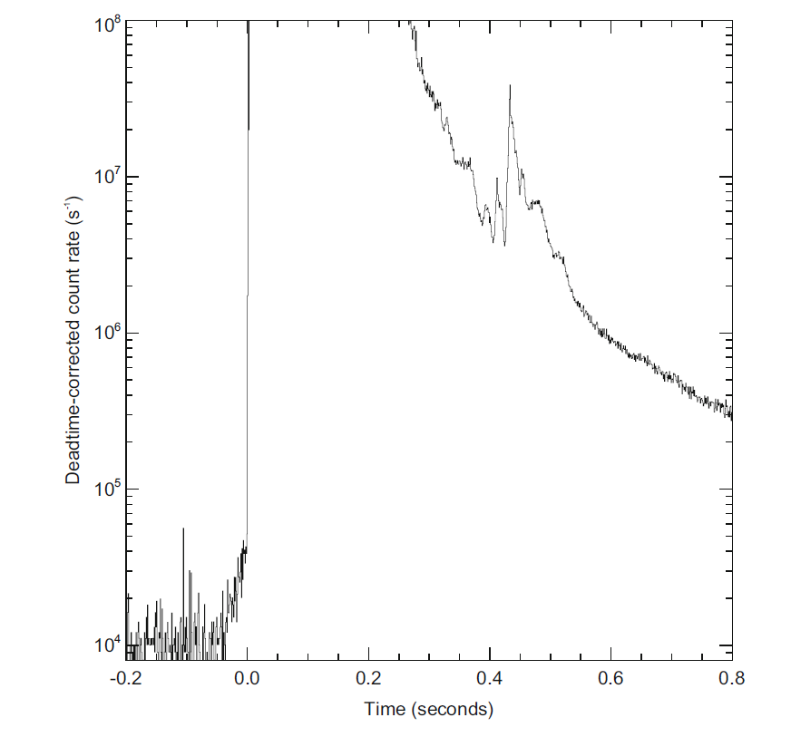
SWIFT light curve of the giant burst of 27 December, 2004 giant burst in SGR 1806-20
(From Palmer et al. 2005)

Slide 14
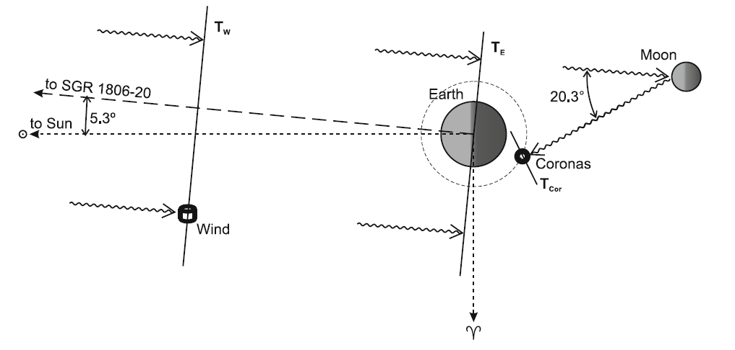
The position of satellites Wind and Coronas-F relative to the Earth and Moon during the outburst of SGR 1806-20 (From Mazets et al. 2005 and Frederiks et al. 2007b)

Slide 15
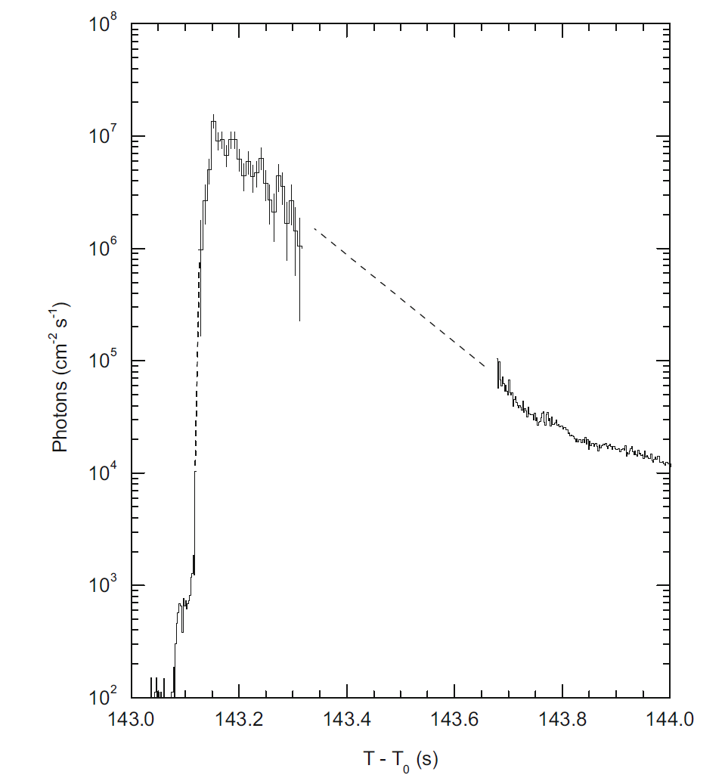
Reconstructed profile of the early part of the pulse from SGR 1806-20. The upper part
of the graph is derived from Helicon data and the lower part represents the KONUS-Wind data. The dashed lines indicate intervals where the outburst intensity still saturates the KONUS-Wind
detector, but is not high enough to be seen by the Helicon (From Mazets et al. 2005 and Frederiks et al. 2007b)

Slide 16
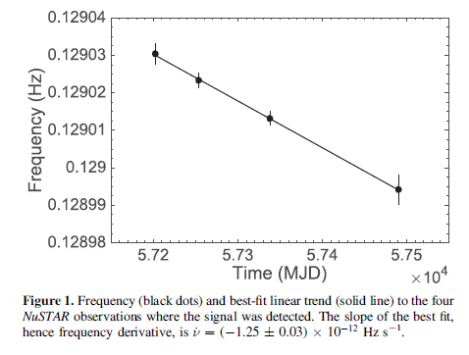
11 years period growth, local period measuremets

Slide 17
SGR 1900+14
The pulsations with a period 5.16 s have been observed in the afterglow of the giant burst during several hundred of seconds. Search for periodic pulsations had been done in recurrent bursts and persistent radiation of this object in subsequent years in the bands from radio to optics and hard X-rays. The pulsation with a corresponding period have been observed in all bands, except radio.
The first measurements of B have been done for SGR 1900+14 in different epochs by measurements of satellites RXTE and ASCA , presented in following Figs.

Slide 18
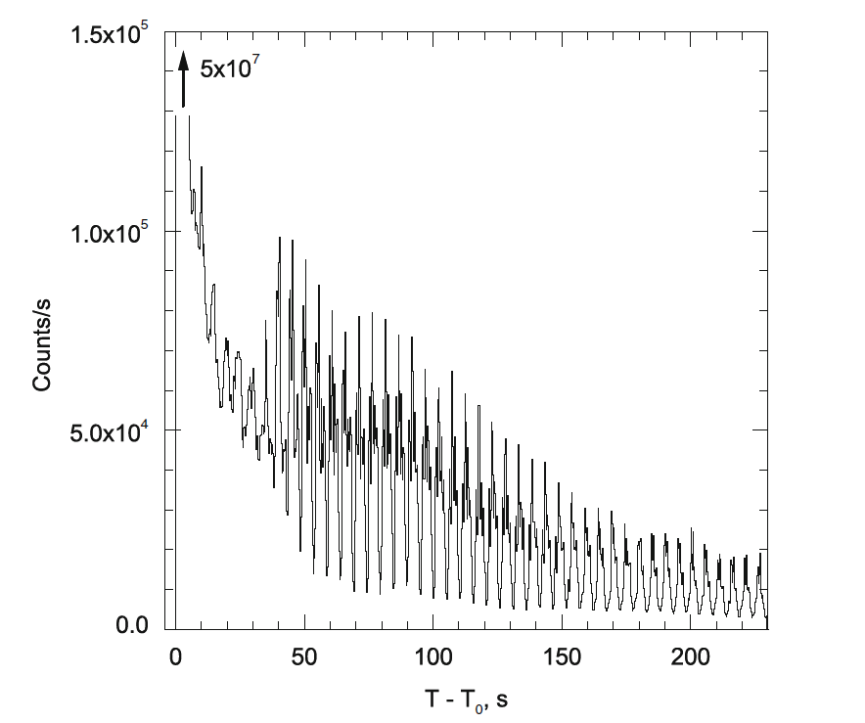
The giant 27 August 1998 outburst of the soft gamma repeater SGR1900 C 14. Intensity
of the E > 15 keV radiation is presented (From Mazets et al. 1999c)

Slide 19
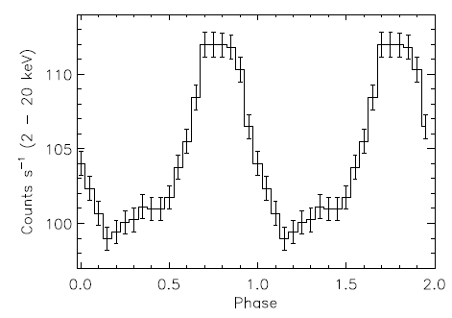
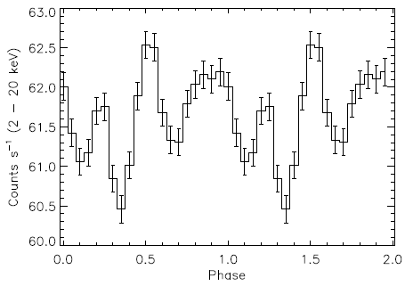
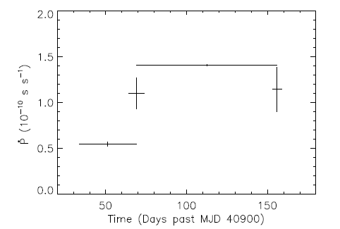
The epoch folded pulse profile of SGR 1900+14 (2-20 keV) for the May 1998 RXTE observations
The epoch folded pulse profile of SGR 1900+14 (2-20 keV) for the August 28,
1998 RXTE observation. The plot is exhibiting two phase cycles
The evolution of \period derivative" versus time since the first period mea-
surement of SGR 1900+14 with ASCA . The time is given in Modied Julian Days (MJDs)

Slide 20
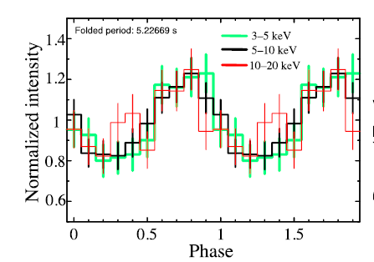
The pulse shape is changing from one epoch to another, inducing errors in finding
derivative of the period. The big jump in \dot_P looks surprising for magnetic dipole losses, because it needs a considerable jump in the magnetic field strength prohibited by self induction effects. Contrarily, in the model of pulsar wind rotational energy losses it looks quite reasonable that these losses strongly increase during the giant burst, when the \dot _P jump was observed.
Pulse profiles of FPMA 3–5, 5–10, and 10–20 keV. The errors indicate the 1 σ confidence level. (Color online)
TAMBA et al., PASJ, 2019

Slide 21
3 SGR J1935+2154
SGR J1935+2154 was discovered in 2014, and has a spin period 3:25 s. It is one of the most
active magnetars, showing outbursts almost every year. Its reactivation date on 2020 April
27, was observed by several X-ray and gamma-ray instruments when a burst storm and an increase of the persistent X-ray flux were detected. Subsequent activity of this GRB during 7 months was followed by XMM and Chandra missions.
FermiGBN - NICER
Kaneko et al., 2020, 2021

Slide 22
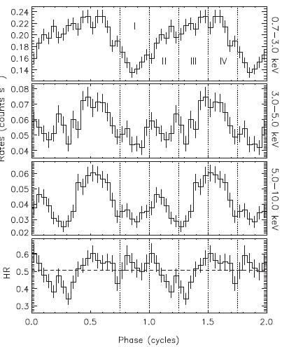
(Upper three panels) Energy-dependent pulse profiles of SGR J1935+2154 folded with the XMM-Newton spin period. The corresponding energy interval of each profile is indicated on the right y-axis. The vertical dotted lines with I–IV indicate the phase intervals used in phase
resolved spectral analysis. (Bottom panel) The ratio of spin-phase-dependent hard count rates in the 3–10 keV band to those in the 0.7–3.0 keV. The dashed horizontal line denotes the mean hardness ratio of 0.51.
Göğüş et al. 2020

Slide 23
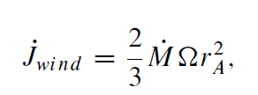
Angular Momentum Losses by a Magnetised StellarWind
A magnetic stellar wind carries away the stellar angular momentum J as (Weber and Davis 1967)
Here r_A is the Alfven radius. For the wind with a constant outflowing velocity w, the energy density is E_w = 0.5 \rho w^2. In a stationary wind with a mass loss rate \dot M the parameters at the Alfven radius are

Slide 24
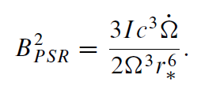
with
At
\dot J = I \dot\Omega
We obtain the estimation of stellar magnetic field B at wind caring away the
angular momentum as

Slide 25
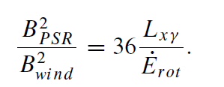
As an estimate of the energy flux carried away by the wind
the average X and -ray luminosity of SGR/AXP L_x\gamma is used, and the wind
velocity is of the order of the freefall velocity of the neutron star. For the low-mass
neutron star
(10)

Slide 26
Conclusions
The three above considered objects were observed during a long time, when several strong outbursts happen. They look out as best candidates for making phase analysis, which should show the behavior of the peak activity spot on the NS surface. If it does not change its position on the NS during all the time, than it is most probably connected with the large scale structure of the magnetic field, and witnesses in favor of the magnetar model. If its position changes after strong outburst that its activity is presumably determined by nuclear explosions, connected with existence of non equilibrium layer in NS envelope.
All references you may find in the publications:
BK, Young Neutron Stars with Soft Gamma Ray Emission, and Anomalous X-Ray Pulsars. A.W. Alsabti, P. Murdin (eds.), Handbook of Supernovae,
Springer International Publishing Switzerland 2016.
arXiv:2205.10294v1 [astro-ph.HE] 20 May 2022;
BK, Astronomy Reports, 2022, Vol. 66, No. 8, pp. 644–647.

