Slide 1
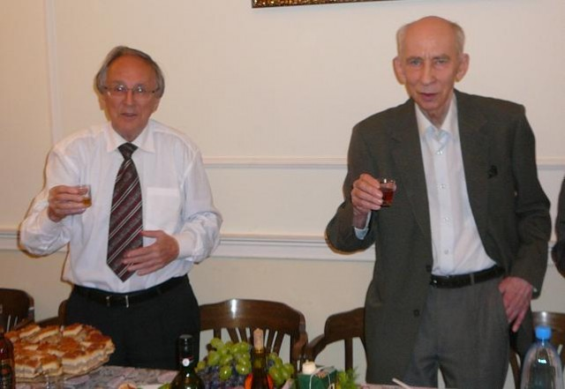
“Физика и астрофизика – от фундаментальных констант до гамма-всплесков и космологии”
памяти Д. А. Варшаловича и Е. П. Мазеца
Дихроизм и двулучепреломление пробного луча
при индуцированном Рамановском рассеянии
в многоатомных молекулах
О. С. Васютинский, Я. М. Бельтюков

Slide 2
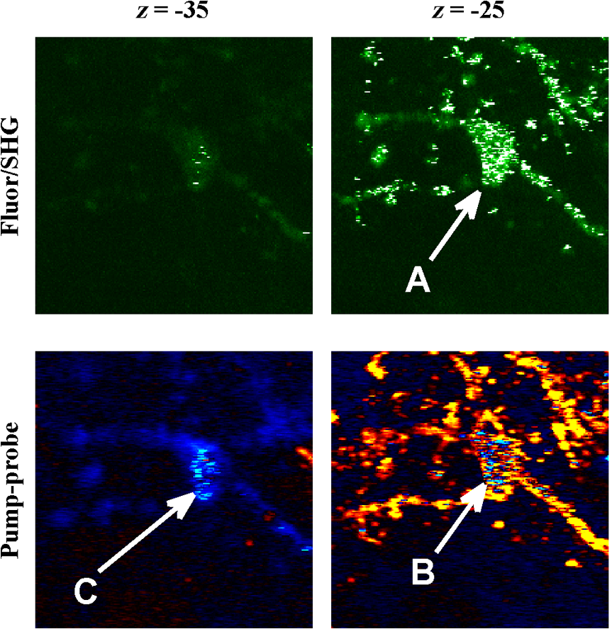
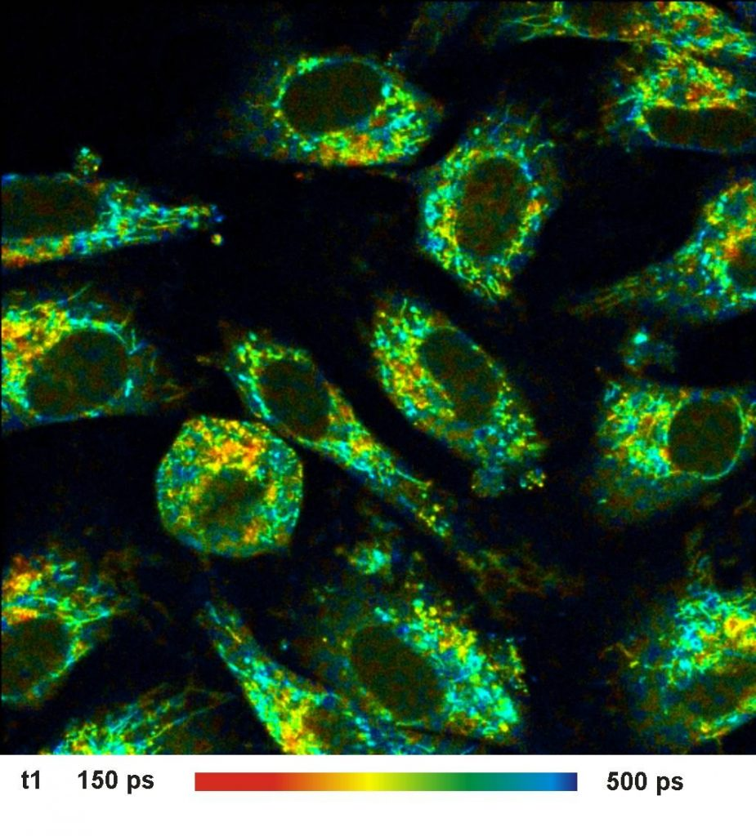
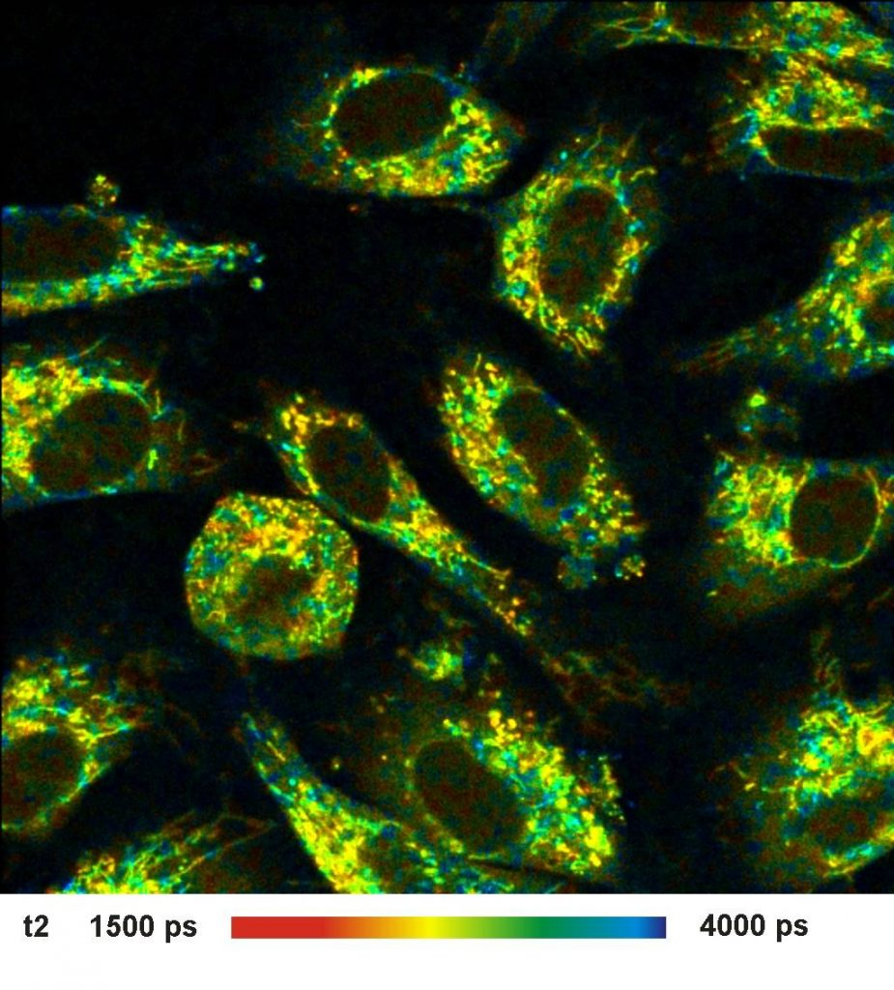
Femtosecond laser spectroscopy of natural molecular probes
in biological media
0.2 – 5 ns
1 – 500 ps
The distribution of fluorescence decay times in NADH in living cells recorded by FLIM
A comparison between the fluorescence and pump-probe images in melanoma cells

Slide 3
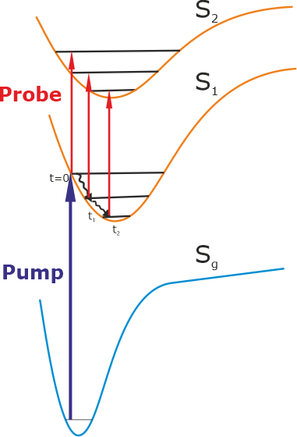
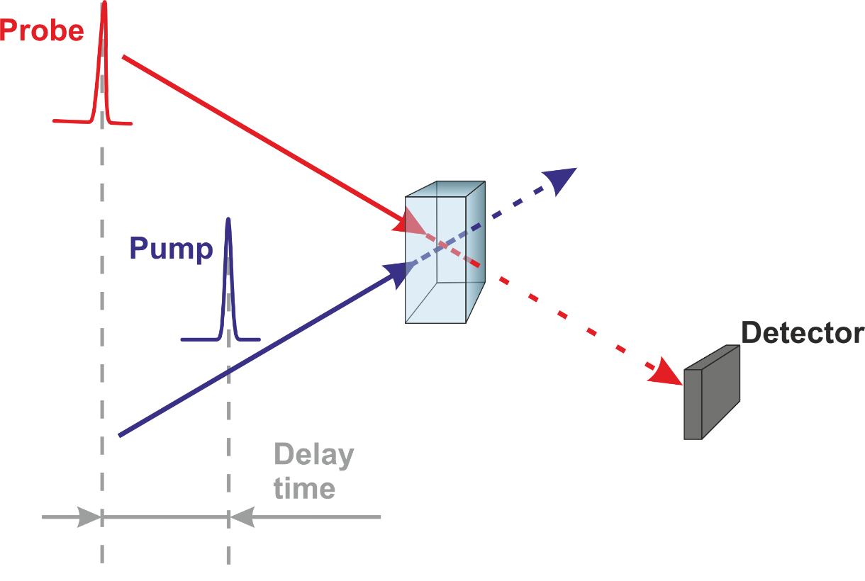
Femtosecond pump-and-probe spectroscopy (A. Zewail, Nobel Prize in Chemistry 1999)
Pump
Probe
However, practically all pump-probe methods used so far utilized relatively large laser pulse energies of E ≥ 1 mkJ.
Aslo, light polarization effects were so far poor developed theoretically and experimentally.

Slide 4
Light polarization density matrix
Media polarization under interaction with intensive laser light can be presented as a series:
$$P\left(t\right)=ε_{0}\left[χ^{\left(1\right)}E\left(t\right)+{χ^{\left(2\right)}E}^{2}\left(t\right)+χ^{\left(3\right)}E^{3}\left(t\right)+…\right]$$
where χ⁽¹⁾, χ⁽²⁾, χ⁽³⁾ are corresponding linear and nonlinear optical susceptibilities
A Cartesian component i of the outgoing probe beam electric field at frequency ω_{pr} is given by:
$E_{i}^{out}\left(ω_{pr}\right)=$ $E_{i}^{in}\left(ω_{pr}\right)+P_{i}\left(ω_{pr}\right); E_{i}=ℇ e_{i}$,
The change of the probe light polarization matrix detected in experiment is given by:
$∆\left[E_{i}\left(ω_{pr}\right){\left(E_{j}\left(ω_{pr}\right)\right)}^{∗}\right]≈E_{i}^{in}\left(ω_{pr}\right){\left(P_{j}\left(ω_{pr}\right)\right)}^{∗}+$ $P_{i}\left(ω_{pr}\right){\left(E_{j}^{in}\left(ω_{pr}\right)\right)}^{∗}$
Light polarization spherical tensor (Fano, Dyakonov, Omont):
$$E_{Kq}(e)=[e⊗e^{∗}]_{Kq}$$
K = 0, 1, 2 q = - K … K

Slide 5
Stokes parameters of the probe light beam
Stokes parameters
Relationship between Stokes parameters and
elements of light polarization matrix
$$S_{1}=\frac{I_{X}−I_{Y}}{I_{X}+I_{Y}}$$
$$S_{2}=\frac{I_{45}−I_{−45}}{I_{45}+I_{−45}}$$
$$S_{3}=\frac{I_{+}−I_{−}}{I_{+}+I_{−}}$$
$${E00=−\frac{1}{√3}; E20=−\frac{1}{√6}; }_{}$$
$S_{1}=$ $E_{22}+E_{2−2}$; $S_{2}=$ $E_{22}−E_{2−2}$; $S3=2E10$

Slide 6
Theory: change of probe beam polarization matrix
The general expression of the change of probe beam polarization matrix
in the spherical tensor representation can be written in the form:
$$I^{out}\left(ω_{pr}\right)E_{KQ}^{out}\left(e_{pr}\right)−I^{in}\left(ω_{pr}\right)E_{KQ}^{in}\left(e_{pr}\right)∝\sum_{K_{pu,}K_{pr}}{\left\{\begin{matrix}K \\ 1\end{matrix} \begin{matrix}K_{pu} \\ 1\end{matrix} \begin{matrix}K_{pr} \\ 1\end{matrix}\right\}}{\left[E_{K_{pu}}^{}\left(e_{pu}\right) ⨂{E_{K_{pr}}^{in}\left(e_{pr}\right)}\right]}_{KQ}$$
$ [AKpr$ $\left(ω_{pr}\right)$ + (-1)^{ϕ} $(AKpr$)* $\left(ω_{pr}\right)$]
Dr. Ya. Beltukov
where
$$AKpr\left(ωpr\right)∝Φ\left(ωpr\right) P_{K_{pu} }^{(n)}\left(ωpr\right)$$
and the phase ϕ = K + K_{pu} + K_{pr}
The ranks K, K_{pu,} K_{pr} characterize light beams, they are all limited to K =0,1,2 and have a clear
physical meaning: K = 0 refers to the total light intensity; K=1 refers to the light circular polarization
K=2 refers to the light linear polarization
The expression is written as a product of the polarization-dependent Field tensor and the
polarization-independent Molecular part. The Field tensor can be completely controlled by
experimentalist that allows for analysis of an arbitrary experimental geometry including all
possible light beams propagation directions and polarizations.
B.Semak, Ya.Beltukov, O.Vasyutinskii, ChemPhysChem, 2023, Vol.24, e202300405.

Slide 7
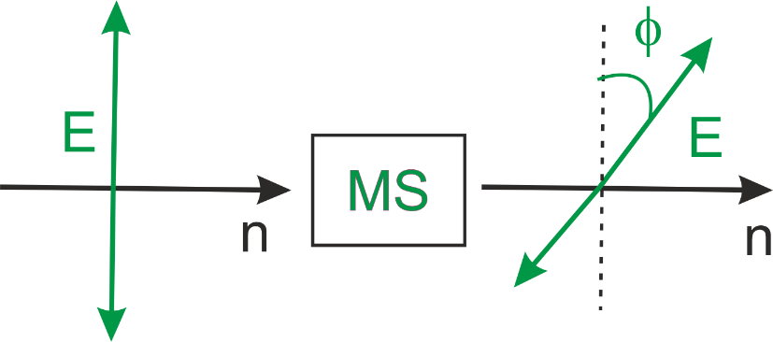
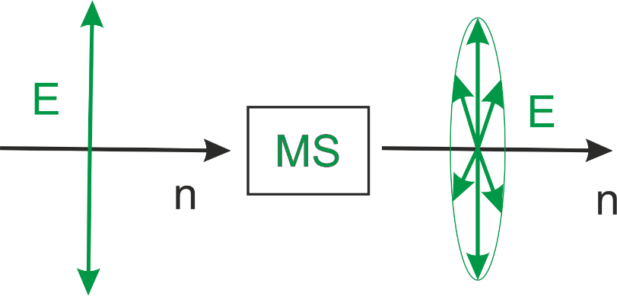
The role of the phase ϕ = K + K_{pu} + K_{pr}
The expression describes three main effects of the probe beam passed through the MS:
absorption/gain, linear dichroism, and birefringence. All of them can occur simultaneously and
can be separated by slight changes of the detection scheme.
If K = 0 the above expression describes
the probe beam absorption/gain:
$$ΔI=ω_{pr}Im[Φ^{∗}\left(ω_{pr}\right)\left(P_{0}^{n}+{\frac{1}{2}P}_{2}^{n}\right)]$$
If the phase ϕ = K + K_{pu} + K_{pr} has
even value, the above expression describes
the absorption beam linear dichroism
$$S_{1}^{out}=\sin\left(2φ\right)=\frac{ω_{pr}Im[Φ^{∗}\left(ω_{pr}\right)P_{2}^{n}]}{I^{out}\left(ω_{pr}\right)}$$
If the phase ϕ = K + K_{pu} + K_{pr} has odd value,
the above expression describes the absorption beam
birefringence.
$$S_{3}^{out}=sin(δ) cos\left(2φ\right)=−\frac{ω_{pr}Re[Φ^{∗}\left(ω_{pr}\right)P_{2}^{n}]}{I^{out}\left(ω_{pr}\right)}$$
B. Semak & O. Vasyutinskii, Optica&Spectr, 2021, Vol. 129, p. 1007.
B.Semak, Ya.Beltukov, O.Vasyutinskii, ChemPhysChem, 2023, Vol. 24, e202300405.

Slide 8
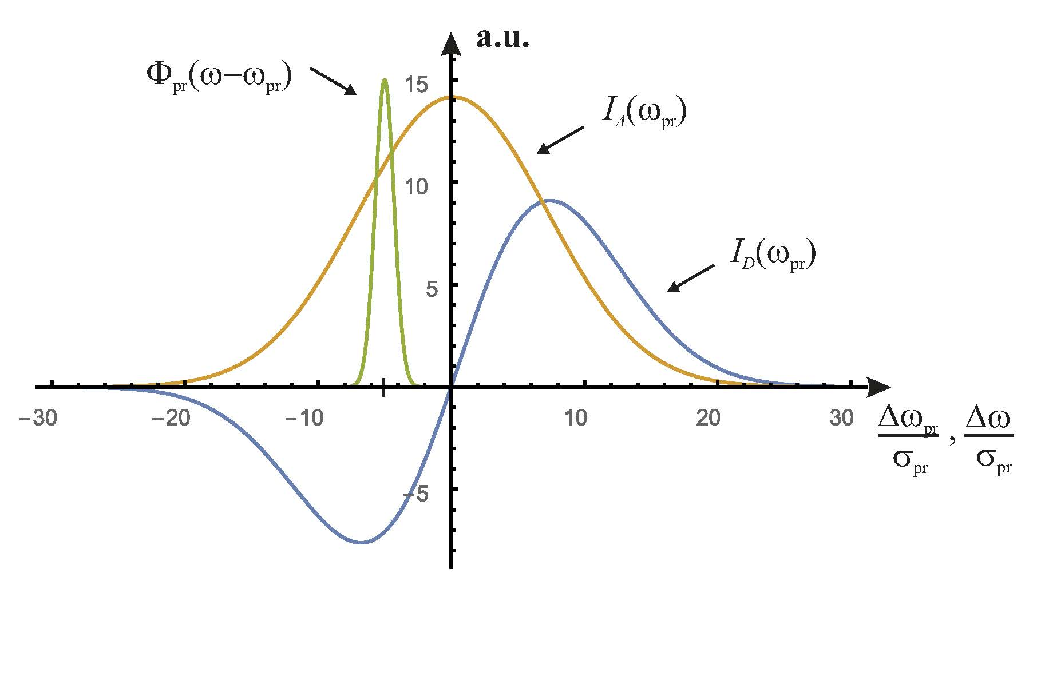
Linear dichroism and birefringence: analysis of the first-order polarization
$$P_{K_{pu} }^{(1)}\left(ωpr\right)$$
Dichroism signal I_{A}(ω_{pr}) refers to resonance transitions from the state S₁ to the state S₂ by the probe beam
Birefringence signal I_{D}(ω_{pr}) refers to off-resonance transitions from the state S₁ to the state S₂ by the probe beam

Slide 9
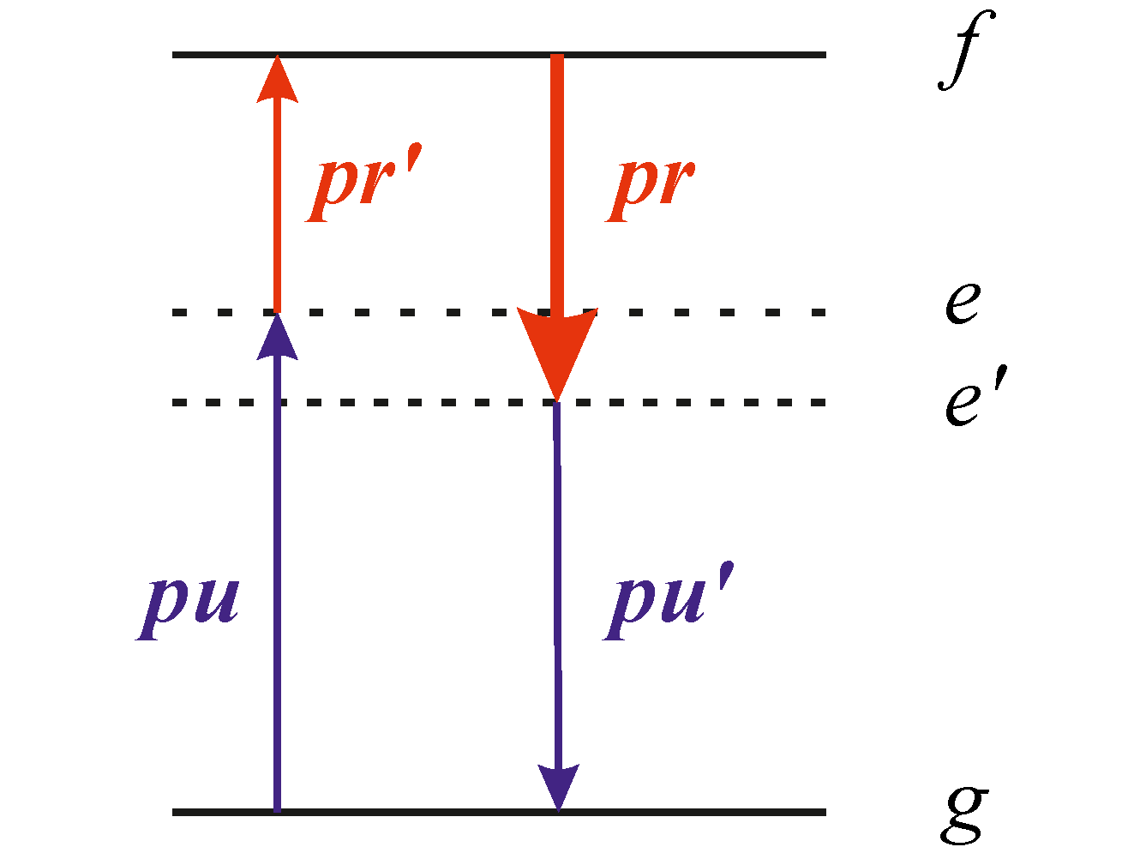
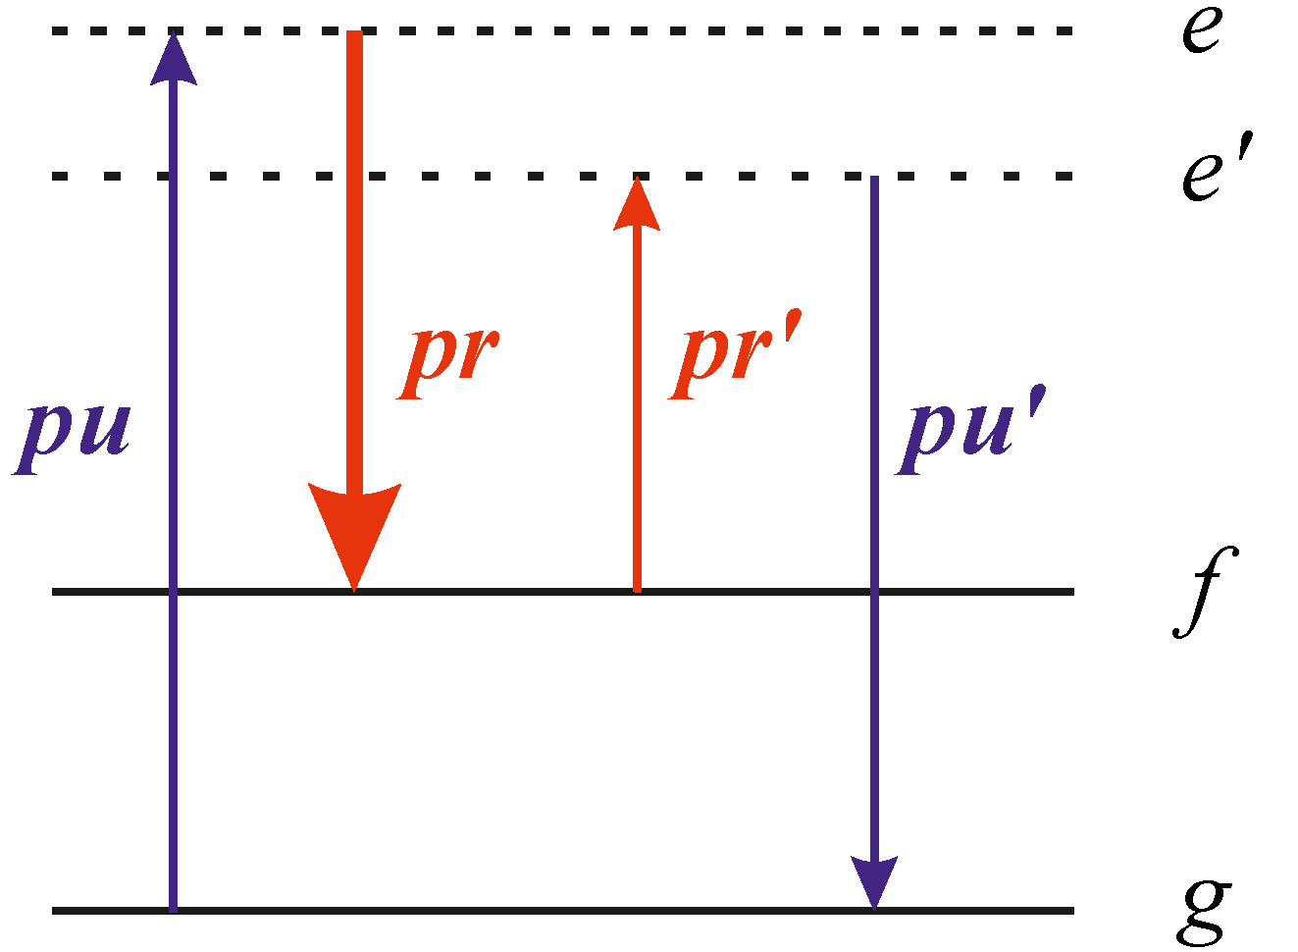
Stimulated Raman scattering: analysis of the third-order nonlinear polarization
$$P_{K_{pu} }^{(3)}\left(ωpr\right)$$
Off-resonant SRS
Resonant SRS
Only linear dichroism can be recorded
Both linear dichroism and birefringence
can be recorded
B.Semak, Ya.Beltukov, O.Vasyutinskii, ChemPhysChem, 2023, Vol.24, e202300405.

Slide 10
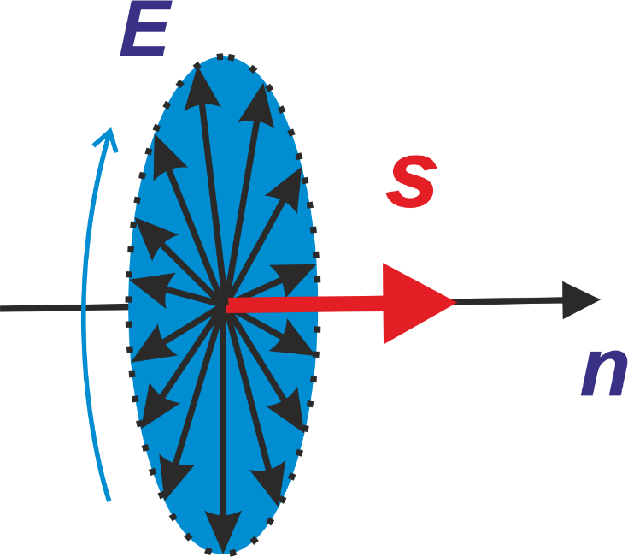
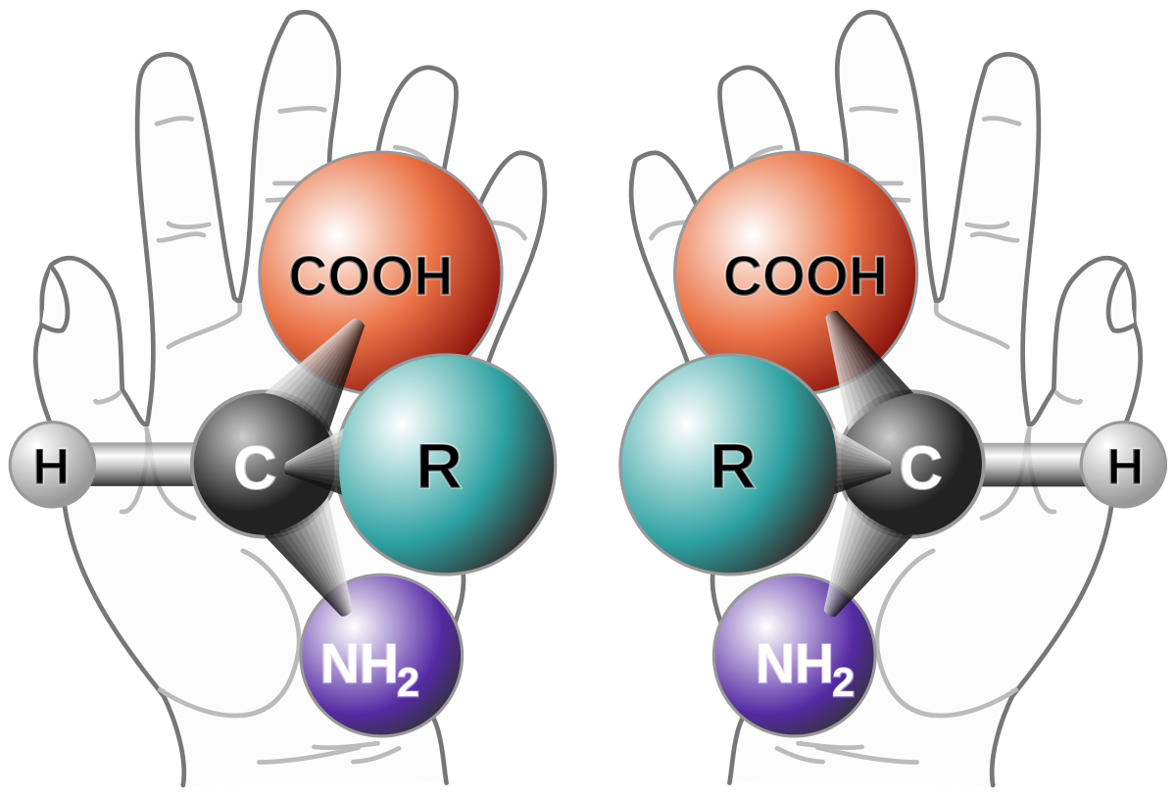
Excitation with circularly polarized light ?
Circularly polarized light beam is characterized by photon spin orientation S and by electric field E alignment.
It can create orientation and alignment of the molecular exes parallel to the propagation direction n both:
Chirality
All amino acids and sugars are chiral!
Only L-forms of amino acids and D-forms
of sugars are biologically active!
Non-chiral molecules are not sensitive to photon spin
orientation under SRS!
Chiral molecules are sensitive to photon spin
orientation under SRS!

Slide 11
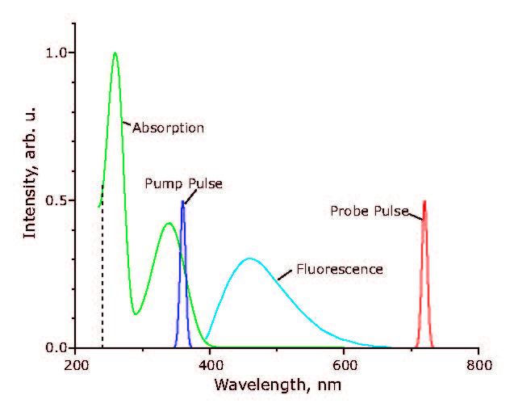
Pump-probe method
τ_{d}
Pump
Probe
Absorption and fluorescence spectra
• The pump laser pulse excited molecules from the ground state S_{g} to the first excited state S₁ via the first absorption band.
• The probe laser pulse transferred molecules from the state S₁ to the state S₂.
Gorbunova et al JTP Letters, 2020, V. 46, N. 4, p. 7.
Gorbunova et al, PCCP, 2020, 22, p. 18155.

Slide 12
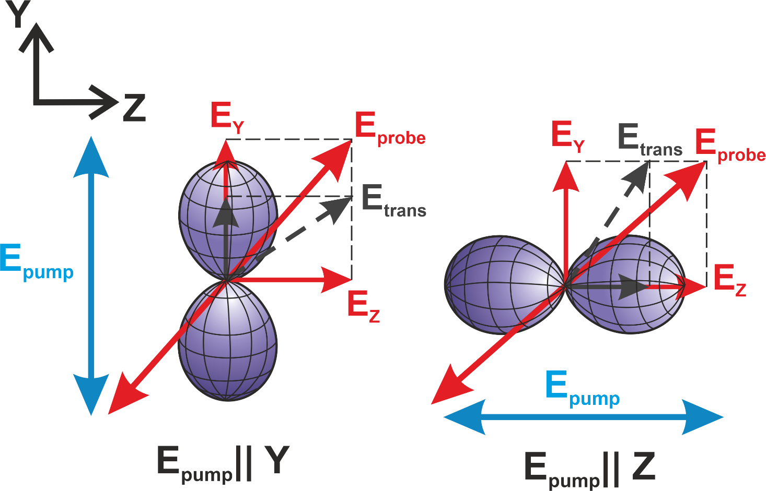
Polarization-modulation pump-probe
Laser polarization was modulated at 100 kHz
Е₂
Е_{probe}
Е₁
Е_{pump}
NADH
X
Linear dichroism of the probe beam transmitted through
the MS was recorded experimentally.
Gorbunova et al, PCCP, 2020, 22, p. 18155.

Slide 13
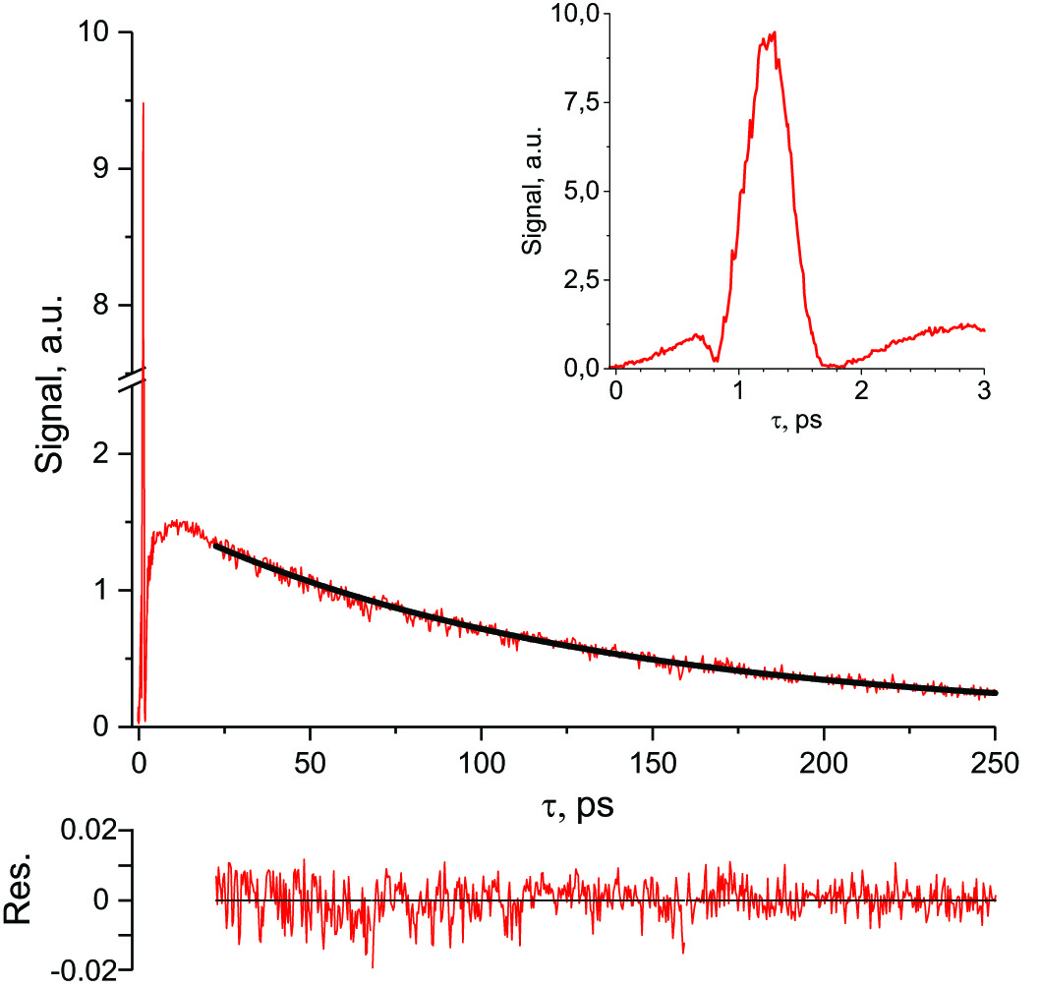
The signal of linear dichroism and SRS in NADH dissolved in water
NADН is a natural intracellular cofactor that regulates redox reactions in life cells occurring via electron transfer. It is widely used for investigation of redox reactions in cells.
SRS within the overlap area of the
pump and probe pulses
Linear dichroism in NADH
Extremely small laser pulse energy allows
to use the method for the study of fast
relaxation processes in living cells
I. Gorbunova et al, PCCP, 2020, Vol. 22, p. 18155.

Slide 14
SRS in pure water and in NADH in aqueous solution

Slide 15
Nature of the recorded signals
Off-resonant Stimulated Raman
scattering in water:
3rd-order polarization
$$P_{K_{pu} }^{(3)}\left(ωpr\right)$$
Resonant linear dichroism in NADH:
1st-order polarization
$$P_{K_{pu} }^{(1)}\left(ωpr\right)$$

Slide 16
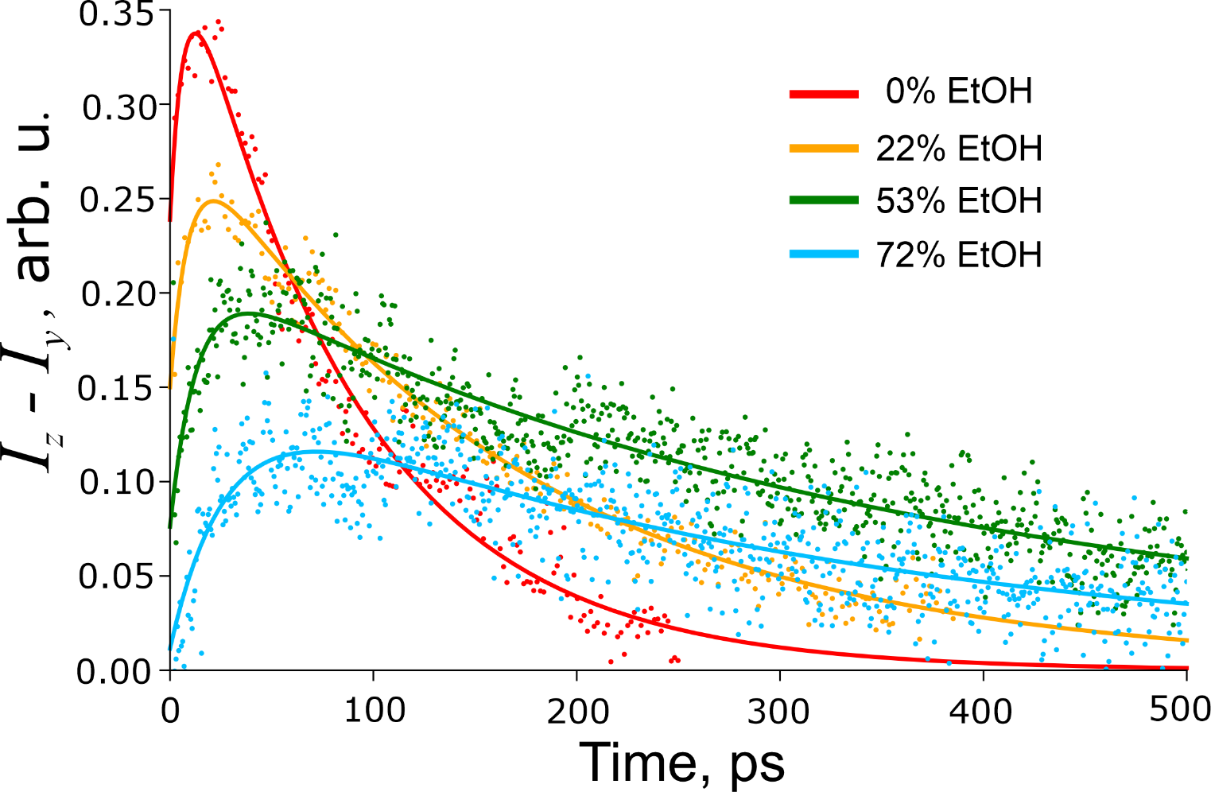
Dichroism of the probe laser beam in NADH in water-ethanol solutions
Experimental results
I. Gorbunova et al, PCCP, 2020, Vol. 22, p. 18155.

Slide 17
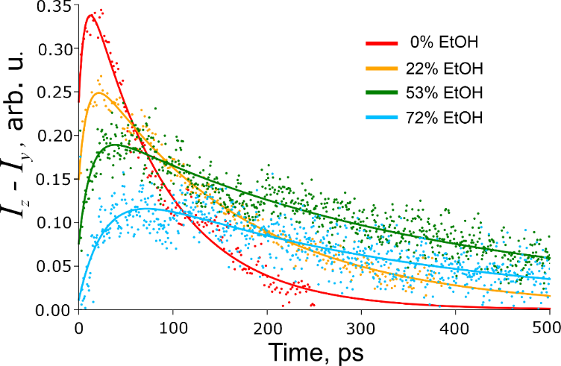
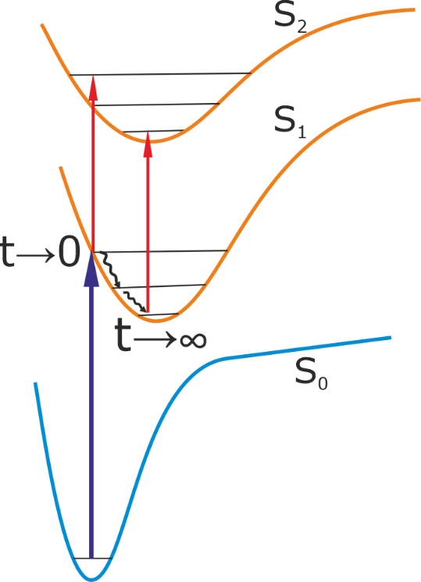
Interpretation of the signals observed
$$I_{z}\left(t\right)−I_{y}\left(t\right)=I_{0}(a_{1}e^{−\frac{t}{τ_{1}}}+a_{2}e^{−\frac{t}{τ_{2}}})r(t)$$
τ₁ и τ₂ – fluorescence decay times
a₁ и a₂ – weighting coefficients
Fluorescence Anisotropy:
Anisotropic vibrational relaxation
( t⩽25 ps):
τ_{v} – vibrational relaxation time
Rotational diffusion( t⩾25 ps) :
τ_{r} – rotational diffusion time

Slide 18
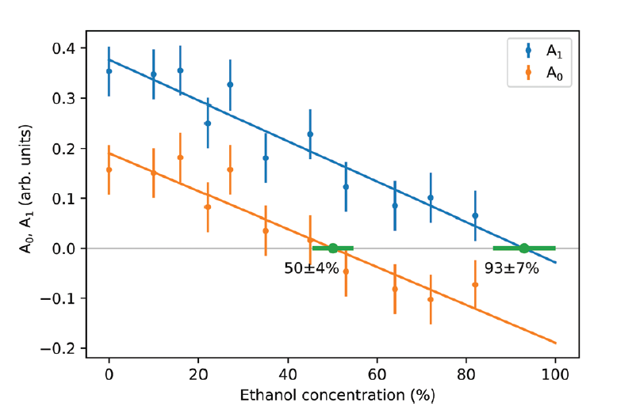
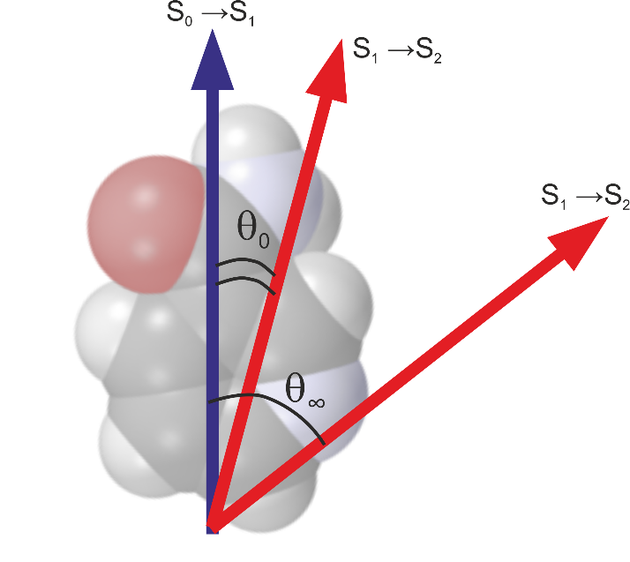
Interpretation of the temporal dependence of the fluorescence anisotropy: the rotation of transition dipole moment in NADH due to rearrangement of nuclear configuration
$$ΔI_{ab}(t{)}=A_{1}+\left(A_{0}−A_{1}\right)e^{−t/τ_{v}}$$
$$A_{0}=\left\langle P_{2}(\cos{θ_{0}})\right\rangle$$
$$A_{1}=\left\langle P_{2}(\cos{θ_{∞}})\right\rangle$$

Slide 19
Conclusions
A new polarization-modulation pump-probe method for the study of ultrafast reactions in
excited states of polyatomic molecules was developed. Due to extremely hight sensitivity
the method can be used for the study of intracellular energy transfer processes and for
imaging of ultrafast relaxation processes in living cells.
A general theoretical description on polarization effects under the 1st order pump-probe
and the 3rd order SRS in biologically molecules in solutions has been developed.
As shown, in general the probe beam can undergo the effects of absorption/gain, linear
dichroism, and birefringence simultaneously. Each of the effects can be isolated by
experimentalist by slight modification of the experimental scheme.
Resonant and off-resonant SRS can be identified experimentally by the analysis of
molecular sample linear dichroism and birefringence.
SPS with circularly polarized pump laser light can be used for the separation of L and
D chiral forms of biological molecules.
The mechanisms of anisotropic picosecond relaxation in excited states of NADH in
water-ethanol solutions were studied experimentally and theoretically.

Slide 20
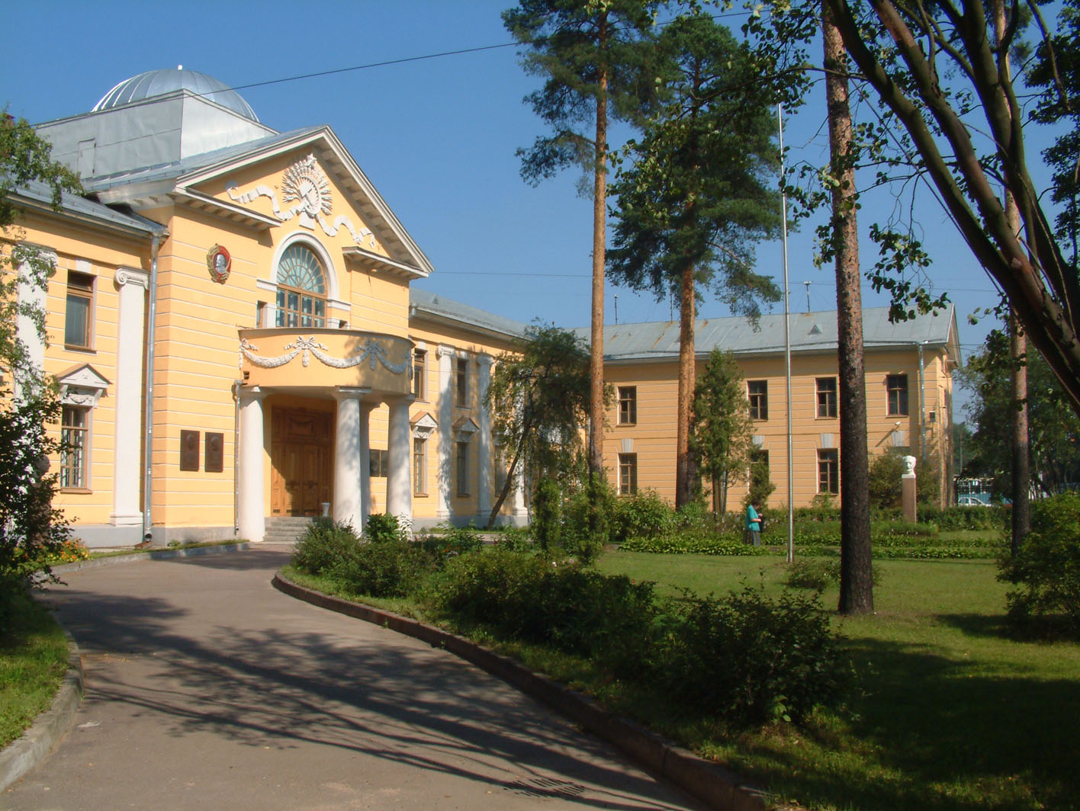
Thank you for your attention!
Notes:
20

