Slide 1
EXCITONS IN NANOSTRUCTURES
Introduction

Slide 2
Reasons for nano
It is desirable to control properties of devices
The decision is NANOSTRUCTURES

Slide 3
Kinds of nanostructures
Single heterojunctions
Quantum wells
Quantum wires
Quantum dots
Superlattices
Types of nanostructures
QWs can be of
Type I
Type II
Type III

Slide 4
Types of heterostructures

Slide 5
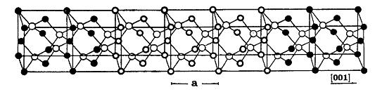
The principle of a semiconductor QW
The main advantage of nanostructures arise from quantization
New artificial material formed by thin layers of semiconductors
with different energy gaps
Ga
Al
As
AlAs
GaAs
AlAs
a QW !
Bound states electron
Bound states holes
new, larger gap

Slide 6
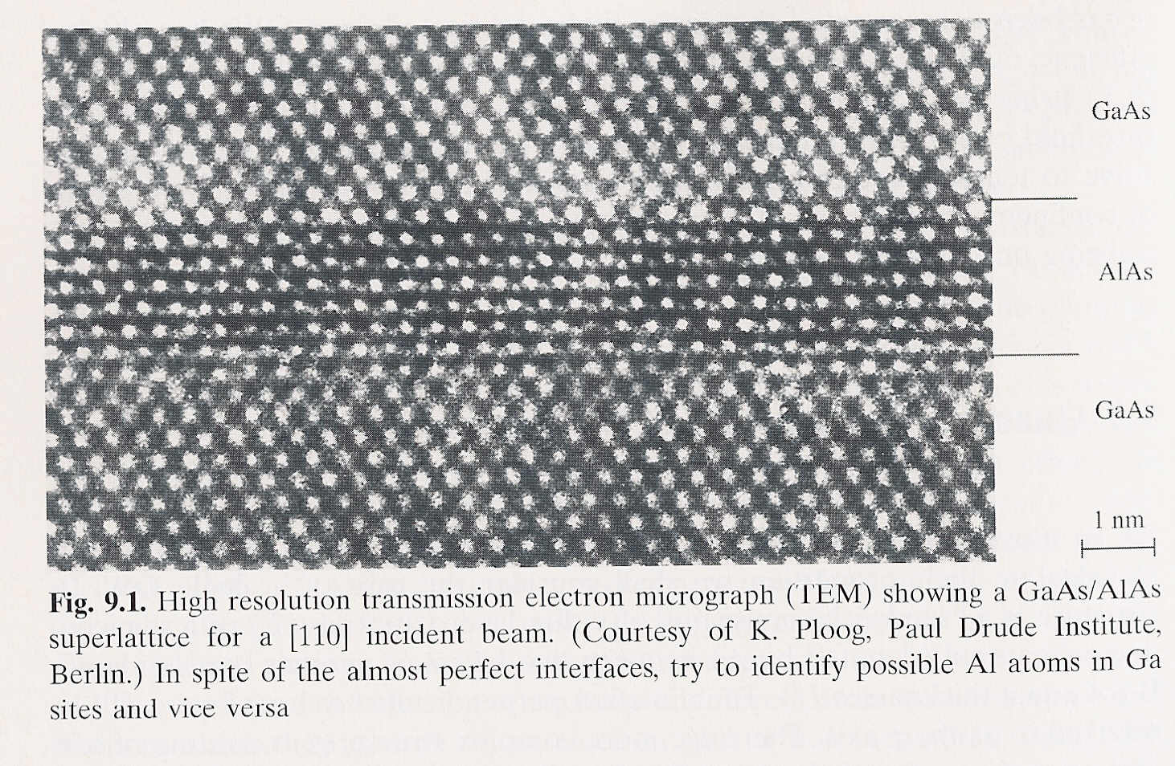
semiconductor QW

Slide 7
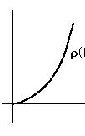
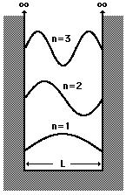
Quantum well (QW)
width L, infinite barriers
E
parabolic
dependence
Quantization in two, three dimensions = NW, QD

Slide 8
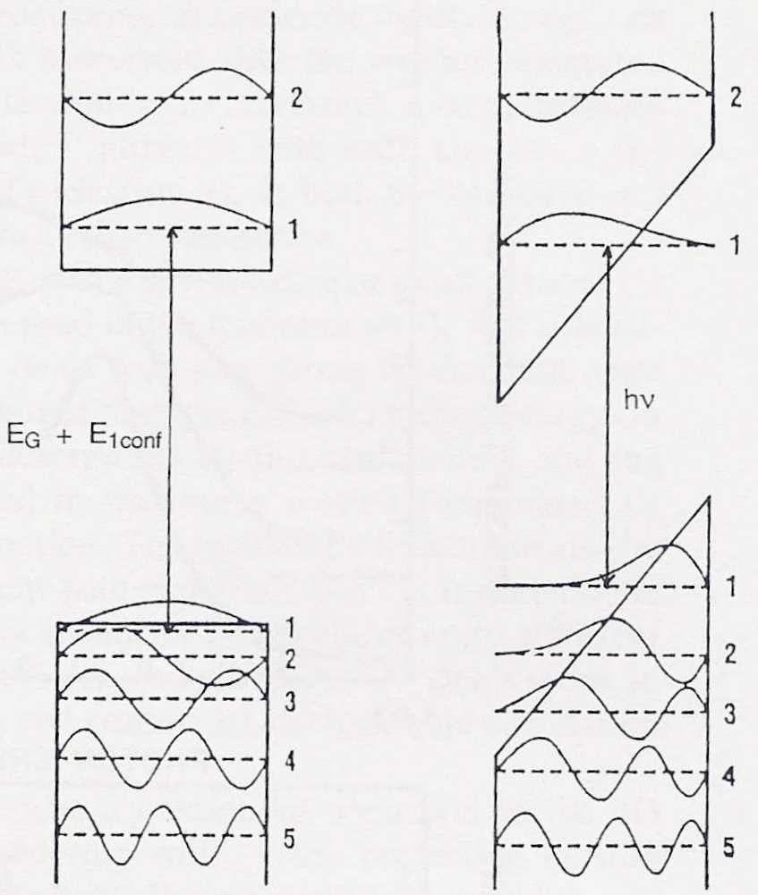
QW with applied electric field
E=0
E≠0
We can control the wavefunction not only due to quantization, but
also by external fields

Slide 9
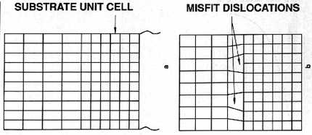
growth of sharp interfaces
Each material has an optimal lattice parameter a
layer by layer growth proceeds nicely if the lattice parameters
of the semiconductors used have almost the same lattice parameter
(<1 % difference)
elastic
deformation
dislocations

Slide 10
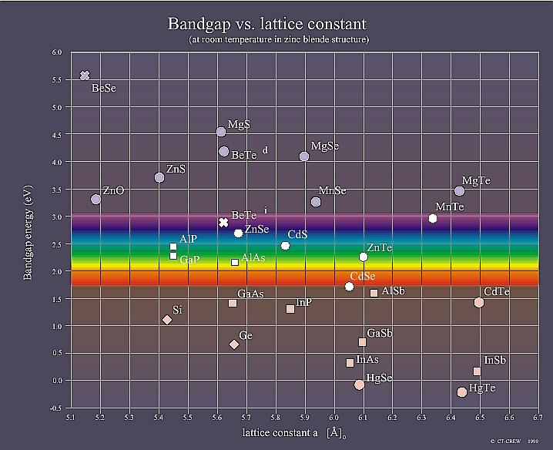
Energy gaps and lattice parameters

Slide 11
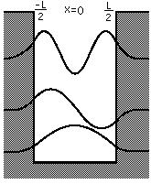
Tunneling
QW with barriers of finite height U
In the barrier
U
Wavefunction decays more
slowly in the barrier when
its energy gets closer to U

Slide 12
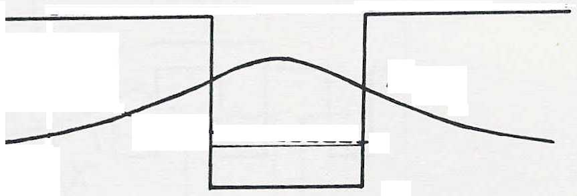
Multiple QW’s versus superlattices (SL)
same energy level in each well
Multi QW
L_{barrier} >> l_{D}
enhances absorption/emission
Superlattice
L_{barrier} ~ l_{D}
formation of minibands
A new 3D material with tunable energy bands !

Slide 13
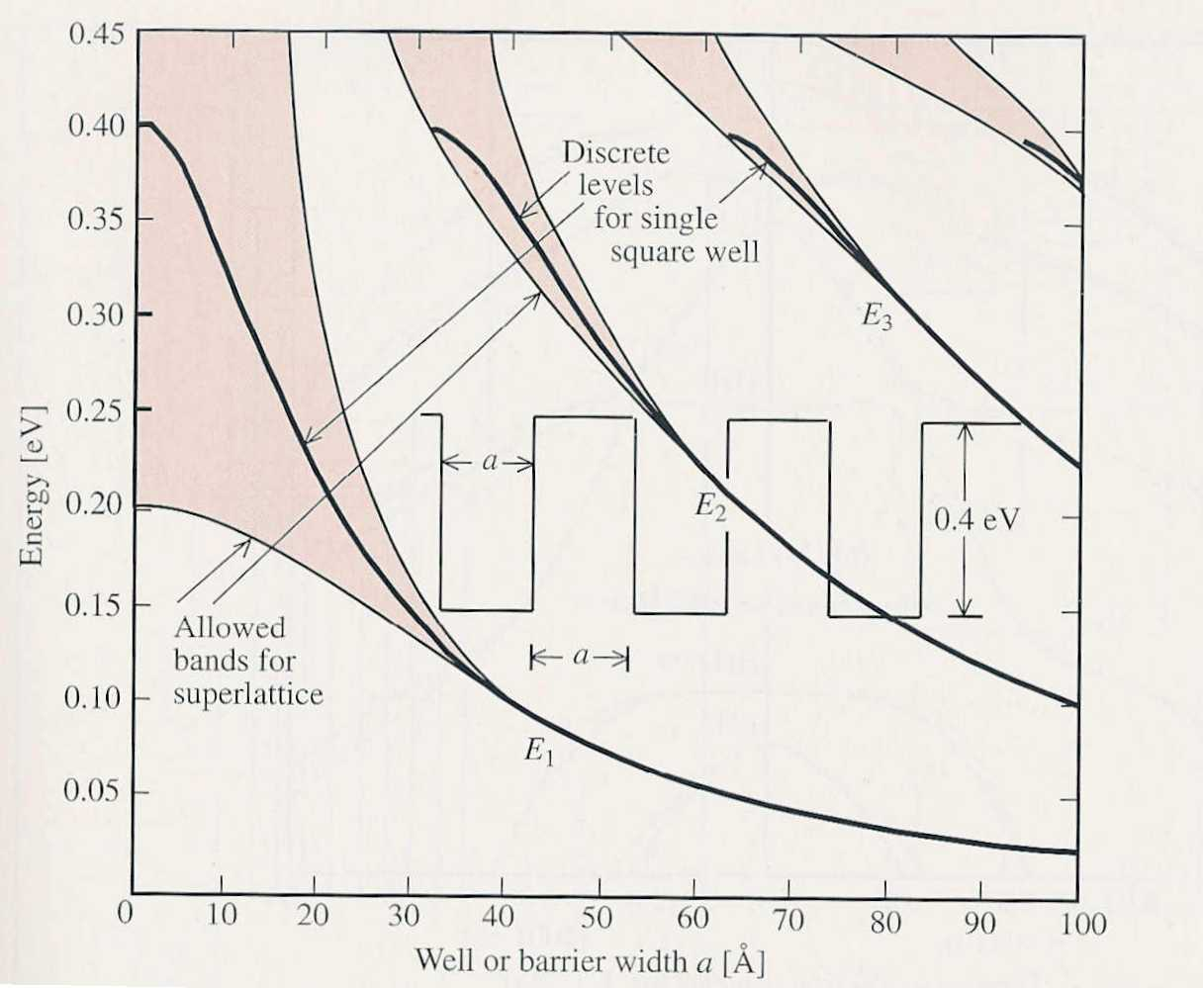
QW ⇒ SL

Slide 14
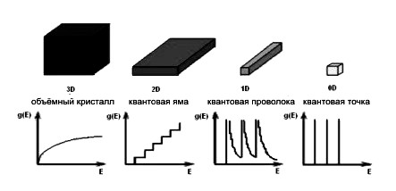
Density of states

Slide 15
EXCITON
The main property of an exciton is it mobility

Slide 16
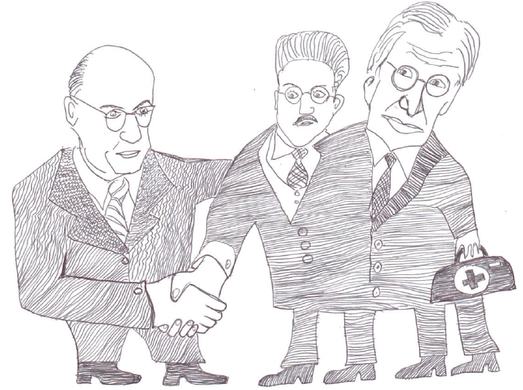
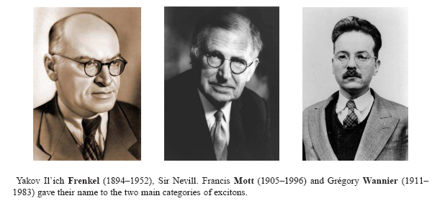
Exciton theory
Frenkel
Mott
Wannier

Slide 17
Experimental observation, 1956
Evgeny Gross

Slide 18
Exciton polaritons. Mixed exciton photon states
Chain of photon absorptions and emissions
Exciton = dielectric response of crystals

Slide 19
Dielectric function

Slide 20
Notes:
20

Slide 21
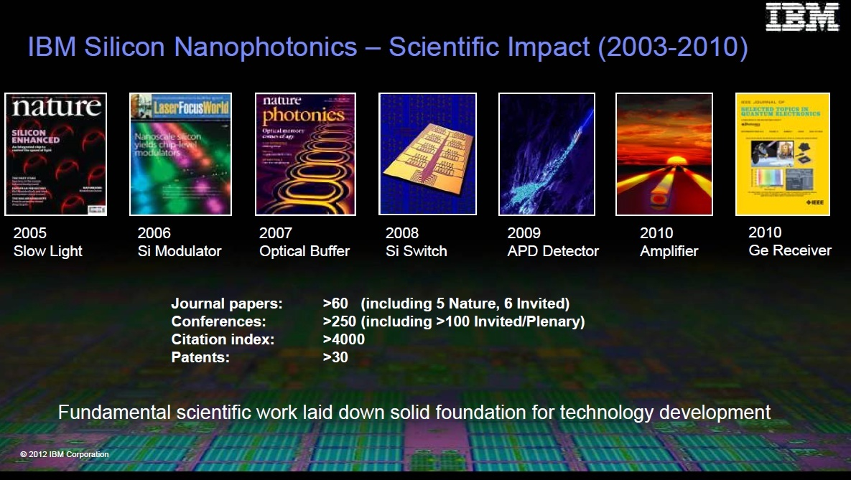

Slide 22
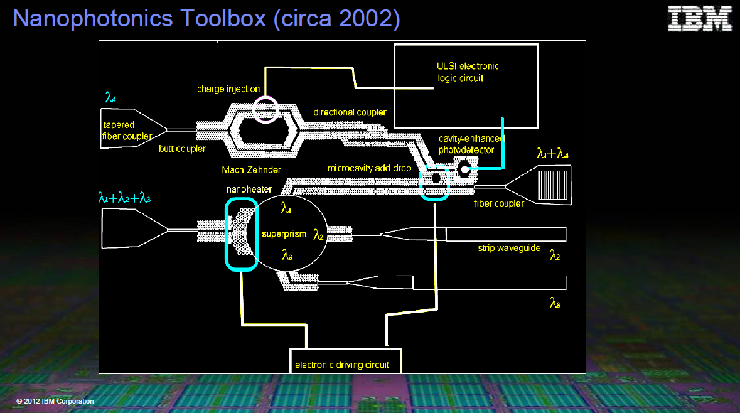

Slide 23
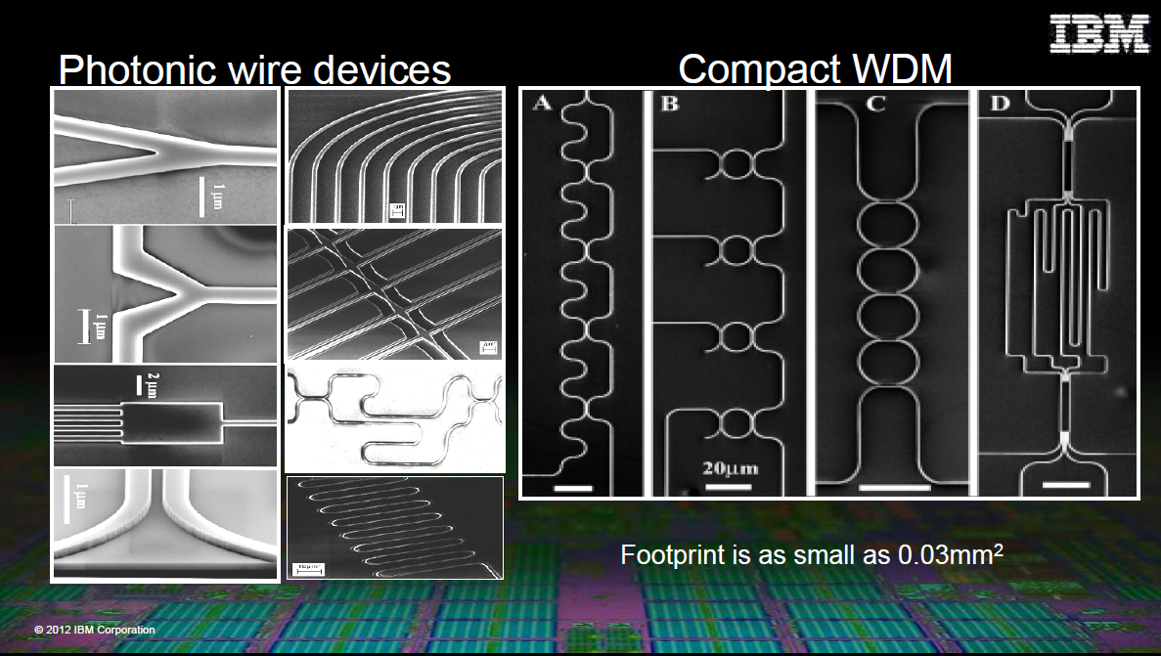

Slide 36
Wishes for devices
Reasons for nano
as small as possible
as fast as possible
low operating costs, small consumption
cheap
Which applications
fast electronics: high frequency GHz
  mobile telephones, satellite receivers (TV), computers
optoelectronics : current ⇔ light
  lasers, LED, telecommunications (light through fibres)
  solar cells, photocells, light detectors

