Slide 1
Excitons in nanostructures
Lection 1
Excitons
(ground state of the crystal; bulk excitons, simplest case; center of mass motion and relative motion; bulk excitons in degenerate bands; quantization in a wide QW, in a narrow well, coulomb corrections; excitons in nanowires; excitons in quantum dots)

Slide 2
Electron system of a crystal
(ground state)
For the ground state we can use determinant trial function:

Slide 3
here
single electron functions
can be used ether as Bloch functions
or as localized Wannier functions
With the same result
Bloch functions satisfied single electron equations
Wannier functions are a linear combination of the
Bloch functions

Slide 4
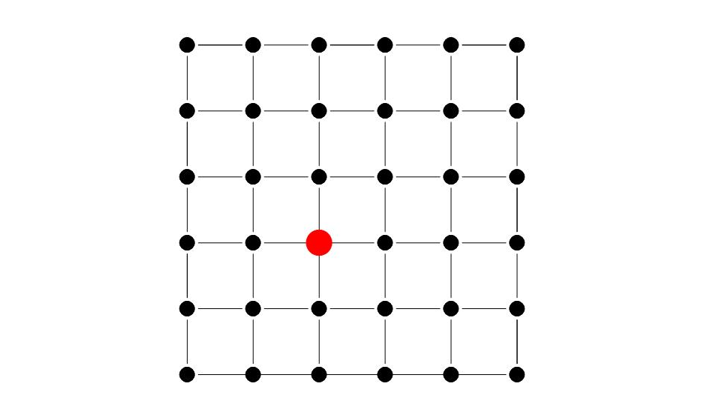
Excited state of the crystal
Because all position of the exited atom are equal,
this excitation can move free in the crystal

Slide 5
Excited state of crystal
(Frenkel exciton)
wave function of the excited electron localized
on the atom (Wannier or atomic functions )

Slide 6
Excited state of crystal
(Wannier-Mott exciton)
are single electron Bloch functions
electron in the ground state
electron in the excited state

Slide 7
Exciton
Because all position of the exited atom are equal,
we have to take a linear combination of such states

Slide 8
Exciton
Linear combination of the single electron determinants
satisfy the equation
here

Slide 9
Exciton effective mass equation
For large distance between electron and hall, or for small we obtain
Center of mass and relative coordinates
Is it possible or not is not obvious
and
In bulk crystal it is possible and one can take

Slide 10
In the center of mass and relative coordinates
the exciton equations are
and
reduced mass
solution
For equation
The solution - Hydrogen like spectrum
Absorption peaks at:

Slide 11
Hydrogen atom
energy
Wave functions
Several radial functions
Several spherical functions

Slide 12
Exciton absorption of Cu2O
n=2 n=3 4 5 6 7

Slide 13
Sommerfeld factor
Arnold Johannes Wilhelm Sommerfeld
Line intensities in the discrete spectrum
Exciton effect in the continuum spectrum
here
Due to the Sommerfeld factor exciton absorption is 3 times higher

Slide 14
Exciton absorption
paradox: there is no absorption at all!

Slide 15
Real exciton is polariton
Chain of photon absorptions and emissions
No absorption in bulk crystal
Exciton is a photon in a crystal
(Lection_3)

Slide 16
The central question:
Is it possible to consider the center of mass
motion independently on the relative motion
for the composite particle like exciton?
1). in bulk material?
2). in nanostructures?

Slide 17
Exciton in a bounded crystal
(first step to nanostructure)

Slide 18
Exciton in a bounded crystal
(EE)
-the potential of the border of the crystal,
For this potential we can separate center of mass and relative motion
- is the well thickness
The solution of the (EE) in infinite rectangular well is
here
and
- are center of mass momentum and radius-vector
are hydrogen-like functions

Slide 19
are eigenfunctions of the center of mass motion in the well
Energy spectrum for center of mass quantization

Slide 20
Exciton center of mass quantization
Odd and even states (Lection 2 and 3)

Slide 21
For arbitrary well necessary adiabatic approximation
(A.B.Migdal «Qualitative Methods in Quantum Theory»)
Adiabatic approximation
Electron – hole relative motion is FAST
Exciton center of mass motion is SLOW
Represent the wave function as
wave functions of the fast subsystem, satisfy equation
Z - is a parameter
Substituting
into initial equation (EE) we get

Slide 22
The way to generalize the adiabatic approximation
Operator of non adiabaticity
For adiabatic approximation
This approximation works only for wide wells
In this case the internal motion and center of mass motion
are independent.
In a quantum well center of mass quantization for each state of internal motion.

Slide 23
Degenerate valence band
( band in cubic crystal)
Exciton Hamiltonian:
electrons
holes
here
Luttinger parameters
Introduce relative and center of mass coordinates

Slide 24
We can rewrite the exciton Hamiltonian as
here
Relative motion
Center of mass motion
Mixed term
Is it possible to separate internal motion and center of mass motion?
In classical mechanics this is always possible

Slide 25
Separation of the center of mass motion and relative motion
Consider
We want for
the Mixed term
The best that we can get
Exciton Hamiltonian

Slide 26
conclusion
For the internal motion we have two kind of excitons:
heavy and light hole exciton
For the center of mass motion we have also heavy and
light excitons
At small the internal motion and center of mass
motion can not be separated
At small the exciton dispersion is essentially nonparabolic
(E.O.Kane «Exciton dispersion in degenerate bands» Phys.Rev. B11, 3850 (1975))

Slide 27
Exciton quantization in a narrow well
Electrons in the well
Holes in the well
Relative motion in the plane
Coulomb term
Center of mass wave-vector in the plane of QW
,

Slide 28
Solve in the limit
In this case
For quantization along z
For 2D exciton

Slide 29
Finite QW width
adiabatic approximation
for
one dimensional potential for hole
For m=0

Slide 30
Hole motion in the additional potential
Two limit cases:
1)
shift
2)

Slide 31
Harmonic oscillator levels for hole
(Al.L.Efros Semicond. V.20, N0.7, p.1281 (1986))

Slide 32
Excitons in nanowires (NW)
Cylindrical wire
In the case of strong radial quantization, exciton wavefunction
and
Envelop functions for electron and hole

Slide 33
Boundary conditions:
Normal vector to the NW surface
In cylindrical NW the projection of the angular momentum
on z axis M is a good quantum number. For M=0
Here J and K are Bessel functions, R is NW radius

Slide 34
The equations for and
and
For rectangular wire

Slide 35
Exciton envelop function
Here is effective coulomb potential
Trial function can be taken

Slide 36
Excitons in quantum dots
Rectangular dot

Slide 37
Spherical dot
In this case angular momentum conserves
For the ground state with zero angular momentum, infinite barriers
Finite barriers
Equation for the energy

Slide 38
Literature
Robert Knox «Theory of excitons»
Sham L.J., Rice T.M. «Many particle derivation of the
effective mass equation for Wannier exciton»
Phys. Rev. 144, p.708 (1966)
F.Bassani, G.Pastori Paravichini «Electronic states and
optical transitions in solids»
G.Bastard Wave mechanics applied to semiconductor
heterostructures

