Slide 1
Lection 2
Excitons in external fields (1h)
(bulk exciton in a magnetic field, Zeeman effect, diamagnetic shift;
exciton in an electric field, Stark effect, the exciton in QW in
external fields, confined stark effect; case of the degenerate
valence band; Pockels effect)

Slide 2
Exciton in magnetic fields
(simple band structure)
In magnetic field we have to change
obtain
Relative motion and center of mass motion
Take the trial function in the form
For get equation

Slide 3
Relative motion
Angular momentum
Magneto stark effect
diamagnetic
Angular momentum L
Orbital Zeeman effect ~
and can be small
usually
Contrary to spin magnetism, here we have effective mass

Slide 4
The term
Is magneto Stark effect
Is the Lorentz force
It can be compensate by an electric field because
The correction to energy is in the second order perturbation
Corrections to effective mass and
diamagnetic shift
and

Slide 5
Magneto-Stark effect in CdS crystal in magnetic fields
(Thomas Hopfield Phys. Rev. Lett. 5, 505 (1960))

Slide 6
In magnetic fields
Additionally to spin magnetism
1). Orbital magnetism on p states
2). Diamagnetic shift
3). Magneto-Stark effect

Slide 7
Exciton in magnetic fields
(cubic Td crystal)
Here: exciton Hamiltonian in zero field and zero
linear in magnetic field contribution
linear in wave vector contribution
bilinear in magnetic field and wavevector term
exciton in the absence of magnetic field

Slide 8
Exciton in magnetic fields
(complex band structure)
Exciton Hamiltonian
Because of the complex band structure we can not separate
internal motion and center of mass motion in Faraday geometry
we always have the term:
This term mixed 1s ground state and all p states of the
internal motion and leads to two effects for moving exciton:

Slide 9
1) Increase exciton Zeeman splitting

Slide 10
2) Decreasing of diamagnetic shift
These effects are present in
narrow wells also and in QDs
and in NWs

Slide 11
In the case of degenerate valence band
Due to mixing of internal and center of
mass motion
1). Zeeman splitting
2). Diamagnetic shift
depend on the center of mass energy

Slide 12
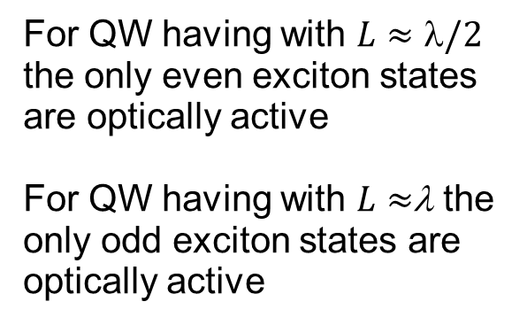
Effect of parity in the exciton spectra
we have even and odd exciton
quantized states

Slide 13
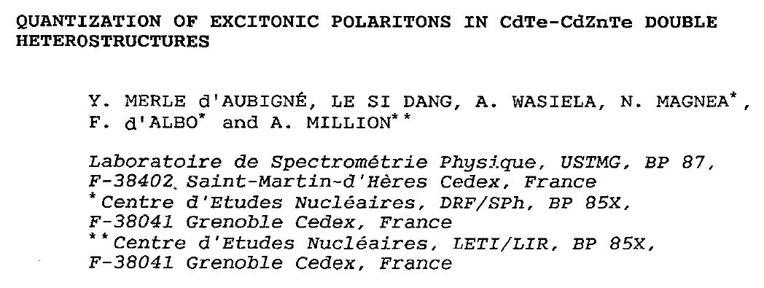
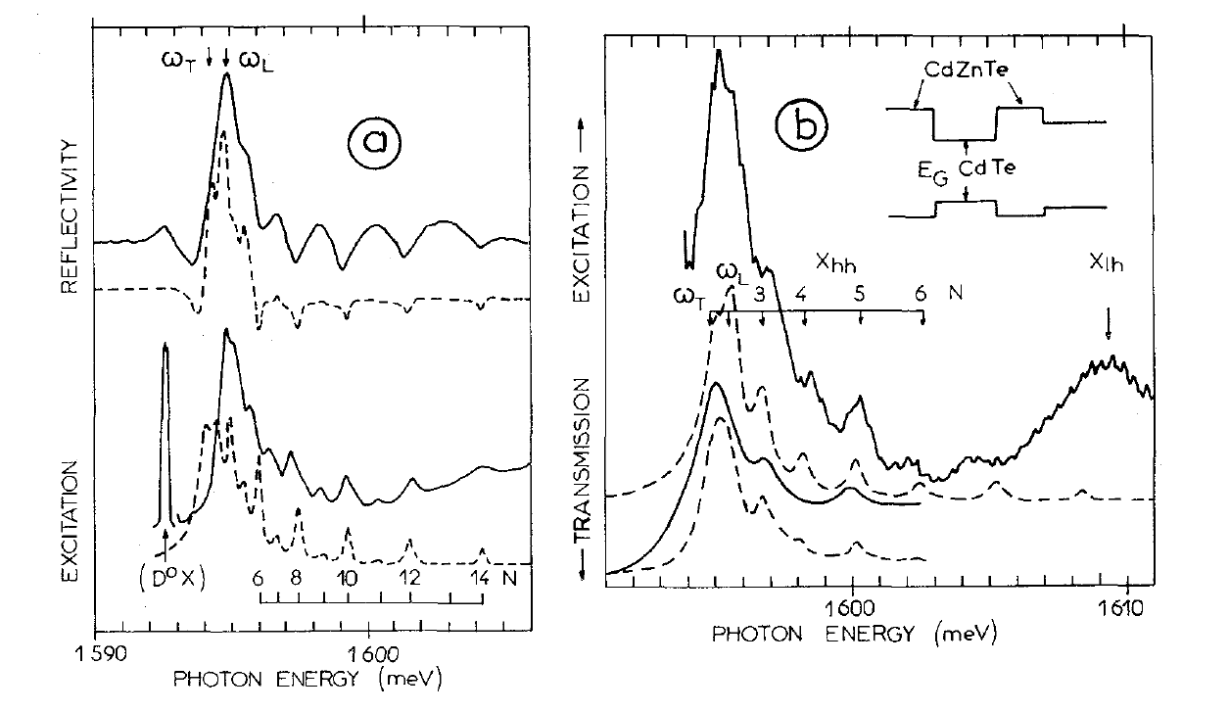

Slide 14
Faraday geometry
Linear in wave vector and magnetic field contribution in bulk
In
similar
consider the first term
Mixing of HH and LH excitons

Slide 16
Reflectivity spectrum taken from GaAs/AlGaAs QW
at zero magnetic field
Incident light is linearly polarized in (100),
circular polarized component is analyzed
L=300nm
Only even states are present in this spectrum

Slide 17
Redistribution of exciton oscillator strength between odd and even states
Incident light is linearly polarized,
circular polarization is analyzed

Slide 18
Voigt geometry
Cubic crystal

Slide 19
Voigt geometry
Magnetic field inversion effect

Slide 20
Voigt geometry
Wurzite crystal
For the conductivity band
For the valence band
optical transitions
and

Slide 21
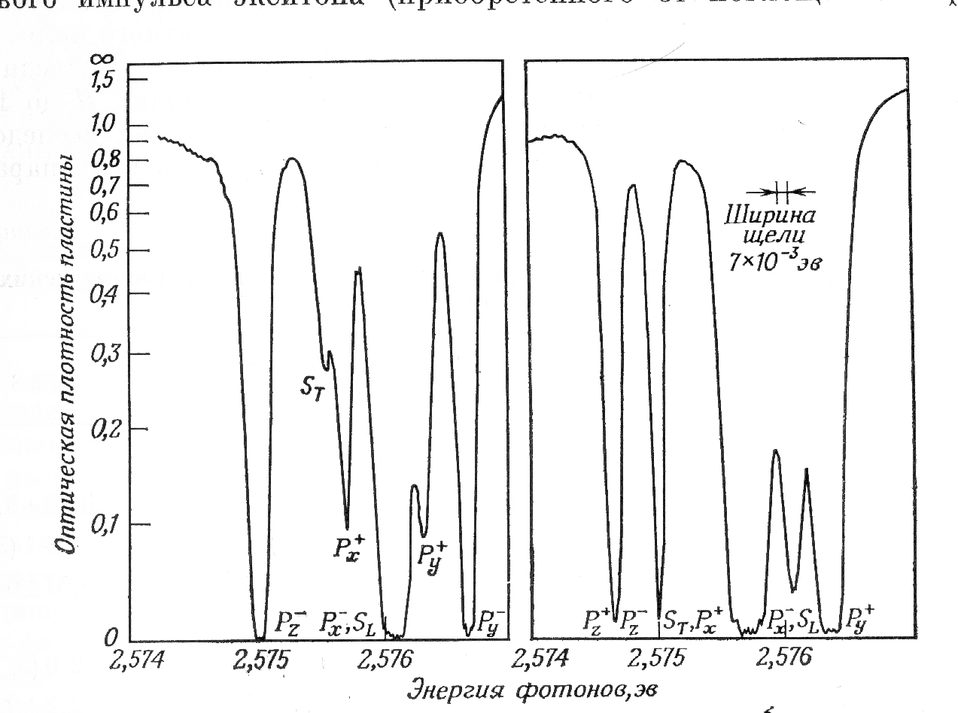
Effect of magnetic field inversion
H⁺
H⁻
Transmission spectra of CdS in magnetic field of 3.1T, H is perpendicular to C₆ axis

Slide 22
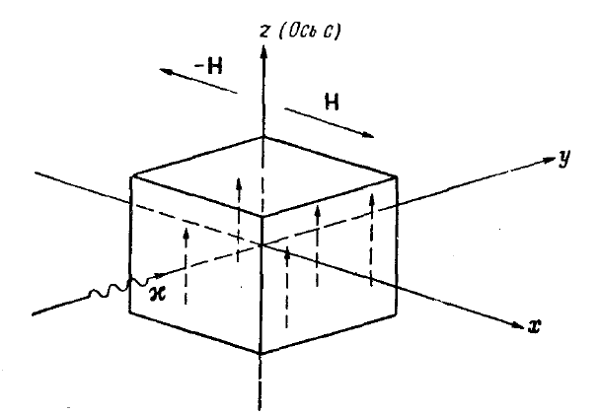
Effect of inversion of magnetic field

Slide 23
In the structures without inversion symmetry
1). Effect of “parity” (due to nonreciprocal
magnetic field induced birefringence)
2). “Effect of inversion of magnetic field”

Slide 24
Quantum confined Stark effect
Lateral electric field
Two effects: 1) current, 2) dissociation of the exciton
Broadening of the exciton level
Transverse field
No dissociation, but Stark shift

Slide 26
Stark effect in superlattice
In the tight binding model we have equation
- Energy, - transfer integral
For the Bloch solutions: miniband:
The miniband width equal
Effective mass

Slide 27
In the presence of electric field tight binding equation
The electric field just shifts the energy
When the detuning becomes bigger the miniband width
LOCALIZATION
Localization length

Slide 28
Wannier Stark localization

Slide 29
Wannier Stark localization

Slide 30
In superlattices
Wannier-Stark localization

Slide 31
Quantum confined Pockels effect
(Linear in electric field Birefringence)
Dielectric function
normal frequency dispersion
natural optical activity (gyrotropy)
Pockels effect
spatial dispersion due to exciton motion
Kerr effect
electric field induced gyrotropy

Slide 32
1). Bulk mechanism
Linear birefringence

Slide 33
2) Interface mechanism
Bloch functions for the valence band are

Slide 34
Boundary conditions
We can expand an arbitrary wave function in the heterostructure in the set of these functions
In a heterostructure we need boundary conditions
1). Continuity of the wavefunction
2). Continuity of flax
- Velocity operator

Slide 35
Symmetry of a normal quantum well

Slide 36
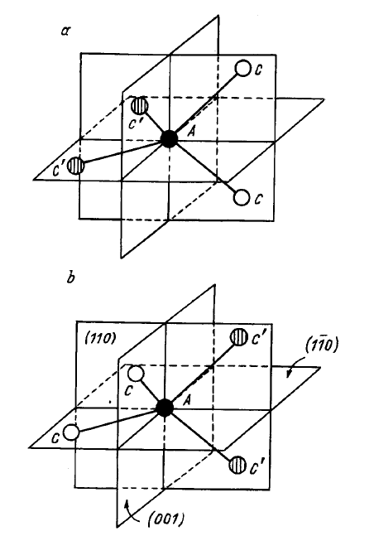
Symmetry of a real interface
In QWs based on zinc blend
type semiconductors

Slide 37
Boundary conditions taking into account low interface symmetry
for valence band
Wave function for electrons
Hole wavefunction from the boundary conditions

Slide 38
Inside the well
In barriers
here
Satisfying the boundary conditions we found and
Transitions and are optically allowed

Slide 39
Matrix element of the transition in linear polarization
Degree of linear polarization

Slide 40
O. Krebs, W. Seidel, J. P. Andr´e, D. Bertho, C. Jouanin, P. Voisin: Semicond.Sci. Technol. 12, 938 (1997).
InGaAs(45A)/InP(68A)

Slide 41
A.A. Toropov, E.L. Ivchenko, O. Krebs, S. Cortez, P. Voisin, J.L. Gentner:
Phys. Rev. B 63, 35302 (2000). (1992).

Slide 42
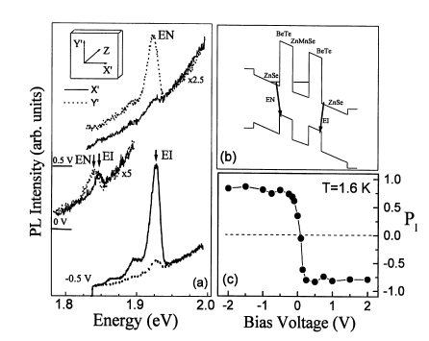
Giant Pockels effect

Slide 43
Giant quantum confined Pockels effect
Due to interface anisotropy

Slide 44
summary
1). Orbital magneton is 10 times larger the spin ones.
2). In Mixing of the center of mass motion and relative
motion cal strongly modify Zeeman effect and diamagnetic shift.
3). In the structures without inversion symmetry there is effect
of "parity".
4). Electric field can leads to localization.
5). Giant Pockels effect due to interfaces.

Slide 45
Literature
Robert Knox «Theory of excitons»
T. Godde, M. M. Glazov, I. A. Akimov, D. R. Yakovlev, H. Mariette, and M. Bayer Phys. Rev. B88, 155203 (2013)
“Magnetic field induced nutation of exciton polariton polarization in (Cd,Zn)Te crystals”
T.E.Dimock Semiconductors and Semimetals Vol. 5
K.Cho Phys. Rev. B14, 4463 (1976)
“Symmetry breaking effect on excitons in cubic and wuerzite structures”
D.G. Thomas, J.J. Hopfield Phys. Rev Lett. 5, 505 (1960)

