Slide 1
Lection 3
3). Optics of excitons in nanostructures (4h)
(exciton -photon interaction, bulk polaritons, exciton -photon
interaction in a SQW; array of QWs; short-period SR;
Bragg QW structures, diffraction from an array of QWWs and QDs;
polaritons in microcavities)

Slide 2
Reflectivity and transmitivity
of a single quantum well

Slide 3
Sandwich В-А-В
Normal incidence
At the left – incident wave with the amplitude
and reflected wave with the amplitude
At the right – transmitted wave

Slide 4
The only difference between А and В is that there are no
excitons in in В = barrier, there is exciton in A = quantum well
Reflection and transmission
If no absorption
- Exciton resonance frequency
Let
- Exciton radiative lifetime
- Exciton nonradiative lifetime
After creation of the exciton its wavefunction
where

Slide 5
Coefficients and are response functions
Reflection and transmission coefficients describes linear response
of the layer A on the incident electromagnetic field
These values should have poles on the eigenfrequencies
As usually in optics, incident field induced polarization that
Is coherent with this field

Slide 6
Let the wave in is a sum of incident and
emitted coherently by exciton waves
Due to mirror symmetry in z=0
Fare from the resonance
If absorption is absent
Solve this square equation

Slide 7
Will get for reflectivity and transmission of QW
Absorption by QW

Slide 8
Quantum well can not be considered as a dielectric media.
It is a 2D molecule.
We can’t use usual dielectric function.
Nonlocal response.

Slide 9
Exciton in a QW
Remaining
QW Exciton Schrödinger equation
2D approximation

Slide 10
Radial trial function, 2D hydrogen-like
Bloch envelop functions are solutions of electron and hole 1D equations

Slide 11
Exciton photon interaction
System of equation for electromagnetic field and exciton polarization
Wave equation for electromagnetic field
For plane waves
Equation for exciton polarization
- Hamiltonian of the mechanical pert of the exciton

Slide 12
Solutions:
For electromagnetic field
Is Green function of the wave equation
In our case of 3D it is
For the exciton polarization
Here is susceptibility

Slide 13
For QW exciton
Consider lowers exciton states
Substituting into eq. for , we obtain
Taking into account

Slide 14
Reflection and Transmission coefficients
here
Overlap of the EM field with electron and hole wavefunctions
Renormalization of the resonant frequency

Slide 15
To describe exciton photon interaction we have
to consider equation for the exciton polarization
induced by the electromagnetic field and equation
for the electromagnetic field induced by exciton
polarization.

Slide 16
Local respond instead of nonlocal
Nonlocal =
Introduce formally dielectric function
effective oscillator strength

Slide 17
Reflectivity from a plate A
Summarizing all multiple reflections in A
here
phase shift in the layer A
In the case if
consequently

Slide 18
Reflectivity from a real structures
Summarizing multiple contributions from surface and QW
here

Slide 19
Reflection from quantum well defined by
interference of the light reflected from the
surface and from the quantum well

Slide 20
Oblique incidence
here

Slide 21
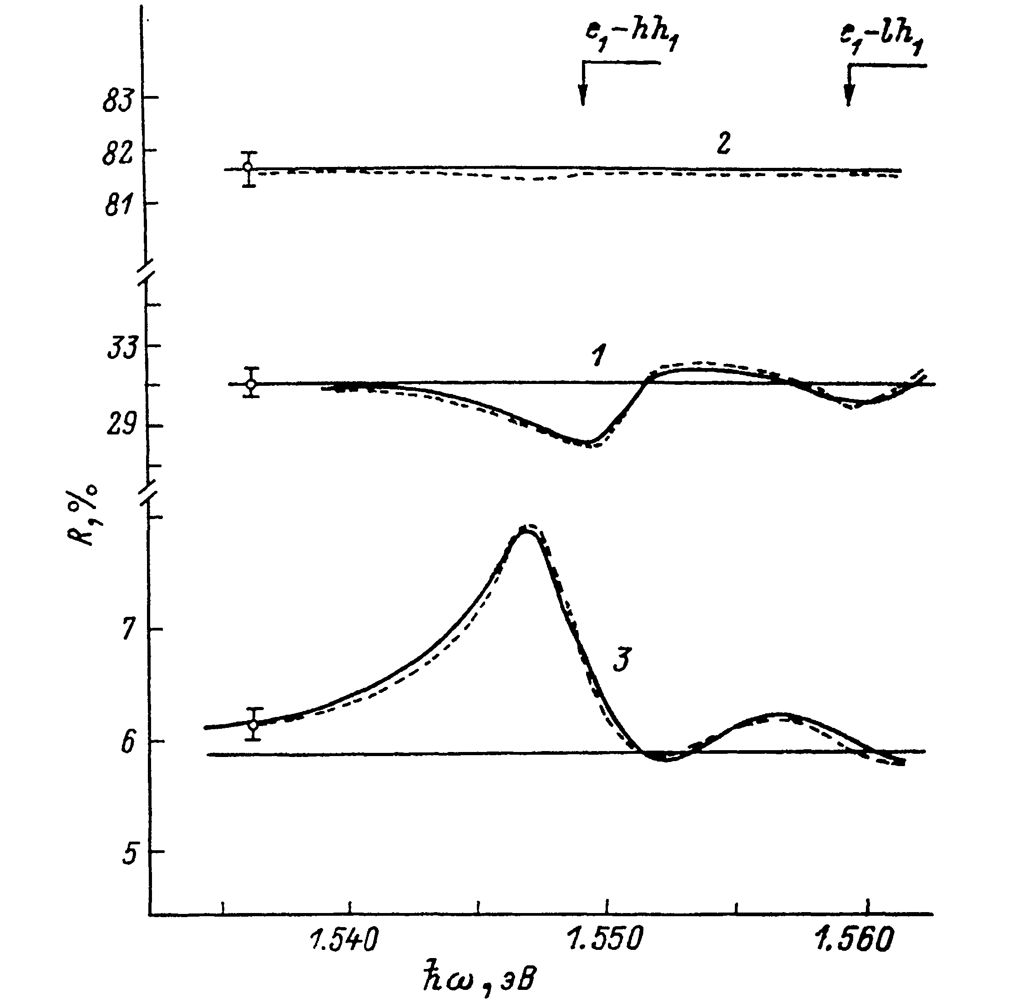

Slide 22
Using oblique geometry we can suppress
reflectivity from the surface and by this way
increase the contribution from the QW

Slide 23
Exciton photon interaction as a function
of QW with
Narrow wells or
Using trial function

Slide 24
Overlap of electron and hole functions

Slide 25
Exciton oscillator strength depends on
the nanostructure size

Slide 26
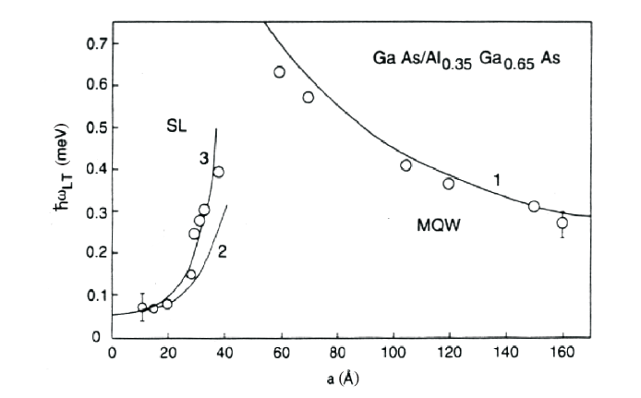
Oscillator strength as a function of the QW width

Slide 27
Short remarks related to oscillator strength
QW exciton wavefunction
Radiative damping
here
Oscillator strength
Because all unit cells can participate in absorption
Here is square of the sample
For the bound (or localized) exciton

Slide 28
The oscillator strength of the bound exciton normalized on one
impurity (or localization) center is equal to the oscillator strength
of the free exciton normalized on unit cell.
The exciton radiative lifetime is equal to the
inverse exciton radiative damping.
It is maximal for bulk and minimal for quantum
dots

Slide 29
Oscillator strength as a function of the environment
Phase shift

Slide 30
let
from to

Slide 31
Exciton oscillator strength depends
on the environment

Slide 32
Exciton reflectivity line-shape as a function of the environment
reflection
here
At normal incidence
consider

Slide 35
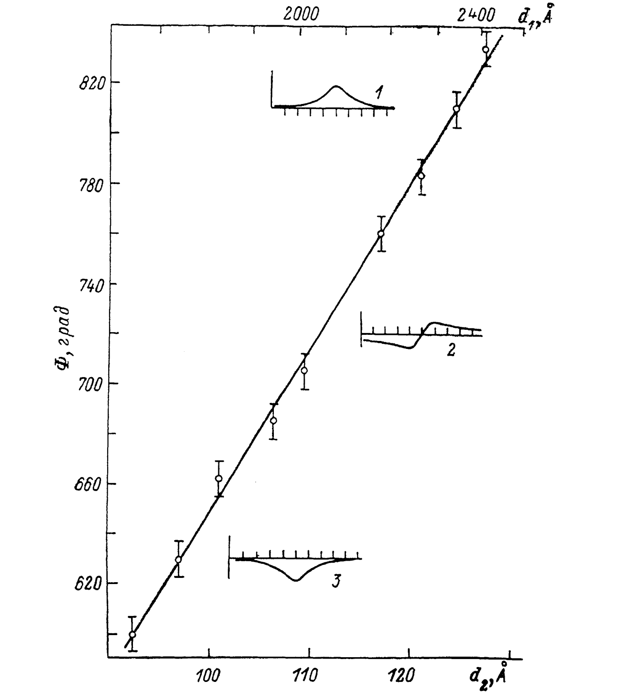

Slide 36
Exciton line-shape depends strongly on the
cap layer thickness

