Slide 1
Lection 4
3). Optics of excitons in nanostructures (4h)
(exciton -photon interaction in an array of QWs; short-period SR;
Bragg QW structures, diffraction from an array of QWW and QD; polaritons in microcavities)

Slide 2
Periodical structures with QWs
Let the period of the structure is so that the exciton
wavefunctions in neighbor well are not overlap. In
this case exciton contribution to the polarization is a
sum over separate wells
here
Consider only lowest state
Electromagnetic field induce exciton polarization
here

Slide 3
Exciton polarization in turn, induced electromagnetic field
Let consider average over the QW
Substituting into we obtain equation for polarizations in different wells
here
This is a task for eigenwaves in a chine of oscillators with
resonance frequency damping and coupling
constants

Slide 4
Substitute Bloch waves for infinite array of the wells
and zero damping
Obtain dispersion equation
From this is clear that not all are available

Slide 5
For the periodic array of quantum wells not all
waves can propagate in the structure

Slide 6
Method of transfer matrixes
Transfer matrix thru N layers is the product of matrixes thru each layer

Slide 7
The amplitudes and are related to the plates
and and corresponds to
Introduce new as
Let the light incident from the left

Slide 8
Let the light incident from the right
Taking into account consequently
We express the transfer matrix in terms of reflectivity
and transmission coefficients

Slide 9
Infinite chain of QWs
Bloch solutions (with period d) satisfy
From the other hand
and

Slide 10
Dispersion equation for polaritons in the infinit
Array of quantum wells
It is clear that there are forbidden and allowed bands

Slide 11
Optical band structure
Let
Forbidden band between
Edges of bands are at:

Slide 12
Short period superlattices
From the other hand
In this case we can use effective media approximation

Slide 13
Finite array of QWs
(Weak exciton photon interaction )

Slide 14
Arbitrary exciton photon interaction
one can obtain
here
One can see that there is a special case

Slide 15
Bragg quantum well structures

Slide 16
Bragg quantum well structures

Slide 17
Bragg quantum well structures, experiment

Slide 18
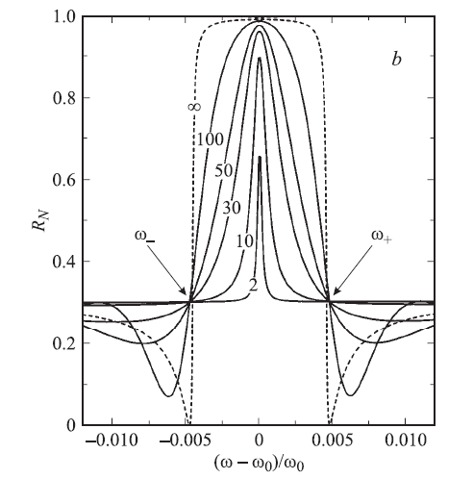
Bragg QWs.
Photonic band-gap versus super radiance

Slide 19
Microcavity
Layers refractive indexes thickness
cavity
layers

Slide 20
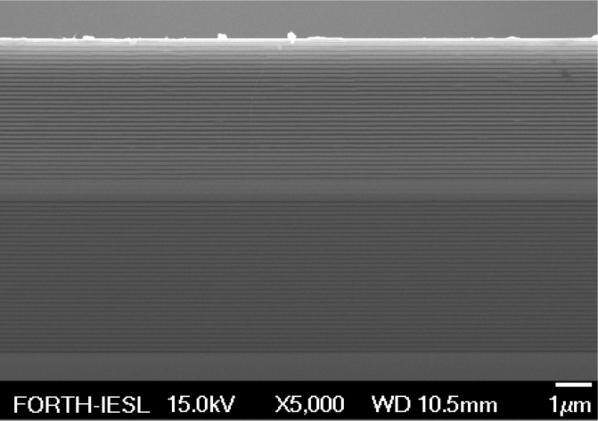
Microcavity

Slide 21
Distribution of the electromagnetic field in a microcavity

Slide 22
Reflection from the Bragg mirror
Stop-band

Slide 23
Two oscillator model
Electromagnetic field polarization
Average polarization
Looking for the solution in harmonic form

Slide 24
Close to the exciton and cavity resonances
solution
here

Slide 25
Weak exciton photon coupling
the exciton photon modes – the same resonant frequency
but different damping

Slide 26
Strong exciton photon coupling
Raby splitting
the exciton photon modes – the same damping but different resonant frequencies

Slide 27
Polariton effective mass in microcavity
The photon mass is of the order of

Slide 28
Exciton and photon modes in microcavity

Slide 29
Parametric polariton scattering

Slide 30
Parametric polariton amplification

Slide 31
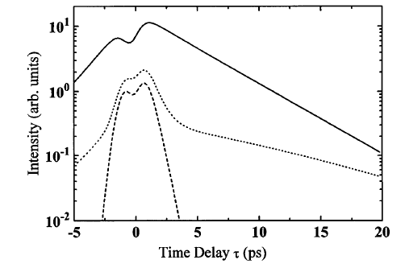
Superaniance in Bragg structures

