Slide 1
Lection5
4). Exciton photoluminescence (1h)
(exciton lifetime in bulk, QW, QWW and QD, homogeneous linewidth, interaction with phonons)
5). Optical orientation and alignment (1h)
(the idea of the optical orientation; mechanisms of exciton spin relaxation, the alignment of the exciton dipole momenta,
polarization conversion)

Slide 2
Photoluminescence
Photoluminescence excitation
Photoluminescence

Slide 3
Normally the exciton PL spectrum determine
by recombination of localized exciton states.
The main mechanism for the localization is
monolayer fluctuation of the interfaces.

Slide 4
Delocalized states
At high temperature excitons become delocalized
here
Number of excitons
Optically active are only excitons with
The excitons with are out of the light cone

Slide 5
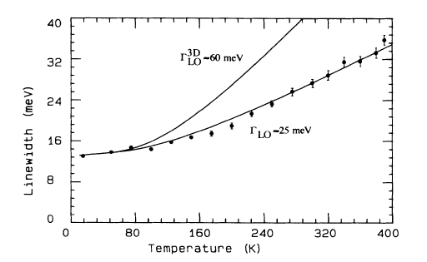
Efficiency of the radiative recombination
Homogeneous linewidth at high temperature
Line width QWs

Slide 6
Resonant fluorescence and Raman scattering
Two level systems. Spectral intensity:
is the lifetime of the excited state

Slide 7
Delocalized excitons can recombine radiativly
only incise light cone
At high temperature excitons delocalized and
linewidth becomes homogeneous
At resonant excitation two processes are undistinguishing:
Raman scattering and resonant fluorescence

Slide 8
Localized states
There are jumps of excitons over these states
The PL spectrum forms due to competition
between recombination and relaxation

Slide 9
Photoluminescence, Stokes shift
Stokes shift: ;
Mobility edge
Mobility edge separates extended and localized states
The density of localized states is exponential
(number of shallow wells is large)
2. Exciton hopping transfer rate between localized states
(probability of the jump defined by distance only)
3. The rate is independent of and , and decays
exponentially because it is the tale of wavefunction

Slide 10
The PL peak and the delay time (at
pulse excitation) is
where
At CW excitation recombination time

Slide 11
4. The recombination time is independent of
Concentration of the states with energy exceeds is
Localized exciton onto the site hopes within
Average distance between localized states with
Lifetime with respect to hopping

Slide 13
In the PL always Stokes shift
The Stokes shift defined by competition between
Relaxation and recombination

Slide 14
Principe of electron optical orientation
1). At interband optical transitions the angular momentum of
photon transforms into the angular momentum of exciton
Here is generation rate
is lifetime
is spin relaxation time

Slide 15
Notify
Total number of electrons
Generation rate
Average spin
Degree of polarization
Average spin of one electron
The solution of the equations
is spin lifetime

Slide 16
2). Oriented spins conserve their polarization (in part)
at a steady state pumping
The initial spin polarization is proportional to the polarization
of excited light
Depends on the selection rules
For bulk GaAs
For QW

Slide 17
3). Due to the same selection rules the ptotoluminecsence
is partially polarized
4). Transverse magnetic field lead to depolarization of the PL
(Hanle effect)
The kinetic equations
Is Larmour frequency

Slide 18
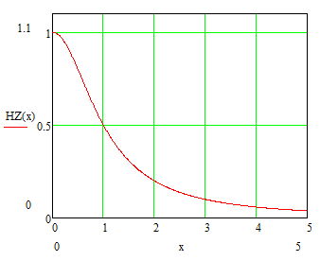
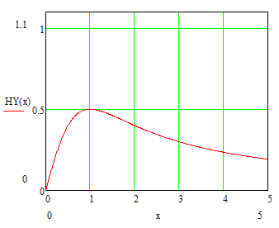
Hanle Effect

Slide 19
In optical orientation an angular momentum
of the photon transfer to the electron
Effect Hanle is a stroboscopic effect and allows to determin
lifetime and spin relaxation time in CW experiment
This method is used for optically detected paramagnetic
resonance, optically detected nuclear magnetic resonance,
optical cooling, etc.

Slide 20
Electron spin relaxation mechanisms
1). Elliott – Yaffet (EY) mechanism. Mixing opposite spin states
from other bands by perturbation
2). Beer-Ahronov-Pikus (BDP). Electron hole scattering with
spin flip
3). D’yakonov and Perel (DP). Precession of the electron spin
in an effective qusi-magnetic field without inversion
symmetry
4). Fluctuation of nuclear spins in QDs

Slide 21
EY is important in narrow gap semiconductors like InSb
In QWs EY is important for holes.
BAP is important for doped structures at low temperatures.
DP is important in wide array of optical nanostructures

Slide 22
Dependence of the main spin on the excitation energy in QWs

Slide 23
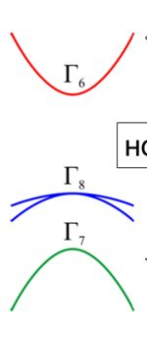
Remain the band structure of cubic semiconductors
In the conductivity band (diamond)
At point
No inversion symmetry

Slide 24
Electron Hamiltonian includes linear term in QWs
is an angle between and

Slide 25
Spin relaxation time
Taking average on magnetic field

Slide 26
Suppression of the spin relaxation in longitudinal magnetic fields
Magnetic field

Slide 27
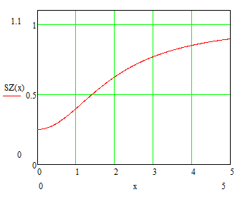
Optical orientation in the longitudinal magnetic field

Slide 28
Spin quantum bits
One can separate anisotropy of g-factor and relaxation time

Slide 29
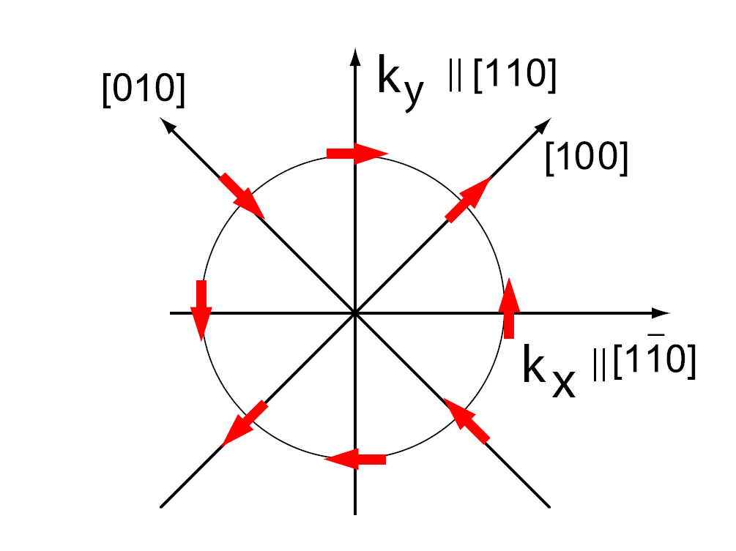
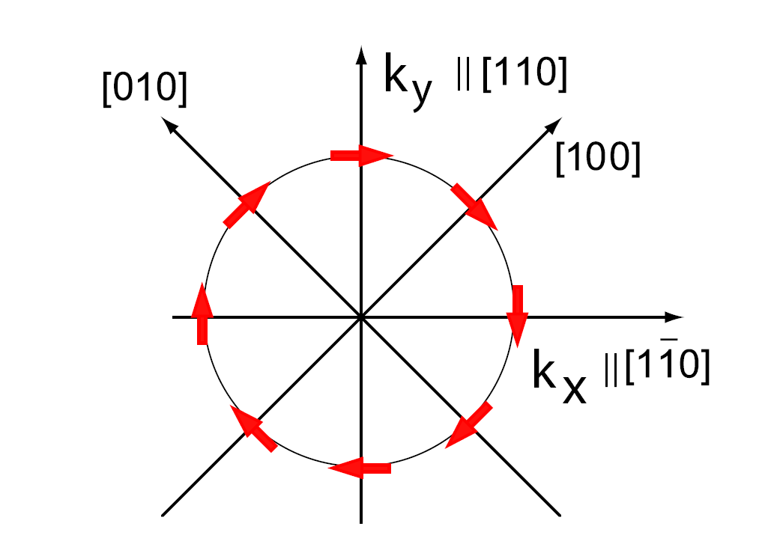
Dresselhous and Rashba effective field
Dresselhaus
Rashba
H_{BIA} = β(σ_{x}k_{x}-σ_{y}k_{y})
H_{SIA} = α(σ_{x}k_{y}-σ_{y}k_{x})

Slide 30
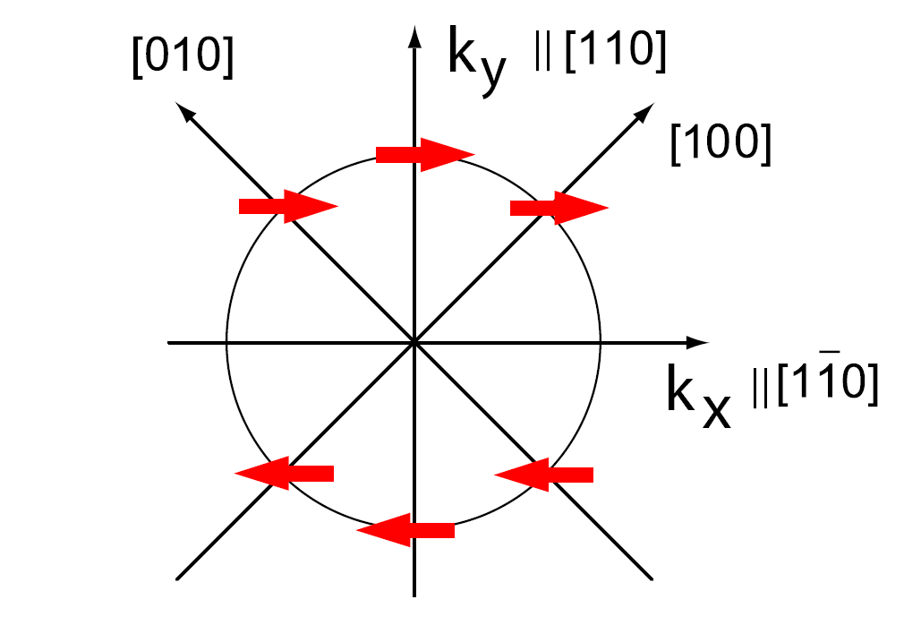

Rashba + Dresselhaus
N.S. Averkiev and L.E. Golub, Phys. Rev. B (1999)

Slide 31
Hanle ⇒different SRT

Slide 32
There are a lot of mechanisms for energy relaxation
but there are only few mechanisms of angular momentum
relaxation.
(For example relaxation between hole states to
is forbidden. But LH HH mixing leads to
allowed transition )

Slide 33
Optical orientation and optical alignment
of excitons
At linearly polarized excitation in longitudinal magnetic field
the polarization plane turns on
The degree of polarization decreases
in times

Slide 34
Consider the exciton as a classic dipole . Let it excided
in direction. In the longitudinal magnetic field
it rotates around with velocity
Created at components of the dipole moment at

Slide 36
Degree of polarization

Slide 37
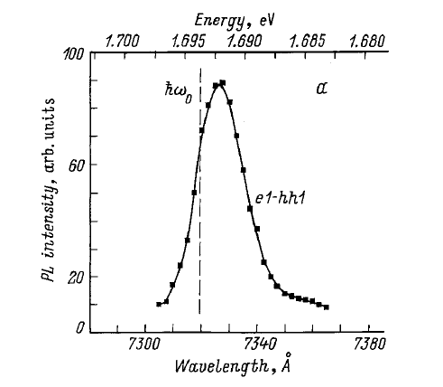
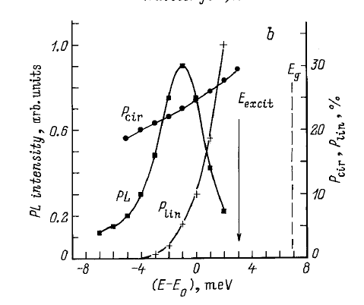
Resonant optical orientation and alignment of excitons in QWs

Slide 38
At circularly polarized excitation longitudinal fields
have no effect on the exciton orientation
Transversal field suppresses the orientation and
can induce linear polarization

Slide 39
Transformation of polarizations in QDs

Slide 40
Specific of excitons is that for exciton additionally to
optical orientation we have optical alignment of dipole
momenta.
The mechanisms for exciton spin relaxation are different
from that for electrons

