Slide 1
Lection 6
6). Excitons in the presence of electron gas (2h)
(bound states - trions, triplet and singlet trions, unbound states, combined exciton electron processes; manifestation
of exciton electron scattering in optical spectra)
7). Biexcitons (1h)

Slide 2
EXCITONS IN 2DEG
Low electron density limit
1. Charged exciton-electron complexes (trions)
2. Singlet and triplet trion states
3. Modulation doped QWs
4. Trions in optical spectra
5. Action of magnetic fields on the trions
High electron density limit
6. Combined exciton cyclotron resonance
7. Combined trion cyclotron resonance
8. Combined exciton electron processes in PL spectra
9. Trion Zeeman splitting

Slide 3
From LOW density to HIGH density
LOW 2DEG DENSITY
Two electrons+one hole states
Trions
Trions in magnetic fields
Trion excited states in magnetic fields

Slide 4
Charged exciton – electron complex (trion)
Negatively charged Trion X⁻
similar to ion H-
Positively charged Trion X⁺
Similar to ionized molecule H+
+
+
-
electrons
holes
electron
hole

Slide 5
Singlet and Triplet trion states
Wavefunction for two electrons in the trion
S_{z} = +1
S_{z} = 0
triplet
S_{z} = -1
Spatial part of the wavefunction
S_{z} = 0
singlet
Singlet state +
S_{z} = 0
Triplet state -
S_{z} = ±1,0
U_{nlm} ≠ 0 , if l ≠ 0 one electron is in 1S and the second is in 2P state – dark triplet
Or if n ≠ 1 one electron is in 1S, and the second is in а 2S state bright triplet

Slide 6
Experimental studies of trions

Slide 7
Modulation doped structures
2DEG
2DEG density varied from n_{e}=5*10⁹ см⁻² to 9*10¹¹ см⁻²

Slide 8
Optical processes with the trion participation
Trion formation time in ZnSe structures is of the order of 2 –4 psec
ε
electron
trion
photon
exciton

Slide 9
Trion binding energy as a function of the QWwidth

Slide 10
Trion states in magnetic fields

Slide 11
Singlet trion in magnetic fields
The circular polarization of the trion absorption (reflectivity line ) in magnetic fields can be used to determine electron concentration by pure optical method

Slide 13
Singlet and Triplet in high fields
E_{trip}^{bind} = 3 meV

Slide 14
EXCITON-ELECTRON SCATTERING
(excited states of a trion in magnetic fields)

Slide 15
Exciton – electron scattering
Exciton – electron scattering
ε
electron
photon
exciton
In magnetic fields in QWs the exciton electron scattering leads to the electron transitions between Landau levels - ExCR
The scattering leads to high energy tail of the exciton absorption line. In magnetic fields it splits into separate lines because the electron spectrum becomes discrete = excited states of trions in magnetic fields.

Slide 16
Combined exciton –cyclotron resonance ExCR
The ExCR line shifts LINEARLY from the exciton resonance to high energies with increase of magnetic fields

Slide 17
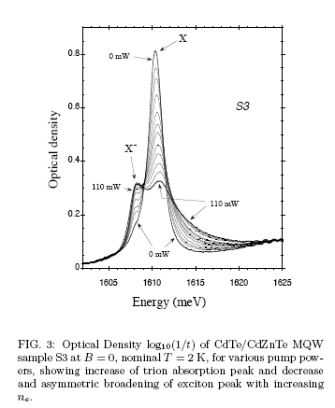
With increase of the electron density there is redistribution of absorption from exciton to trion and ExCRС

Slide 18


Slide 19
WHAT IS THE BURSTEIN-MOSS SHIFT?

Slide 20
Photoluminescence

Slide 21
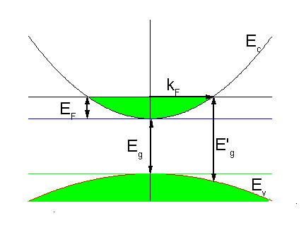
Conventional scheme of the B-M shift

Slide 22
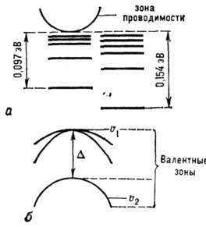
Where is the exciton here?

Slide 24
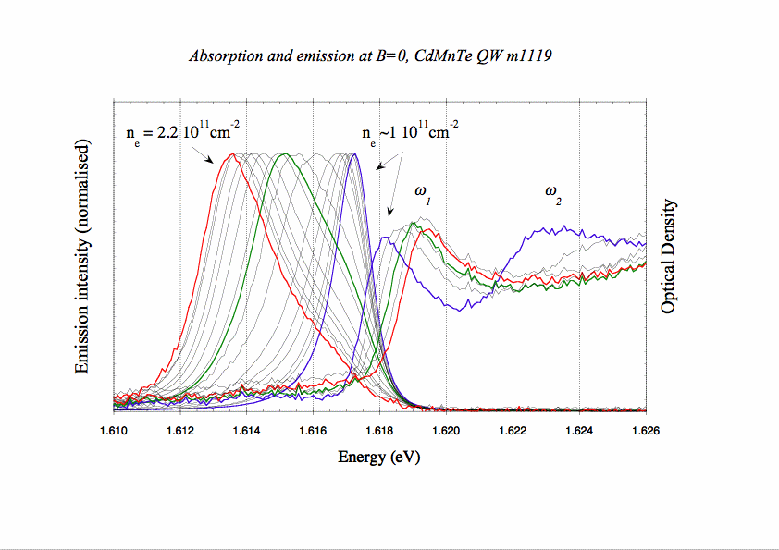

Slide 25
“Recreation” of the exciton and trion lines in magnetic field

Slide 27
In heavily doped QW in zero magnetic fields the PL line
is shifted to the low energies from its position in low
doped structure. The value of this shift is of the order of
Fermi energy

Slide 28
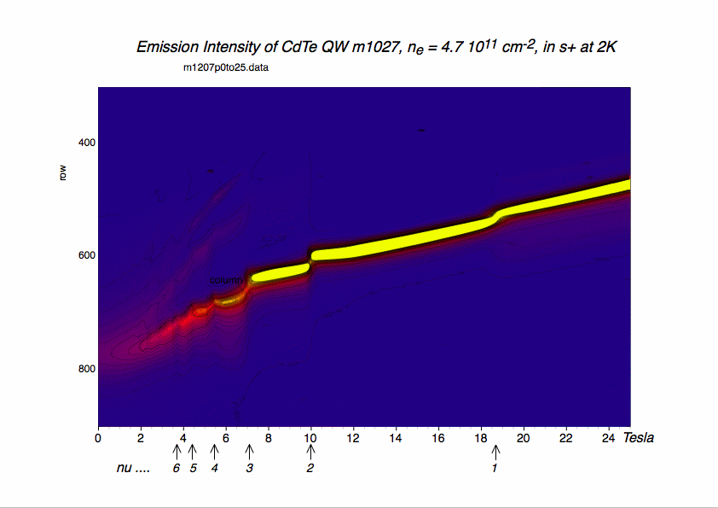

Slide 29
Combined processes in PL
Comparison of PL and reflectivity
PL and SU

Slide 30
Circular polarization induced by magnetic field

Slide 33
In Emission the initial state is: trion in a ground or excited states;
the final state is: an electron above Fermi level
The energy of the transition is

Slide 34
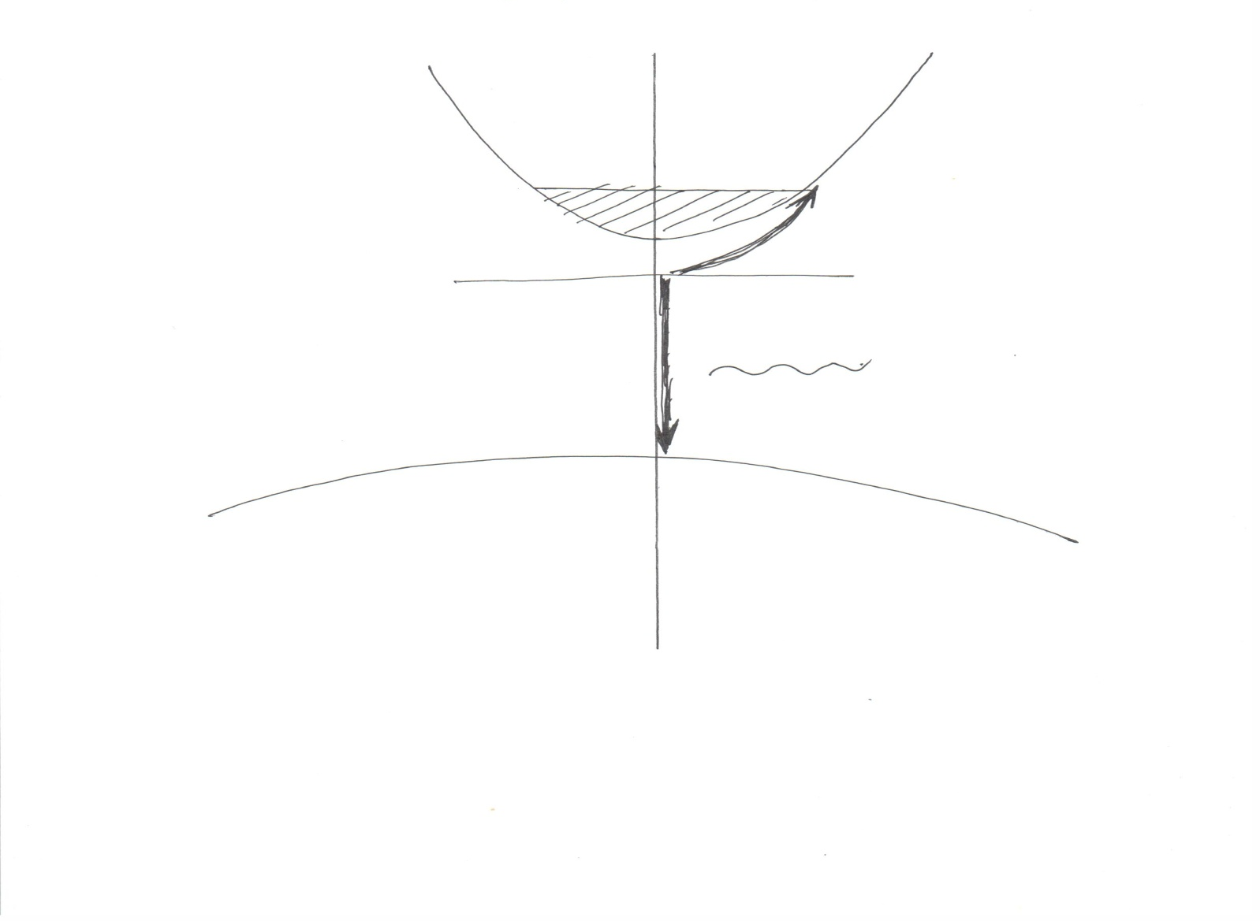

Slide 35
Recombination
In the recombination:
there is a trion in the initial state; in the final state there is photon and one electron on one of the Landau levels
In our magnetic fields we have hierarchy of energies:
where are binding energies of exciton and trion respectively. Hence we can assume that these magnetic fields are small for exciton and strong for trion,
and the trion has energies:
The residual electron after the trion annihilation can have
energy:
, and Е* corresponds to the empty Landau levels above the Fermi level of 2DEG.

Slide 36
Shake-up
Shake up процессы SU

Slide 37
Linear shift of the trion line in magnetic fields
In the final state after the trion recombination a free electron remains. It can appears in the unoccupied states above Fermi level
In magnetic fields the Fermi energy decreases as

Slide 38
Theory
Figure gives the energy positions of maxima of emitted bands which are described by equation
The shape of the states in presented by the Gaussian form

Slide 39
Conclusions
In 2D structures contained electron gas the screening effects are suppressed, and the scattering effects are in contrary enhanced.
Analyzing the optical spectra we shell have in mind that initial and final state of “dark” electron can be different.
In PL the Moss-Burstein shift displays in combined exciton electron processes.

Slide 49
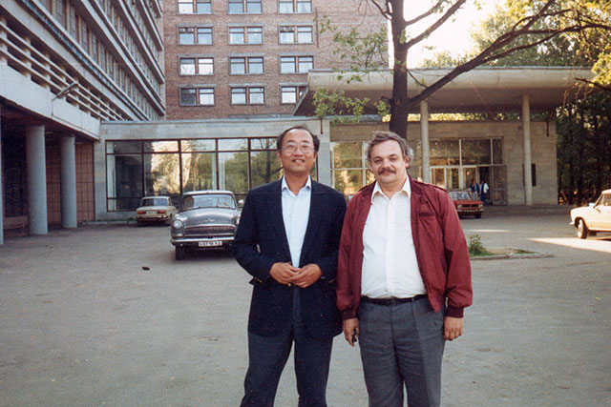

Slide 50
Conclusions
In 2D structures containing electron gas the scattering effects are enhanced.
In the presence of magnetic fields the electron energy spectrum becomes discreet and the scattering processes revel as combined exciton- electron processes.
In such processes we can see directly only the exciton transition but the state of the additional electron, which we can not see, reveals only in the final result.

Slide 51
Combined processes in
Dense 2DEG
Three electrons+one hole states

Slide 52
In the dense 2DEG two-electron processes emerge in the spectra TrCR
There are two electrons in the initial state; an incident photon creates an exciton which binds with one of the electrons forming a trion; and the second electron excites on the second Landau level

Slide 53
Trion Cyclotron Resonance

Slide 54
Line of the TrCR is observable at filling factors > 1. The intensity of the TrCR line is proportional to the second power of the 2DEG density

Slide 55
Surprising Trion stability against free electron screening

Slide 56
Экситон исчезает из спектра при относительно малых концентрациях электронов, а трион остается

Slide 57
Сила осциллятора экситона не зависит от плотности 2DEG
Затухание экситона
растет с ростом
плотности

Slide 58
Спектры поглощения (PLE) как функция концентрации

Slide 59
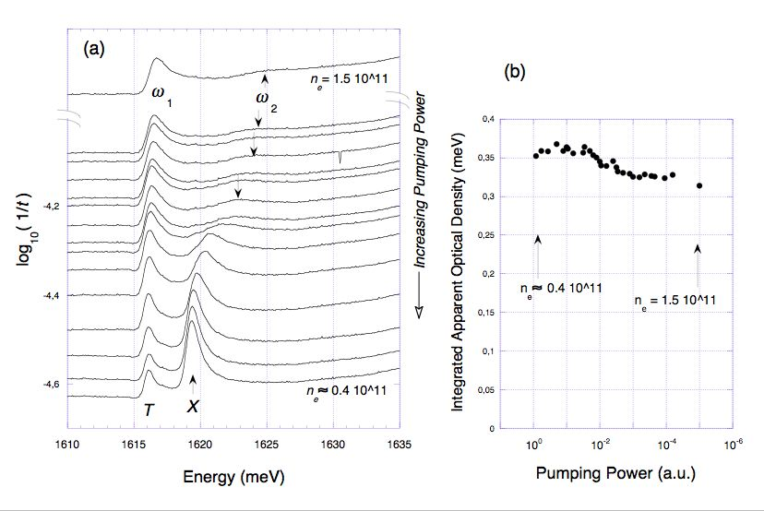
Optical density of CdMnTe QW m1120 in zero field at 2K

Slide 61
Trion Zeeman splitting as a function of the electron density

Slide 62
The value of the exciton and trion Zeeman splitting?
Because the initial and the final state of the electron are
the same (the same spin and the same Landau level)
we should see only the exciton Zeeman splitting on exciton
and on trion line
ε
electron
trion
photon
exciton

Slide 63
Photoluminescence
In PL the exciton and trion
Zeeman splitting are equal

Slide 64
Exciton and trion Zeeman splitting at high electron concentrations

Slide 65
This is possible only in the case if the initial and
final spin state of the electron are not the same –
we need spin-flip
For spin-flip we need spin-orbital interaction.
This can be the triplet-singlet splitting of the trion
In the initial state the photon creates virtual state of the triplet trion. Because of very fast spin-flip of one of the electrons in the final state we have the singlet trion (already real).
This is the process reversal to the ExCR

Slide 66
An incident photon creates a virtual trion in the triplet state. This trion produces a spin-flip with one of the electrons on the first Landau level.
As a result, in the final state, we get a trion in the singlet state plus an electron on the second Landau level with opposite spin.
This reaction looks

Slide 69
Трионы можно наблюдать и в нелегированных структурах

Slide 70
Сила осциллятора экситона
приходящаяся на элементарную
ячейку равна силе осциллятора
триона на один электрон, также
Как для связанных экситонов

Slide 71
The value of the exciton and trion Zeeman splitting?
Because the initial and the final state of the electron are
the same (the same spin and the same Landau level)
we should see only the exciton Zeeman splitting on exciton
and on trion line
ε
electron
trion
photon
exciton

Slide 72
Еще сильнее эффект подсветки
проявляется в спектрах PLE на
линии ExCR

Slide 73
Triplet trion in high magnetic fields

Slide 74
We can neglect the trion binding energy because
The intensity of the ExCR absorption line is comparable with the intensity of the exciton line

Slide 75
ТРИОНЫ В КВАНТОВЫХ ЯМАХ
КОЧЕРЕШКО В.П.
Trions at low electron density limit
1. Charged exciton-electron complexes (trions)
2. Singlet and triplet trion states
3. Modulation doped QWs
4. Trions in optical spectra
5. Action of magnetic fields on the trions
Trions at high electron density limit
6. Combined exciton cyclotron resonance
7. Combined trion cyclotron resonance
8. Combined exciton electron processes in PL spectra
9. Trion Zeeman splitting

Slide 76
Спин зависимое экситон – электронное рассеяние

Slide 77
Singlet trion in magnetic fields
The circular polarization of the trion absorption (reflectivity line ) in magnetic fields can be used to determine electron concentration by pure optical method

Slide 78
Изменение экситонных и трионных параметров в магнитном поле

Slide 79
Спин зависимое рассеяние экситонов
M=1
M=1
M=-2
M=-1

